Slide 1
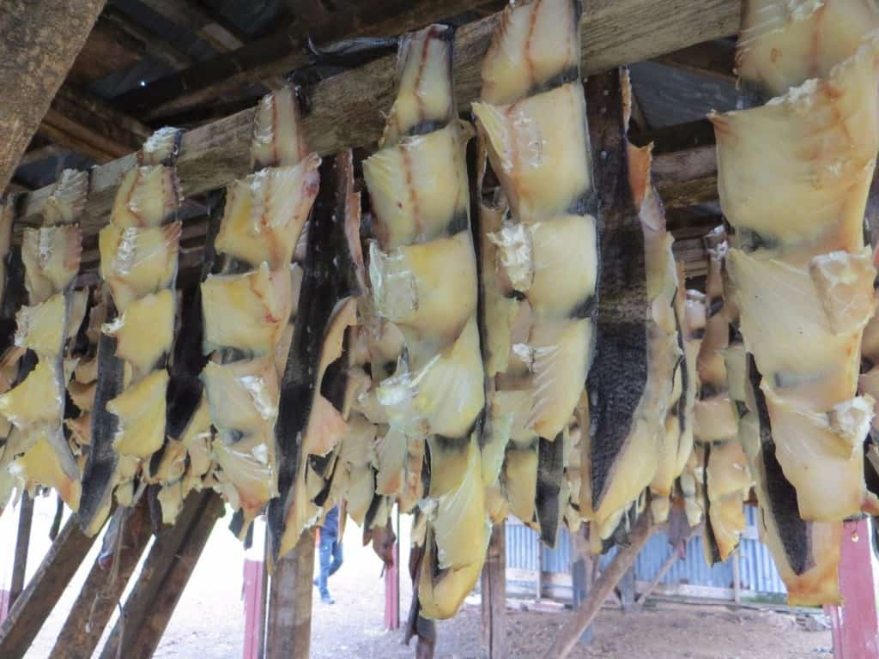
Hakari
Hakari is the national dish of Iceland and has fermented shark meat which has been hung to dry for five monts. Many think the taste is good

Slide 2
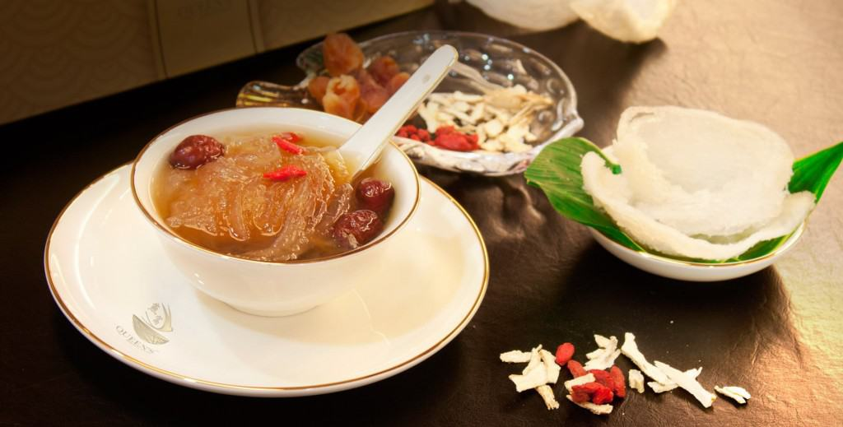
Bird’s Nest soup
This soup doesn’t have bird’s nest as we know it. It is made from the bird’s saliva. Which dries and hardens. It is not only just a delicasy but also a medicine for many Asian people.It is very very expensive.

Slide 3
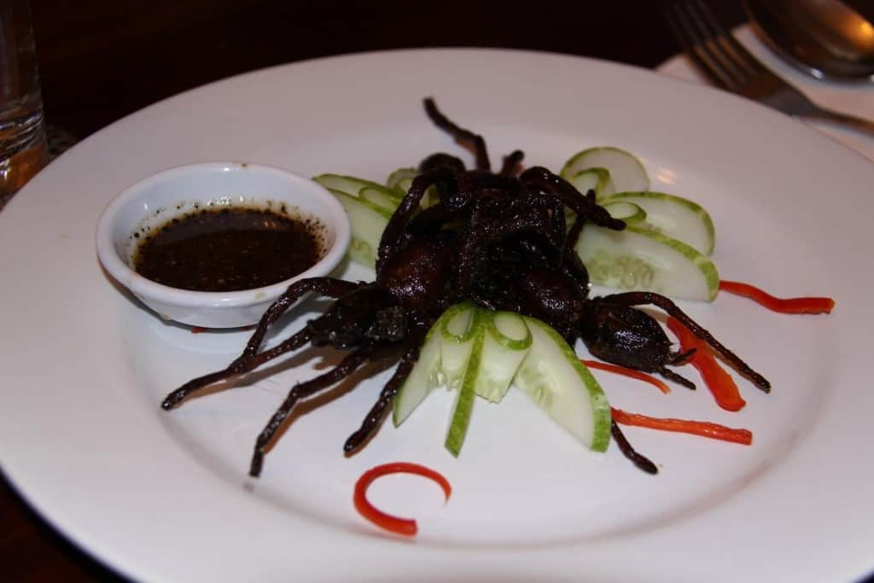
A ping
When Cambodia had war,people had nothing to eat so they tried everything they could. The big tarantula spiders are aso tasty so they continue to eat them,after the war

Slide 4
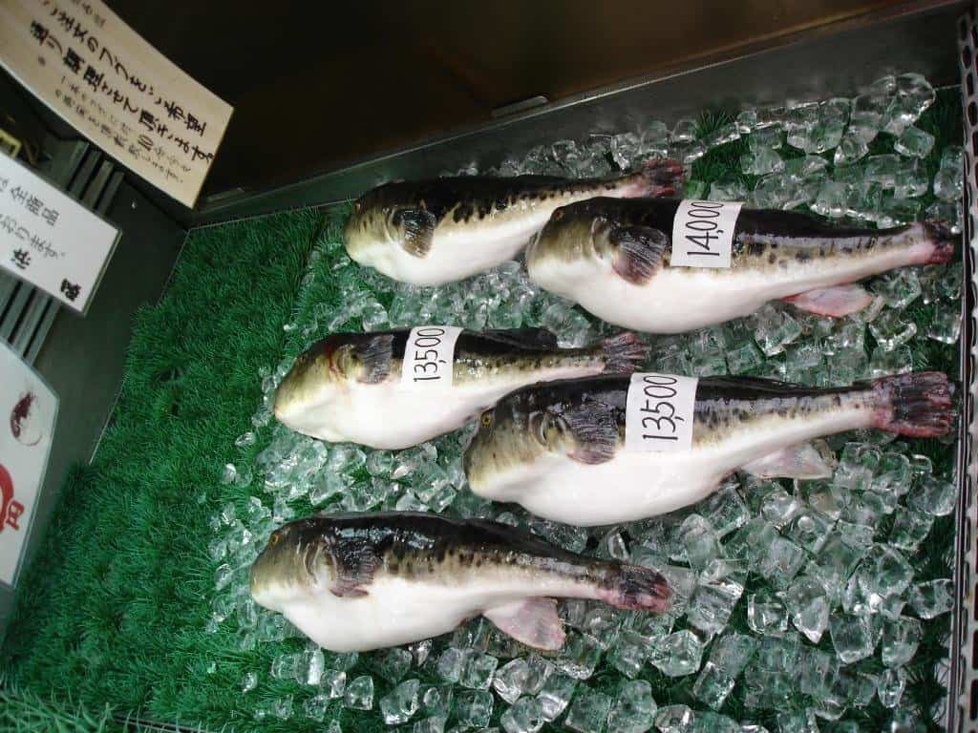
Fugu-Japan
Fugu or pufferfish is very poisonous. It’s poison can kill 40 adults if eaten. Only specially licensed chefs can handle it,if you prepare it wrong and eat it you die.

Slide 5
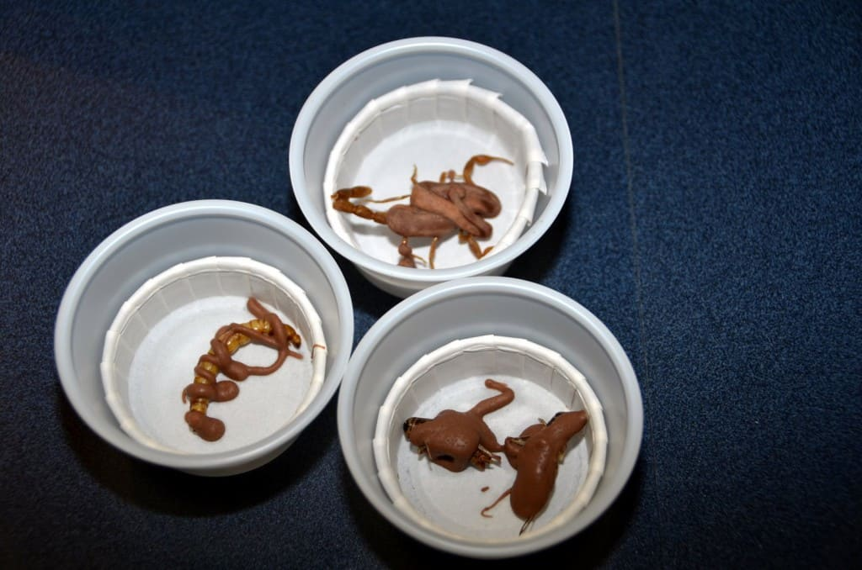
Fried Scorpions
People from Arizona USA catch scorpions kill them and then put them in chocolate fry them. Of course they do it in China too.

Slide 6
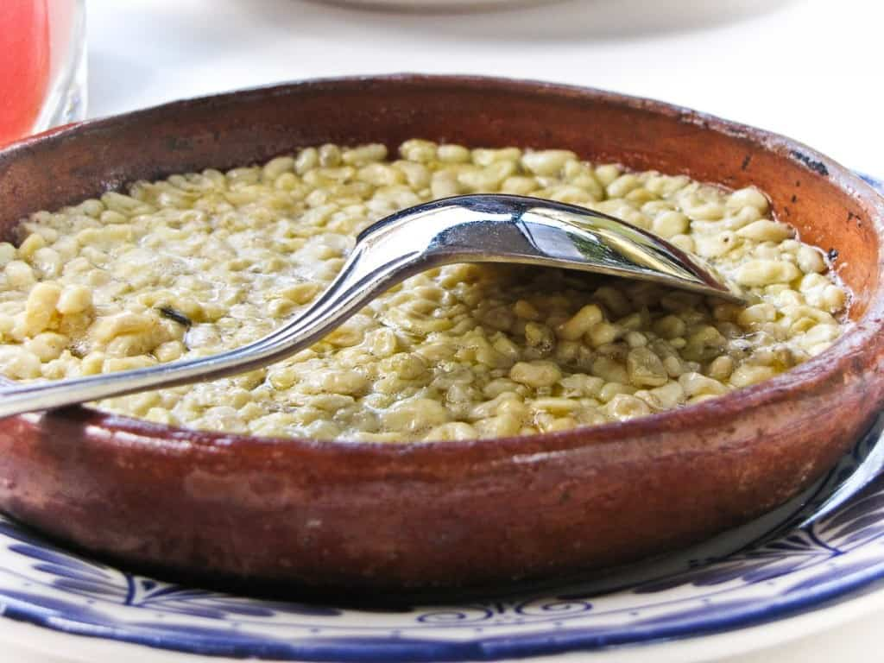
Escamoles
Ant’s Larvae is collected from the agave leaves and often cooked in butter.

Slide 7
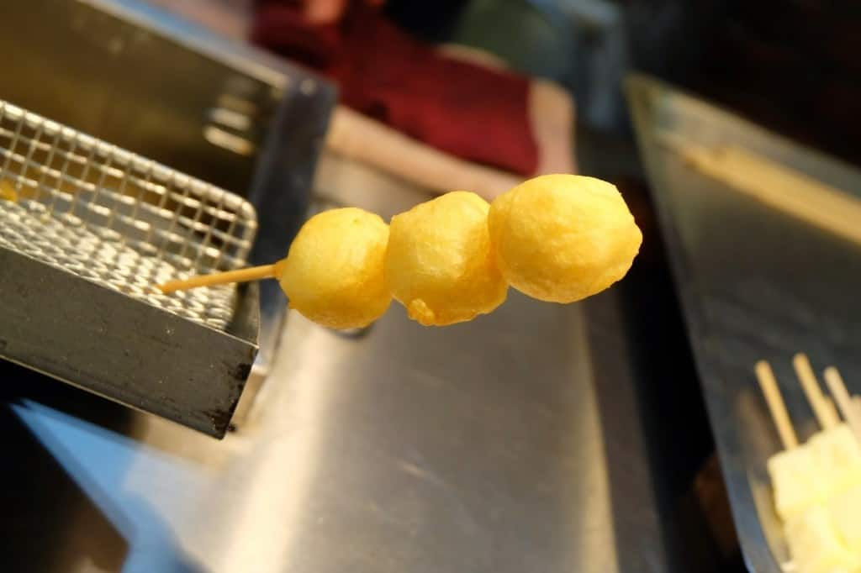
Fried Milk
This is actually sweet cream deep fat fried and it is good but strange.

Slide 8
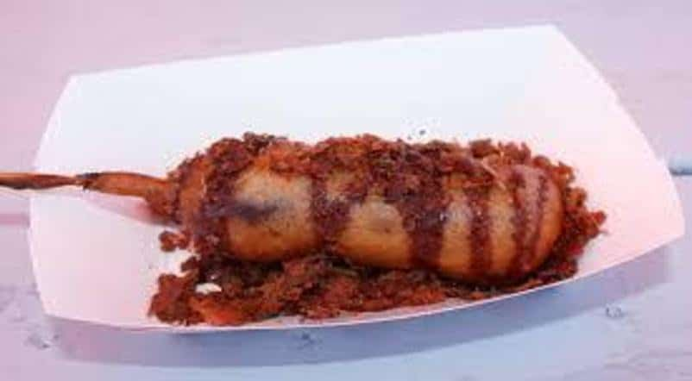
Elvis On A Stick
If you know anything about Elvis, it’s that he had a thing for peanut-butter and banana sandwiches with bacon. Well, the Wisconsin state fair took that strange love combo and turned it into something that could be eaten on a stick — like any other weird fair food.

Slide 9
Trochidis Hristos A4
Strange foods from Around The Globe

