Slide 1
Strange hotels 🏨

Slide 2
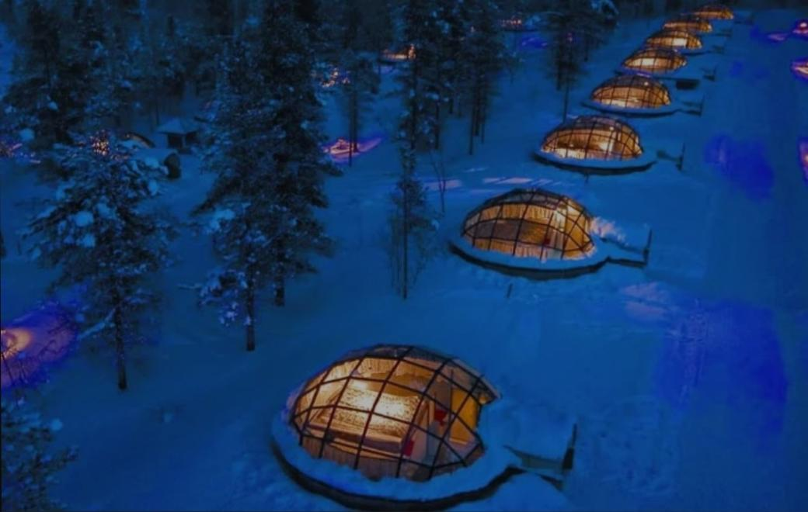
1. Hotel Kakslauttanen in Saariselka, Finland
The problem with the Northern Lights is that it’s so cold in the Arctic it’s impossible to stay outside for more than five minutes. Kakslauttanen’s luxury rooms are glass igloos, ingeniously shaped to keep you toasty warm. Admiring the Northern Lights is simple – just lie back and watch the show from your bed.

Slide 3
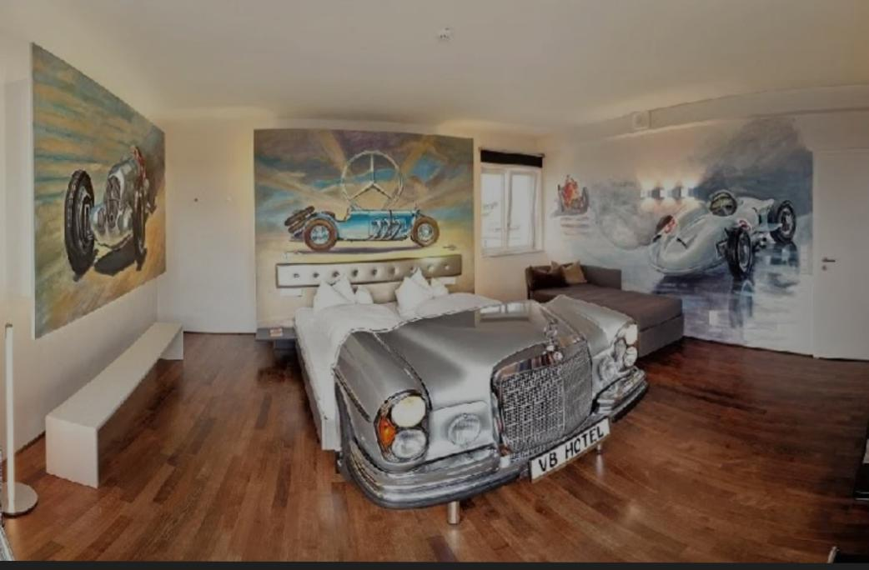
2. The V8 Hotel in Stuttgart, Germany
Don’t show up at the V8 Hotel in a Toyota. Here you’ll find a 70’s Cadillac drive-in cinema room, a Morris Minor garage bedroom, and a Mercedes Benz car wash. Every room is themed after classic cars, meaning you can spend the night in the back seat of a converted chassis of a car. In case you didn’t get enough of that in high school.

Slide 4
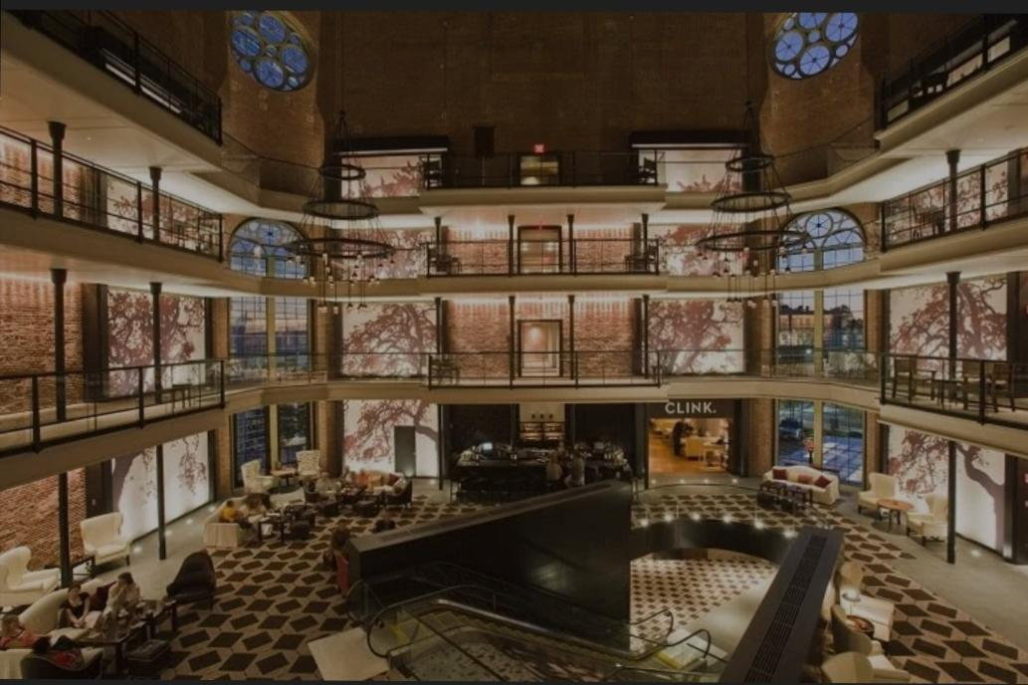
3. The Liberty Hotel in Boston, USA
Malcolm X and disgraced Boston mayor James Curley didn’t have to pay to stay in the Liberty Hotel – this used to be Charles Street Prison, but it’s been elegantly converted into a luxury hotel. The hotel’s Alibi Bar is the former drunk tank and 18 of the rooms feature pieces of the original jail.

Slide 5
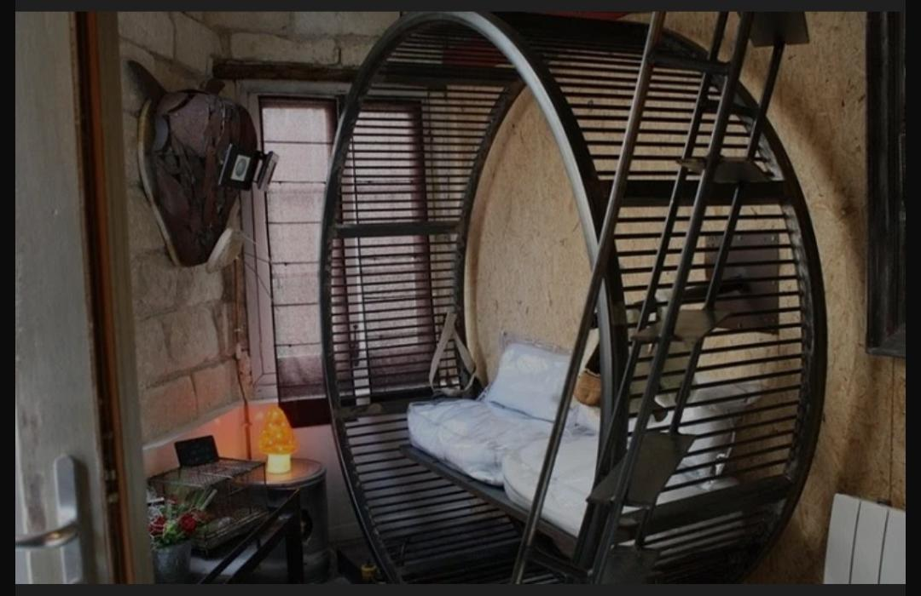
4. La villa Hamster in nantes,France
You’re given hamster masks to wear when you check into La Villa Hamster. It’s all about getting into the hamster mood as you sleep on a giant haystack and find a bathroom floor scattered with woodchips. A life-size hamster wheel provides ongoing entertainment and La Ville Hamster is certainly cool until you realise you’re imitating a glorified rodent.

Slide 6
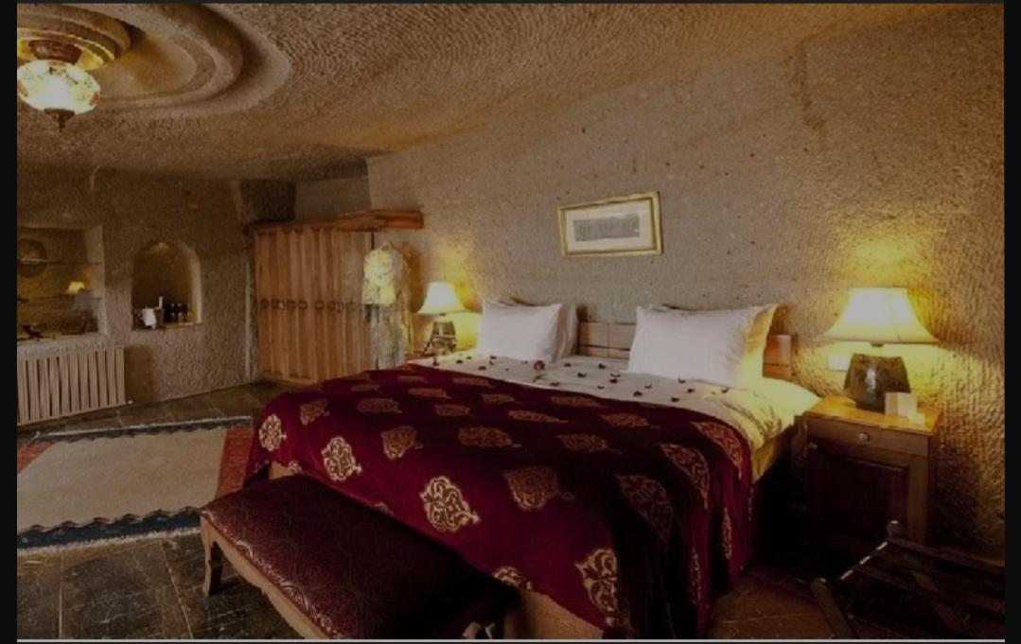
5. The Museum Hotel in Cappadocia, Turkey
You don’t need to be Fred Flinstone to sleep in a cave. Turkey’s surreal Cappadocia region looks a bit like the moon, full of weird fairytale chimneys and caves.
For thousands of years, monks used to live and preach from the caves. Now they’ve been converted into boutique hotels, the finest being the Museum Hotel. The walls, the ceiling, the floor…everything is an original cave.

Slide 7
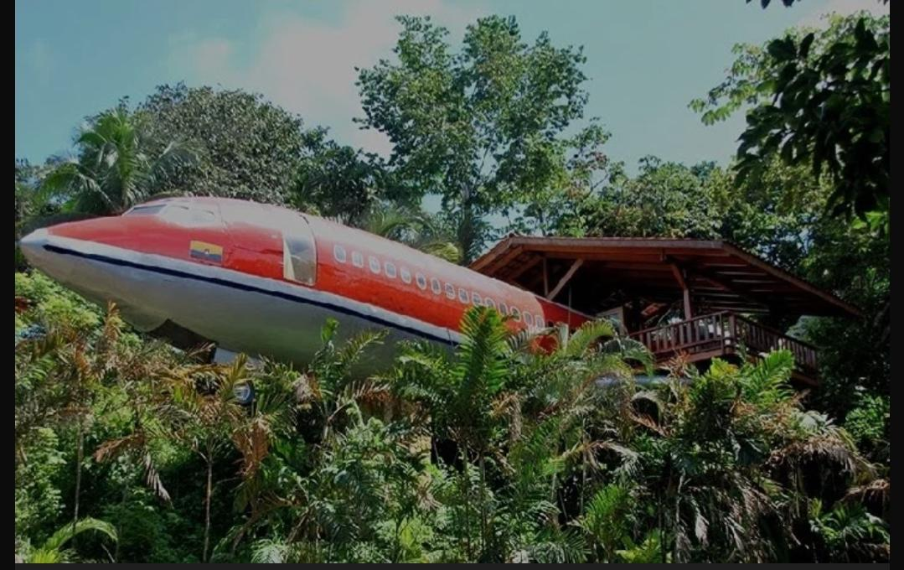
6. Costa Verde in Quepos, Costa Rica
It’s not a plane crash. You’re not in the Congo. At Costa Verde, there’s a vintage 60’s Boeing that’s been lovingly transformed into a two bedroom suite that hangs over a rainforest bluff.
Monkeys and sloths peer in through the plane’s windows while the wing offers a place to sit and watch the jungle canopy life roll by.

Slide 8
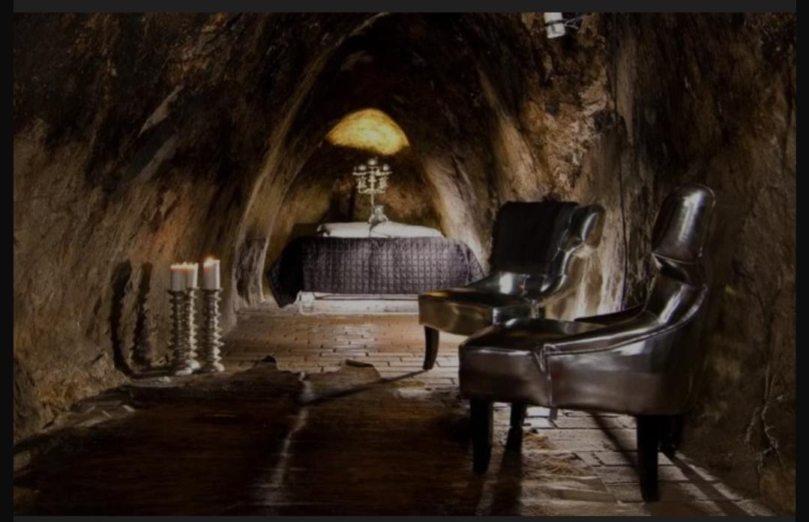
7. Sala Silvermine Underground Suite in Vastmanland, Sweden
Sculpted out of the rock, over 500 feet beneath the earth’s surface, there’s only one room at this abandoned silver mine. It’s small and dark, only brightened by furniture made exclusively from silver.
Clearly not for the claustrophobic, the expensive suite in Vastmanland ensures a complete escape from the world.

Slide 9
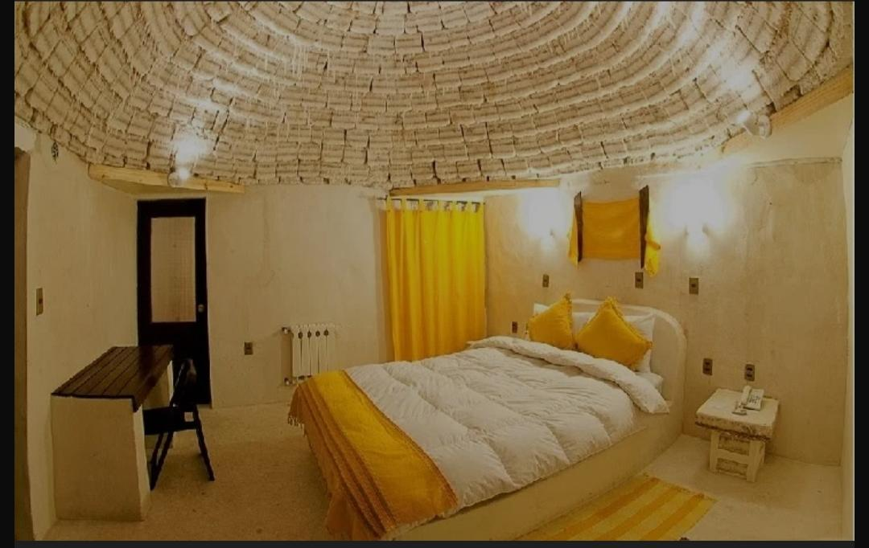
8. Palacio de Sal in Uyuni, Bolivia
Organic eco-building means utilising the most readily available local material. In Bolivia that means salt.
It took one million salt blocks to create this strange hotel. Which wasn’t actually that challenging, seeing as how as it’s located on the world’s largest salt flats. If you’re visiting the salt flat, you might as well just stay in a hotel made exclusively from salt!

Slide 10
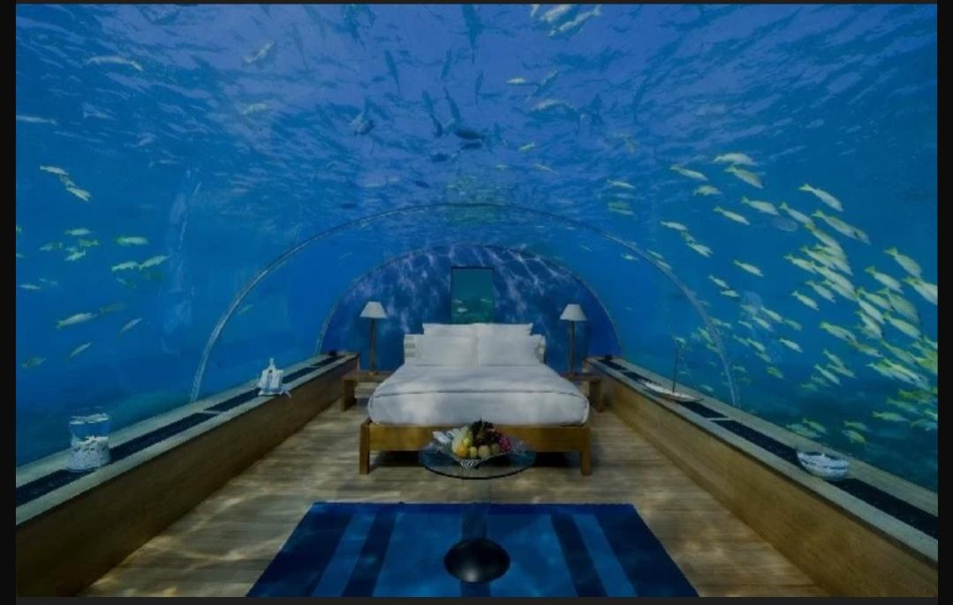
9. The Manta Resort in Pemba Island, Tanzania
Submerged in a vibrant Indian Ocean reef, 250 meters off the coast of Pemba Island, Tanzania, the Manta Resort is an inverted fish tank. You’re sleeping in a natural aquarium!
Rather than just looking out at sharks, the marine life is gazing in at the weird people that inhabit their space. Fish become the beholders of man!

Slide 11
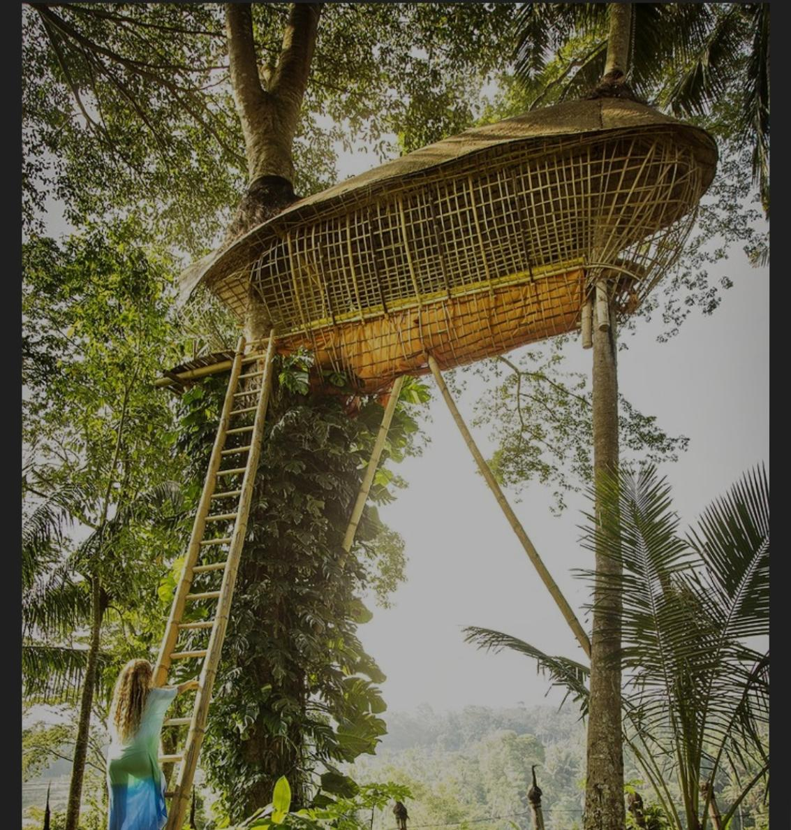
10. Bambu Indah – Authentic Javanese Homes Turned Into Eco Retreat
Bambu Indah consists of eleven wooden Javanese homes that were brought to Bali to create a sustainable retreat among the rice paddies and lush gardens. Each house has its own unique character and is furnished with antique furniture and locally made art.

