Slide 1
Strange Buildings
In this research, you will see the most strange buildings around the world.

Slide 2
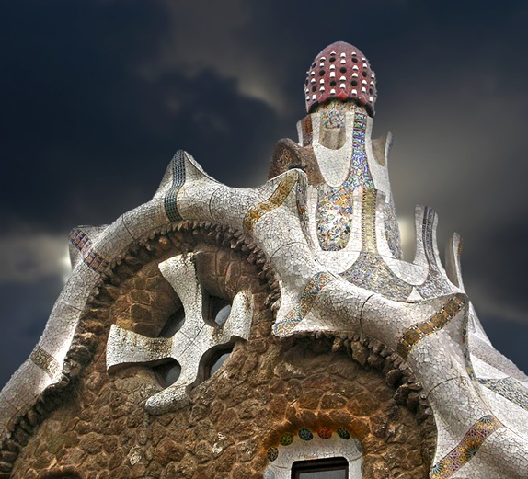
Mind House
The Mind House or the official name Park Güell is a public park system composed of gardens and architectonic elements located on Carmel Hill, in Barcelona, Catalonia, Spain.The park was built from 1900 to 1914 and was officially opened as a public park in 1926.

Slide 3
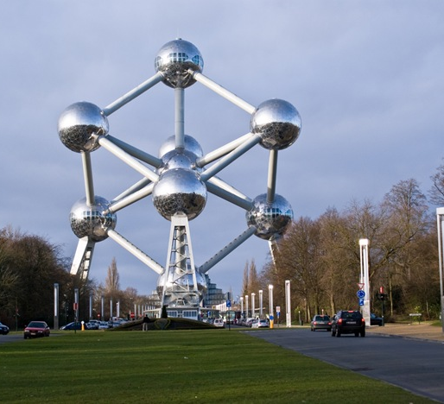
Atonium
The Atonium is a landmark building in Brussels, Belgium. It is now a museum. It was build 1950 They enclose stairs, escalators and a lift o allow access to the five habitable spheres, which contain exhibit halls and other public spaces. The top sphere includes a restaurant which has a panoramic view of Brussels.

Slide 4
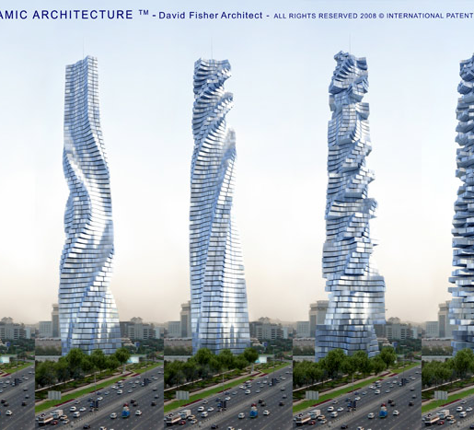
DynamicTower
The Dynamic Tower (also known as Dynamic Architecture Building or the Da Vinci Tower) is a proposed 420-metre (1,378 ft), 80-floor moving scyscraper,each floor is designed to rotate independently. The building is not finished in Dubai.

Slide 5
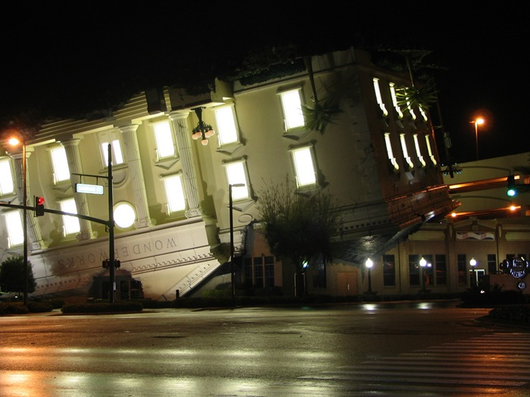
Wonderworks
WonderWorks is an entertainment center focused on science exhibits with five locations in the United States. It was build in 1994.

Slide 6
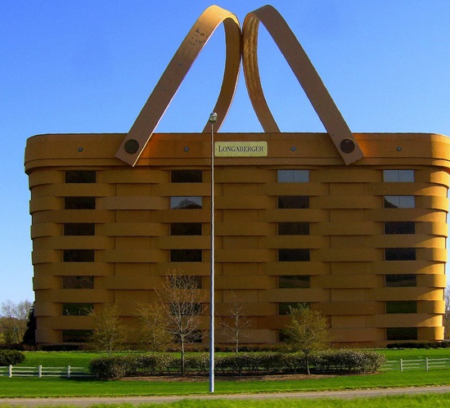
The Longaberger Company
The Longaberger Company is an American manufacturer and distributor of handcrafted maple wood baskets and other home and lifestyle products. It was build in 1973.

Slide 7
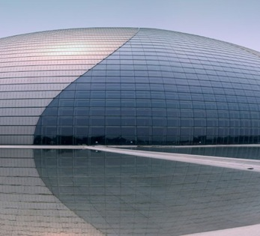
National Theatre
  The National Theatre of China or National Theatre Company of China is China's national theatrical company, founded on December 25, 2001 with the merger of China National Youth Theatre and China National Experimental Theatre . It is based in Beijing.

Slide 8
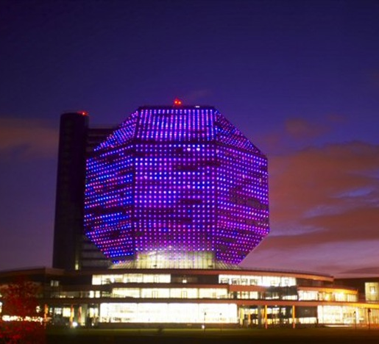
National Library of Belarus
The National Library of Belarus, is the biggest library in the Republic of Belarus. The library is located in Minsk, the capital of Belarus. It houses the largest collection of Belarusian printed materials and the third largest collection of books in Russian behind the Russian State Library (Moscow) and the Russian National Library (Saint Petersburg).

Slide 9
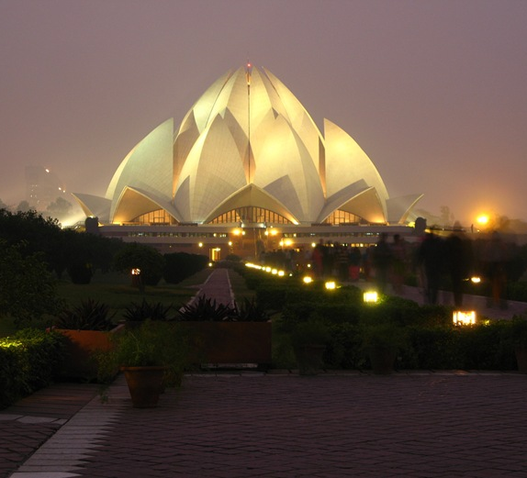
Lotus Temple
The Lotus Temple, located in Delhi, India, is a Baháʼí House of Worship that was dedicated in December 1986. The building is composed of 27 free-standing marble-clad "petals" arranged in clusters of three to form nine sides. A 2001 CNN report referred to it as the most visited building in the world.

Slide 10

Konstantinos Almpanis

