Slide 1
“time”
All day lunch and coffee

Slide 2

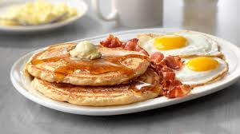
Menu
Breakfast
Pancakes...3,50$
(honey, chocolate and bananas, other fruits, biscuit, caprice, bueno)
Toast...1,50$
(cheese, turkey, tomato, lettuce, egg, bacon, sauce)
Waffles...4$
(chocolate, biscuit, caprice, bueno)
Croissant...2,50$

Slide 3

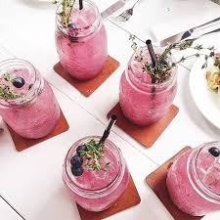

Coffee
hot/iced frappe
Espresso...2,00$ -
Americano...2,50$ 3,25$
Cafe Late...2,50$ 3,50$
Cafe Mocha...2,75$ 3,80$
Cappucino...2,90$ 4,00$
Teas
Matcha...2,50$
Citrus...2,25$
Caramel...2,50$
Juice
Amita...2,85$
(motion, cherry, banana, pineapple, apple)
Fresh juice...3,25$
(orange, carrot/orange)

Slide 4
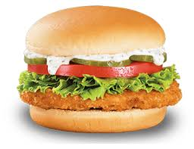
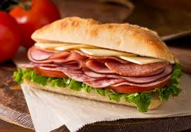
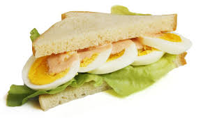
Lunch
Sandwiches
Cheese...1,90$
Ham...2,30$
Chicken...2,50$
Salami...1,80$
Smoked salmon....2,60$
Hot sandwiches
Bacon...2,20$
Bacon & Egg...2,50$
Sausage $ Egg...3,00$
Egg, Bacon & Sausage...3,80$

Slide 5
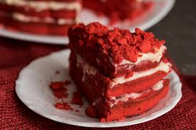
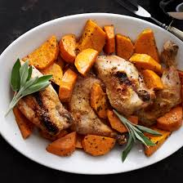
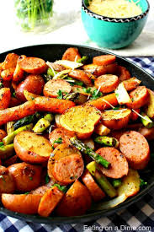
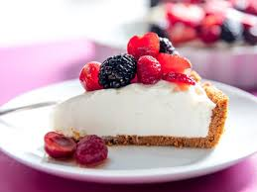
.
Roasted meals
smal medium large
Beef....5.30$ 6.50$ 7.80$
Pork....5.50$ 6.80$ 8.00$
Chicken..6.00$ 7.30$ 8.50$
Vegeterian..3.10$ 4.80$ 6.00$
(All meals have roast potatoes, peas, carrots & a special gravy)
Salads
Garden salad...4.00$
Greek salad...5.50$
Ceasar salad...5.70$
(chicken 1.50$ , shrimp 2.50$)
Dessert
New York Cheesecake...4.00$
Red Velvet Cake...4.80$
Chocolate Cake...3.40$
Apple Crisp...6.30$
Creme Brulee...6.90$

Slide 6


Drinks
Beer
Heineken...3.00$
Amstel...3.00$
Sol...3.50$
John Smiths...4.00$
Corona...4.00$
Shots
Whiskey...6.00$
Gin...6.00$
Vodka...6.00$
Rum...6.00$

