Slide 1
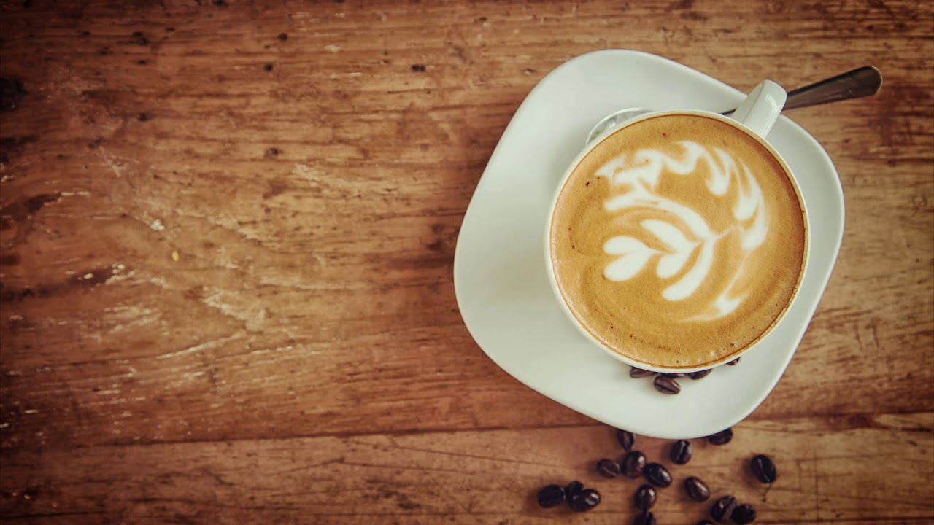
Café Bar “Ami”
COFFE,DRINKS AND MORE…

Slide 2
MENU:
HOT DRINKS
Cappuccino 2.00€
Espresso 1.80€
Americano 2.00€
Latte 1.80€
Mocha 1.80€
Added shot of syrup 0.50€
Tea
Speciality tea 1.00€
Pot of tea for one 1.00€
Pot of tea for two 2.00€
Hot Chocolate 1.50€
Hot Chocolate mountain 1.80€

Slide 3
Cold Drinks:
Fresh juices(Orange,banana,apple,Cherry…) 1.50€
Smoothies 1.70€
Milk Shake 2.20€
Beers 3.00 €

