Slide 2
Comedy
Comedy movies are a type of film in which the main emphasis is on humour. These films are designed to make the audience laugh through amusement and most often work by exaggerating characteristics for humorous effect. Films in this style traditionally have a happy ending.

Slide 4
2. Drama
drama movies are a type of narrative fiction intended to be more serious than humorous in tone.Drama of this kind is usually qualified with additional terms that specify its particular subgenre, such as "police crime drama", "political drama", "legal drama", "historical period drama", "domestic drama", or "comedy-drama". These terms tend to indicate a particular setting or subject-matter, or else they qualify the otherwise serious tone of a drama with elements that encourage a broader range of moods.

Slide 6
3. Adventure
adventure films include survival films, superhero films and pirate films. Main plot elements include quests for lost continents and exotic setting; the creation of empires, characters embarking on treasure and heroic journeys, travels, explorations, quests and searches for the unknown usually also having to overcome an adversary.

Slide 8
4. Thriller
Thriller film, is a broad film genre that involves excitement and suspense in the audience. The suspense element, found in most films' plots, is particularly exploited by the filmmaker in this genre. Tension is created by delaying what the audience sees as inevitable, and is built through situations that are menacing or where escape seems impossible

Slide 10
5. Romance
Romance films are romantic love stories that focus on passion, emotion, and the affectionate romantic involvement of the main characters and the journey that their genuinely strong, true and pure romantic love takes them through dating and marriage. Romance films make the romantic love story or the search for strong and pure love and romance the main plot focus. As in all quite strong, deep, and close romantic relationships, tensions of day-to-day life, temptations, and differences in compatibility enter into the plots of romantic films.

Slide 12
6. Horror
A horror film is a film that seeks to elicit fear. Initially inspired by literature horror has existed as a film genre for more than a century. The macabre and the supernatural are frequent themes. Horror may also overlap with the fantasy, supernatural fiction, and thriller genres.

Slide 14
7. Cartoons
A cartoon is a type of illustration, possibly animated, typically in a non-realistic or semi-realistic style. The specific meaning has evolved over time, but the modern usage usually refers to either: an image or series of images intended for satire, caricature, or humor; or a motion picture that relies on a sequence of illustrations for its animation.

Slide 16
8. Science Fiction (Sci-fi)
Science fiction film (or sci-fi film) is a genre that uses speculative, fictional science-based depictions of phenomena that are not fully accepted by mainstream science, such as extraterrestrial lifeforms, alien worlds, extrasensory perception and time travel, along with futuristic elements such as spacecraft, robots, cyborgs, interstellar travel or other technologies. In many cases, tropes derived from written science fiction may be used by filmmakers ignorant of or at best indifferent to the standards of scientific plausibility and plot logic to which written science fiction is traditionally held.

Slide 18
9.Documentary
A documentary film is a nonfictional motion picture intended to document some aspect of reality, primarily for the purposes of instruction, education, or maintaining a historical record. "Documentary" has been described as a "filmmaking practice, a cinematic tradition, and mode of audience reception" that is continually evolving and is without clear boundaries.Documentary films were originally called 'actuality' films and were only a minute or less in length. Over time documentaries have evolved to be longer in length and to include more categories, such as educational, observational, and even 'docufiction'. Documentaries are also educational and often used in schools to teach various

Slide 20
10.Anime
The word anime is the Japanese term for animation, which means all forms of animated media. Outside Japan, anime refers specifically to animation from Japan or as a Japanese-disseminated animation style often characterized by colorful graphics, vibrant characters and fantastical themes. The culturally abstract approach to the word's meaning may open up the possibility of anime produced in countries other than Japan. For simplicity, many Westerners strictly view anime as a Japanese animation product.[3] Some scholars suggest defining anime as specifically or quintessentially Japanese may be related to a new form of Orientalism.

Slide 21
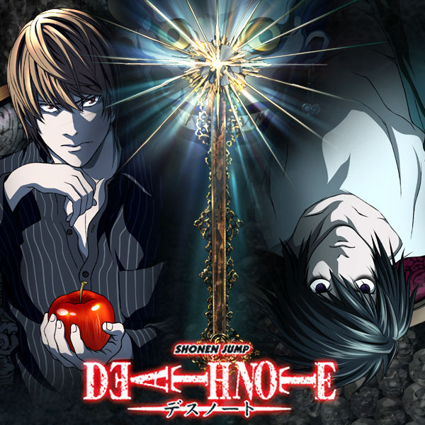

Slide 22
11. Mystery
A mystery film is a type of film that revolves around the solution of a problem or a crime. It focuses on the efforts of the detective, private investigator or amateur sleuth to solve the mysterious circumstances of an issue by means of clues, investigation, and clever deduction.
The plot often centers on the deductive ability, prowess, confidence, or diligence of the detective as they attempt to unravel the crime or situation by piecing together clues and circumstances, seeking evidence, interrogating witnesses, and tracking down a criminal.

Slide 24
12. Crime
Crime films, in the broadest sense, are a cinematic genre inspired by and analogous to the crime fiction literary genre. Films of this genre generally involve various aspects of crime and its detection. Stylistically, the genre may overlap and combine with many other genres, such as drama or gangster film, but also include comedy, and, in turn, is divided into many sub-genres, such as mystery, suspense or noir.

Slide 26
13. Musical
Musical film is a type of films in which songs sung by the characters are interwoven into the narrative, sometimes accompanied by dancing.
The songs usually advance the plot or develop the film's characters, but in some cases, they serve merely as breaks in the storyline, often as elaborate "production numbers".

Slide 27
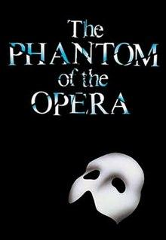

Slide 28
14.Action
Action film is a type of film in which the protagonist or protagonists are thrust into a series of challenges that typically include violence, extended fighting, physical feats, and frantic chases.

Slide 30
15.Sports
A sports film is a film genre that uses sport as the theme of a film. It is a production in which a sport, sporting event, athlete (and their sport), or follower of sport (and the sport they follow) are prominently featured, and which depend on sport to a significant degree for their plot motivation or resolution.

Slide 32
END
By Lefteris Chatziparaskevas
and
Triantafillos Chalkias

