Slide 1
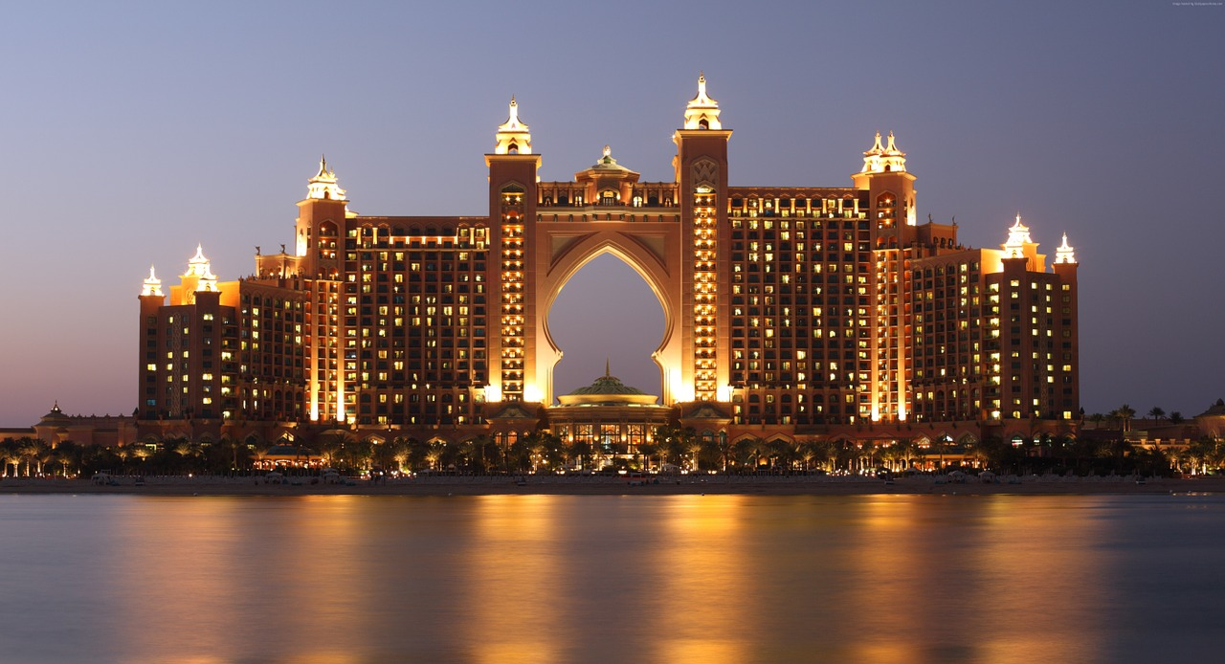
Strange
buildings

Slide 2
Eden project
The Eden Project is a popular visitor attraction in Cornwall, England, UK. Inside the two biomes are plants that are collected from many diverse climates and environments. The project is located in a reclaimed china clay pit, located 2 km from the town of St Blazey and 5 km from the larger town of St Austell. The complex is dominated by two huge enclosures consisting of adjoining domes that house thousands of plant species, and each enclosure emulates a natural biome.

Slide 3
Cube houses
Cube houses are a set of innovative houses built in Rotterdam and Helmond in the Netherlands, designed by architect Piet Blom and based on the concept of "living as an urban roof": high density housing with sufficient space on the ground level, since its main purpose is to optimise the space inside. Blom tilted the cube of a conventional house 45 degrees, and rested it upon a hexagon-shaped pylon.

Slide 4
House attack
House Attack was an architectural installation created in central Vienna, Austria. Austrian artist Erwin Wurm collaborated with the Museum Moderner Kunst for a publicity stunt in the form of architecture, for which he perched a cottage-sized house in a precarious position on the side of MUMOK’s large gray building. Completed in October 2006, the house appeared to have fallen from the sky and implanted itself into the museum. Known for his irreverent approach to projects, Wurm said that “House Attack is a symbol for an everyday occurrence as well as small-mindedness”. He intended that the project would break architectural thinking from so-called ‘normal’ limits. The house was constructed with a large wedge-shaped gap in the roof and was carefully craned into position before being secured to the museum’s steel structure. The installation has since been dismantled.

Slide 5
Conch Shell house
Shell House is an area of coastal cliffs located between Red Bluff and Bluff Point in Kalbarri National Park in Mid West Western Australia. They are highly regarded for their scenery, and also for the exposures of geological strata, which include Ordovician Tumblagooda sandstone, Triassic Wittecarra sandstone and Kockatea shale. The Shell House cliffs have been listed on Australia's Register of the National Estate since 1978.

Slide 6
Nautilus house
The Nautilus House, designed by Mexican architect Javier Senosiain Organic Architecture, combines modern architecture with contemporary art and belongs to the category of “organic work” of the architect, inspired by the sea. Completed in 2007, the social life within the housing flows without divisions, with furnishings that are part of the same house, making its inhabitants and guests are integrated and part of nature feel, like a snail indweller.

Slide 7
Casa da Musica
The Casa da Música is a Portuguese concert hall in civil parish of Cedofeita, Santo Ildefonso, Sé, Miragaia, São Nicolau e Vitória, in the municipality of Porto, in northern Portugal. The building engineers were AFA Arup Group Limited (London) together with Afassociados (Porto). It was designed by Dutch architect was Rem Koolhaas, in association with the Porto Office of Metropolitan Architecture, the scene agency Ducks scéno, the acoustician Renz Van Luxemburg and AFA, while the interiors were designed by Inside Outside (Petra Blaisse), that included the large 13 surfaces, ranging from 22 by 15 meters to 65 by 8 meters (with a gold leaf wood grain pattern in the large auditorium).

Slide 8
Habitat 67
This article is about the housing complex. For the adjacent surf break, see Habitat 67 (standing wave). Habitat 67, as seen from street level. Habitat 67, or simply Habitat, is a model community and housing complex in Montreal, Quebec, Canada, designed by Israeli/Canadian architect Moshe Safdie. It was originally conceived as his master's thesis in architecture at McGill University and then built as a pavilion for Expo 67, the World's Fair held from April to October 1967. It is located at 2600 Avenue Pierre-Dupuy on the Marc-Drouin Quay next to the Saint Lawrence River. Habitat 67 is widely considered an architectural landmark and one of the most recognizable and spectacular buildings in both Montreal and Canada. In 2017, Canada Post issued a commemorative stamp for the 50th anniversary of Expo 67 featuring the structure.

Slide 9
Dynamic Tower
The Dynamic Tower (also known as Dynamic Architecture Building or the Da Vinci Tower) is a proposed 420-metre, 80-floor moving skyscraper, designed by architect David Fisher. Similar to the Suite Vollard completed in 2001 in Brazil, each floor is designed to rotate independently, resulting in a changing shape of the tower. Each floor is designed to rotate a maximum of 6 meters per minute, or one full rotation in 180 minutes. It was proposed as the world's first prefabricated skyscraper with 40 factory-built modules for each floor.

Slide 10
Kansas city Library
The Kansas City Public Library is a public system headquartered in the Central Library in Kansas City, Missouri. The system operates its Central Library and neighborhood branches located in Kansas City, Independence, and Sugar Creek. Founded on December 5, 1873, it is the oldest and third largest public library system in the metropolitan Kansas City area. Its special collections, housed in the Central Library's Missouri Valley Room, has a collection of Kansas City local history, including original and published materials, news articles, post cards, photographs, maps, and city directories dating from the community's earliest history. The Library's Ramos Collection includes books, pamphlets, journal articles and other materials relating to African-American history and culture.

Slide 11
Maria Parlakidou

