Slide 1
Εργασία αγγλικών
Countries

Slide 2
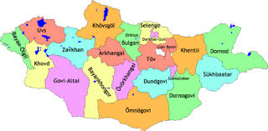
Countries
Mongolia
It is a country with an area of 1.564.116 km2 and a population of 3,120,000. It is the 2 largest enclosed country after Kazakhstan. It borders with Russia, with the People's Republic of China and is only a few kilometers from Kazakhstan. The capital of the is Ulan Bator.

Slide 3
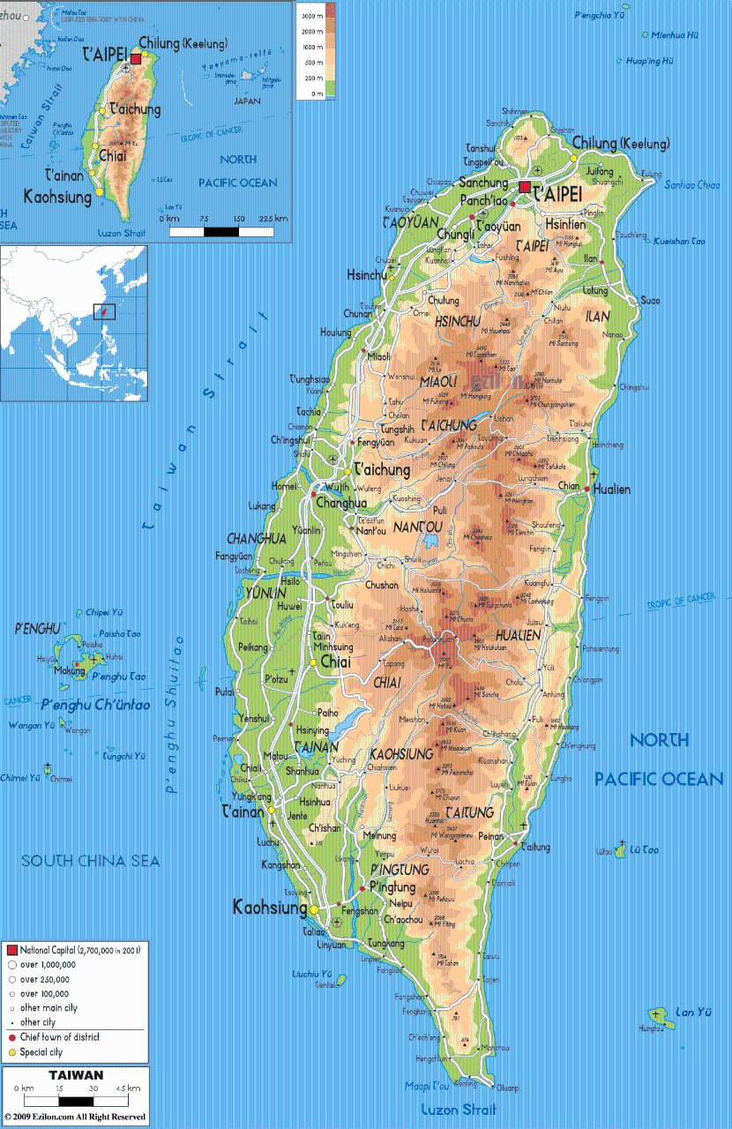
Countries
Taiwan
The Republic of China. It is an island country of East Asia. It occupies an area of 36,197 sq. Km. and its population is 23,543,346. The capital is Taipei.

Slide 4
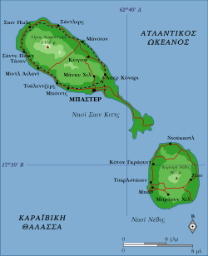
Countries
Saint Bartholomew
It is one of the four areas of the Caribbean Small Antilles that make up the French West Indies. It has a total area of 21 sq. Km. and a population of 9,427. The capital city is Gustavia.

Slide 5
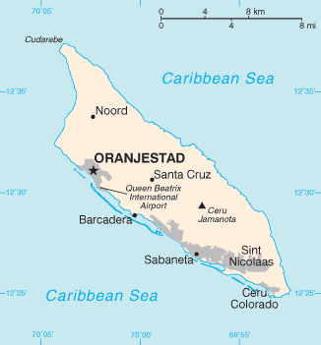
Countries
Aruba.
It has an area of 180 sq. Km. and a population of 110,576. It is located in the Caribbean Sea north of Venezuela. Its climate is dry, while its capital is the Oranjestad

Slide 6
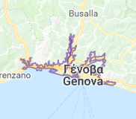
City
Genoa
It is an important historic city of Italy with about 800,000. residents of Liguria, in the center of the homonymous bay and very important port of Italy.

Slide 7
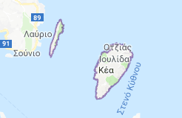
City
Kea
.
Or Tzia is a Cycladic island of the Aegean. It is the nearest inhabited Cycladic island of Attica. It is the sixth largest and the 10th most densely populated island of the Cyclades.

Slide 8
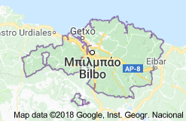
City
Vizcaya
It is a province of the Basque Country in Spain. Of the 1,133,444 inhabitants living in Vizcaya
about 35% live in the capital, Bilbao, and 88% in its metropolitan area.

Slide 9
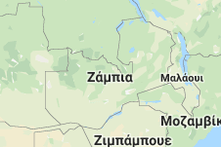
Countries
Zambia
is a landlocked country in the north of South Africa with an area of 752,614 sq. km. and a population of 16,887,720. Its capital is Lusaka.

Slide 10
Από την Μαθήτρια του Α΄2 :
Τραικου Αγάπη

