Slide 1
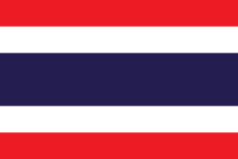
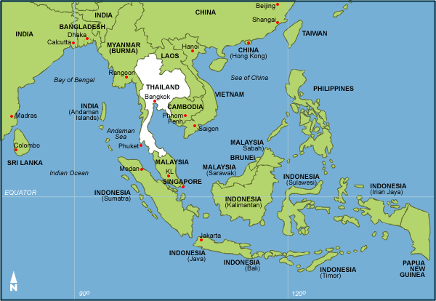
Thailand

Slide 2
About Thailand
Thailand, is a country at the centre of the Indochinese peninsula in Mainland Southeast Asia. It is bordered to the north by Myanmar and Laos, to the east by Laos and Cambodia, to the south by the Gulf of Thailand and Malaysia, and to the west by the Andaman Sea and the southern extremity of Myanmar. Its maritime boundaries include Vietnam in the Gulf of Thailand to the southeast, and Indonesia and India on the Andaman Sea to the southwest.

Slide 3
The food of Thailand
The food in Thailand consist of:
Dehydrated warms
Dehydrated beetle
Lizard sticks

Slide 4
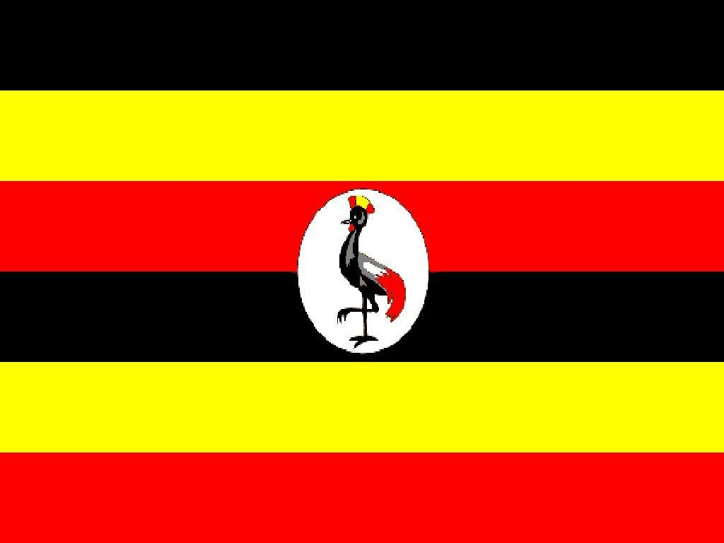
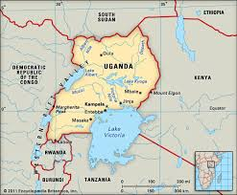
Uganda

Slide 5
About Uganda
Uganda, officially the Republic of Uganda, is a landlocked country in East Africa. It is bordered to the east by Kenya, to the north by South Sudan, to the west by the Democratic Republic of the Congo, to the southwest by Rwanda, and to the south by Tanzania. Uganda is the world's second most populous landlocked country after Ethiopia. The southern part of the country includes a substantial portion of Lake Victoria, shared with Kenya and Tanzania, situating the country in the African Great Lakes region. Uganda also lies within the Nile basin, and has a varied but generally a modified equatorial climate.

Slide 6
The food of Uganda
Ugandan cuisine consists of traditional and modern cooking styles. Like the cuisines of most countries, it varies in complexity, from the most basic, a starchy filler with a sauce of beans or meat, to several-course meals.

Slide 7
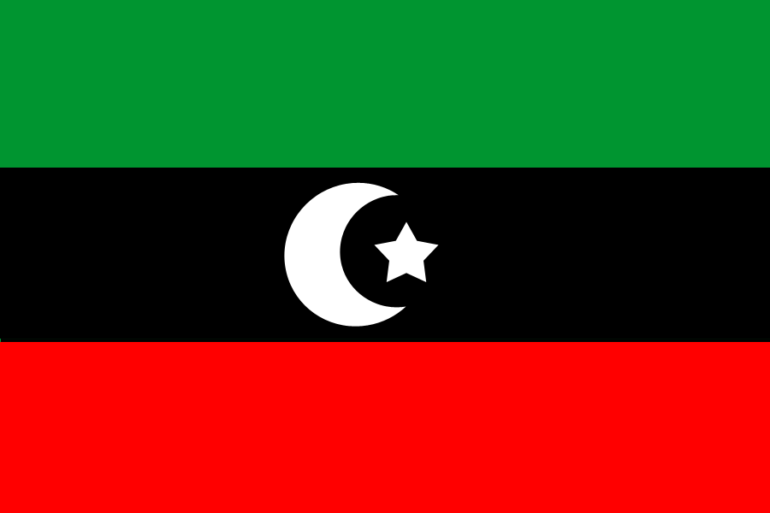
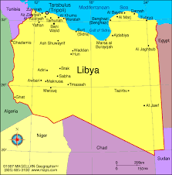
Libya

Slide 8
About Libya
Libya is a country in the Maghreb region of North Africa bordered by the Mediterranean Sea to the north, Egypt to the east, Sudan to the southeast, Chad and Niger to the south, and Algeria and Tunisia to the west. The three traditional parts of the country are Tripolitania, Fezzan and Cyrenaica. With an area of almost 1.8 million square kilometers (700,000 sq mi), Libya is the fourth largest country in Africa, and is the 16th largest country in the world. Libya has the 10th-largest proven oil reserves of any country in the world.

Slide 9
The food in Libya
Libyan cuisine is the cooking traditions, practices, foods and dishes associated with the country of Libya. The cuisine derives much from the traditions of the Mediterranean, North Africa, and the Middle East. One of the most popular Libyan dishes is a thick highly spiced soup, known simply as Shorba Arabiya, or "Arabian soup". Shorba Arabiya contains: onions, tomatoes, lamb, chili peppers, cayenne pepper, saffron, chickpeas, mint, cilantro and parsley. Tripoli is Libya's capital, and the cuisine there is particularly influenced by Italian cuisine. Pasta is common, and many seafood dishes are available. Southern Libyan cuisine is more traditionally Arab and Berber. Common fruits and vegetables include figs, dates, oranges, apricots and olives.

Slide 10
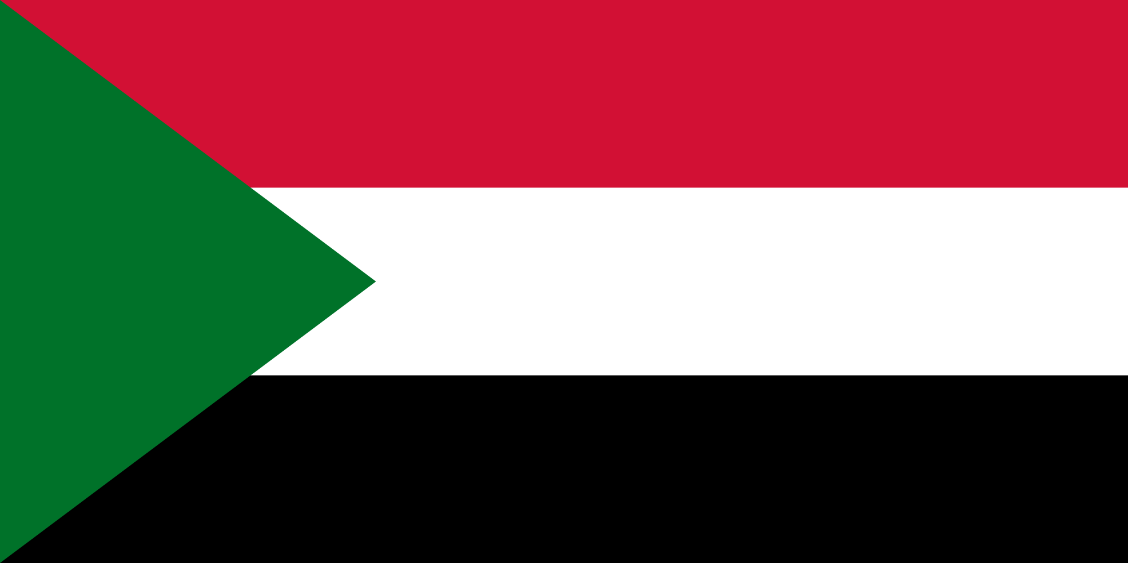
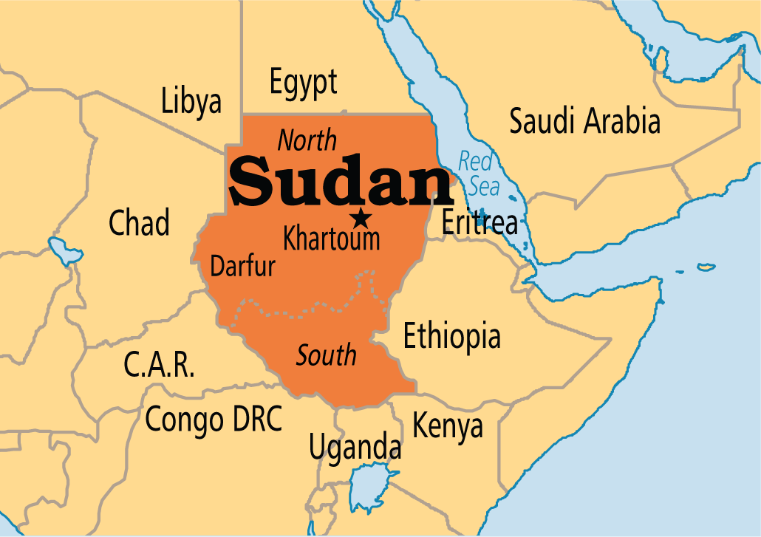
Sudan

Slide 11
About Sudan
Sudan, is a country in Africa or East Africa, bordered by Egypt to the north, the Red Sea, Eritrea, and Ethiopia, to the east, South Sudan to the south, the Central African Republic to the southwest, Chad to the west and Libya to the northwest. It is the third largest country in Africa. The River Nile divides the country into eastern and western halves. Its predominant religion is Islam.

Slide 12
The food in Sudan
A wide variety of stews exist in Sudan, often paired with a staple bread or porridge. Further south, fish dishes are popular. Sudanese food in the north is simpler, whereas foods further south reflect the influence of surrounding areas, such as the Yemeni influenced mokhbaza (banana paste) of Eastern Sudan.

Slide 13
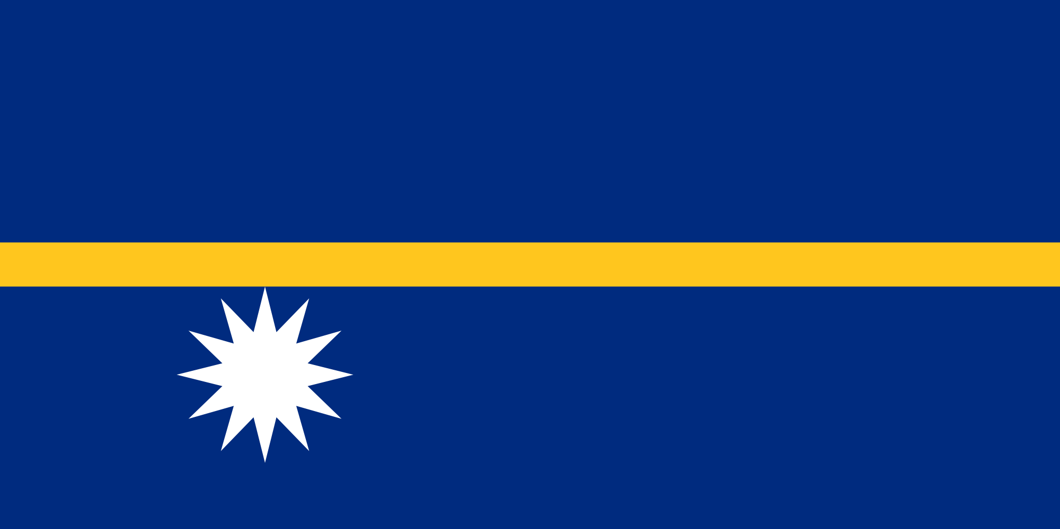
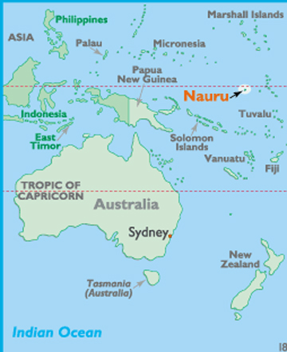
Nauru

Slide 14
About Nauru
Nauru officially the Republic of Nauru and formerly known as Pleasant Island, is an island country in Micronesia in the Central Pacific. Its nearest neighbour is Banaba Island in Kiribati, 300 kilometers to the east. With 9,488 residents in 8.1 sq mi area, Nauru is the smallest state in the South Pacific and third smallest state by area in the world, behind only Vatican City and Monaco.

Slide 15
The food in Nauru
Almost all food is imported, with the exception of fish caught by Kiribati fishermen. Nauru provided pandanus and fish in premining times, and these were eaten with coconut meat. As a result of mining revenues, the people have a variety of supermarket foods, from turkey to milk. Rice is the basic staple, and fish with rice is the ideal meal.

Slide 16
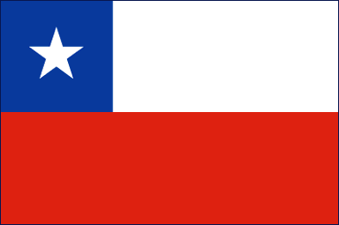
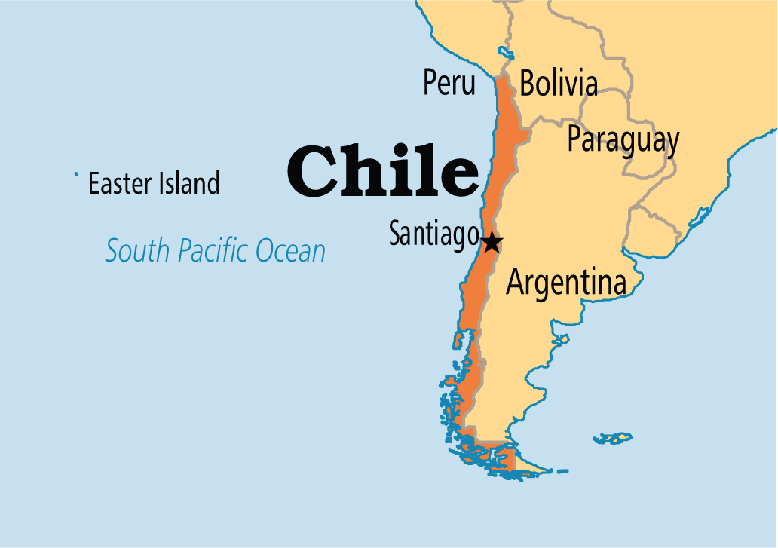
Chile

Slide 17
About Chile
Chile, officially the Republic of Chile, is a South American country occupying a long, narrow strip of land between the Andes to the east and the Pacific Ocean to the west. It borders Peru to the north, Bolivia to the northeast, Argentina to the east, and the Drake Passage in the far south. Chilean territory includes the Pacific islands of Juan Fernández, Salas y Gómez, Desventuradas, and Easter Island in Oceania. Chile also claims about 1,250,000 square kilometres (480,000 sq mi) of Antarctica, although all claims are suspended under the Antarctic Treaty.

Slide 18
The food in Chile
Arrollado de Chancho - chunks of pork wrapped in pork fat smothered in red ají (chili).
Bistec a lo pobre - beefsteak, French fries, fried onions, topped with a couple of fried eggs.
Carbonada - meat soup with finely diced beef and all kinds of vegetables such as potatoes, onions, carrots, broccoli, green pepper and parsley.
Chancho en Piedra - a typical Chilean seasoning. Tomatoes, garlic, and onions grounded together in a stone.
Charquican - ground or diced meat cooked with garlic, onions, potatoes and pumpkin all mashed. It is a mushy dish but great.
Cazuela de Ave - chicken soup with pieces of meat, potatoes, green beans or peas, rice or noodles.
Cazuela de Vacuno - beef soup with pieces of meat, potatoes, corn on the cob, carrots, onions, green beans, garlic, chunks of pumpkin, rice or noodles.
Charquicán - potato, pumpkin, mince, onion, carrot sometimes with peas and corn (both optional) all mashed together

Slide 19
By :
Maria Diafonidou
Konstantina Kuriakidou

