Slide 1
STRANGE COSTUMES

Slide 2
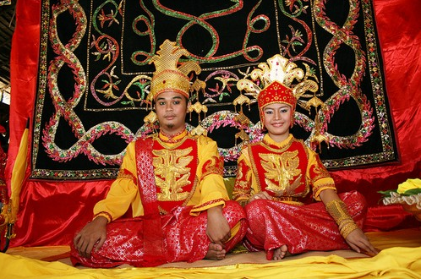
1. BATHROOM BAN OF TIDONG
Weddings in the Indonesian Tidong community have traditions that are truly unique. Perhaps the most adorable of their customs is the one where the groom isn’t allowed to see the bride’s face until he sings her several love songs. The curtain separating the couple is raised only after the musical requirement is met, and then they can see each other on a dais. But the weirdest of them all is this – the bride and the groom aren’t allowed to use the bathroom for three days and nights after the wedding.

Slide 3
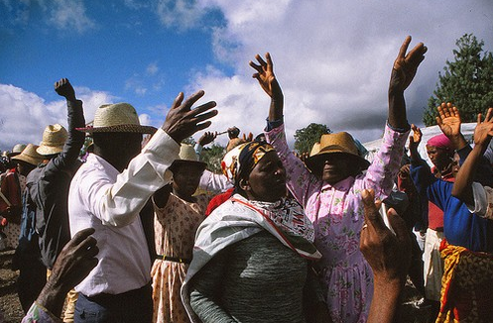
2. FAMADIHANA DANCING WITH THE DEAD
The Famadihana is a traditional festival which is celebrated in both urban and rural areas of the country especially in Madagascar, it is more popular among the tribal communities. It is a funerary tradition, known as the turning of the bones, people bring forth the bodies of their ancestors from the family crypts and rewrap them in fresh cloth, then dance with the corpses around the tomb to live music.

Slide 4
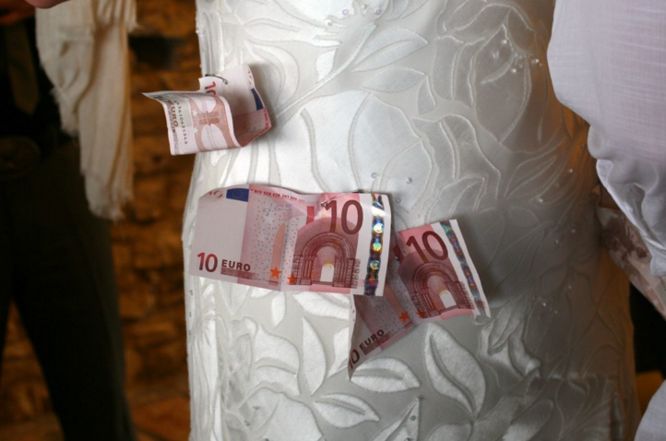
3. THE MONEY DANCE
During Greek weddings, the bride and groom share a traditional dance, during which guests pin money to their clothing.

Slide 5
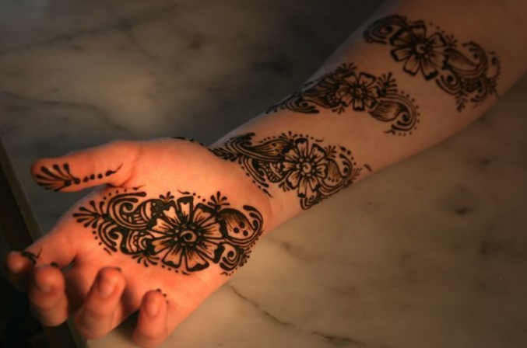
4. THE MOST ROMANTIC TATTOOS IN THE WORLD
Arabic, African, and Indian women tattoo themselves with henna before their wedding days. The tattoos symbolize the bride's elegance and beauty.

Slide 6
THE END !!!
Sissy Sarra ♥☺

