Slide 1
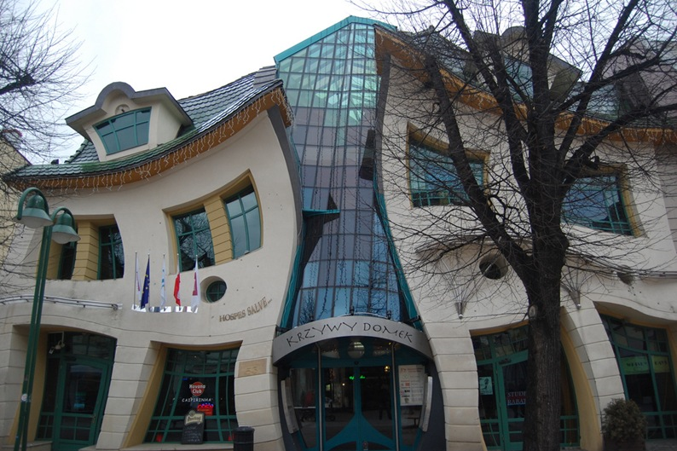
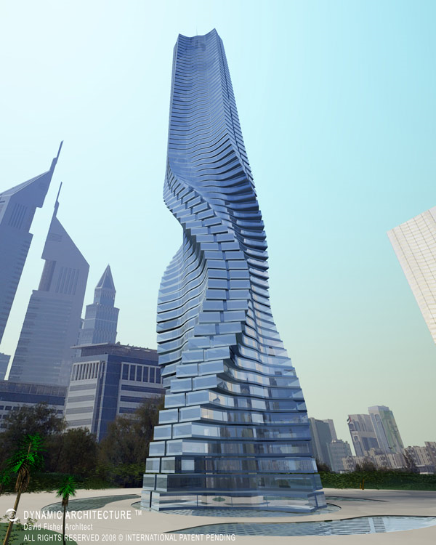
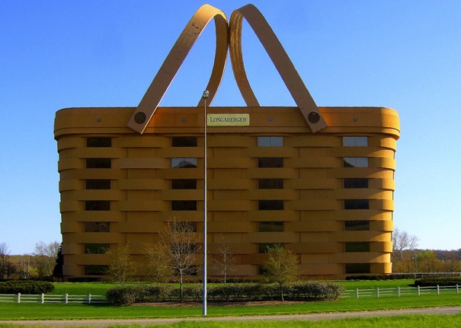
STRANGE BUILDINGS

Slide 2
The Crooked House
-The Crooked House ( or Krzywy Domek)
was built in 2004
-It is about 4,000 square meters (43,000 sq ft) in size and is part of the Rezydent shopping center
-This building is located in Sopot, Poland
- It was designed by Szotynscy and Zaleski who were inspired by the fairytale illustrations and drawings of Jan Marcin Szancer and Per Dahlberg
- It can be entered from either Monte Cassino or Morska Streets.

Slide 3
Rotating Tower, Dubai, UAE
-This building has the ability which actually can change the building’s shape.
-The creator Dr. David Fisher thinks that a building changing its shape is something usual.
- The building is located in Dubai , UAE.

Slide 4
The Longaberger Company
- The Longaberger Company was started by Dave Longaberger in 1973, and is currently led by John Rochon Jr. who is a CVSL director and son of the CVSL chairman.
- The Longaberger Company is located in Ohoi , USA.
- On May 5, 2015, it was announced that Tami Longaberger, who led The Longaberger Co. since her father died in 1999, resigned as chief executive officer and director of the company.

Slide 5
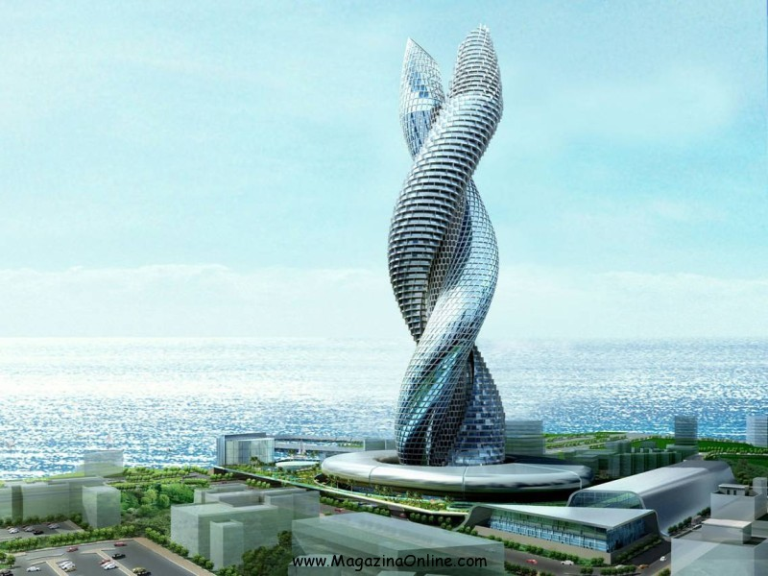
THANK YOU FOR YOUR ATTENTION!!!
DIRECTOR:
Delibei Chrysa
SOURCES:
Wikipedia
IMAGINES:
Google Imagines

