Slide 1
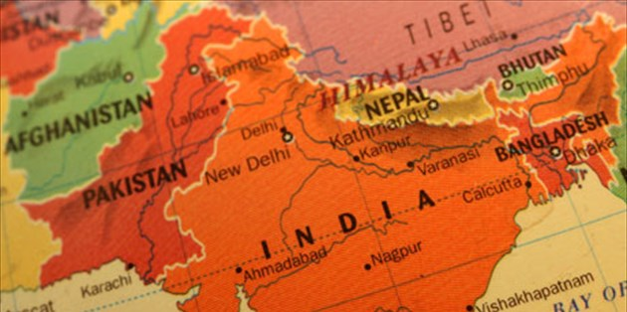
INDIA
India, or the official Republic of India (Bhārat Ganarājya) is a country in South Asia. It is the second largest country in the world.

Slide 2
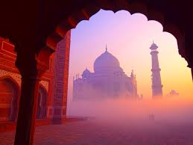
Taj Mahal
The Taj Mahal is a building complex located in India, built on the south bank of the Yamuna River near the city of Agra. The complex develops around the mausoleum built by Shah Yahan Mongol emperor (Shahis) to honor his beloved wife, Mumtaz Mahal, who died in 1631 during childbirth.

Slide 3
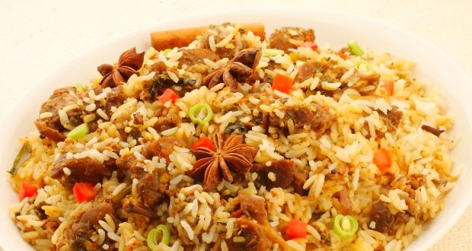
Biryani
It is an aromatic rice cooked with various spices - mainly saffron - and marinated meat, mainly chicken or lamb.

Slide 4
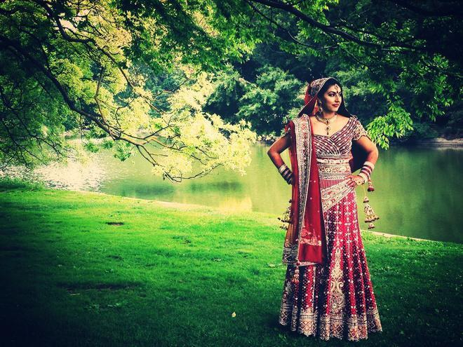
Wedding custom in India.
The curse that they carry is that the man to be married will die very young and soon after their union. That's why the girls in this category know what they are forced to do according to their custom? They marry a tree.

Slide 5
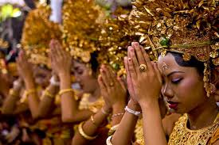
Hinduism
Hinduism, religion are denominations that describe the many local religions, religious practices and individual schools of India.

Slide 6
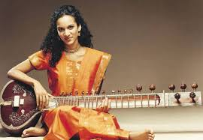
The music of India
The music of northern India is known by the name "Hindustani" Hindustanica and the South as "karnatic" Karnataka. Their origin is the same, only the approach and style change.

Slide 7
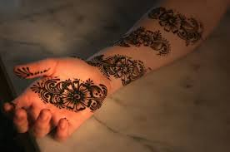
Tattoos in Indian weddings
Indian weddings are full of special rituals. One of these, and particularly important, is the so-called Mehndi-ki-raat, which takes place one day before the wedding.

Slide 8
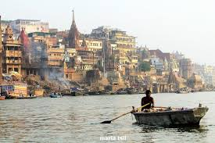
river gang
Ganges is one of the largest rivers in the Indian Peninsula. It is considered to be the holiest Hindu River and has been designated by India as "National River« Kuriakh Kotzoglou

