Slide 1
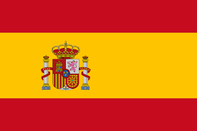
Spain
Spain,officially the Kingdom of Spain is a country mostly located on the Iberian Peninsula in Europe with there also being two large archipelagoes, the Balearic Islands in the Mediterranean Sea and the Canary Islands off the African Atlantic coast, two cities, Ceuta and Melilla, on the African mainland and several small islands in the Alboran Sea near the African coast.

Slide 2
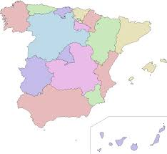
The country's mainland is bordered to the south and east by the Mediterranean Sea except for a small land boundary with Gibraltar; to the north and northeast by France, Andorra, and the Bay of Biscay; and to the west and northwest by Portugal and the Atlantic Ocean.

Slide 3
HISTORY
Iberia enters written records as a land populated largely by the Iberians, Basques and Celts. Early on its coastal areas were settled by Phoenicians who founded Western Europe's most ancient cities Cadiz and Malaga. Phoenician influence expanded as much of the Peninsula was eventually incorporated into the Carthaginian Empire, becoming a major theater of the Punic Wars against the expanding Roman Empire. After an arduous conquest, the peninsula came fully under Roman Rule

Slide 4
Also…
During the early Middle Ages it came under Germanic rule but later, much of it was conquered by Moorish invaders from North Africa. In a process that took centuries, the small Christian kingdoms in the north gradually regained control of the peninsula.

Slide 5
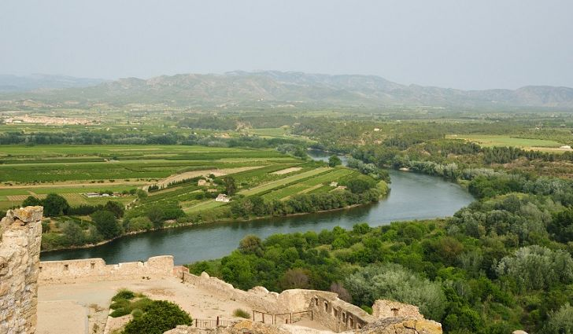
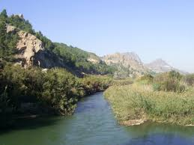
Rivers
There are several major rivers in Spain such as the Tagus (Tajo), Ebro, Guadalquivir, Jucar, Segura, Turia and Minho.

Slide 6
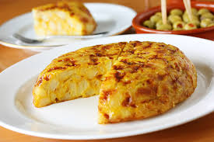
Spanish Food
Spanish food is often recognised as one of the top cuisines in the world, and some traditional Spanish dishes and recipes date hundreds of years. Food has become as integral to Spain as its rich and tumultuous history, with each region of Spain – once a collection of numerous, distinct kingdoms – boasting their own unique cuisines and flavours.

Slide 7
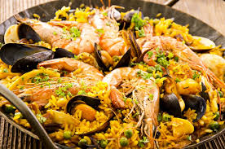
Also..
Each regional speciality in Spain is worth trying, and many of the top Spanish restaurants are known by the different regions they come from. In the main Spanish cities you can find Basque, Galician, Asturian and Valencian restaurants, to name but a few of the renowned regions for local food specialities.

Slide 8
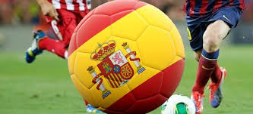
Sport
Sport in Spain in the second half of the 20th century has always been dominated by football. Other popular sport activities include basketball, tennis, cycling, handball, motorcycling, Formula One, water sports, rhythmic gymnastics, golf, bullfighting and skiing. Spain has also hosted a number of international events such as the 1992 Summer Olympics in Barcelona and the 1982 FIFA World Cup.

Slide 9
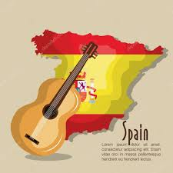
Music of Spain
The music of Spain has a long history. It has played an important role in the development of Western music, and has greatly influenced Latin American music. Spanish music is often associated with traditional styles such as flamenco and classical guitar. While these forms of music are common, there are many different traditional musical and dance styles across the regions

Slide 10
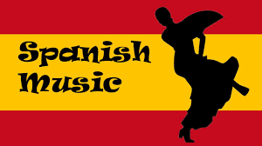
For example, music from the north-west regions is heavily reliant on bagpipes, the jota is widespread in the centre and north of the country, and flamenco originated in the south. Spanish music played a notable part in the early developments of western classical music, from the 15th through the early 17th century.

Slide 11
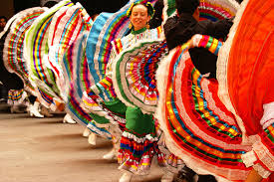
Cultures of Spain
The cultures of Spain are Westernized cultures based on a variety of historical influences, primarily based on pre-Roman Celtic and Iberian culture. Other peoples such as Romans, Phoenicians, Carthaginians, Greeks. In the areas of language and also religion, the Ancient Romans left a lasting legacy in the Spanish culture because Rome created Hispania as a political, legal and administrative unit.[1] The subsequent course of Spanish history added other elements to the country's culture and traditions.

Slide 12


