Slide 1
PANAGIOTIS FOUGIAS
A2 1 GYMNASIO KRIAS VRISIS

Slide 2
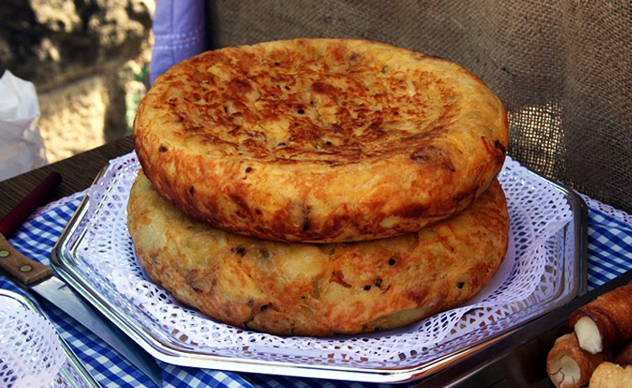
TRADITIONAL FOODS
The Spanish omelette is another beloved top Spanish food – and everyone has an opinion on how to cook it. It's a great starter for breakfast, lunch and dinner, and no doubt you'll come across many Spanish potato omelettes during your time in Spain.

Slide 3
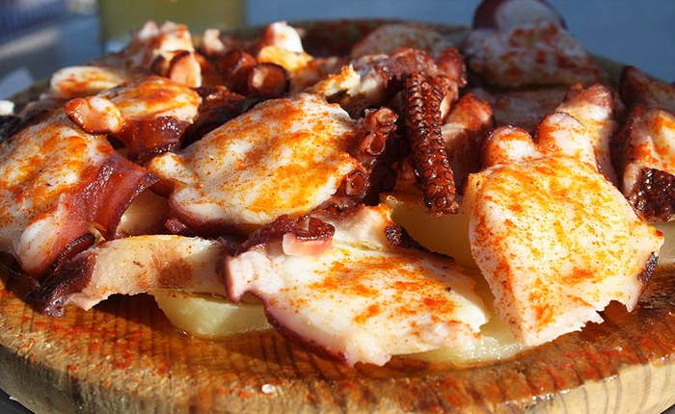
TRADITIONAL FOODS
This boiled octopus dish gets its unique flavours from maceration in three simple ingredients: paprika crusty rock salt and a drizzle of olive oil. It's a signature Galician dish and you'll find it on the menu in many Galician restaurants around Spain, and especially in the many polbeiras (octopus restaurants) dotting the Galician region.

Slide 4
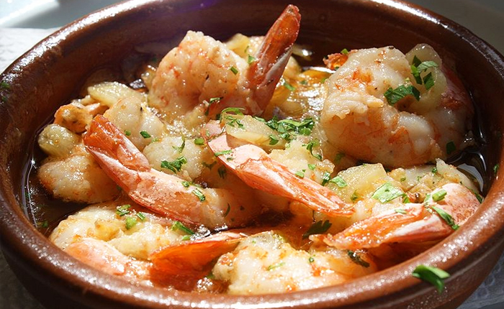
TRADITIONAL FOODS
As in many top Spanish foods, simplicity and drawing out natural flavours of fresh ingredients are key, and this is easily seen in this tantalising yet simple dish gambas al ajillo. Small Spanish prawns are typically lightly cooked in a small clay dish of hot olive oil, roasted garlic and usually a small chilli that gives this dish a little kick.

Slide 5
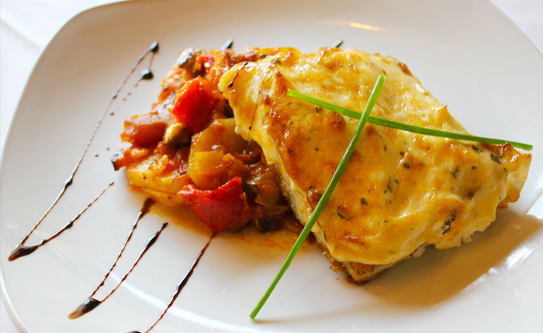
TRADITIONAL FOODS
This vegetarian top Spanish dish is for all ages, eaten in Spain appetiser, a side dish to meats, or even as a meal with a fried egg on top or chorizo.

Slide 6
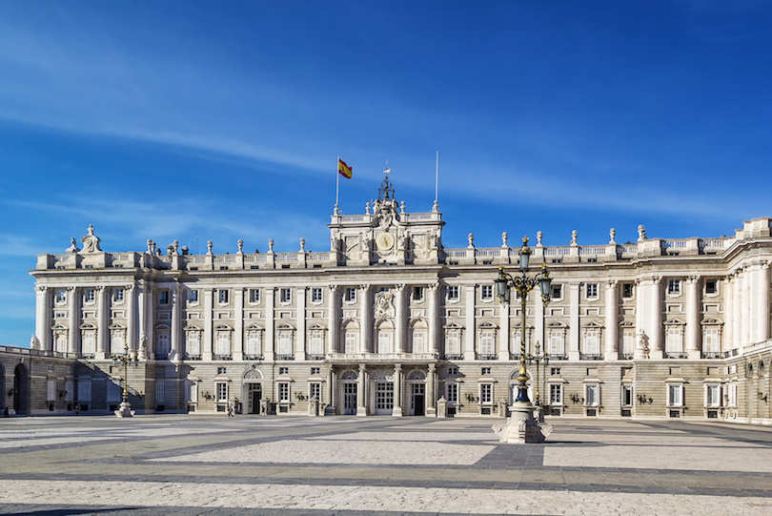
TOURIST ATTRACTIONS
The Palacio Real (Royal Palace) of Madrid is the official residence of the King of Spain although it is only used for state ceremonies. The Royal Palace was built between 1738 to 1755 and King Carlos III took up residence in the palace in 1764.

Slide 7
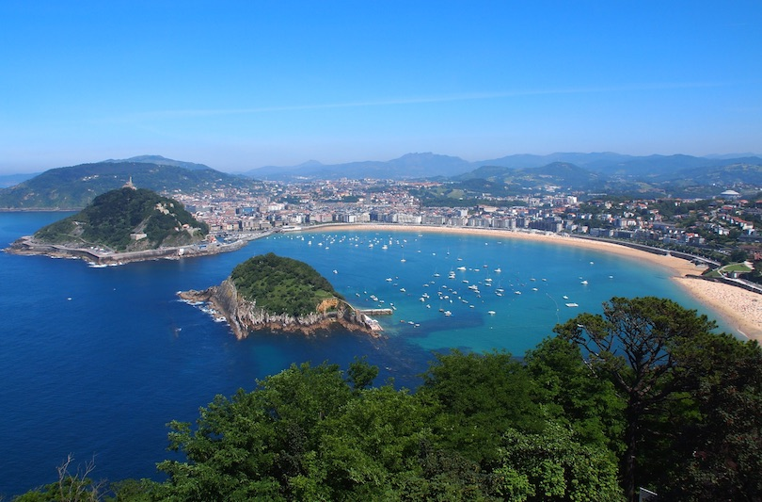
TOURIST ATTRACTIONS
Protected from strong winds by steep cliffs and islands, La Concha in San Sebastian is said by many to be one of the best city beaches in Europe, let alone Spain. Here you can go surfing, walk along the promenade in search of good restaurants and enjoy the beautiful views of the beach.

Slide 8
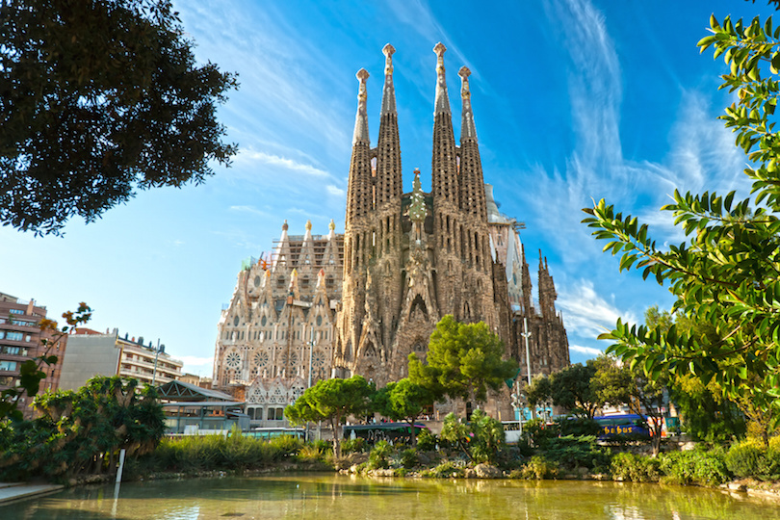
TOURIST ATTRACTIONS
The Sagrada Familia is a large Roman Catholic church in Barcelona, and one of Spain’s most visited tourist attractions. It’s a design by Antoni Gaudí, a Catalan architect who worked on this project for almost 40 years until his death in 1926. The construction of the basilica began in 1882 and still as yet not finished.

Slide 9
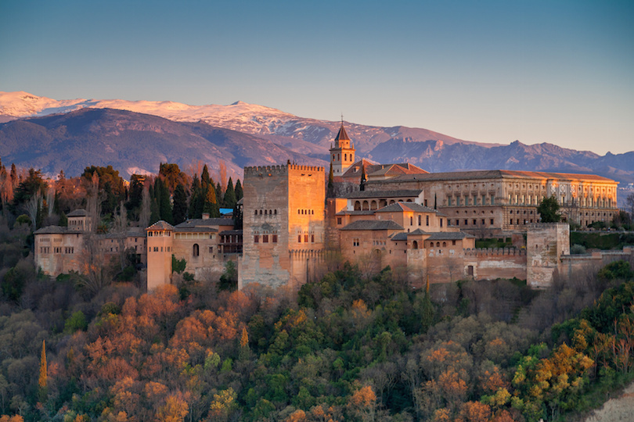
TOURIST ATTRACTIONS
Part fortress, part palace and part garden the Alhambra is situated on a plateau overlooking the city of Granada in southern Spain. The palace was constructed in the 14th century by the Nasrid sultans. The Alhambra is now one of Spain’s major tourist attractions and many visitors come to Granada just to see the Alhambra.

Slide 10
THANKS!!
FOR THE INTEREST

