Slide 1
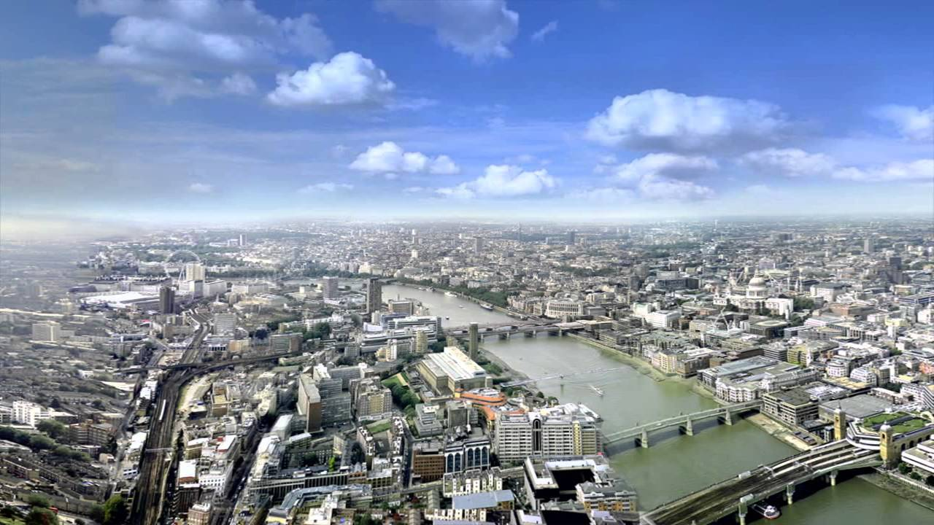
London
is the capital and most populous city of England and the United Kingdom

Slide 2
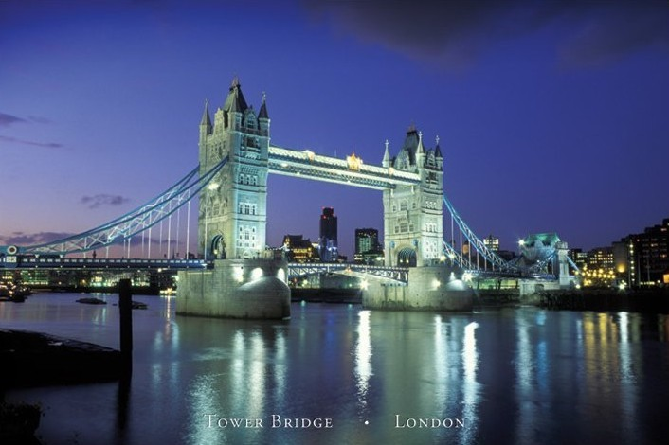
Tower Bridge of London
Tower Bridge is a combined bascule and suspension bridge in London built between 1886 and 1894. The bridge crosses the River Thames close to the Tower of London and has become an iconic symbol of London

Slide 3
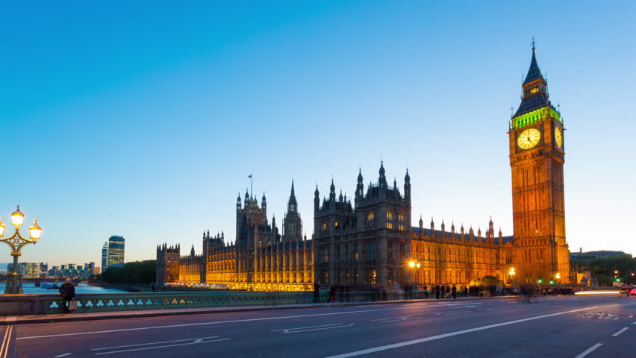
BIG BEN
Big Ben is the most famous sight in the London. This clock is very big and is very famous for tourist.

Slide 4
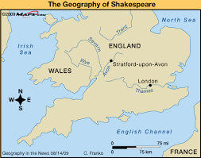
Geography of London
London is the largest urban area and capital city of the United Kingdom. It is located in the southeast of Great Britain. The London region covers an area of 1,579 square kilometres (610 sq mi), and had a population of 7,172,036 in 2001 and a population density of 4,542 people per square kilometre.

Slide 5
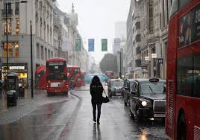
Weather in London
.
Weather in london is different because all day rain but sometimes have sun in the sumer.But winter all day rain and snow. The weather in london its bad but many tourist came in London for sights and not for weather.

Slide 6
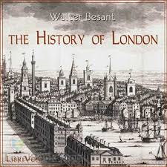
History of London
The history of London, the capital city of England and the United Kingdom, extends over 2000 years. In that time, it has become one of the world's most significant financial and cultural capital cities. It has withstood plague, devastating fire, civil war, aerial bombardment, terrorist attacks, and riots.
The City of London, often referred to simply as "the City", is the historic core of the Greater London area, and is today its primary financial district, though it represents only a small part of the wider metropolis.

Slide 7
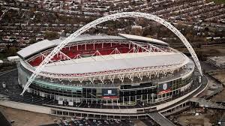
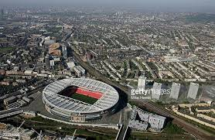
London it has many football clubs and stadiums : such as , arsenal chelsea, tottenham . And stadiums stamford bridge , white hart lane or emirates

Slide 8
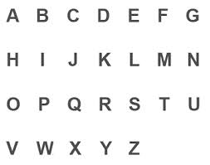
Language of London is English

Slide 9

cars(LONDON)
Cars in England and London is different because the sheat of driver is right of the car.

Slide 10
Thanks for watching
My name is …SARRAS DIMITRIS
AND MY TEACHER’S NAME IS..PERDIKATSIS DIONISIS

