Slide 1
1st junior high school of Kria Vrisi
Kiose Marios

Slide 2
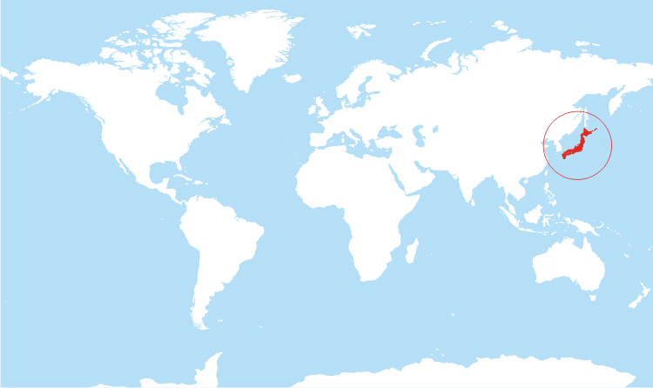
JAPAN
Japan is located in east Asia. It has 127 million residents. About 9.1 million live in Tokyo, the capital of Japan.

Slide 3
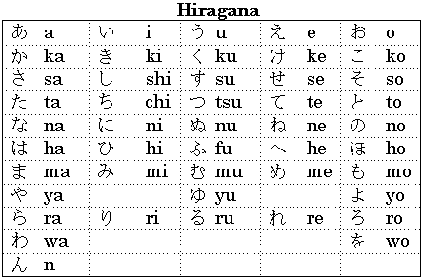
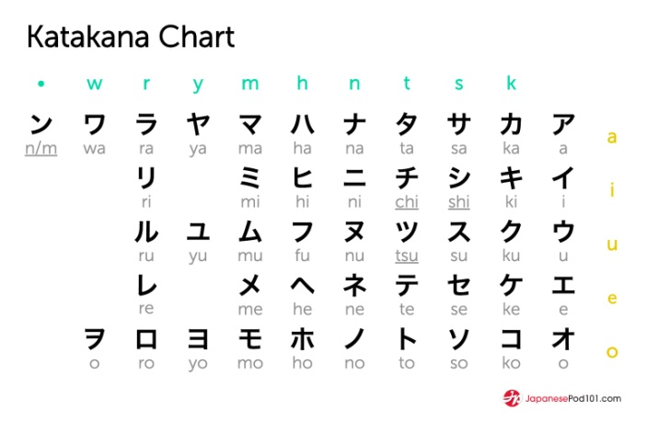
LANGUAGES
More than 99% of the country’s population speaks Japanese. Japanese writing uses kanji and two sets of kana (Hiragana and katakana).

Slide 4
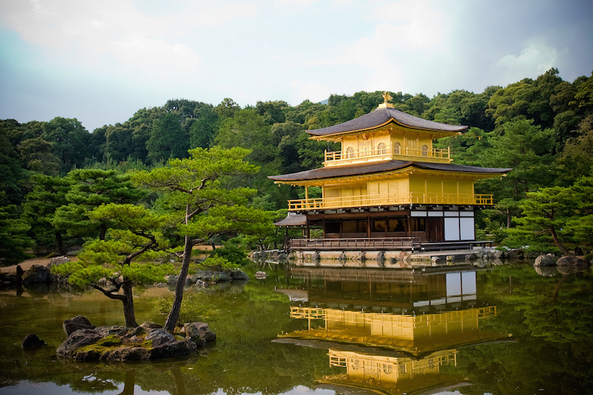
SIGHTS
Japan is one of the most popular travel destinations in the world. Almost all of the historical sites are still used for their original purposes while remaining open to the public.
The Temple of the Golden Pavilion is the most popular tourist attraction in Japan.
Golden Pavilion

Slide 5
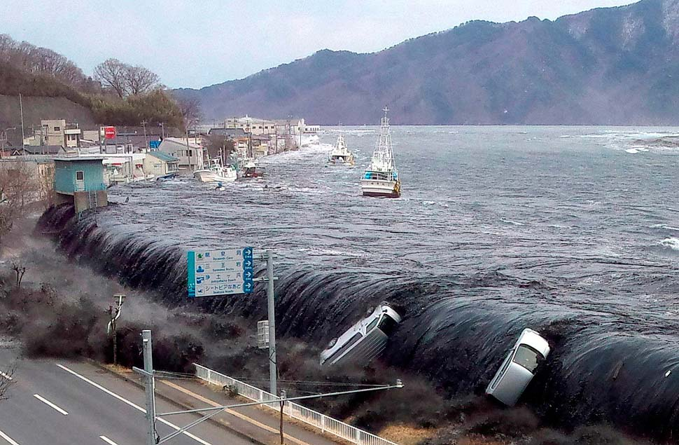
HISTORY
In 1956 Japan becomes a member of The United Nations. In 1964 Olympic games are held in Tokyo. In 2011 a magnitude-7.3 earthquake struck off the coast of Japan.

Slide 6
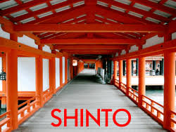
RELIGION
Japan has full religious freedom based on Article 20 of its Constitution. According to researches conducted 84–96 percent of the Japanese population subscribe to Shinto as its indigenous religion.

Slide 7
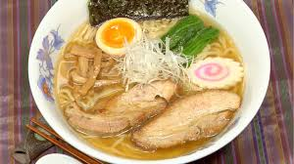
CUISINE
Japanese cuisine is based on combining staple foods, typically Japanese rice or noodles, with a soup.
RAMEN
Ramen is a Japanese dish. It consists of Chinese-style wheat noodles served in a meat or fish-based broth.

Slide 8
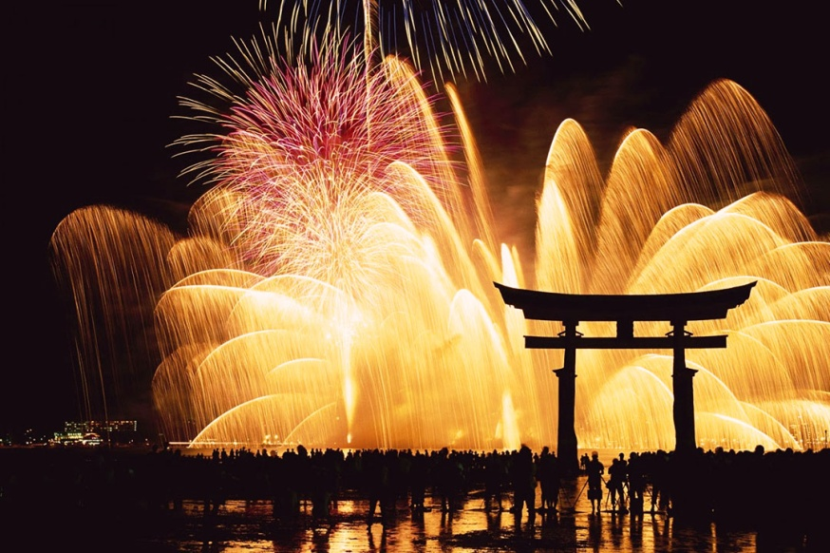
CELEBRATIONS
Some festivals have their roots in Chinese festivals from centuries ago. Some are so different that do not even remotely resemble the original festival despite sharing the same name and date.
NEW YEAR IN JAPAN

Slide 9
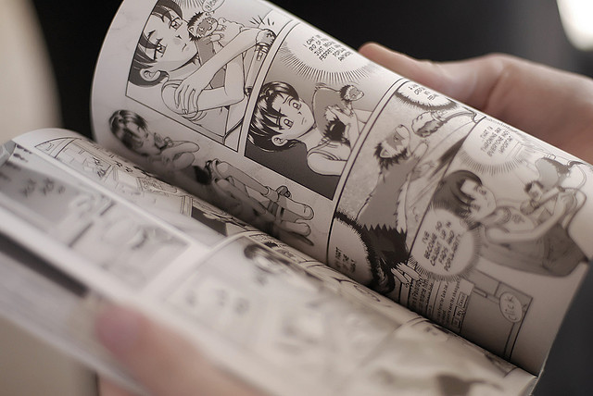
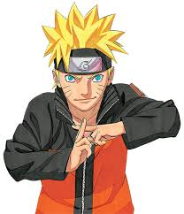
ART
Japanese comics, known as manga, developed in the 20th century and have become popular worldwide. Japanese animated films and television series, known as anime.
This is an Anime character
This is a Manga

Slide 10
THANKS FOR WATCHING!
i got my information from: https://en.wikipedia.org/wiki/Japan

