Slide 1

Japan

Slide 2
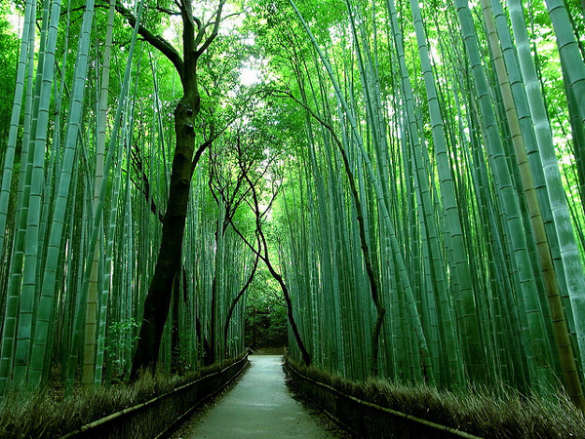
Prehistory and ancient history
Scientists believe that the Japanese as a whole come from many groups that migrated to the islands from other parts of Asia, including China and Korea. Archaeological research, however, suggests that the Japanese islands were inhabited already since 30,000 BC. This was followed at the beginning of the Jomon period (about 14,000 BC)
from a Mesolithic to Neolithic semi-nomic hunter and feeder culture, including the ancestors of modern Aino and Yamato, [10] [11] and is characterized by dwelling pits and elementary crops. [12] Decorated clay pots of this period are some of the oldest surviving traces of pottery in the world.

Slide 3
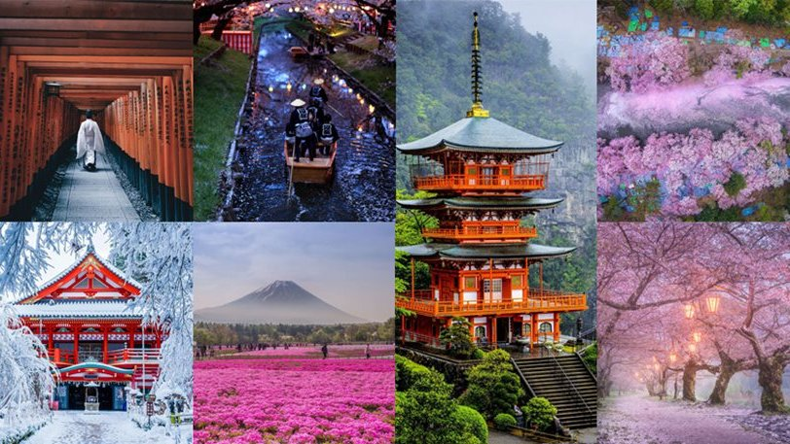
I Iaponía emfanízetai gia próti forá sti grafikí istoría tou kinezikoú vivlíou Chansoú. Sýmfona me ta Chroniká ton Trión Vasileíon, to pio ischyró vasíleio sto archipélagos katá to 3o aióna onomazótan Giamaïkókokou. O Voudismós eisíchthi stin Iaponía apó ton Badetzé tis Koréas, allá i metagenésteri anáptyxi tis iaponikís voudisías epireástike kyríos apó tin Kína [18]. Pará tis archikés antistáseis, o Voudismós proíchthi stis exousiastikés táxeis kai eíche evreía apodochí xekinóntas apó tin período Asoúka

Slide 4
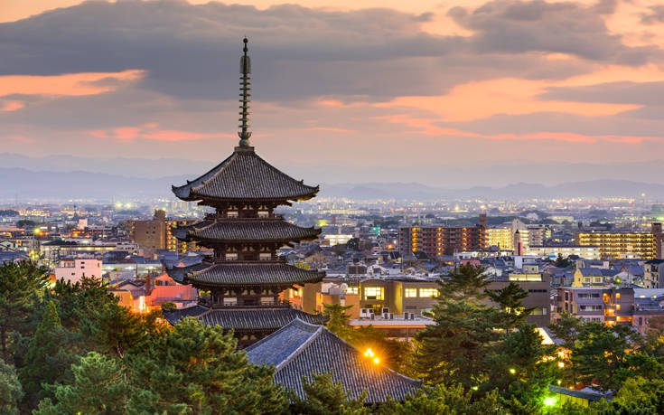

Slide 5
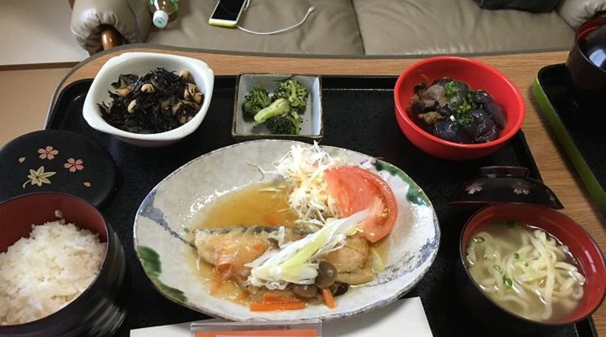
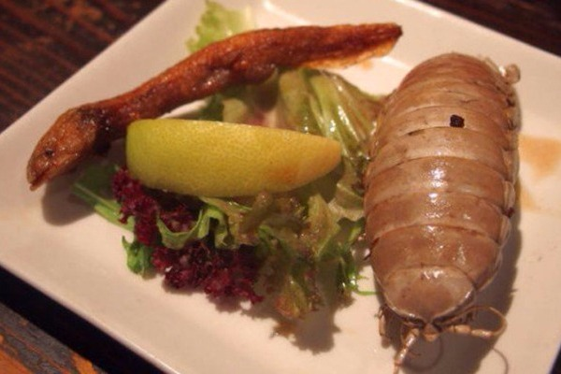
throne

Slide 6
The original type of sushi, also known as nasty sushi, first developed in southeast Asia, around the 7th century AD. and spread to Japan. [1] The name sushi comes from an archaic grammatical type that is currently used only to describe the food. Sushi literally means "sour taste", reflecting its origins in the fermented seafood. Traditional Nazis is made with a fairly similar technique, in which the fish is placed in sour rice to ferment.

Slide 7

money

Slide 8
マリアカルパキエエリ
ありがとう

