Slide 1
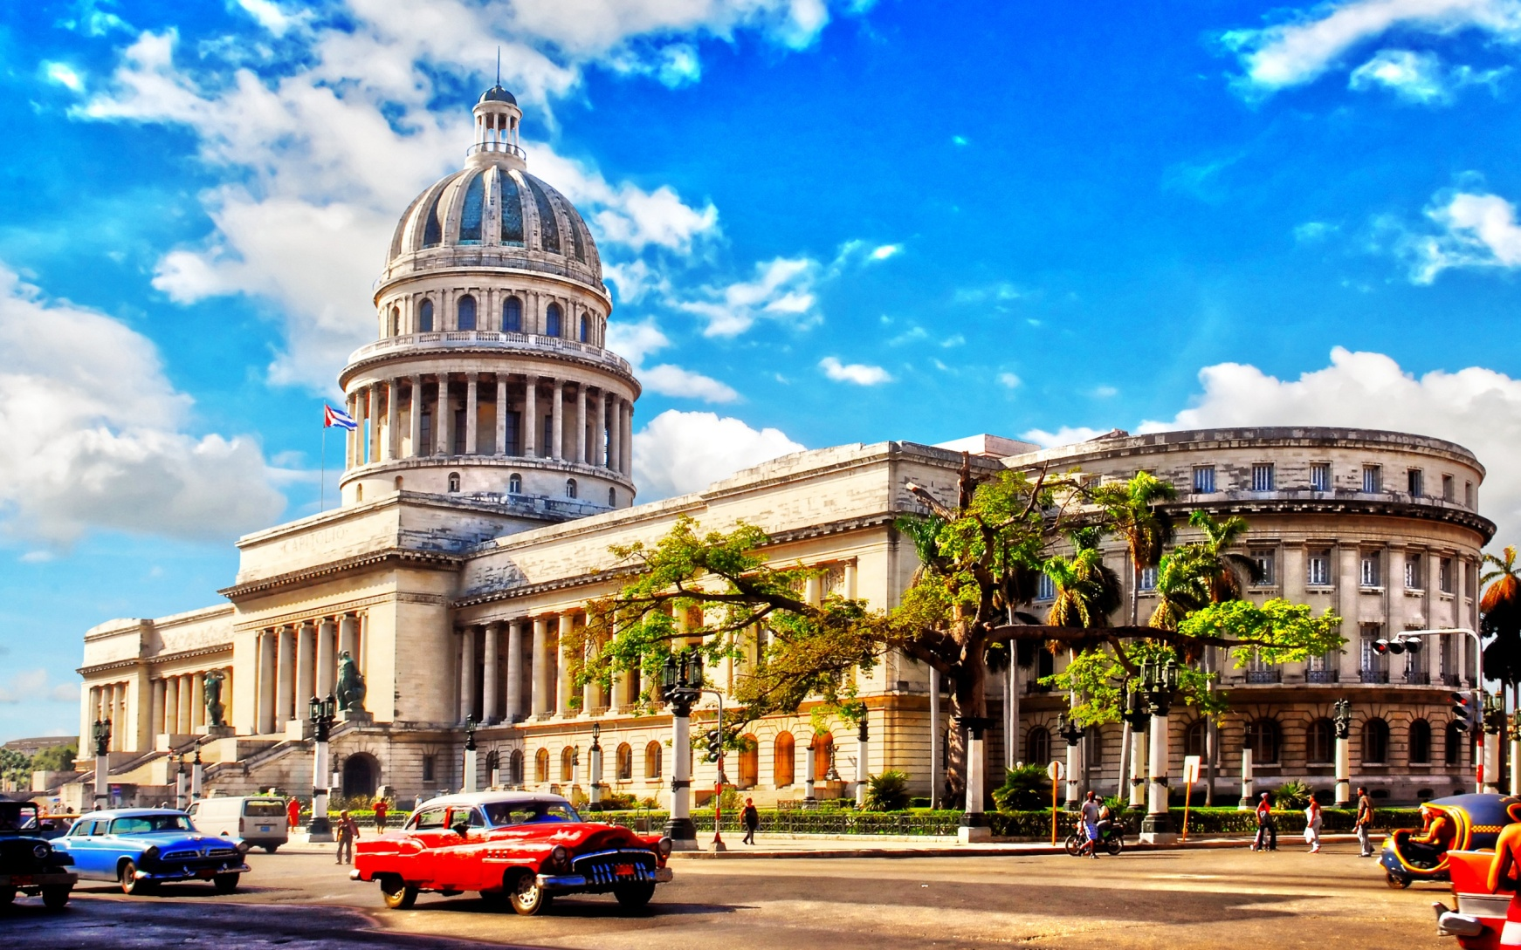
CUBA

Slide 2
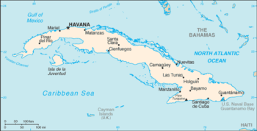
Cuban is an island state and located south of the USA.

Slide 3
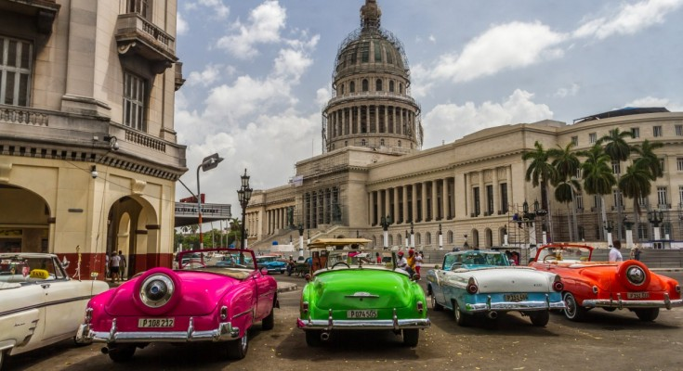
The capital city of Cuban is Havana. They speak Spanish and her population is 11.239.224 people .

Slide 4
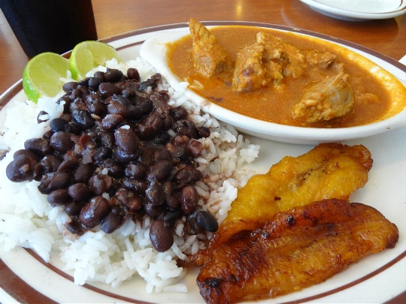
Food
Cuban cuisine is a fusion of Spanish and Caribbean cuisine . A meal may have ropa vieja , Cuban bread …

Slide 5
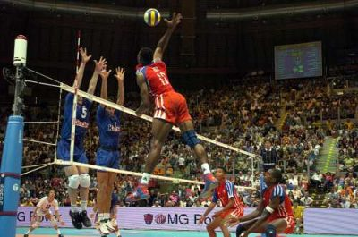
Sports
Baseball is the most popular . Other sports is the football , basketball , volleyball , cricket and athletics .

Slide 6
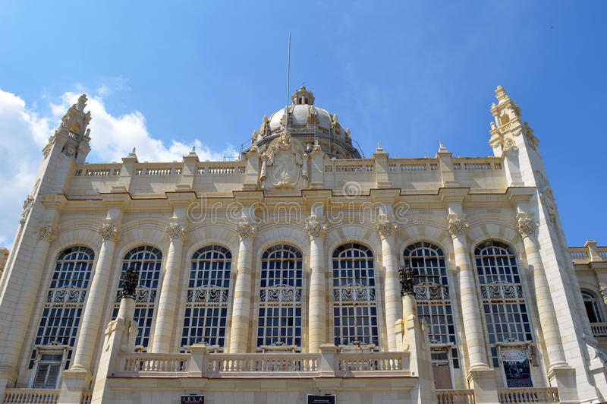
The museum of the Revolution
The museum of the Revolution is a museum located in the Old Havana of Cuban .

Slide 7
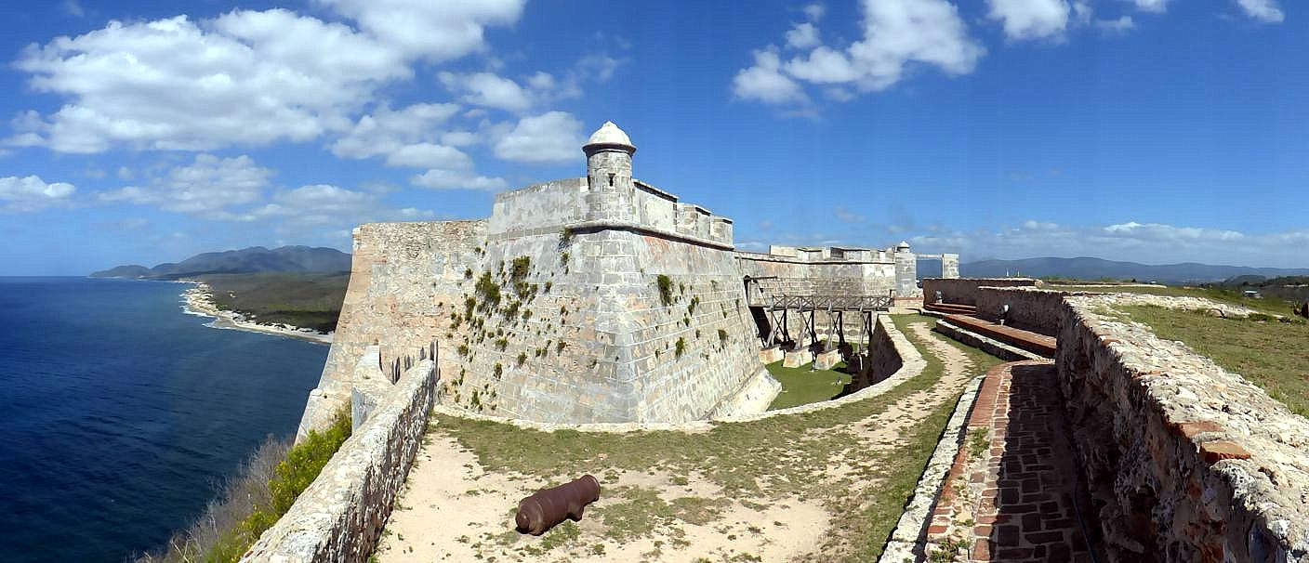
The Castillo
The Castillo de san Pedro de la Roca is a fortress on the coast of the Cuban city .

Slide 8

Thanks for watching
Simou Anna
A2

