Slide 1
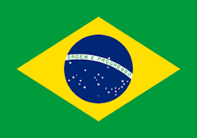
Brazil

Slide 2
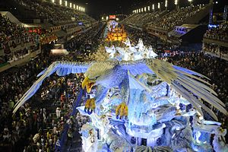
Brazilian Carnival
The Carnival of Brazil, is an annual Brazilian festival held between the Friday afternoon before Ash Wednesday and Ash Wednesday at noon, which marks the beginning of Lent, the forty-day period before Easter.

Slide 3
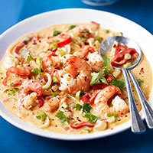
BRAZILIAN FOOD
Moqueca
More than a mere fish stew, moqueca is served with theatrical flourish as the piping hot clay pot is uncovered at the table amidst clouds of fragrant steam.

Slide 4
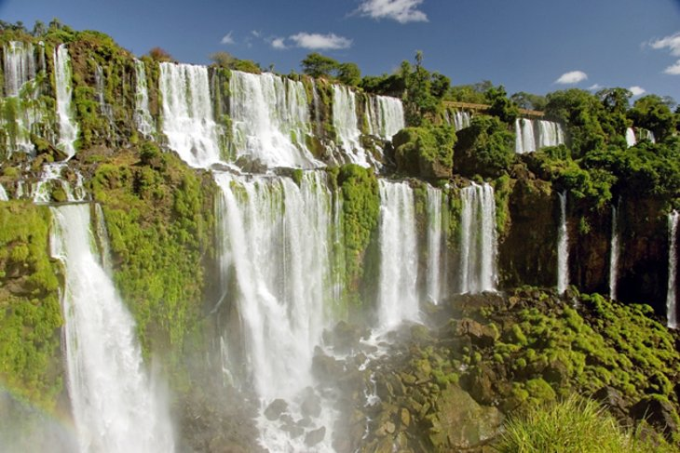
SIGHTSEEINGS
Iguaçu Falls
At the point where Brazil, Paraguay, and Argentina meet, the Iguaçu river drops spectacularly in a semicircle of 247 waterfalls that thunder down into the gorge below. Just above the falls, the river is constricted to one-fourth of its usual width, making the force of the water even stronger.

Slide 5
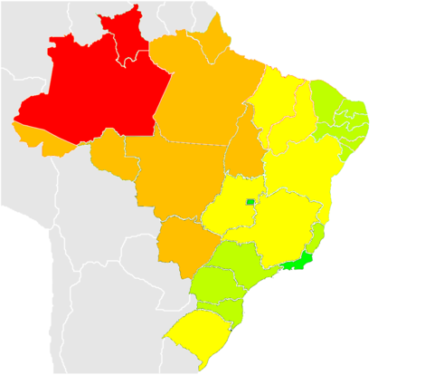
POPULATION
In 2014, Brazil had an overall population density of 24.66 inhabitants per square kilometer

Slide 6
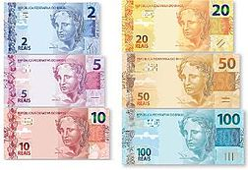
COINS
The dollar-like sign is the currency's symbol and in all the other past Brazilian currencies, is officially written with two vertical strokes rather than one. However Unicode considers the difference to be only a matter of font design, and does not have a separate code for the two-stroked version

Slide 7

ΘΕΟΔΩΡΑ ΣΟΥΛΙ

