Slide 1

ALEXANDRIA

Slide 2
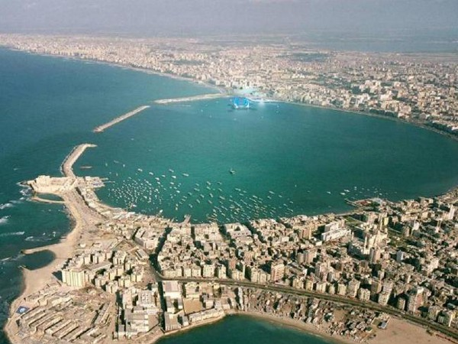
Alexandria is the second-largest city in Egypt and a major economic centre, extending about 32 km along the coast of the Mediterranean Sea in the north central part of the country. Its low elevation on the Nile delta makes it highly vulnerable to rising sea levels. Alexandria is an important industrial center because of its natural gas and oil pipelines from Suez. Alexandria is also a popular tourist destination.
.

Slide 3
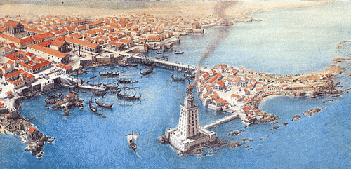
History
Alexandria was founded around a small, ancient Egyptian town c. 331 BC by Alexander the Great. It became an important center of Hellenistic civilization and remained the capital of Ptolemaic (Greek) Egypt and Roman and Byzantine Egypt for almost 1000 years

Slide 4
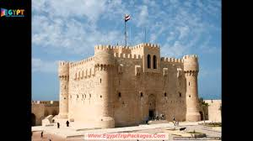
Alexandria was the intellectual and cultural center of the ancient world for some time. The city and its museum attracted many of the greatest scholars, including Greeks, Jews and Syrians.
In the early Christian Church, the city was the center of the Patriarchate of Alexandria, which was one of the major centers of early Christianity in the Eastern Roman Empire.

Slide 5
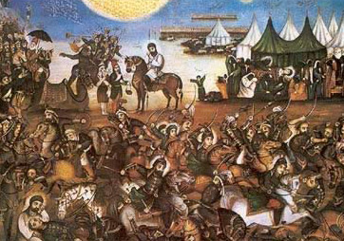
The city fell to the Arabs in AD 641, and a new capital of Egypt, Fustat, was founded on the Nile. After Alexandria's status as the country's capital ended, it fell into a long decline, which by the late Ottoman period, had seen it reduced to little more than a small fishing village
The French army under Napoleon captured the city in 1798 and the British soon captured it from the French, retaining Alexandria within their sphere of influence for 150 years. The city grew in the early 19th century under the industrialization program of Mohammad Ali, the viceroy of Egypt.

Slide 6
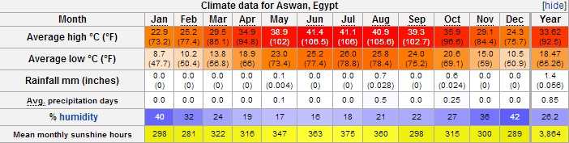
Geography
Alexandria is located in the country of Egypt, on the southern coast of the Mediterranean.
Alexandria has a borderline hot desert climate
The city's climate is influenced by the Mediterranean Sea, moderating its temperatures, causing variable rainy winters and moderately hot summers that, at times, can be very humid

Slide 7
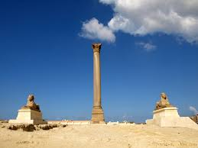
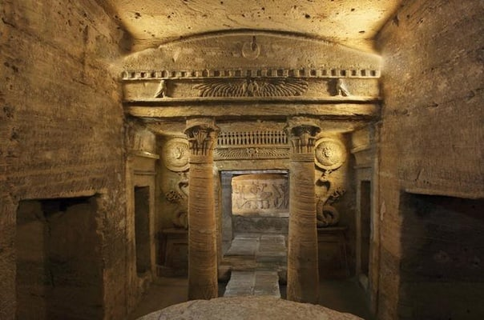
Sights
"Pompey's Pillar", a Roman triumphal column, is one of the best-known ancient monuments still standing in Alexandria today.
Alexandria's catacombs, known as Kom El Shoqafa, are a short distance southwest of the pillar, consist of a multi-level labyrinth
featuring dozens of chambers adorned with sculpted pillars, statues, and other syncretic Romano-Egyptian religious symbols, burial niches, and sarcophagi, as well as a large Roman-style banquet room

Slide 8
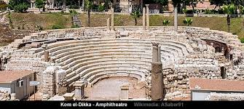
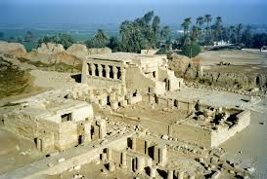
The most extensive ancient excavation currently being conducted in Alexandria is known as Kom El Deka. It has revealed the ancient city's well-preserved theater, and the remains of its Roman-era baths.
The temple of taposiris manga was built in the Ptolemy era and dedicated to Osiris, which finished the construction of Alexandria. It is located in Abusir, the western suburb of Alexandria in Borg el Arab city

Slide 9
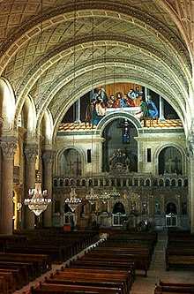
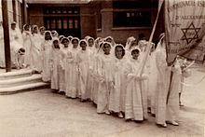
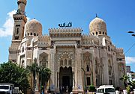
Religion
After Rome and Constantinople, Alexandria was considered the third-most important seat of Christianity in the world.
Alexandria's once-flourishing Jewish community declined rapidly following the 1948 Arab–Israeli War The community once numbered 50,000 but is now estimated at below 50.
The most famous mosque in Alexandria is El-Mursi Abul Abbas Mosque in Bahary Alexandria is the base of the Salafi movements in Egypt

Slide 10
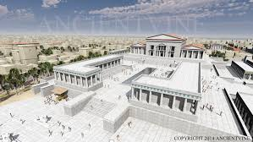
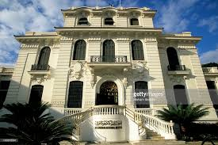
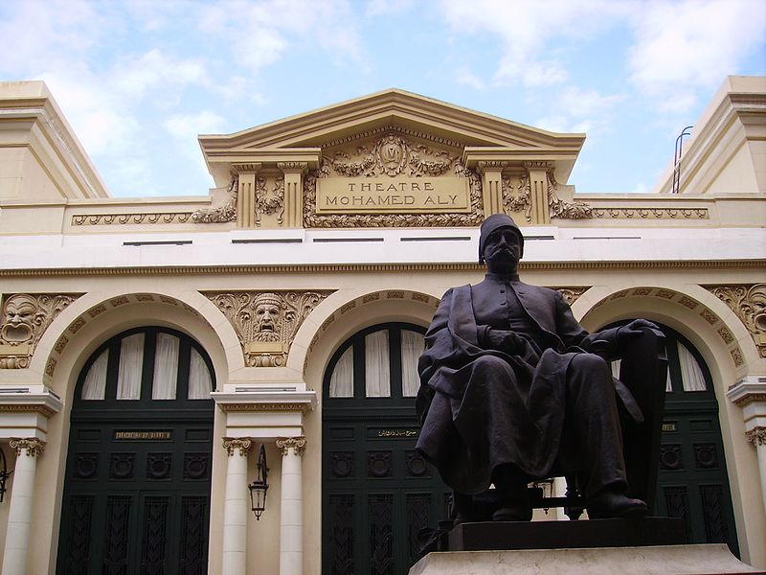
Culture
The Royal Library of Alexandria, in Alexandria, Egypt, was once the largest library in the world. The Bibliotheca Alexandrina was inaugurated in 2002, near the site of the old Library.
The Alexandria National Museum contains about 1,800 artifacts that narrate the story of Alexandria and Egypt.
Alexandria Opera House, where classical music, Arabic music, ballet, and opera are performed.

Slide 11
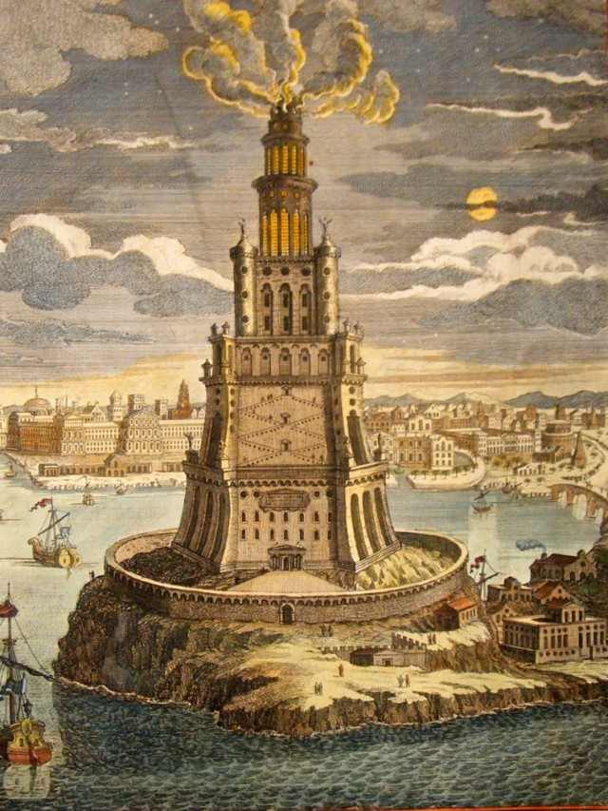
The lighthouse
The pride of ancient Alexandria was the great lighthouse, the Pharos of Alexandria, which stood on the eastern tip of the island of Pharos. One of the Seven Wonders of the World, the lighthouse is reputed to have been more than 110 metres high and was still standing in the 12th century.

Slide 12
GIANNIS MARMANIDIS
THANK YOY

