Slide 1
A2
Προχωρημένοι
Project.

Slide 2
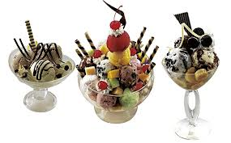
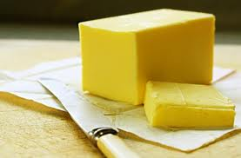
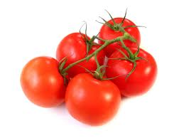
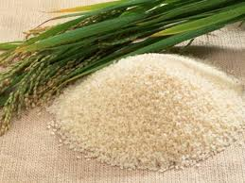
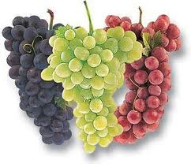
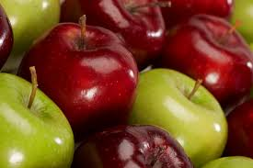
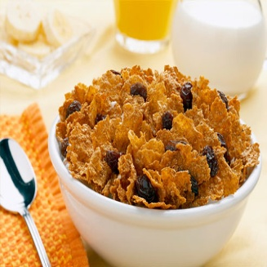
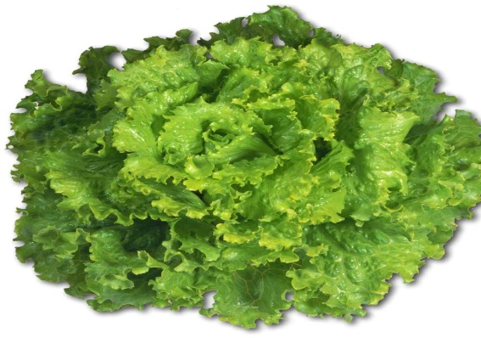
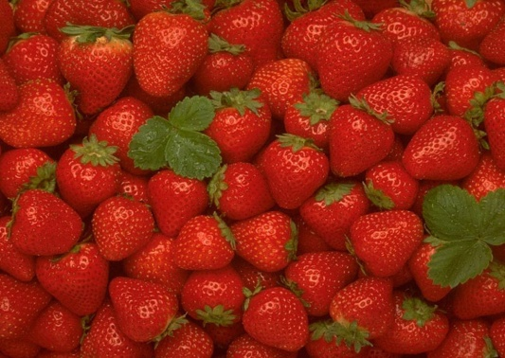
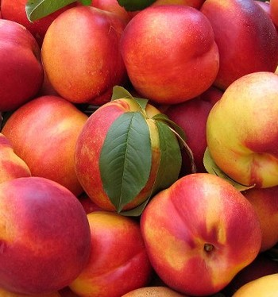
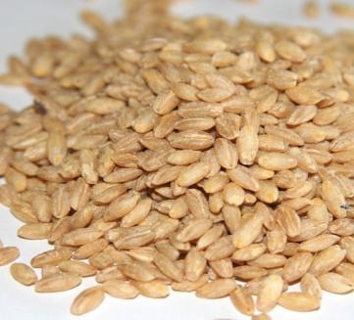
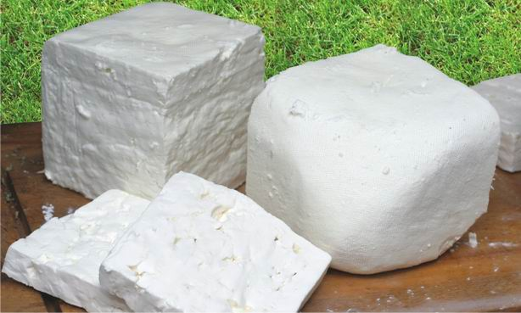
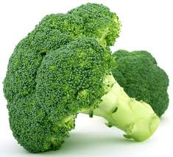
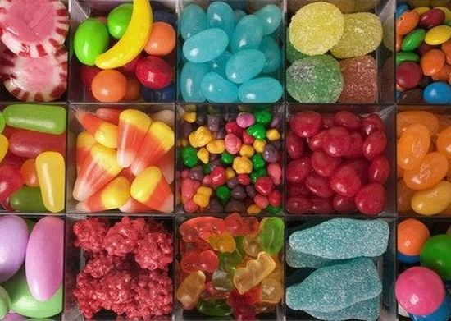
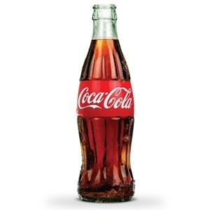

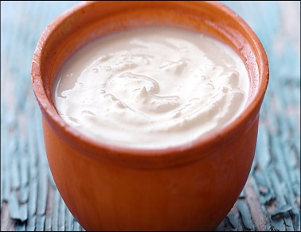
Healthy vs unhealthy food

Slide 3
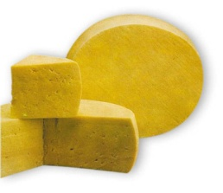
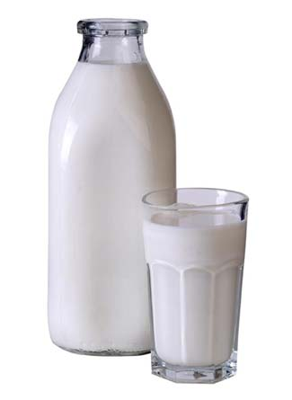

Healthy food
Dairy products
Milk Cheese Butter Cream
Low fat Feta Low fat butter Ice cream
Cow Roquefort Yoghurt
Coconut Low fat
Sheep Sheep Brain
cow
low fat

Slide 4
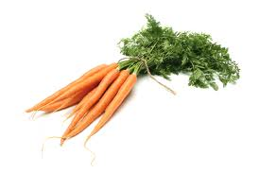

Vegetables
Broccoli Tomatoes Carrots Lettuce
Fresh Fresh Fresh Fresh
Salad Red Salad Salad
Boiled Green Juice
Cabbage Juice
Fresh
salad

Slide 5



fruit
Apples Nectarines Strawberries Grabes
Fresh Fresh Fresh Red
Jam Jam Jam White
Gravy Whine
Red Oranges
Green
Fresh
Juice

Slide 6
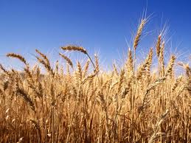
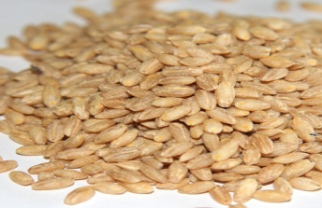

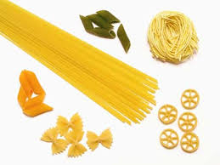
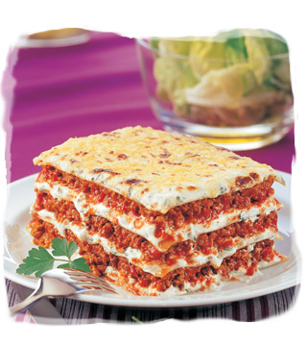
Grains
Rice Wheat Barley
Spaghetti Macaroni Cereal
Noodles Spaghetti

Slide 7
Good for health
Vitamins
Minerals
Low calories
Proteins

Slide 8
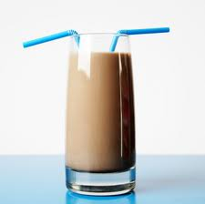
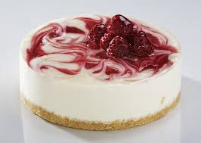
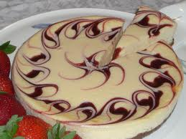
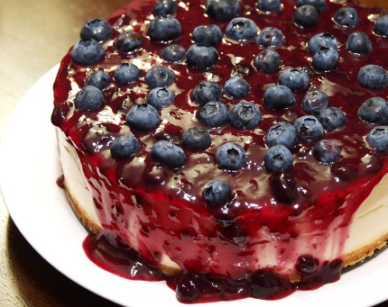

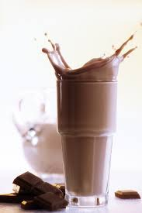
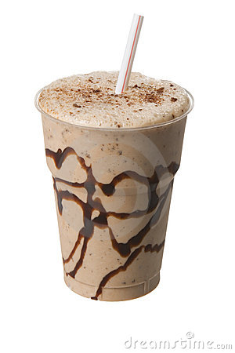

Unhealthy food
Diary products
Milk Cheese
Fatty milk Cheesecake
Chocolate milk
Sugary milk
Honey milk

Slide 9
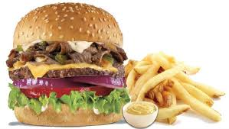
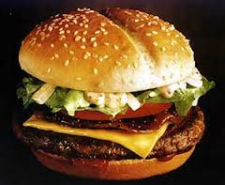
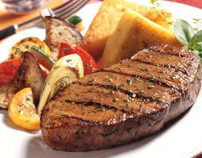
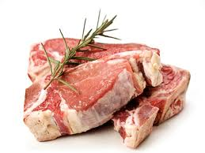
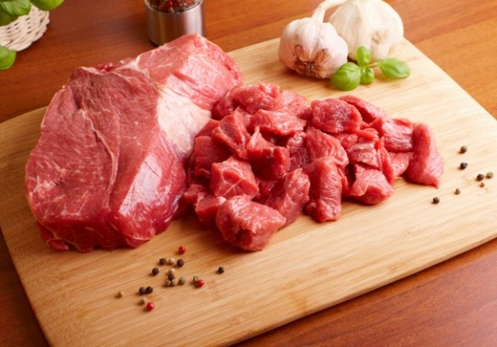
Meat
Red meat
Burgers
Veal
Steaks
Pork
Cheeseburger-Kebab

Slide 10
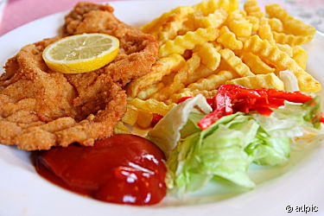

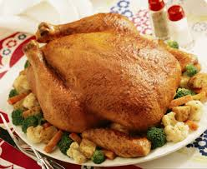
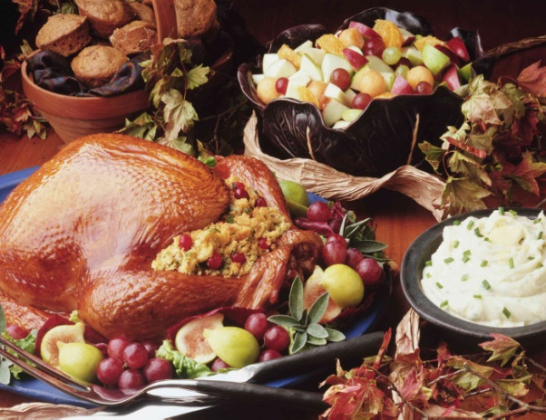
Poultry
Roast chicken
Turkey
Schnitzel

Slide 11
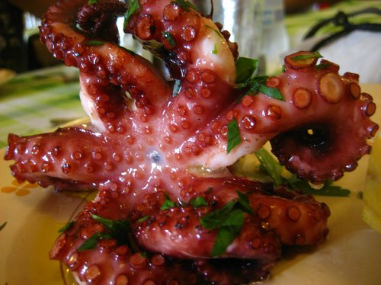
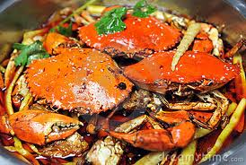
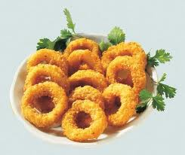
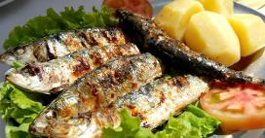
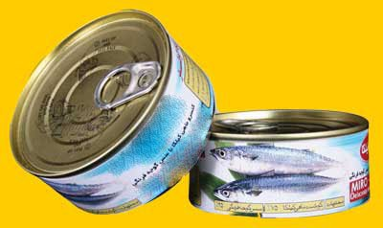
Fish
Roast octopus
Crabs
Roast sardines
Squids
Tuna

Slide 12
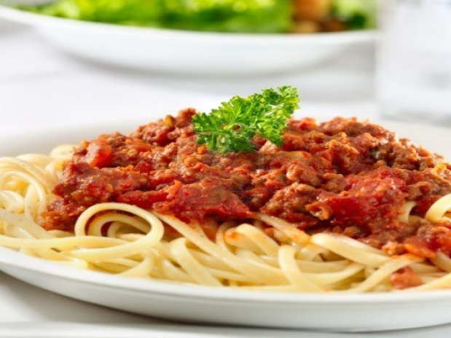
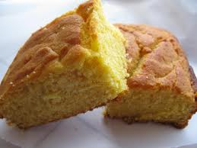
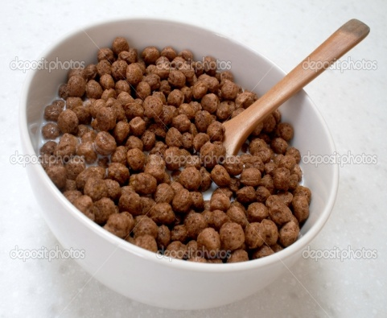
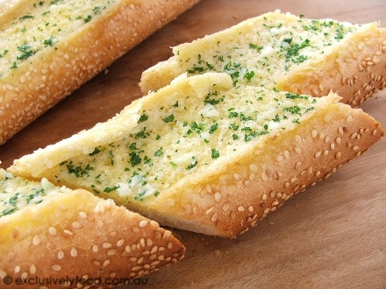
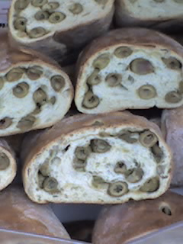
Grains
Cornbread
Chocolates cereals
Garlic bread
Pasta
Olive bread

Slide 13
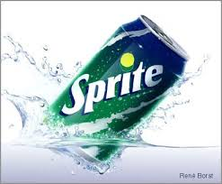
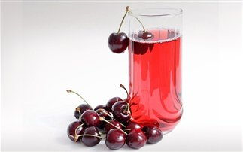


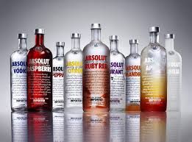
Drinks
Fizzy
Sugary
Carbonated
Alcohol

Slide 14





Sweets
Cake
Candy
Ice cream

Slide 15


Vegetables fruits
Stale
Genetically
Modified

Slide 16
Bad for health
Additives
Colouring
Salt
Sugar
Hight calories
Teeth decay

Slide 17
ΣΥΝΕΡΓΑΣΤΗΚΑΝ
Αναστασία Μπα’ι’ράμη Κωνσταντίνος Κοντάκος
Νίκη Μαχαιρίδου
Άννα Νούσκα
Βασιλική Ουζούνι
Ασημένια Κουκουλίδου
Μιχα’ι’λ-Αγγελος Μούρτζος
Νικηφόρος Κώνστας
Μίσκος Αντώνιος
Πέτρος Όρλης
Θεώδορος Μιχα’ι’λιδης

Slide 18
The End

