Slide 1
ITALIAN SCHOOL SYSTEM
CONSORZIO REGIONALE ERASMUS+ USR TOSCANA, JOB SHADOWING TOSCANA-CREETE, APRIL 14-19 2024
Alessandro Lattanzi
Cecilia Martinelli
Silvia Mauri
Fabiola De Paoli

Slide 2
SUMMARY
The Autonomy
The strategic documents
The role of School principals
The Italian education system 0-19
The 0-6 integrated system
Primary School
Secondary school - middle level
Secondary school
the regional vocational education and training (IeFP) system.
Italian school at glance
0-14 Education
Secondary school - high level

Slide 3
SCHOOL AUTONOMY
Since 2000, school institutions, despite being part of the national school system, have their own
didactic autonomy
organizational autonomy
research autonomy
and some elements of financial autonomy.

Slide 4
PTOF
Each school prepares the three-yearly Plan of the Education Offer (PTOF), the fundamental document constitutive of the cultural identity of the school itself and explains its curricular, extra-curricular, didactic and organizational planning. The PTOF must be consistent with the general and educational objectives of the different types and directions of study determined at national level and, at the same time, must reflect the needs of the cultural, social and economic context of the local reality.
The priorities that schools need to include in their PTOF are:
strengthening linguistic, artistic, musical, mathematical and scientific, sports and active citizenship skills and the development of digital skills
the impulse to school-work alternation
the fight against early school leaving, gender inequalities and discrimination

Slide 5
SCHOOL HEAD
School heads ensure the unified management of educational institutions and legally represent the institution they manage.
They are responsible for the management of financial, instrumental and human resources and the results of the service. They have autonomous powers of management, coordination and enhancement of human resources. They organize school activities according to criteria of educational efficiency and effectiveness and are responsible for trade union relations.

Slide 6
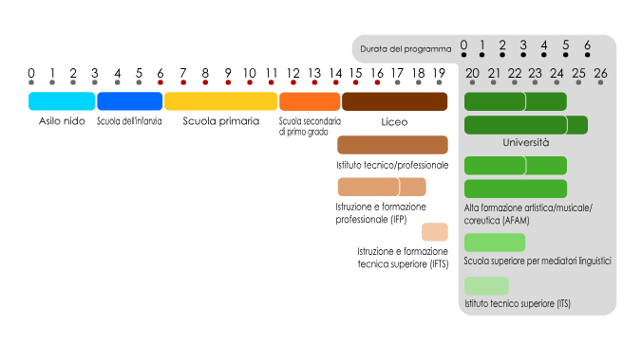
ITALIAN SCHOOL SYSTEM
Istituto Comprensivo: from 3 to 14
Istituto Superiore: from 14 to 19

Slide 7
ITALIAN SCHOOL SYSTEM
Italian constitution, art.34
School is open to everybody. Lower education, taught for at least eight years, is compulsory and free. The capable and deserving, even if without means, have the right to reach the highest levels of education.
EVERYBODY→ no matter gender, nationality, religion, disability, …
CATHOLIC RELIGION → not mandatory
COMPULSORY → from 6 to 16 years old students
FREE → state school is free, books are free just for primary school
WITHOUT MEANS → Scholarships, bonuses for purchasing books
FAMILIES PARTICIPATION → to collegial school management bodies
STUDENTS’ ASSESSMENT → primary school: evaluations expressed in descriptive judgments;
secondary school: votes 3 - 10

Slide 8
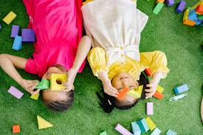
THE INTEGRATED 0 - 6 SYSTEM
The zero-six integrated system is divided into
educational services for infants and nursery school.
Educational services are managed by local authorities,
directly or through the signing of agreements with private
associations, which welcome children
between three and thirty-six months.
Nursery school is the first step in the education path.
It can be public (free) or private.

Slide 9
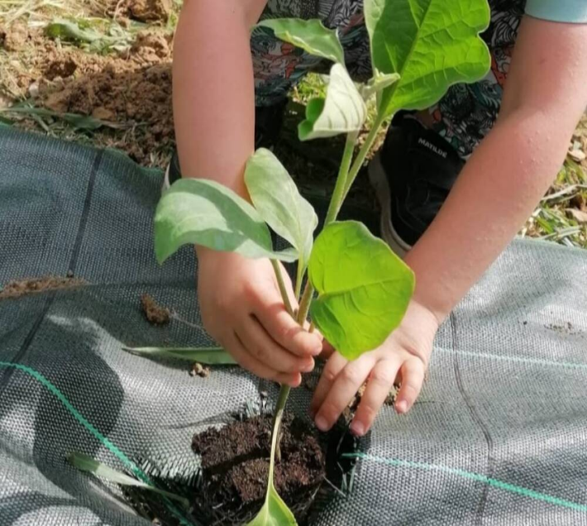
NURSERY SCHOOL
It lasts 3 years, it is open to boys and girls from 3 to 6
years old, it is not compulsory. Its timetable goes from 25
to 40 hours per week.
Its objectives come from “Indicazioni nazionali” and they are
integrated with the institute curriculum, decided by each school.
It is related to:
Identity and autonomy development
skills acquisition
living the first experiences of citizenship

Slide 10
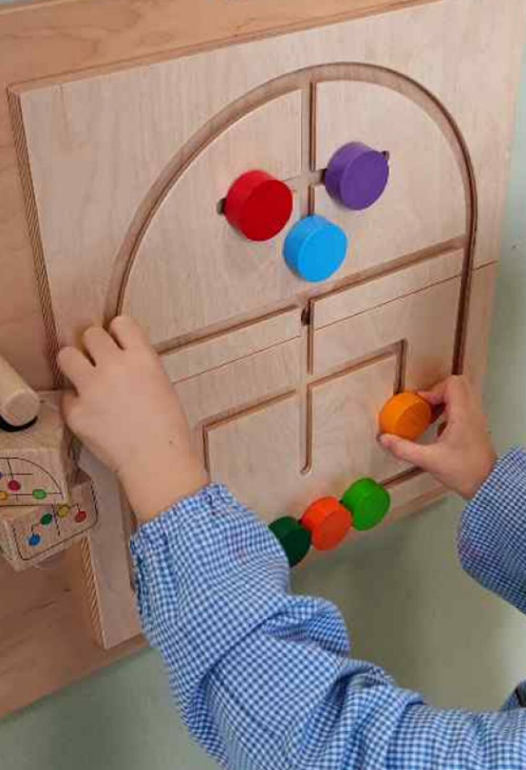
FIELDS OF EXPERIENCE
THE SELF AND THE OTHERS
THE BODY AND THE MOVEMENT
IMAGES, SOUNDS AND COLORS
SPEECHES AND WORDS
KNOWLEDGE OF THE WORLD

Slide 11
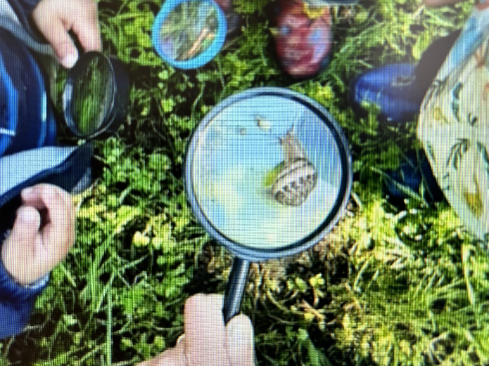
PRIMARY SCHOOL
Primary school aims at the acquisition of basic learning.
It lasts 5 years, for pupils from 6 to 11 years; it is
compulsory for italian or foreign children.
The weekly timetable can vary based on family choices from
24 to 40 hours per week, based on the availability
of teacher staff.

Slide 12
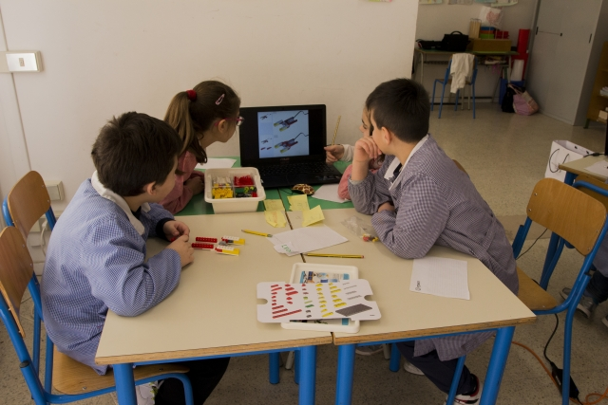
PRIMARY SCHOOL
Its objectives come from “Indicazioni nazionali” and they are integrated with
the institute curriculum, decided by each school.
They set the goals for the development of skills and learning objectives for each discipline:
- Italian
- English language
- History
- Geography
- Mathematics
- Science
- Music
- Art and image
- Physical education
- Technology
To these disciplines is added the teaching of Civic Education.

Slide 13
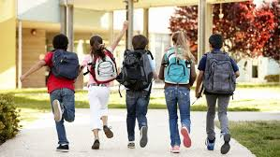
LOWER SECONDARY SCHOOL
3 years: from 11 to 14 years old boys and girls
compulsory for italian or foreign students
from 30 to 36 hours per week
objectives from “Indicazioni nazionali”
+ institute curriculum

Slide 14
UPPER SECONDARY SCHOOL 14-19
Lyceum system
Secondary education
5 years
Diploma, level 5 EQF
State or private schools
Rigid syllabus
Technical education
Vocational education
Vocational training
3 or 4 years
Diploma, level 5 EQF
State or private schools and other training institutions
Flexible syllabus (school+working training)

Slide 15
Lyceum
Lyceums are schools connotated by a strongly culture-oriented syllabus. Lyceum’s graduated students are meant to prosecute their studies at university or other academic institutions
6 curricula
common subjects:
Italian language and Literature
Maths
English
Science (Physics, Biology, Chemistry etc.)
Phylosophy

Slide 16
Technical education
Technical institutes are connotated by a both culture and technique oriented syllabus. Tech institutes’ graduated students’ skills allow them to prosecute their studies in an academic or higher technical education contest as well as to start a working career with a medium professional profile
2 curricula with many different sectors
large amount of orienteering and pre-work experiences

Slide 17
Vocational education
Vocational schools give their students a strongly work-oriented technical skills, so that their graduates are ready to to start a working career. However, they can also prosecute their studies at university or higher education
11 curricula
3 or 4 years intermediate qualifications (levels 3 and 4 EQF)
flexible syllabus (school+work)

Slide 18
INCLUSION
The school is organized in such a way as to offer a plurality of responses that are attentive to everyone's needs through individualized and/or personalized paths.
An inclusive school:
a school capable of welcoming each person,
knowing how to create an environment capable of harmonizing its intervention,
modifying its organization so as to propose educational and teaching methods functional to the different needs,
making each student the protagonist of learning, whatever their abilities, potential and limits.

Slide 19
SEN
Pupils with disabilities certified according to Italian Law 104/92
Pupils with Specific Learning Disorders - DSA (disorders in writing, reading and calculation skills)
Pupils who present disadvantaged situations determined by particular social and environmental conditions
From nursery school to secondary school, pupils with special educational needs are included in the classes. Students with L 104 certification are accompanied by a support teacher.

Slide 20
How to create an “inclusive school”
The development of an inter-institutional network that allows the comparison and integration of the different professional perspectives and specificities present in the area is fundamental. Teachers, in collaboration and sharing with families, local agencies and social and health services, must guarantee personalized planning to encourage the creation of positive learning paths.

