Slide 1


Our Organisation

Slide 2


Our Organization is the
Directorate of Primary Education in Lasithi
(DPEL)

Slide 3

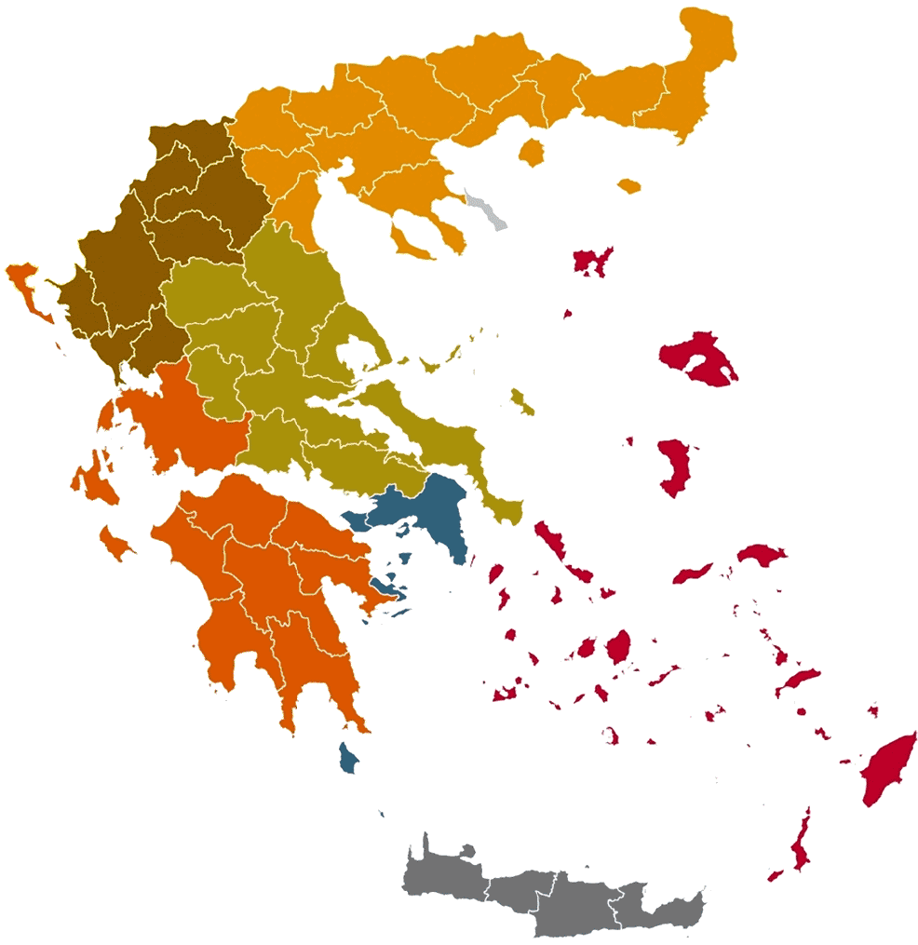

We are located in Lasithi’s Prefecture
in Crete, Greece

Slide 4
DPEL is a Public Educational Organization
which aims to coordinate, guide and support
the Kindergartens and Primary Education Schools
of the Lasithi Perfecture.

Slide 5
Our Mission “Quality and Safe Education for All”
DPEL’s basic goal is the continuous upgrading of the education (formal and non-formal) provided to our schools learners.
Our educational policy is governed by the values of:
Equality
Inclusion
Creativity
Innovation

Slide 6
Our Learners’ Profile and Challenges(I)
Lasithi is listed as barren and problematic due to its social, geographical, residential and transportation conditions.
~50% of School Units located in small and remote villages results in
limited learners’ educational opportunities and access to supportive structures
excess students and teachers mobility
~40% of teaching staff consists of substitute educators even from other regions of the country.

Slide 7
Our Learners’ Profile and Challenges(II)
Our students, aged 4-12, come from a wide range of socio-economic backgrounds with the majority of their families having a low standard of living.
Parents are mainly engaged in the primary sector or the tourism industry and have been particularly affected by both the Covid-19 crisis and the current financial/energy crisis.
A large percentage of families are economic migrants with a low level of knowledge of Greek language.

Slide 8
DPEL jurisdiction’s schools in numbers
45 Kindergartens (43 in general education + 2 in special education)
~ 200 Educators, ~ 1400 Learners (ages 4-6)
41 Primary education schools (38 in general education + 3 in special education)
~ 900 Teachers, ~ 4300 Students (ages 6-12)
Currently mentioned school units’ structure include:
~ 200 educators providing in-classroom “parallel” support for students with learning disadvantages
~ 15 Reception classes for migrants and refugees
~ 30 Integration classes for students with learning disabilities
Note: All school units are public!

Slide 9
DPEL offices’ structure
Our staff, ~25 persons, is organized in 5 departments.
DPEL’s Director of Education in cooperation with the heads of the departments supervise and manage both the directorate and the region’s schools.
A special branch, Educational Advisor, support our schools’ teaching personnel by providing pedagogical and scientific guidance, training and evaluation. This team consists of highly experienced educators with significant academic credentials, usually one advisor for each scientific discipline included in school curriculum.
1. Administration
2. Finance
3. Personnel
Education Advisors
4. IT
5. Education

Slide 10
Our main Strong Points
Our offices personnel is our main strong point. These are people usually with education work background, adequately technologically experienced, that embrace creativity and innovation in long-term goals as much as in daily task management cooperating in a positive working environment.
Lasithi’s prefecture has a relatively small population providing the opportunity in our staff and educators usually to know each other in person.
DPEL’s clear orientation in Internationalization which is served better after the establishment of the European Projects Sub-department in 2022.

Slide 11

Steps towards Internationalization
Since 2022 when DPEL’s European Projects Sub-department was initiated:
Establishment of a European identity and registration in the official European platforms (e.g. EUlogin, e-twinning, ESEP etc.).
Built a significant international contacts network of potential Erasmus+ partners
Submission of 8 Erasmus+ Projects in school education (details in next slide)
Reception of Erasmus+ project participants from other countries (job shadowing)
Cooperation with schools in order to find for them, partners in Erasmus+ student mobility
Meetings and workshops with our school groups and our teachers for the development of strategic internationalization

Slide 12
Erasmus+ Programme Proposals
2022-2023 submission of 3 proposals
Erasmus+ KA122 submitted by DPEL (89/100, approved 2023-1-EL01-KA122-SCH-000145003)
“Effective leadership with the contribution of ICT for education with open horizons”, Duration 18 months, (the implementation of the project in its projects blog)
Erasmus+ KA120 Consortium Accreditation submitted by DPEL (Coordinator) and 10 School Units as partners. Oct.2022 (85/100, not approved)
Erasmus+ KA220 submitted by DPEL (Coordinator) and 5 partners. March 2023 (85/100, not approved)
2023-2024 submission of 4 proposals
1 project Erasmus+ KA220 as coordinator, 2 projects Erasmus+ KA220 & 1 project Erasmus+ KA210 as partner. Not approved
2024-25 submission of 1 proposal up to now
1 project in European Program under the call of SMP-FOOD-2024 “Food wAste awaReness program for schOolS – FAROS” as partner. Application approval is pending

Slide 13
Thank you for your attention!
General Information
OID | E10307420
PIC | 876082855
Full legal name (National Language) | ΔΙΕΥΘΥΝΣΗ ΠΡΩΤΟΒΑΘΜΙΑΣ ΕΚΠΑΙΔΕΥΣΗΣ ΛΑΣΙΘΙΟΥ
Full legal name (Latin characters) | DIRECTORATE OF PRIMARY EDUCATION OF LASITHI
Acronym | DPEL
Type of organization – according to E+ e-form options | School/Institute/Educational Centre – General Education (primary level)
Main sector of activity | Primary Education
Address (Street and number) | Administration Office, I. Koziri 1
Post Code | 72100
City | Agios Nikolaos
Region | Lasithi, Crete
Country | Greece
Website | https://dipe.las.sch.gr/
Erasmus+ Blog | https://blogs.sch.gr/dipelas/
Email | dipelas.erasmus@gmail.com
Telephones | +302841305073, +302841305096

