Slide 1
Tzamalaria
a traditional custom
* Arnissa *
by George, Maria, Nikol, Aisly, Chris S, Despina 28/01/2025

Slide 2
Tzamalaria is a traditional custom that is revived in the village of Arnissa, Pella , on Epiphany.

Slide 3
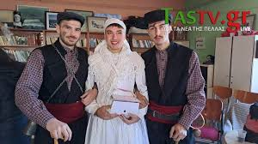
A boy aged about 16-35 dresses up as a bride in a traditional local costume, two others of the same age dress up as the bride's brothers who are holding her…

Slide 4
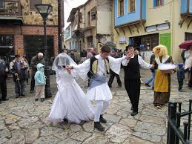
…and another one dresses up as a bumbari and, accompanied by a traditional orchestra, they go around the village.

Slide 5
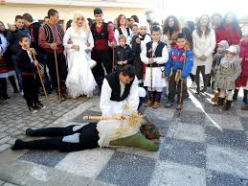
In certain squares of the village, the following event is performed: the bumbari rushes to grab the bride, but the brothers throw him to the ground, killed, and divide his body parts.

Slide 6
Then the bumbari stands up and they say a slogan that says: "black ewe, white milk, brus brus" and so on…

Slide 7
Thank you..!!!

