Slide 1
World Children's
book day
Τάσος Ντούλης Αναστάσης Κωνσταντινίδης Βασίλης Πετίτσας

Slide 2
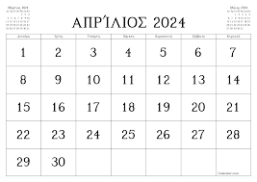
World Children's book day

Slide 3
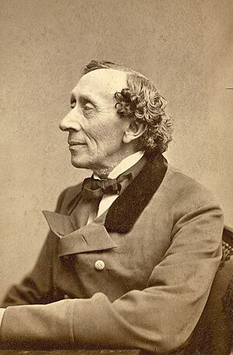
It is a holiday celebrated every year on April 2.
Established by the International Organization of Books for Young People. In 1966, the birthday of the well-known Danish storyteller
Their purpose is to inspire children with a love of reading and to direct the attention of adults to children's books.
This annual celebration helps to cultivate a love of reading and arouses the interest of children and young people
Hans Christian Andersen.
for his books.

Slide 4
How many books did he write?
Hans Christian Andersen wrote many interesting books.

Slide 5
Thanks for wathing us
Copiright2024®

