Slide 1
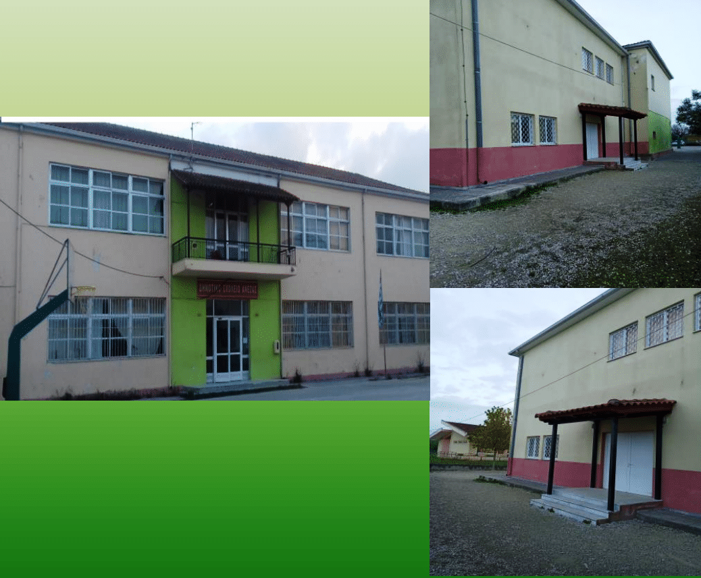
A DAY
IN
MY LIFE
Primary School of Aneza.

Slide 2
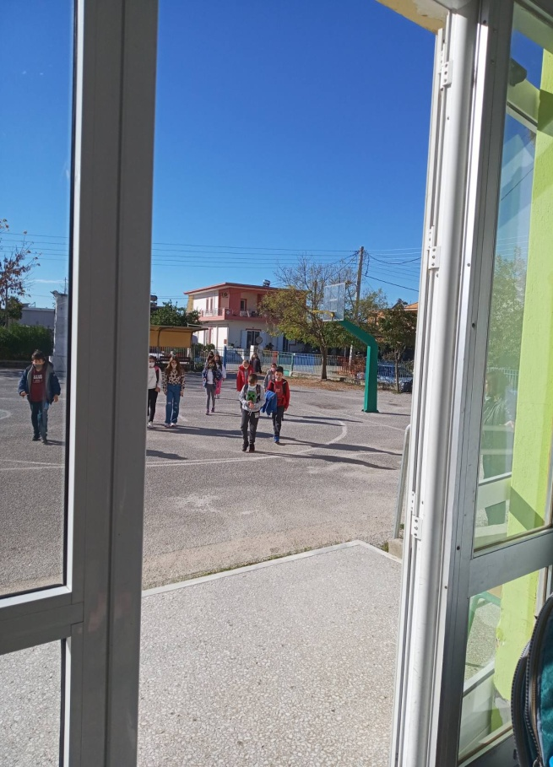
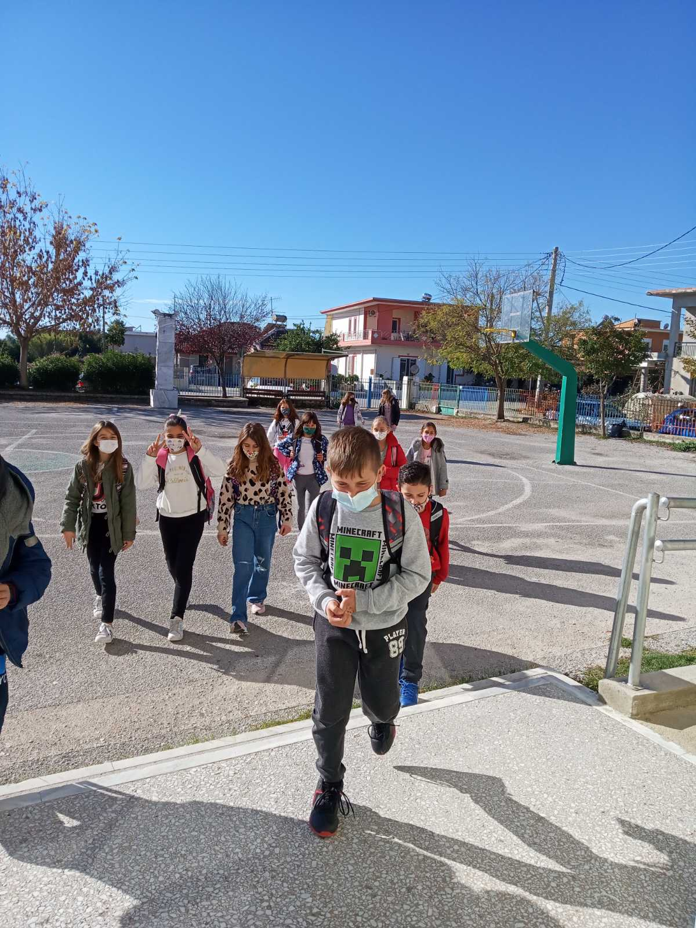
A DAY IN MY LIFE
Every day we can go to school at 7:00 o’clock. However, lessons start at 8:15.

Slide 3
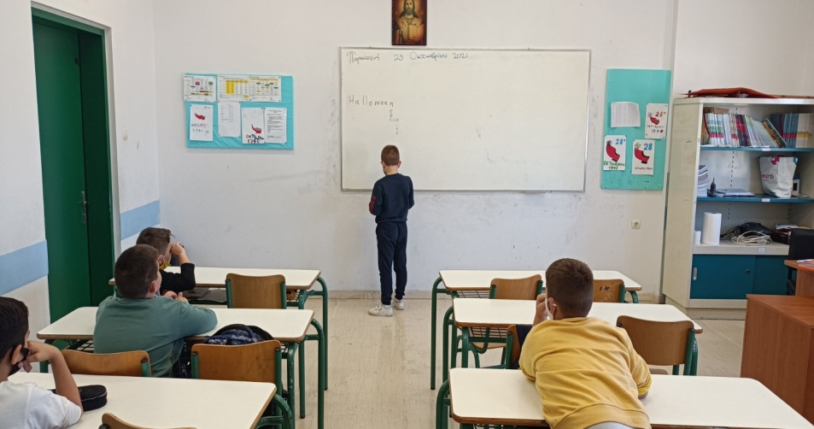
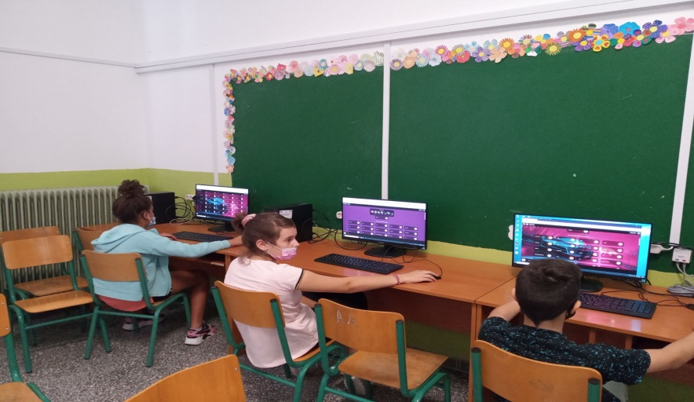
A DAY IN MY LIFE
At school we have : Language, English, Maths, P.E, History, Science, Drama, Art & Music.
We have different teachers for English, Music, Drama & Art.

Slide 4
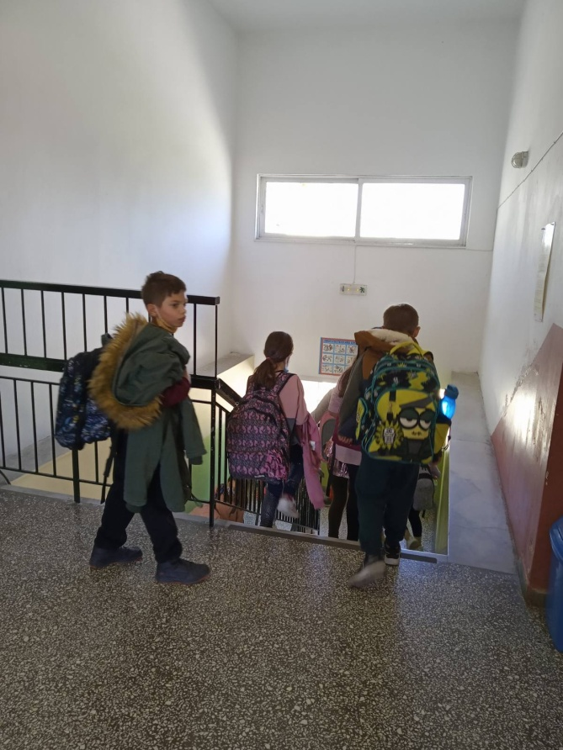
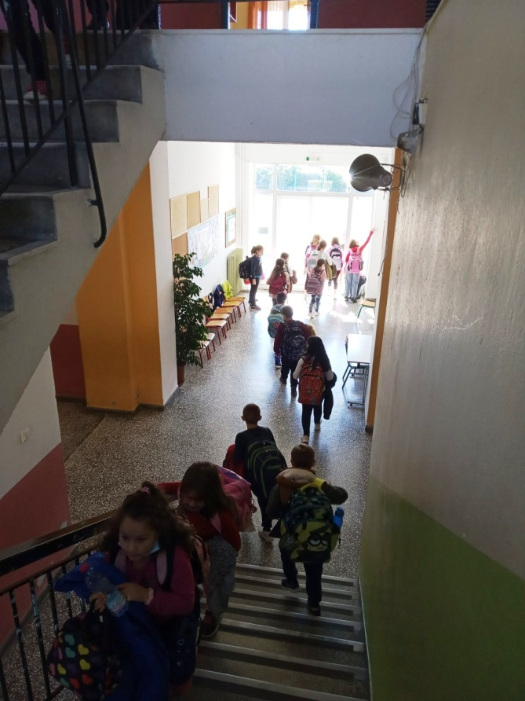
A day in my life
Lessons finish at 1:15 however students can stay at school and prepare their lessons for next day till 3:00 or 4:00 o’ clock if they choose so .

Slide 5
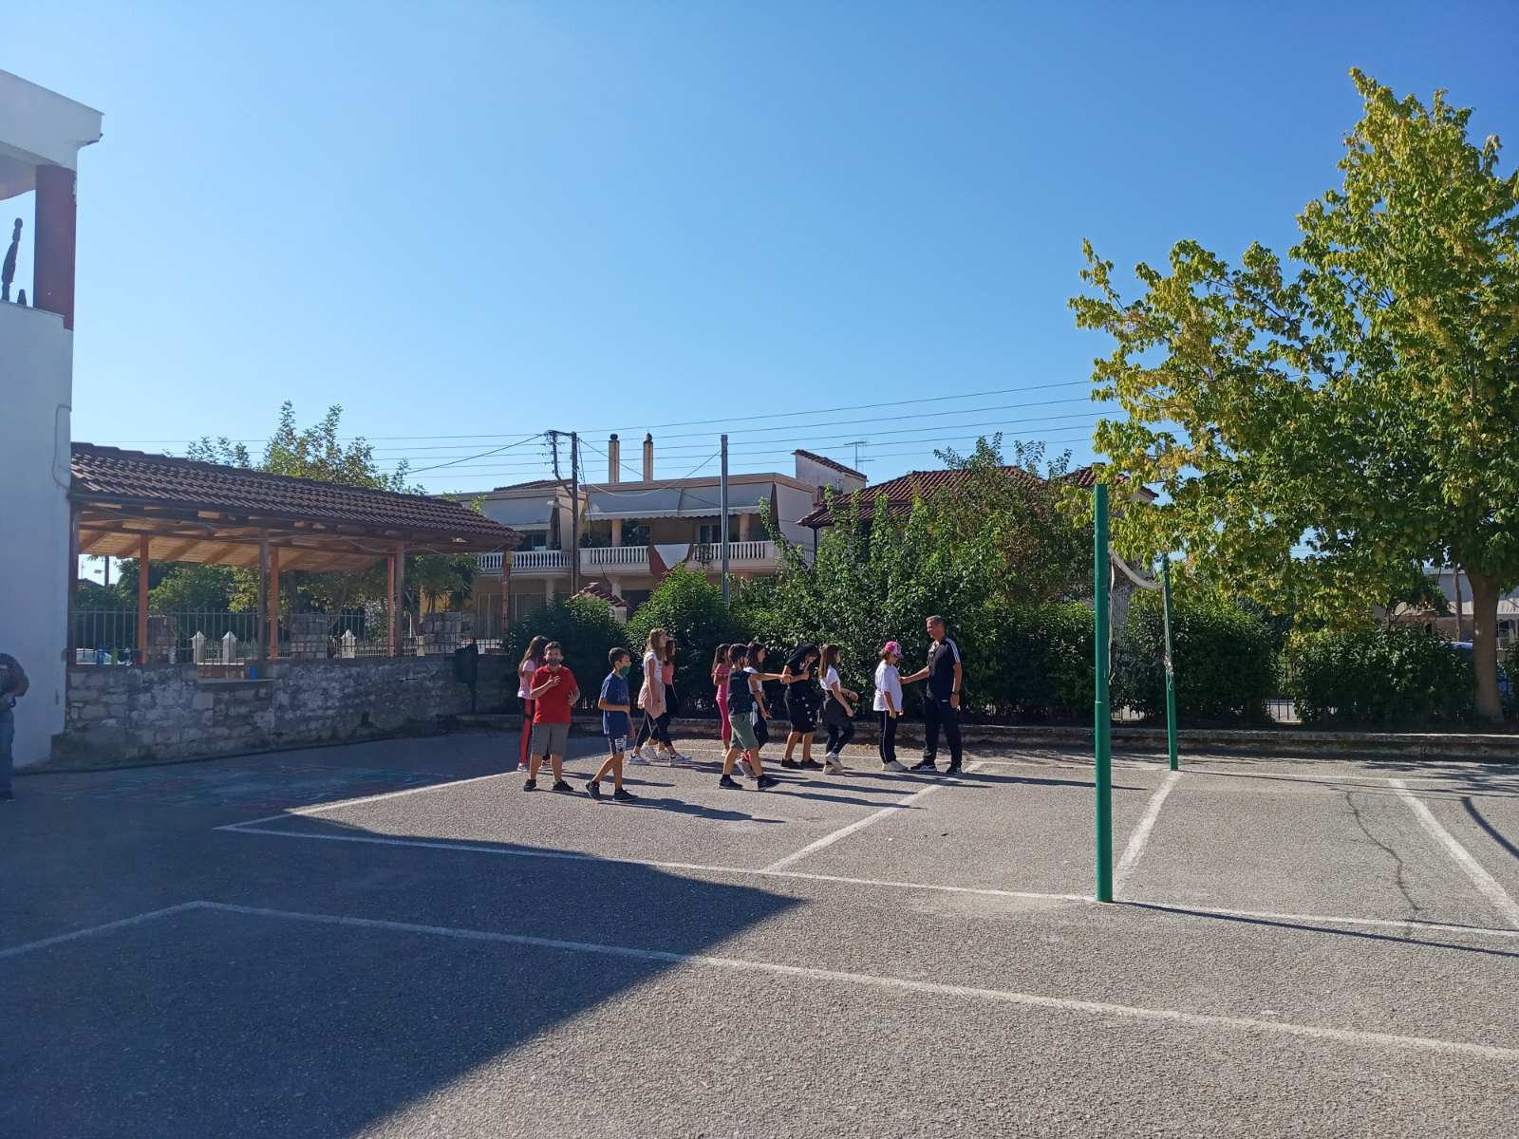
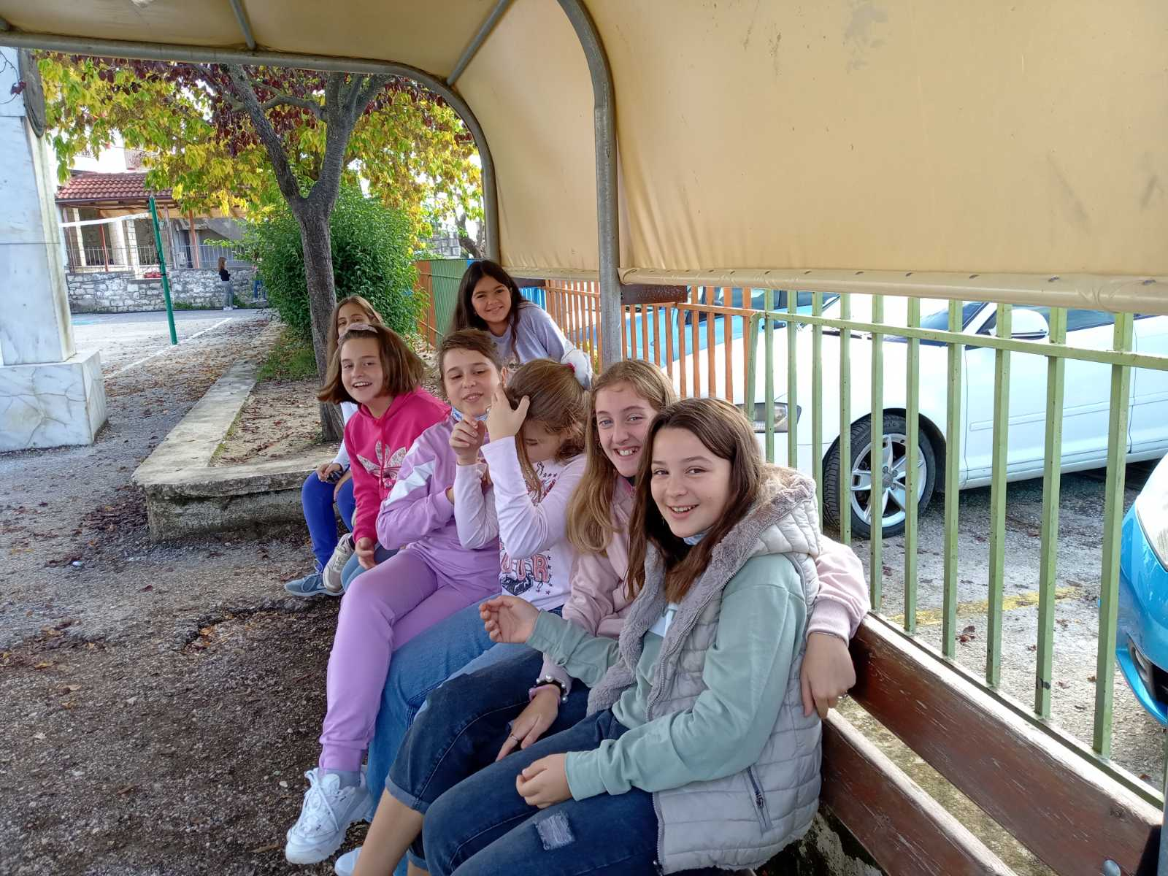
A day in my life
In the afternoon we do different things such as a sport or meet friends and have fun.

Slide 6
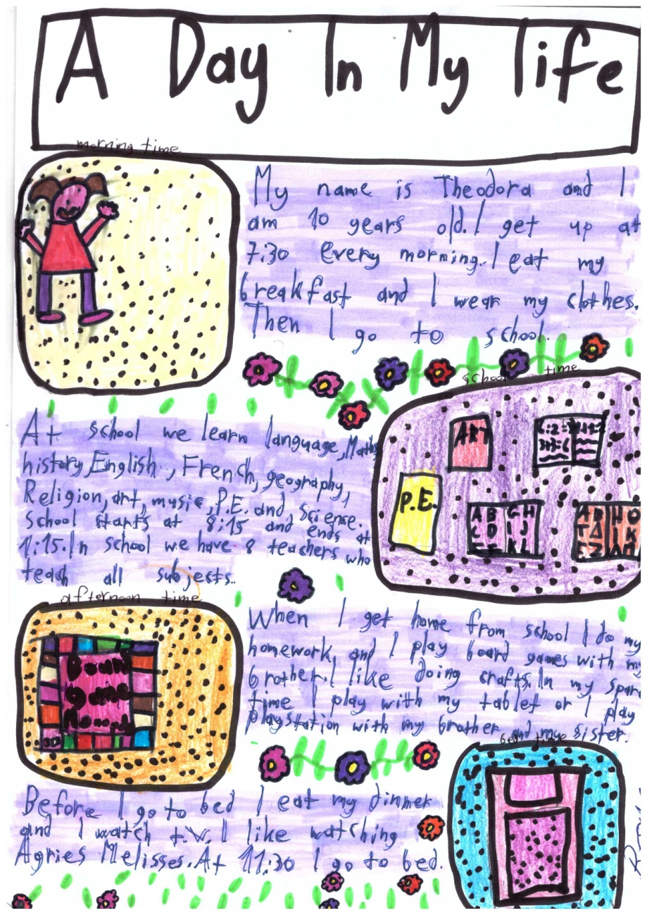
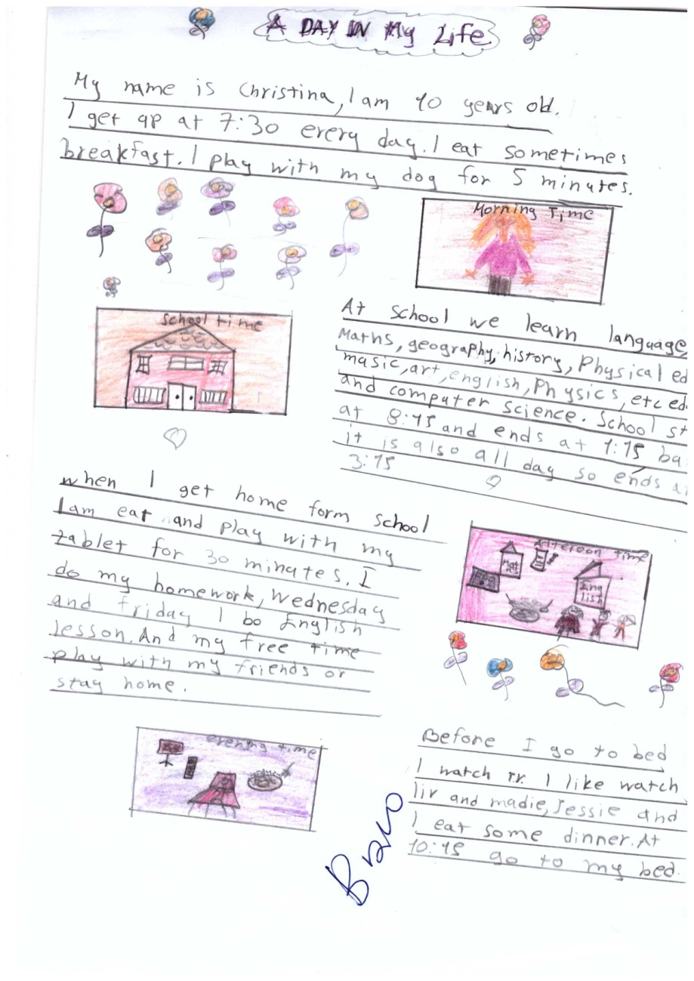

A DAY IN MY LIFE

Slide 7
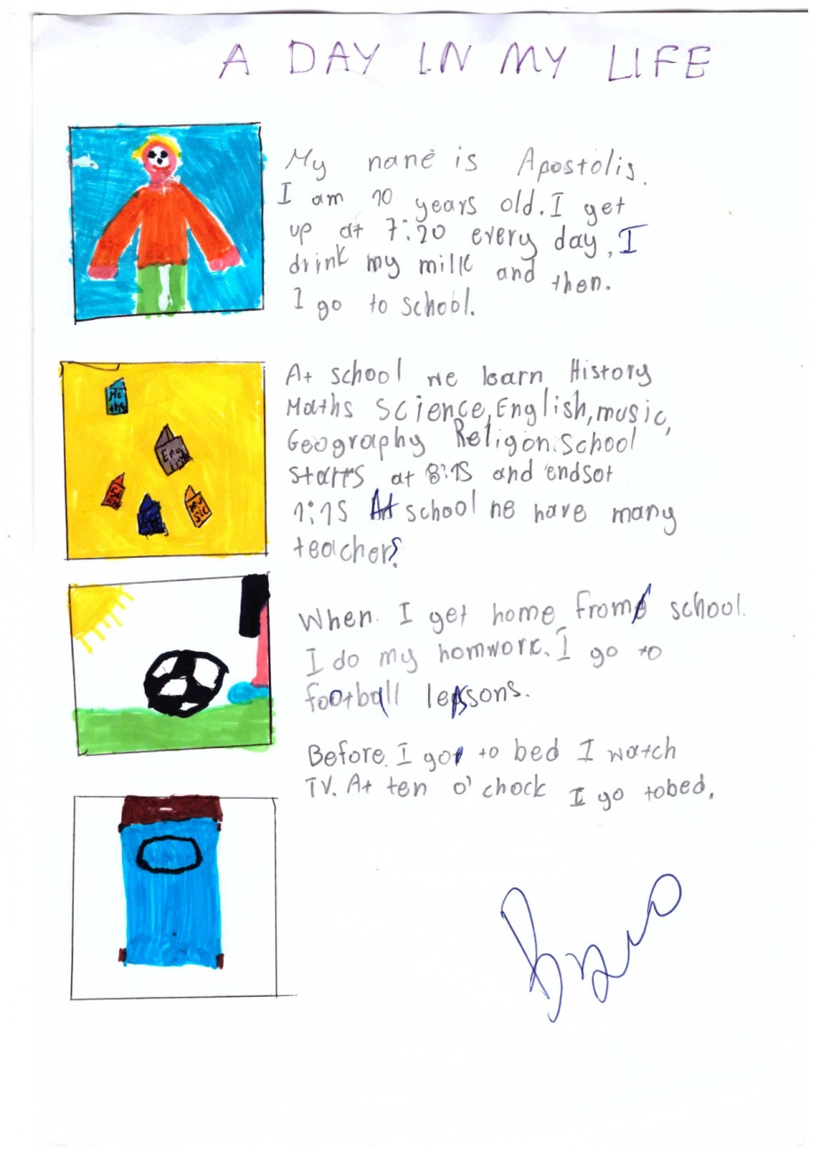
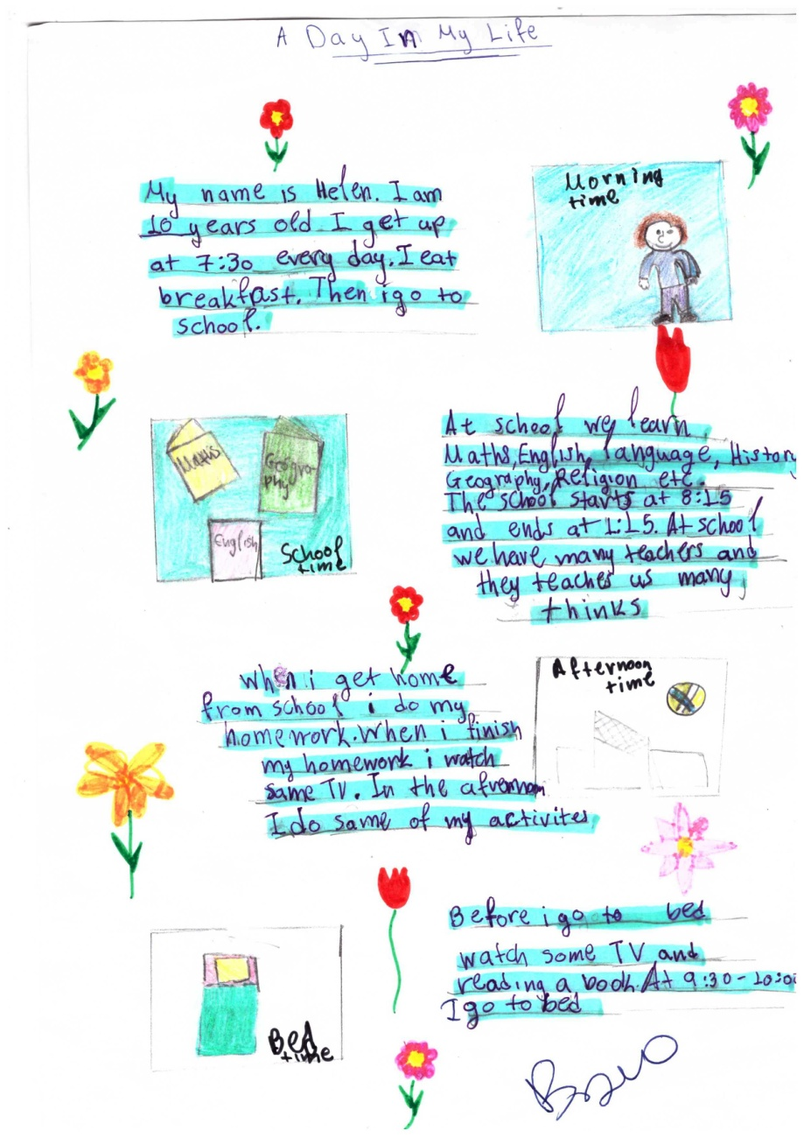


A DAY IN MY LIFE

Slide 8
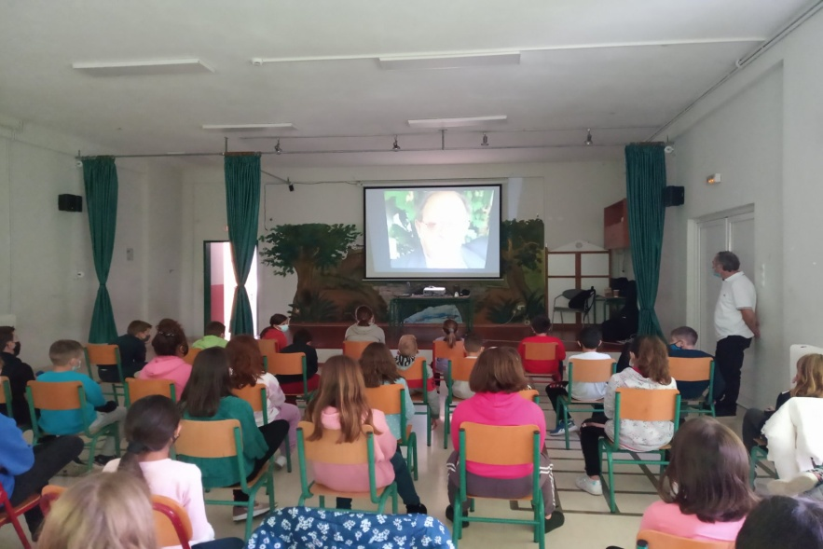
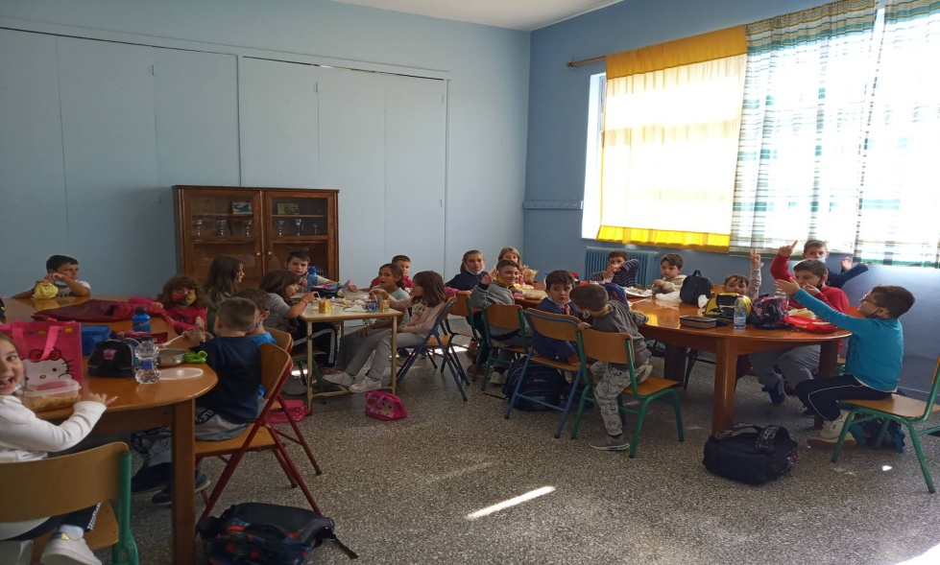
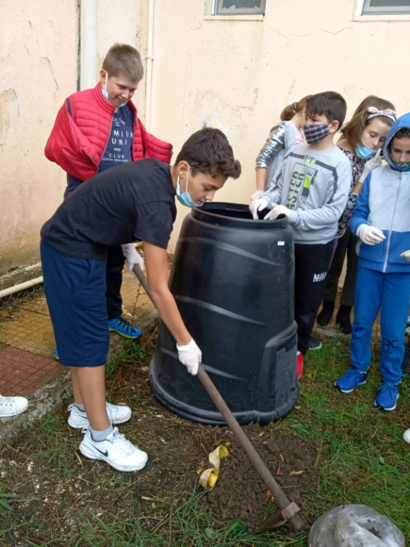
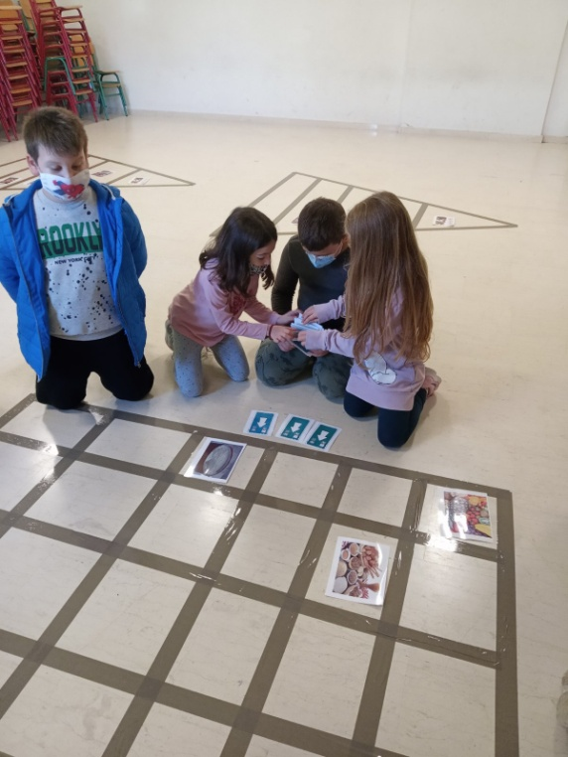
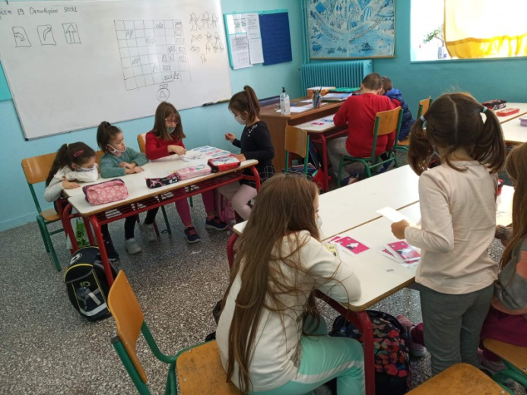
A DAY IN MY LIFE
Different activities at school.

Slide 9
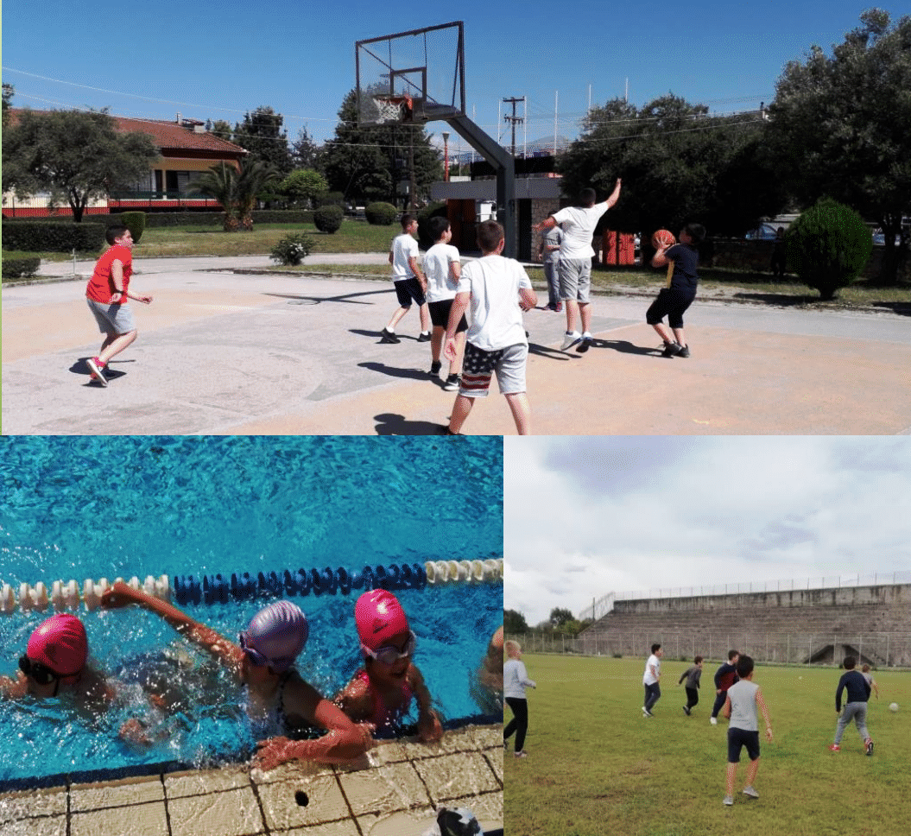

A day in my life
Primary School of Aneza.

