Slide 1
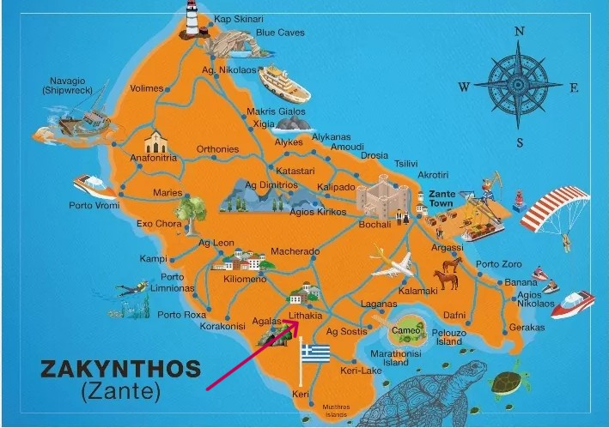
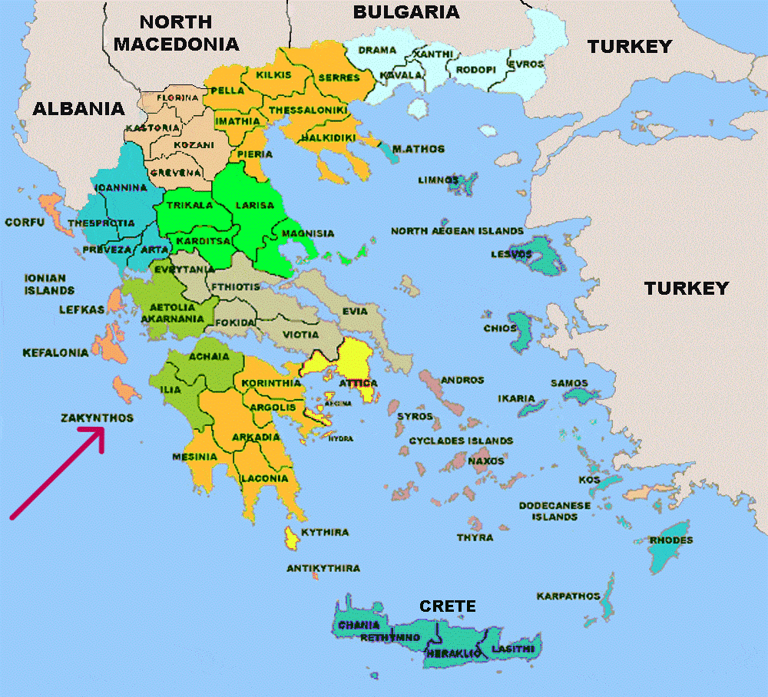
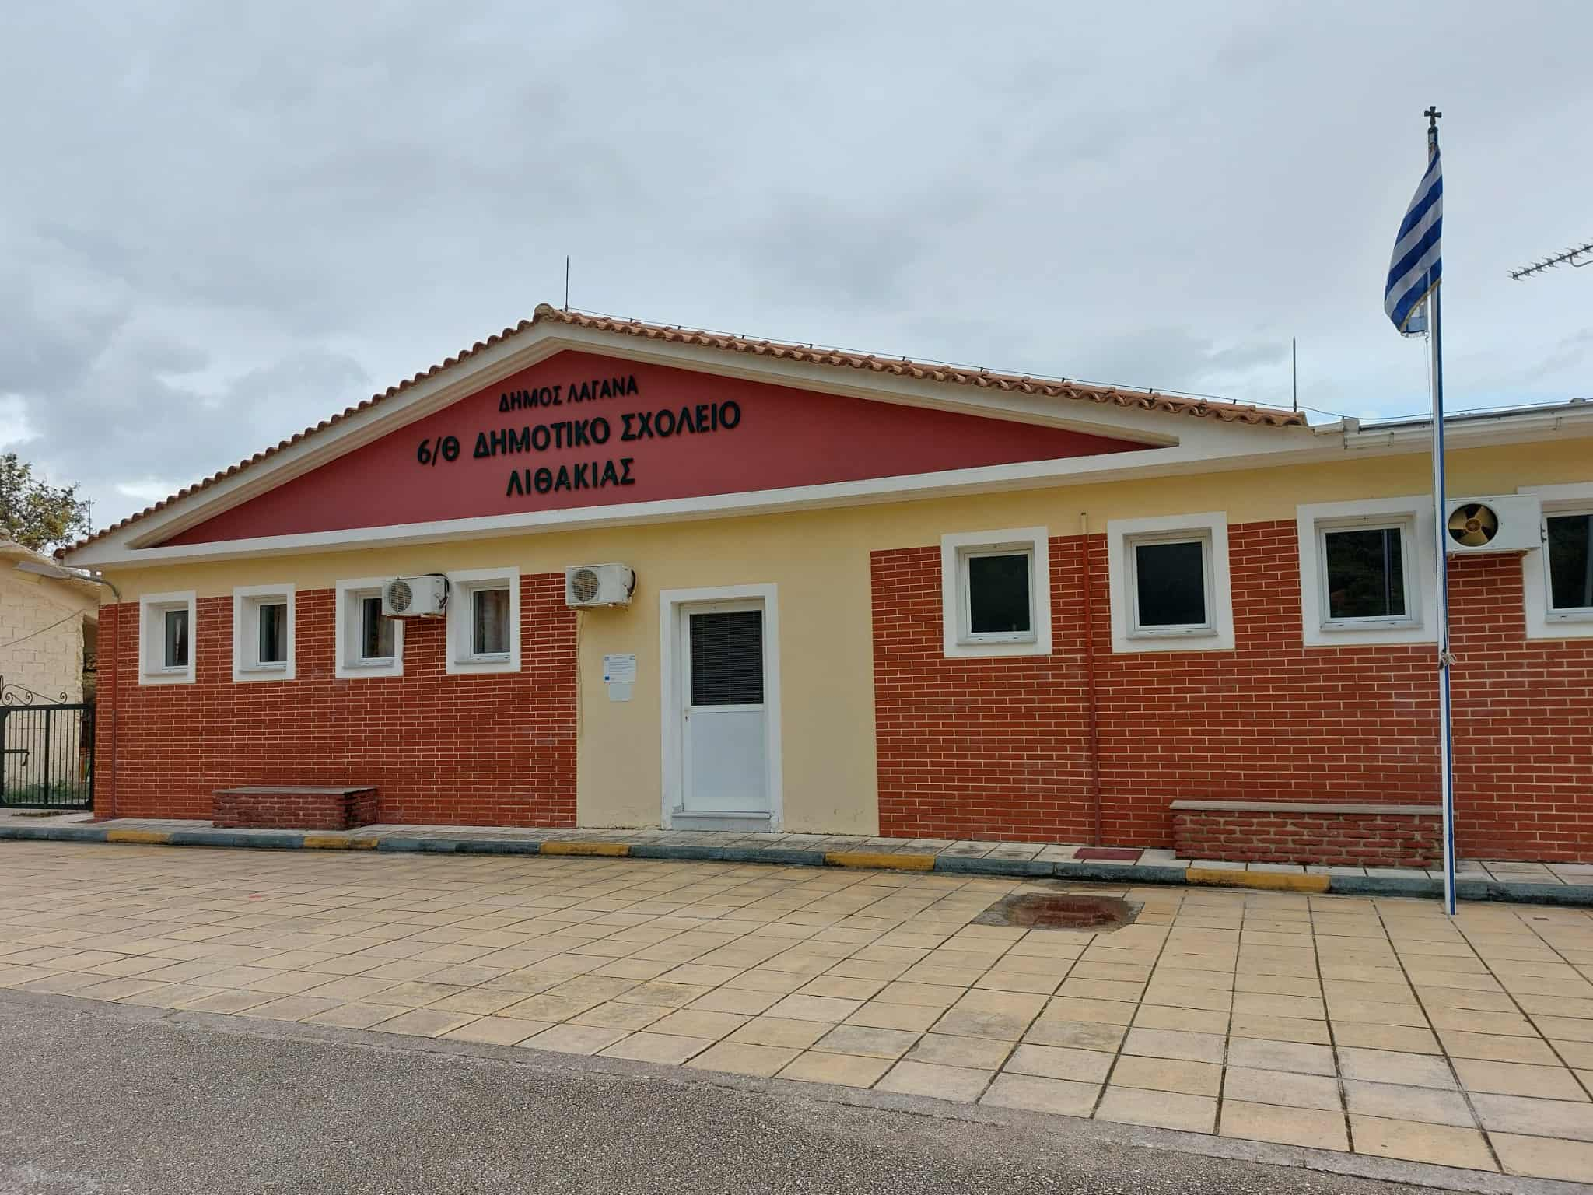
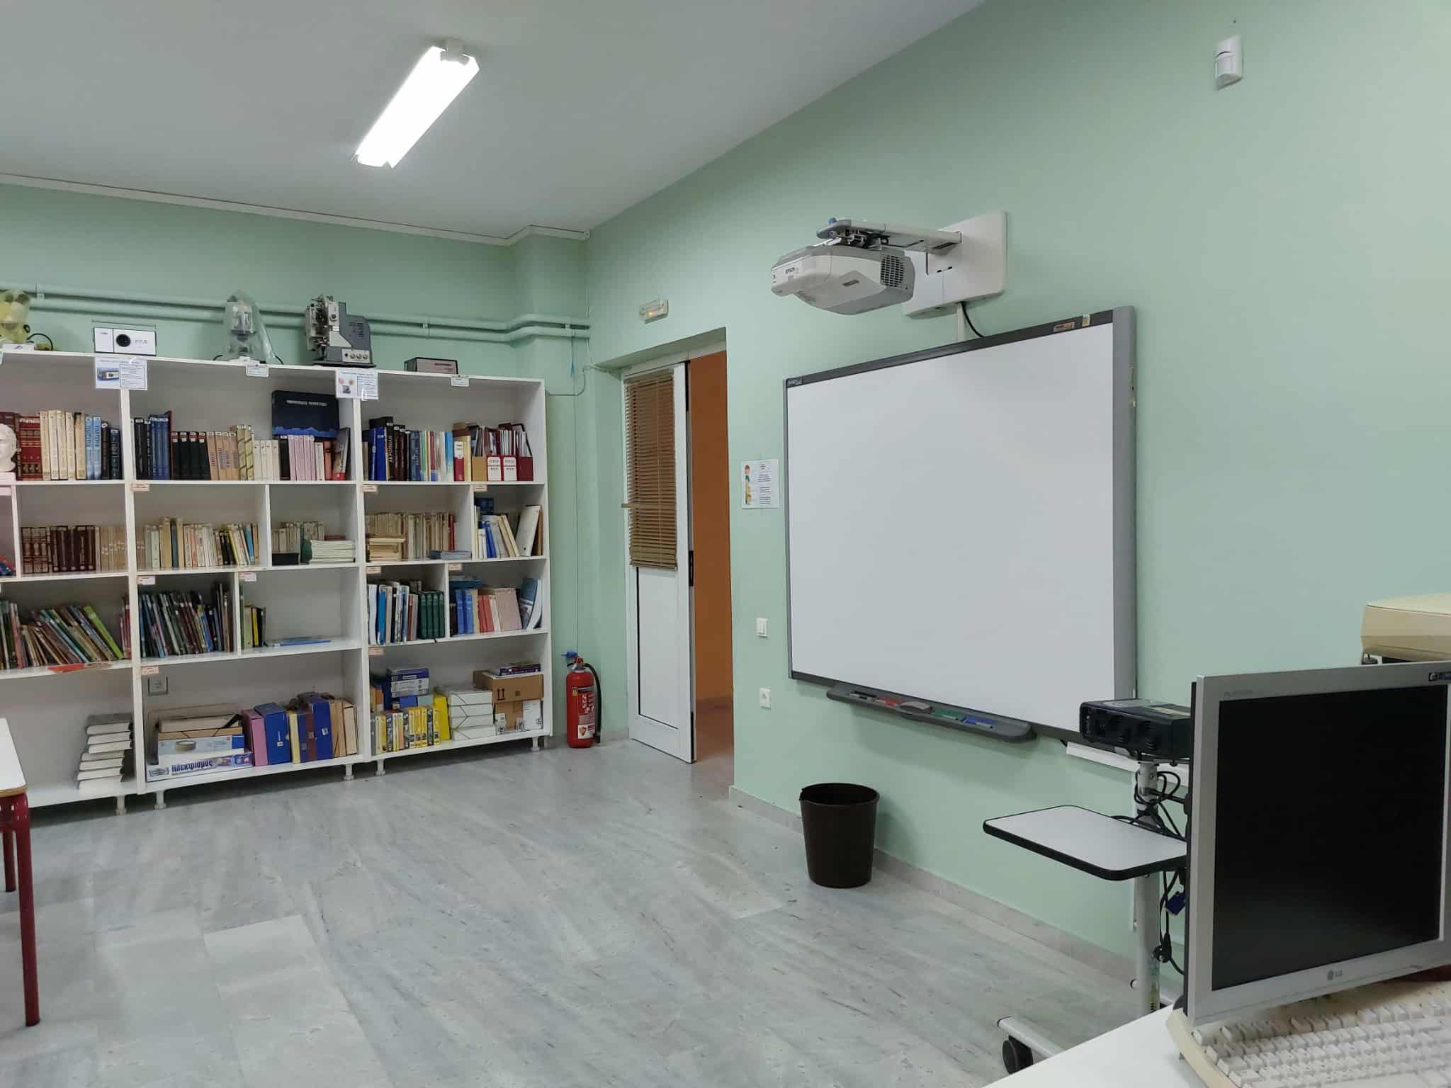
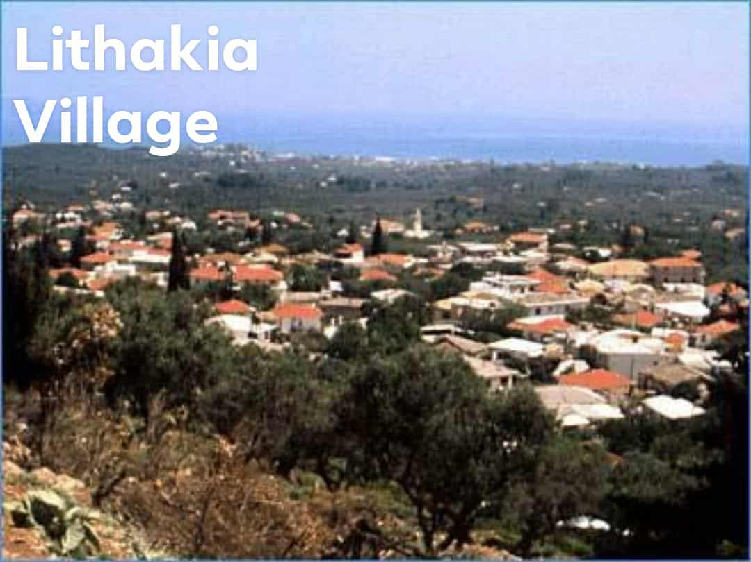
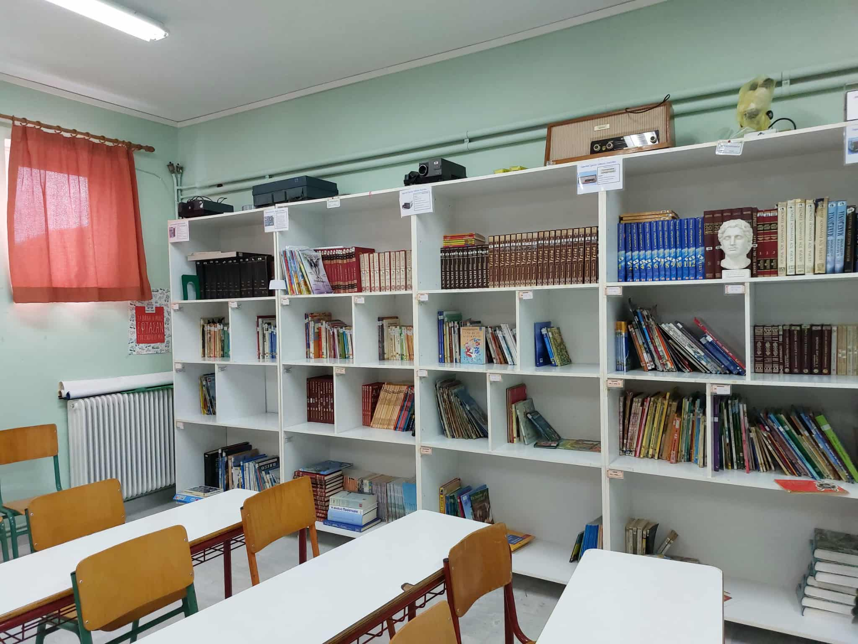
International Symposium “CREATIVITY AND INNOVATION, CHALLENGES IN TEACHING PRACTICES” November 21st-22nd, 2025 , Jibou, Romania The Experiential Learning Hive: A Project-Based Utilization of the School Library Author: Kalliopi Kokla, English Teacher and Principal, Lithakia Primary School, Zakynthos, Greece

Slide 2
The Evolving Role of the Modern School Library
The 21st-century school library is a dynamic center for creativity, literacy growth, and community partnerships.
It serves as a protective factor against excessive screen time.
It is a platform for project-based learning and interdisciplinary teaching.
It supports students' cognitive, emotional, and social balance through meaningful book engagement.
It fosters collaboration with families, teachers, and the local community.

Slide 3
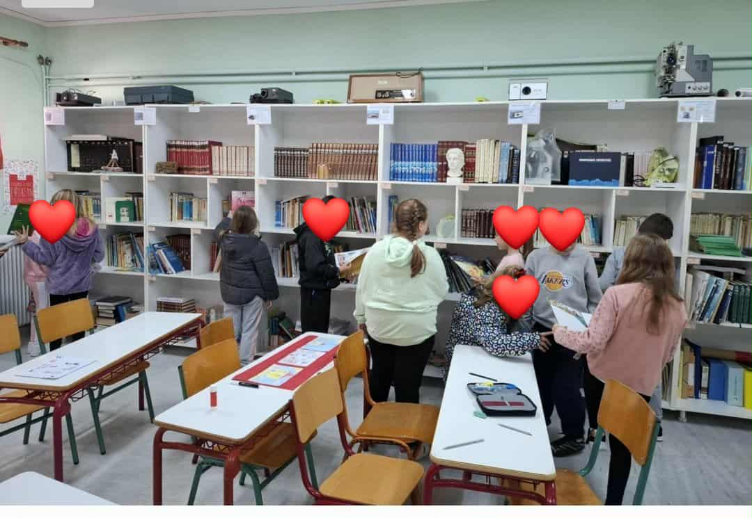
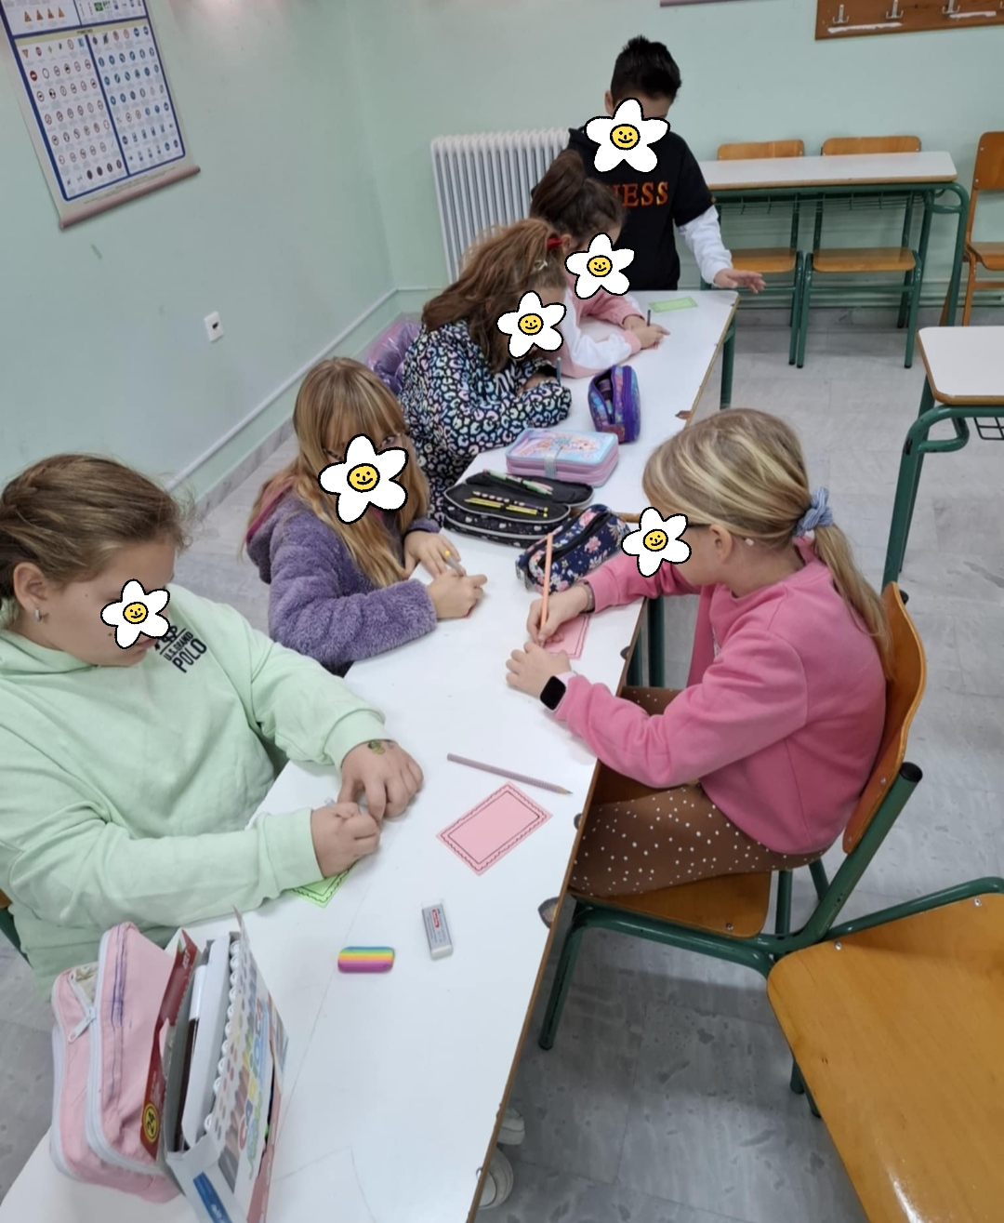
The Library as a Lively Learning Centre at Lithakia Primary School of Zakynthos, Greece
At Lithakia Primary School, the library has transformed from a quiet reading space into a vibrant hive for literacy, creativity, and collaboration.
Holistic Engagement Activities : reading, writing, dramatization, creativity, and community engagement.
Reading Resilience: reading alternatives to counteract dependency on social media and video games.
Collaborative Learning : Students work in groups, sharing ideas and expressing understanding through art and writing.

Slide 4
Key Objectives of the Project
Responsibility
Through donation, borrowing, and organization of books.
Holistic Education
Integrating Art, Drama, Music, ICT, and languages into literacy projects.
Lifelong Learning
Aligning activities with Key Competences for Lifelong Learning in the European Schools (literacy, multilingual, digital , cultural awareness and expression competences)
Critical Skills
Cultivating critical thinking, imagination, and creative writing.

Slide 5
Core Activities of the Project A. Building Ownership and Routine
1. Donating and Borrowing Books
Students regularly donated books, enriching the collection and encouraging empathy and sustainability. Teachers guided discussions on book choices to develop self-reflection.
2. Library Organization
A teacher and student assistants designed simple colour-coded classification systems and created Library cards. Weekly "Library Hour" sessions established routine and discipline.

Slide 6
B. Creative Engagement with Authors and Stories
Local Author Visit
Students prepared questions, illustrated scenes, and created story maps with the author of the Christmas story "The Tree of Wishes.“
Family Dramatization
Parents and children dramatized scenes from the children’s book "Speak to me" at the historic Public Library, integrating Music and Drama.
Local History Exploration
Visits to local libraries to discover how stories connect to Zakynthos’s cultural identity.

Slide 7
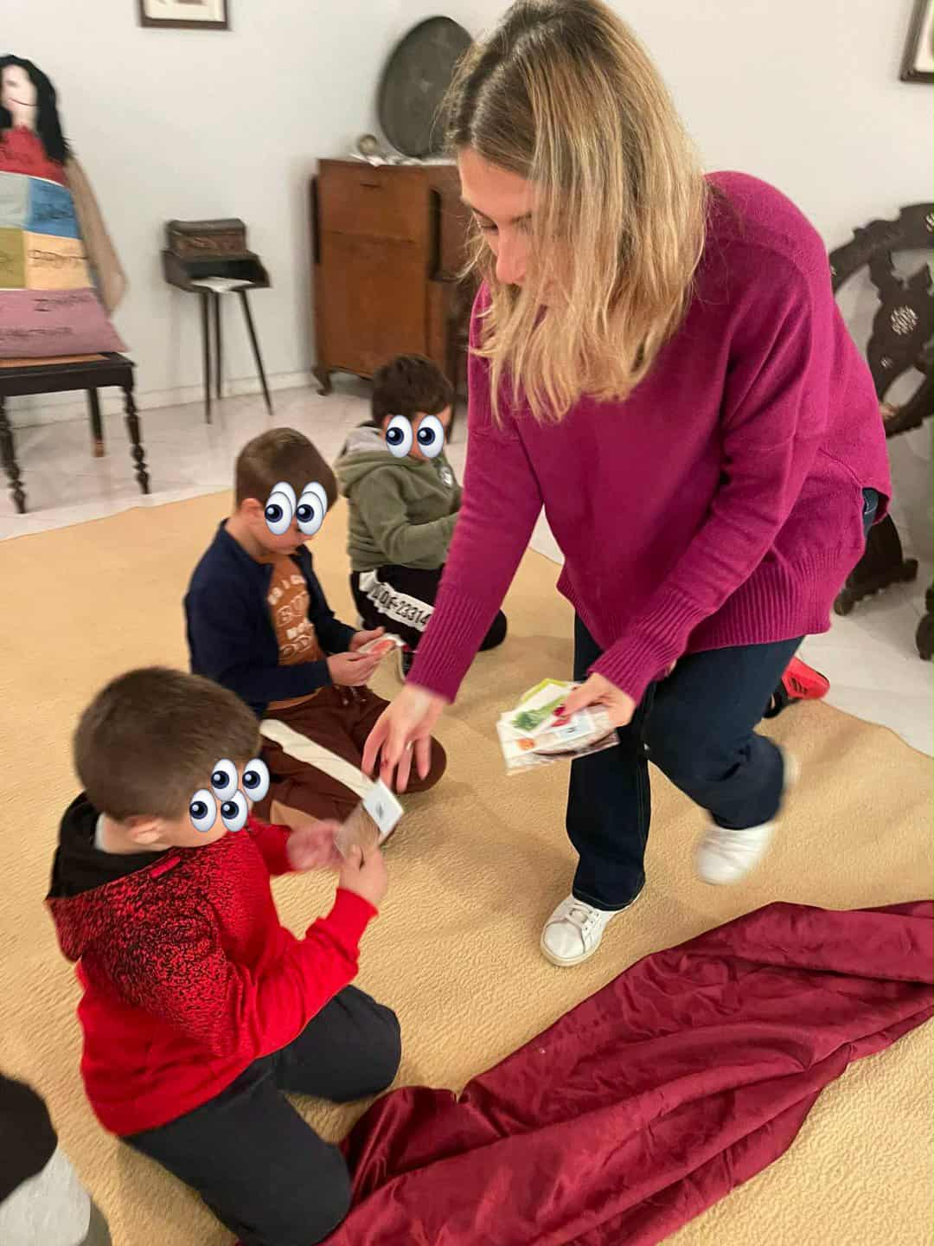
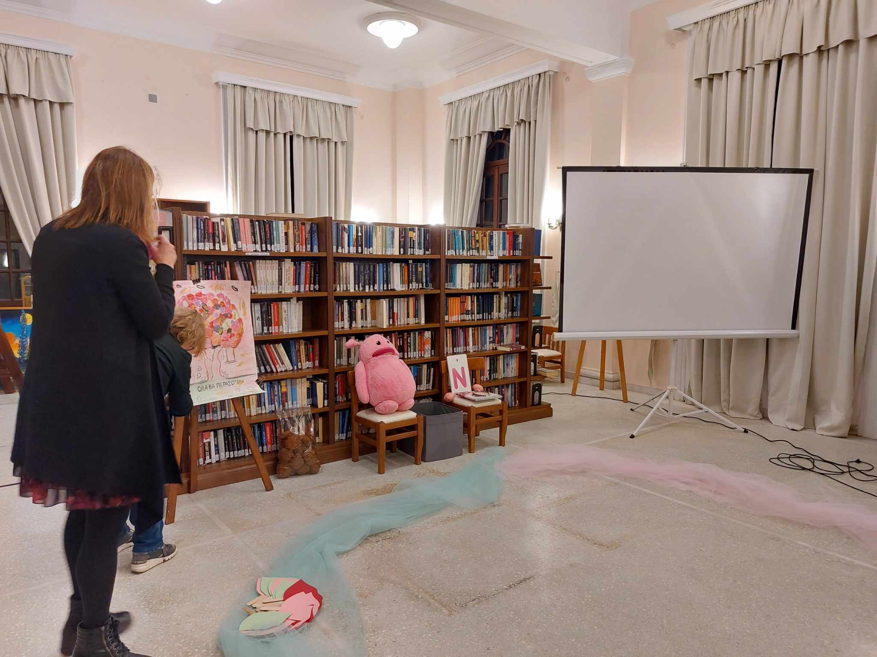
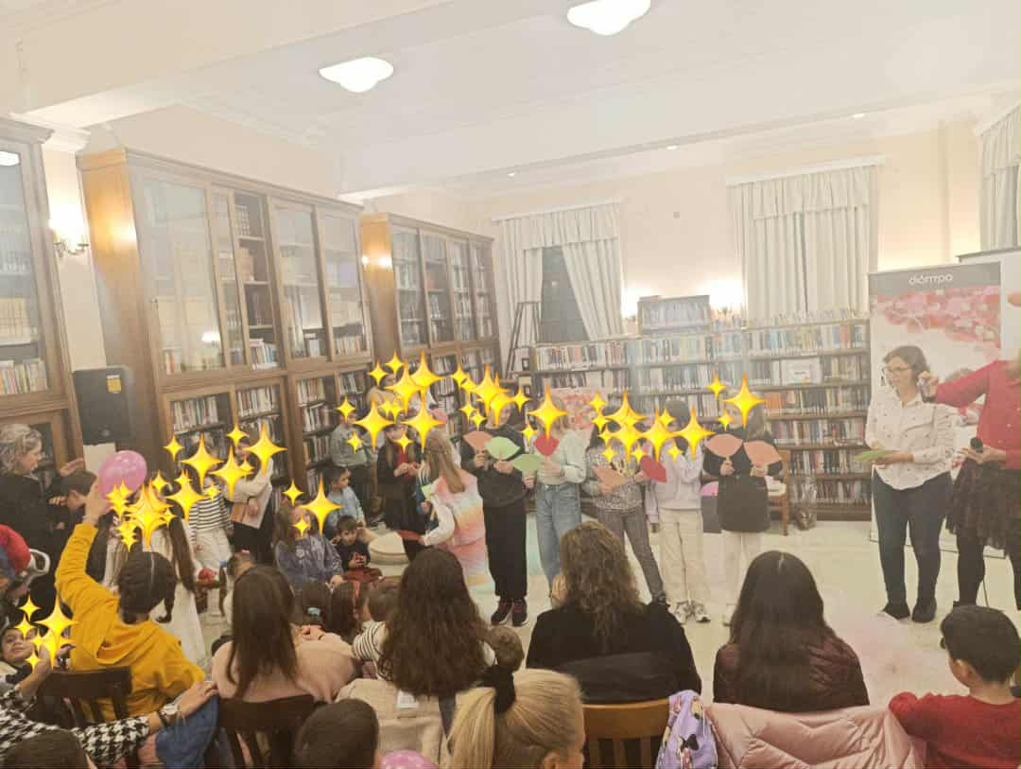
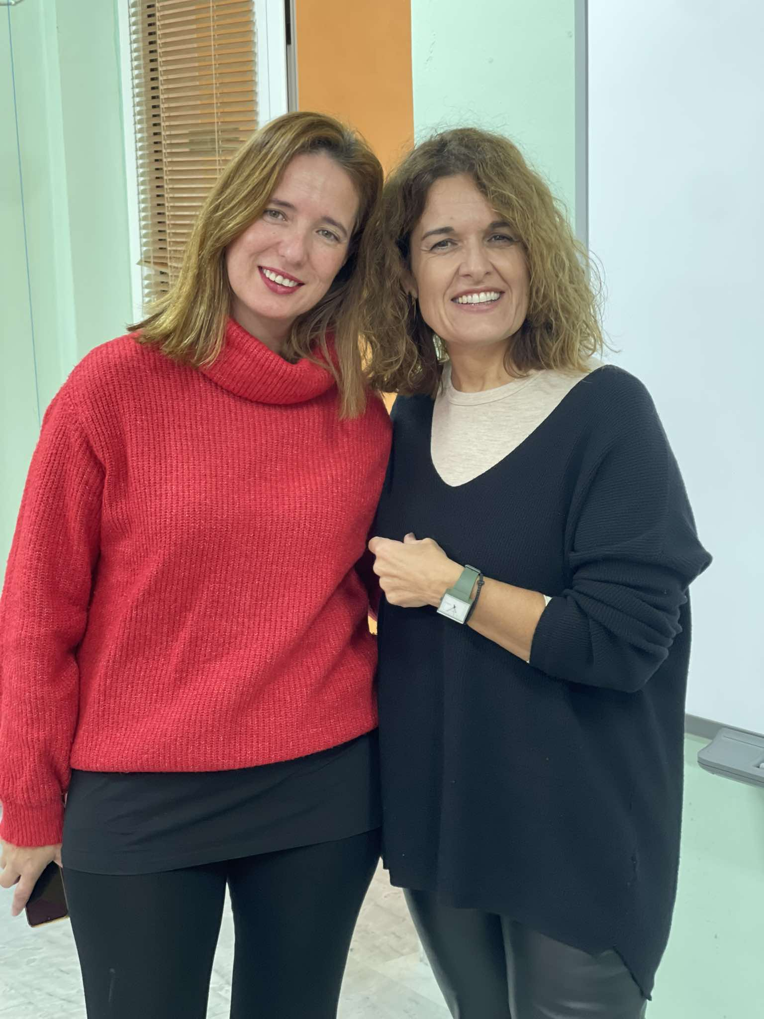
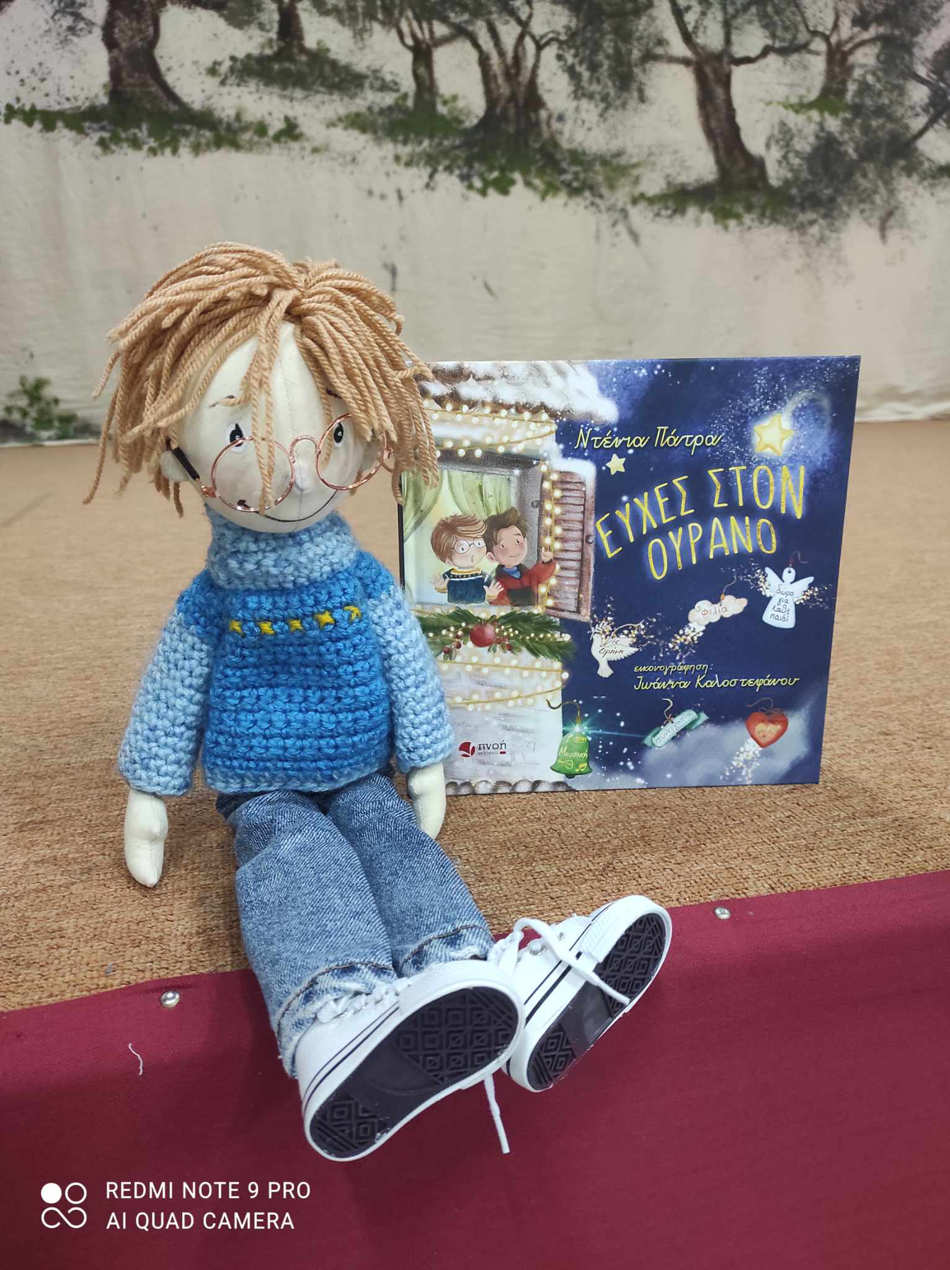
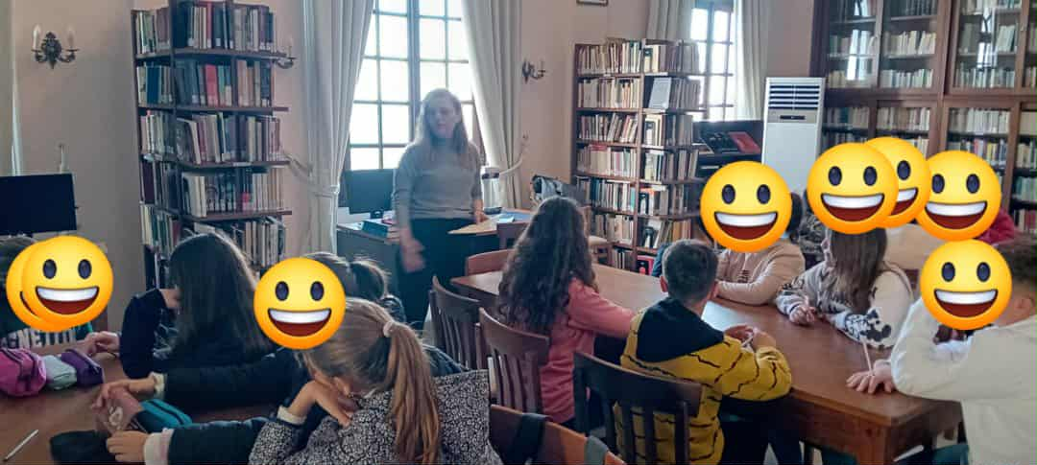
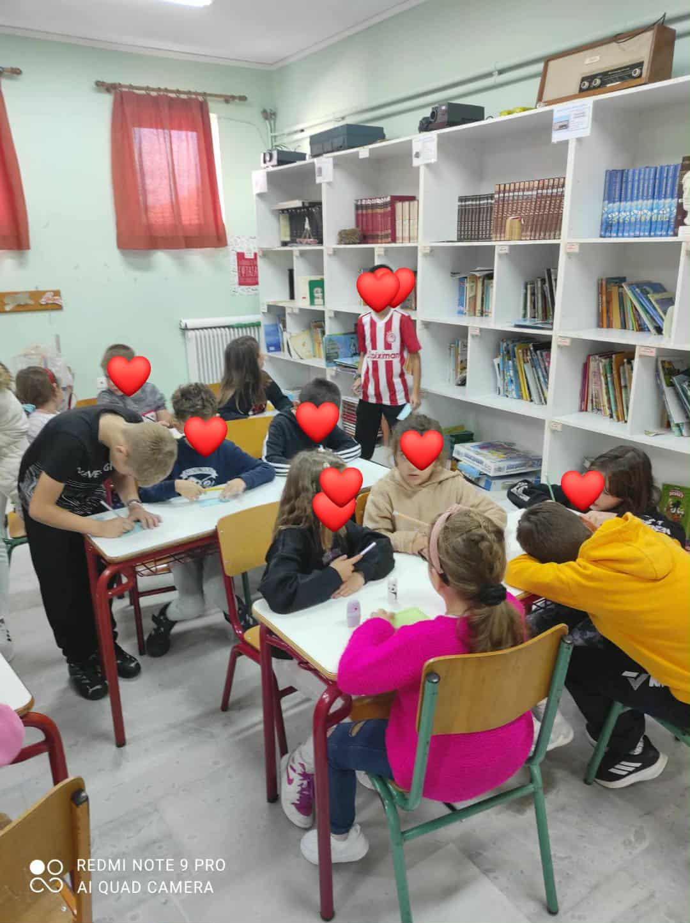
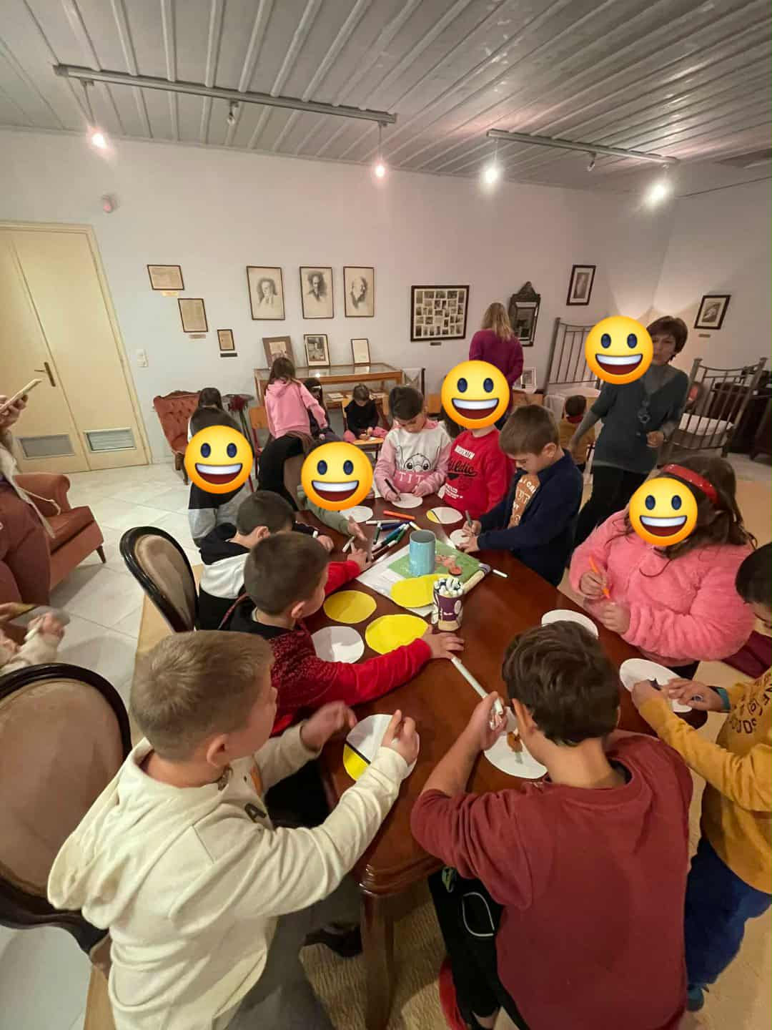
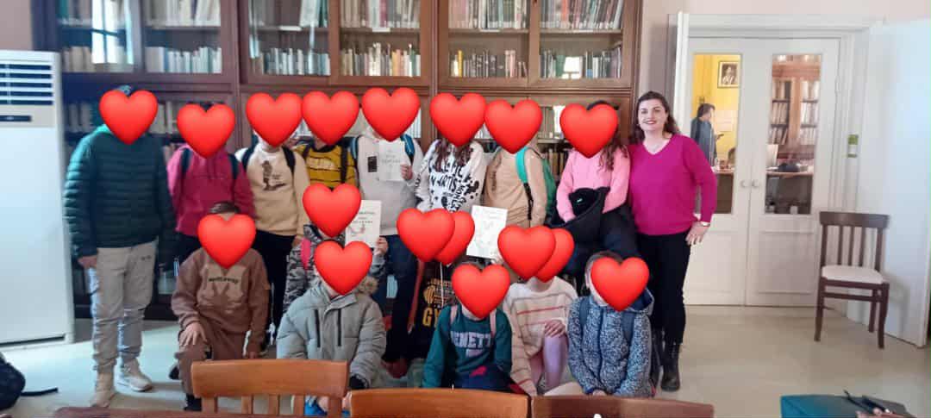
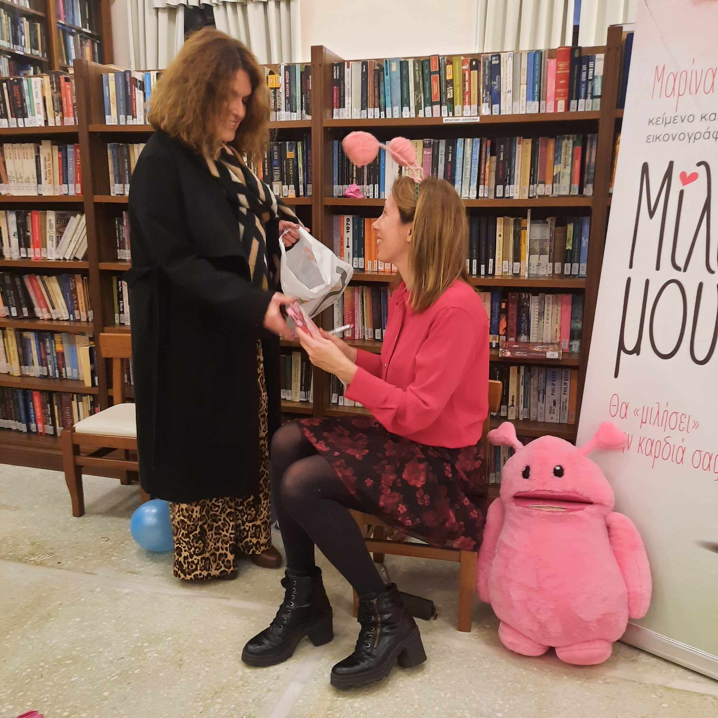
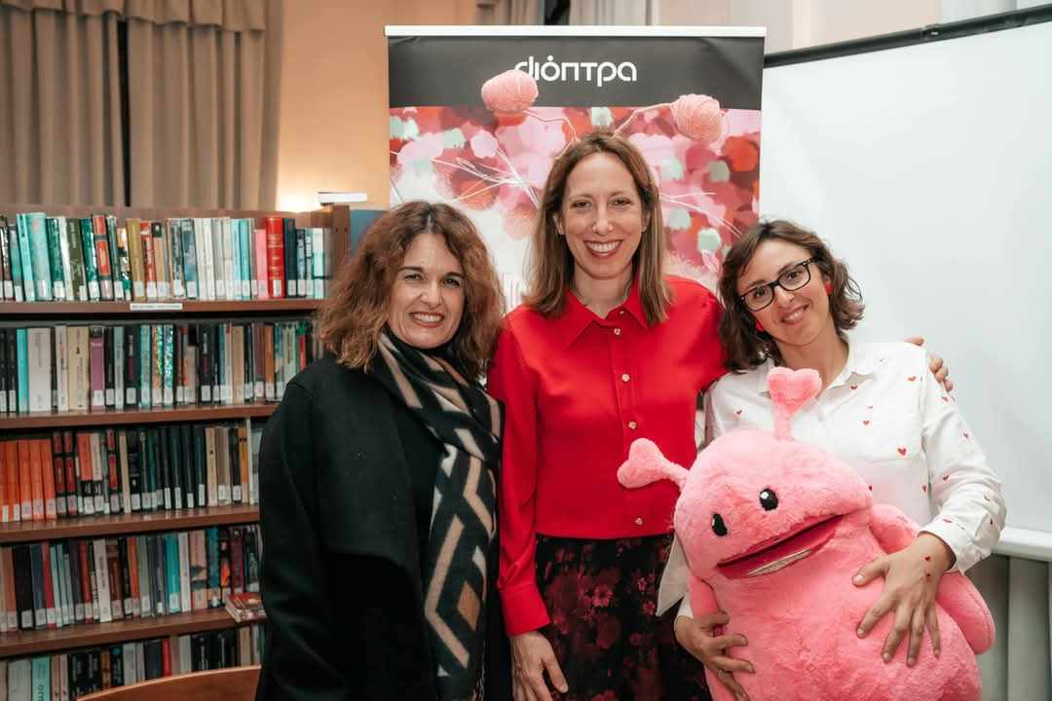
Photo Material (1)

Slide 8
C. Peer-to-Peer Learning and Public Speaking
Peer Reading
Sixth Graders prepared and read short stories to First Graders, strengthening reading fluency, empathy, and leadership skills for the older students.
Book Presentations
Classes presented selected books during a "Reading Marathon" day. Preparation involved plot summarisation and author research, improving speaking skills and confidence.
Digital Library Creation
Second Graders created recorded narrations of books with artistic creations, fostering collaboration, inclusion, and improved speaking skills.

Slide 9
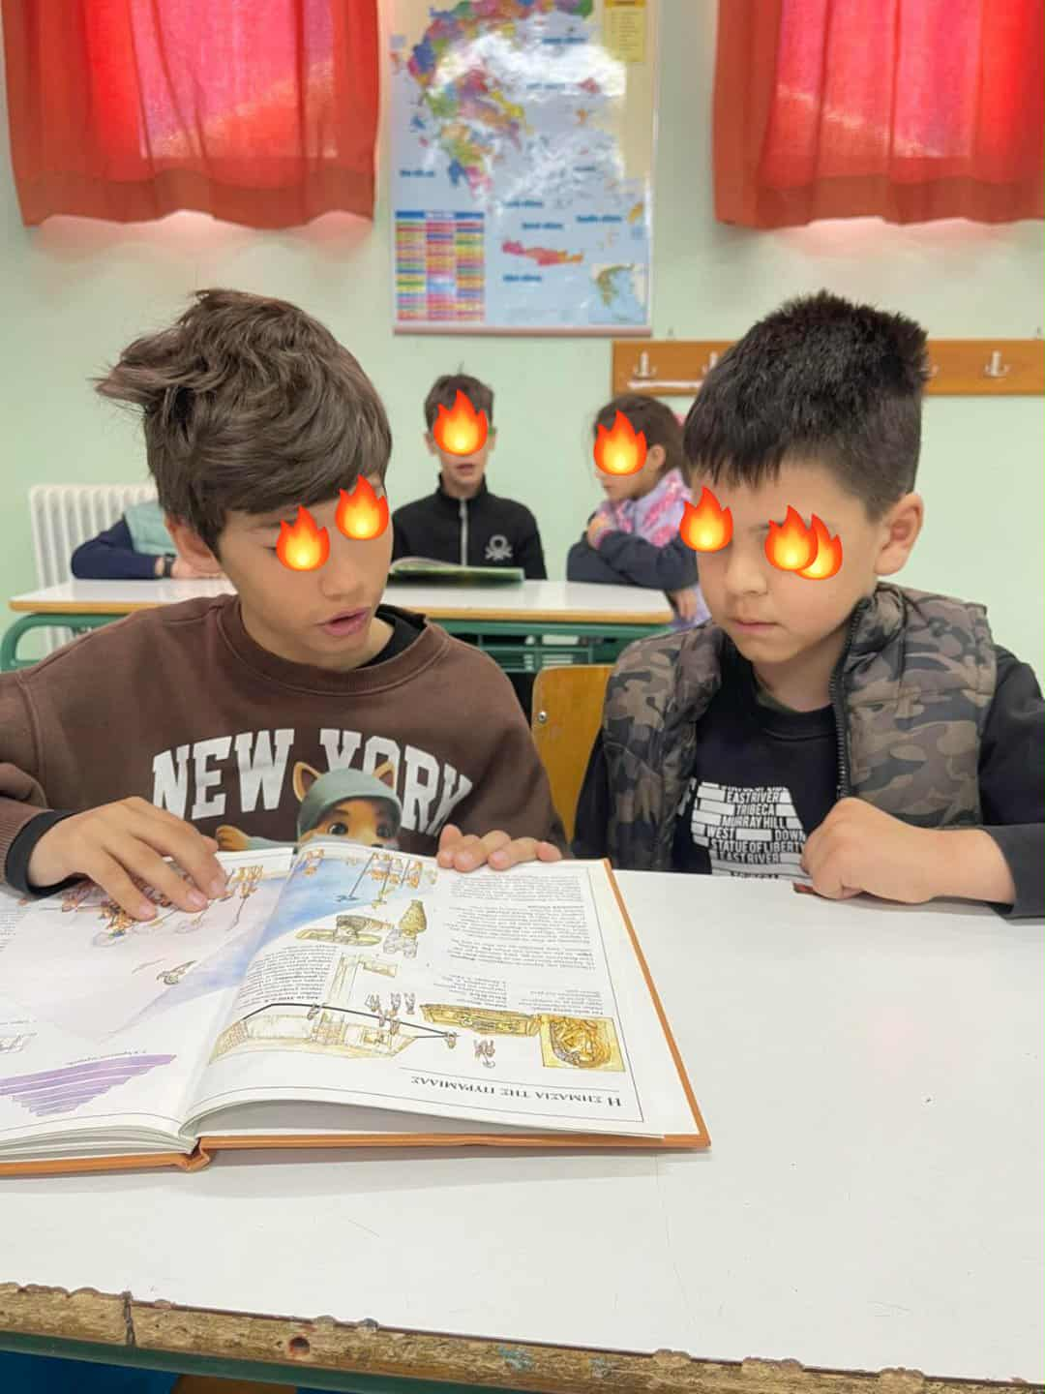
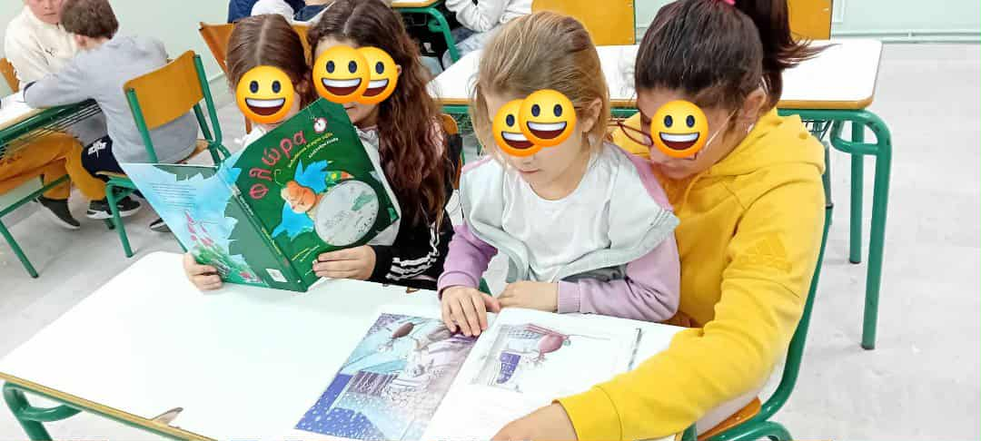
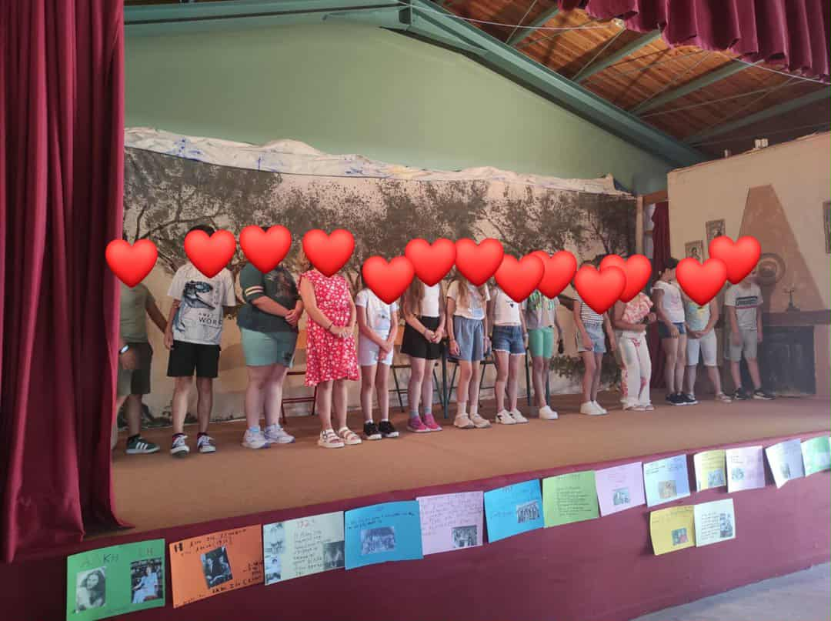
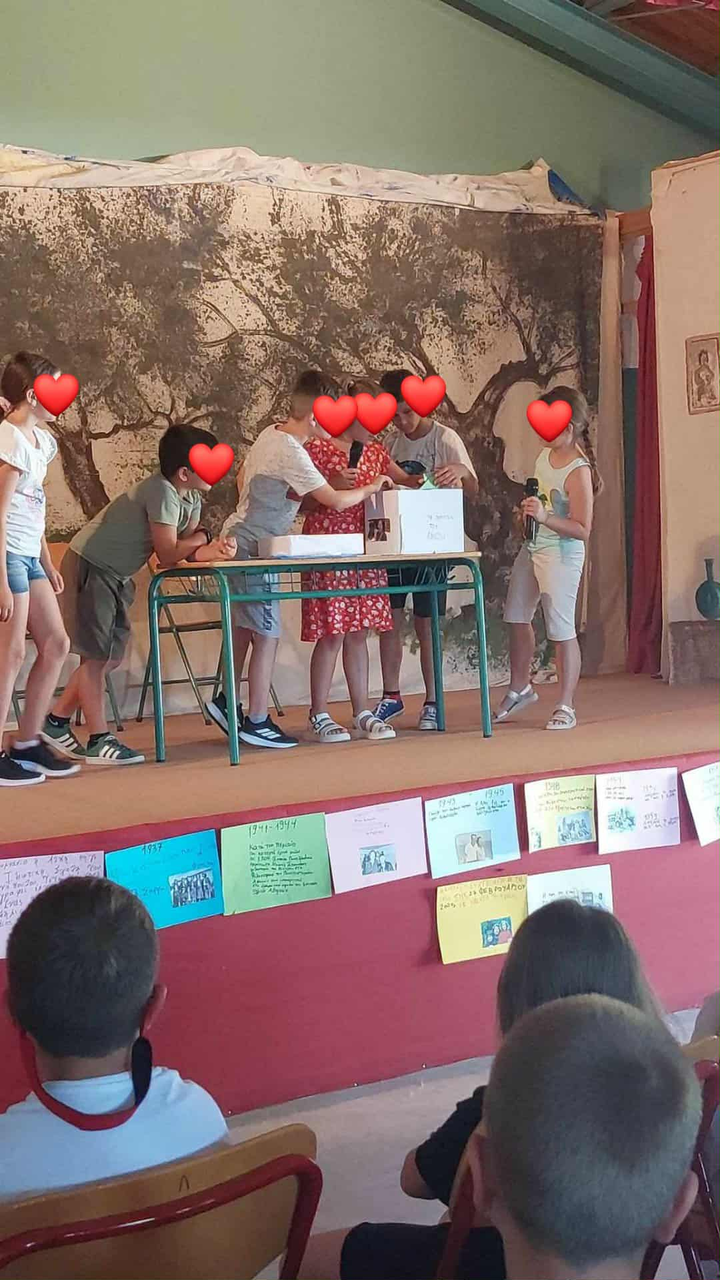
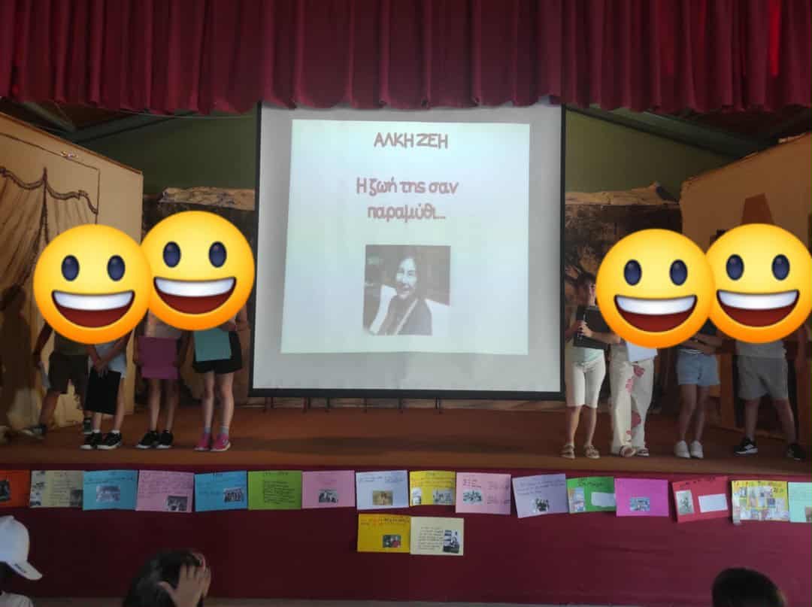
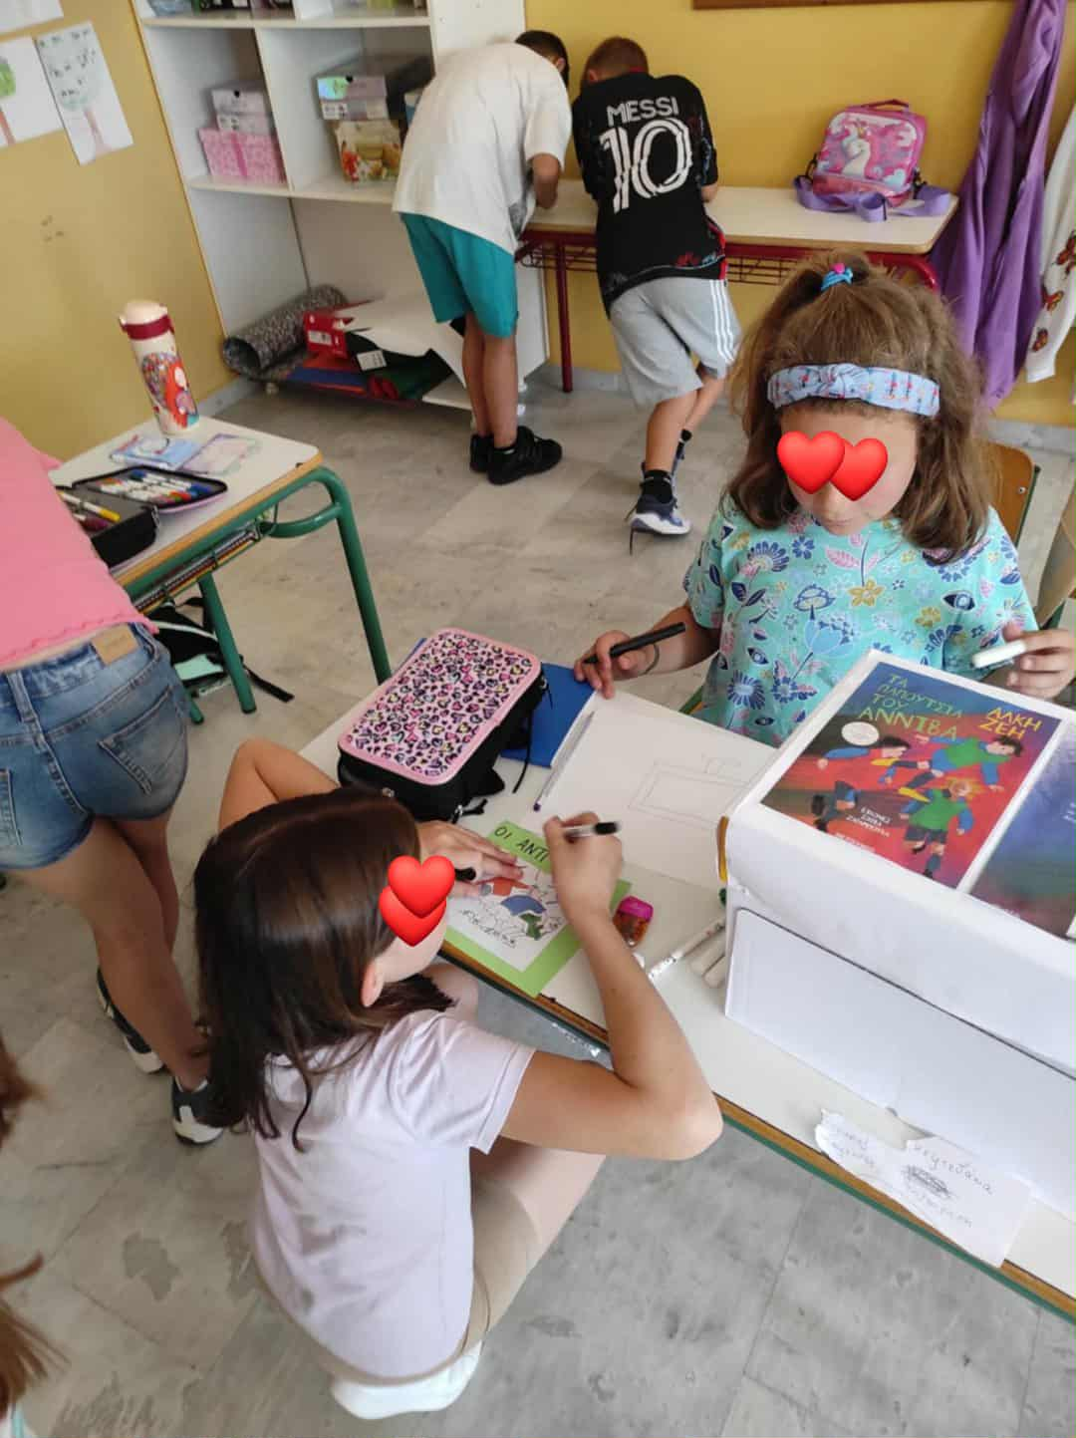
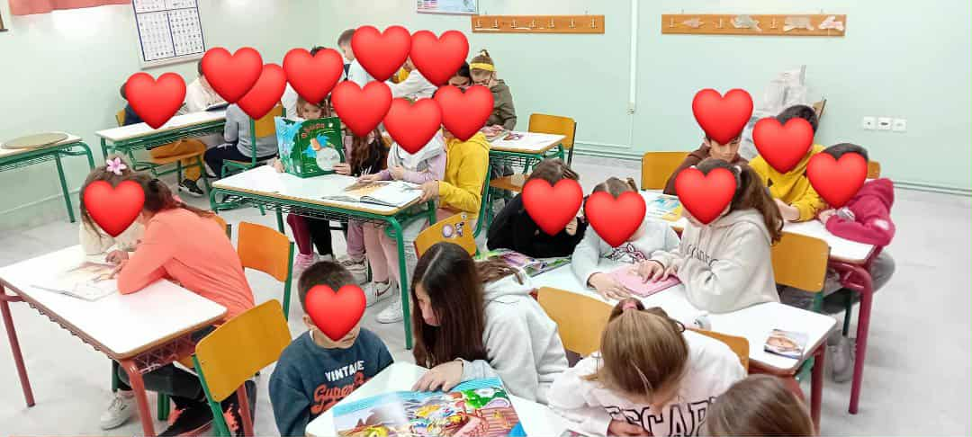
Photo Material (2)

Slide 10
D. Creative Writing and Community Outreach
Student Writing and Donation
Inspired by their readings, students wrote and illustrated their own short stories. These were compiled into handmade books and donated to the library, giving students a sense of contribution.
English Fairytale on Local Radio
Sixth-grade students dramatized an English fairytale and broadcast it live on local radio. This promoted English language learning, media literacy, and public communication.

Slide 11
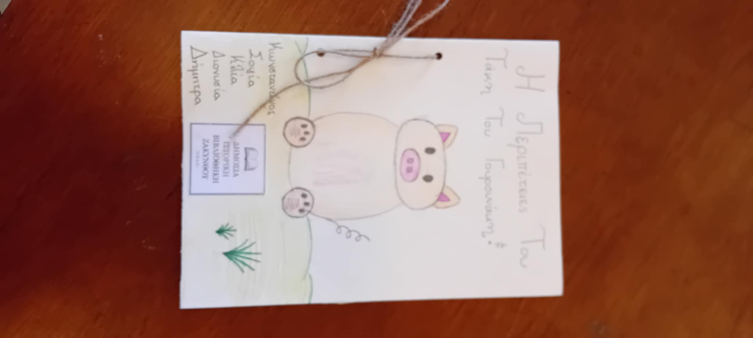
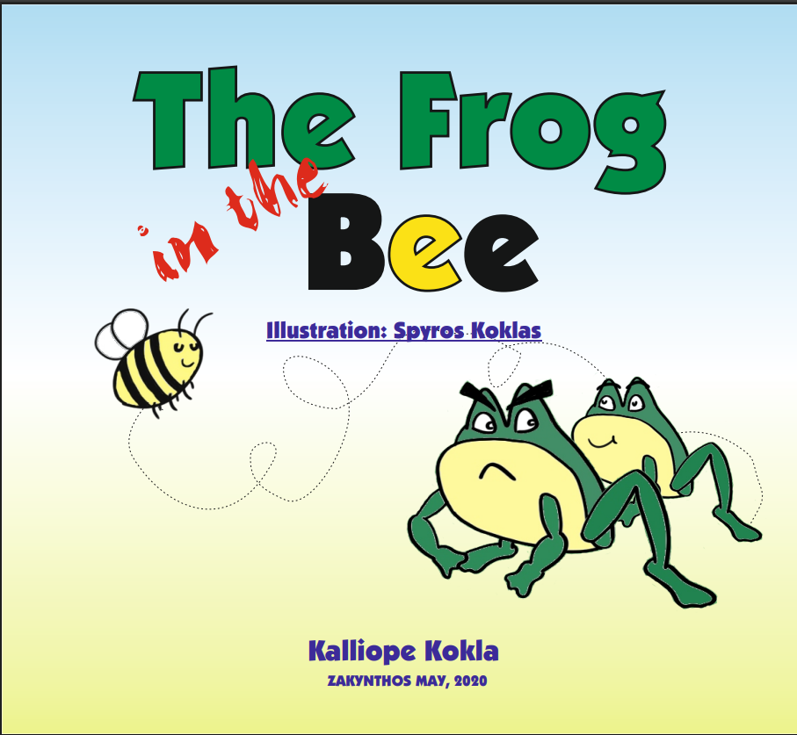
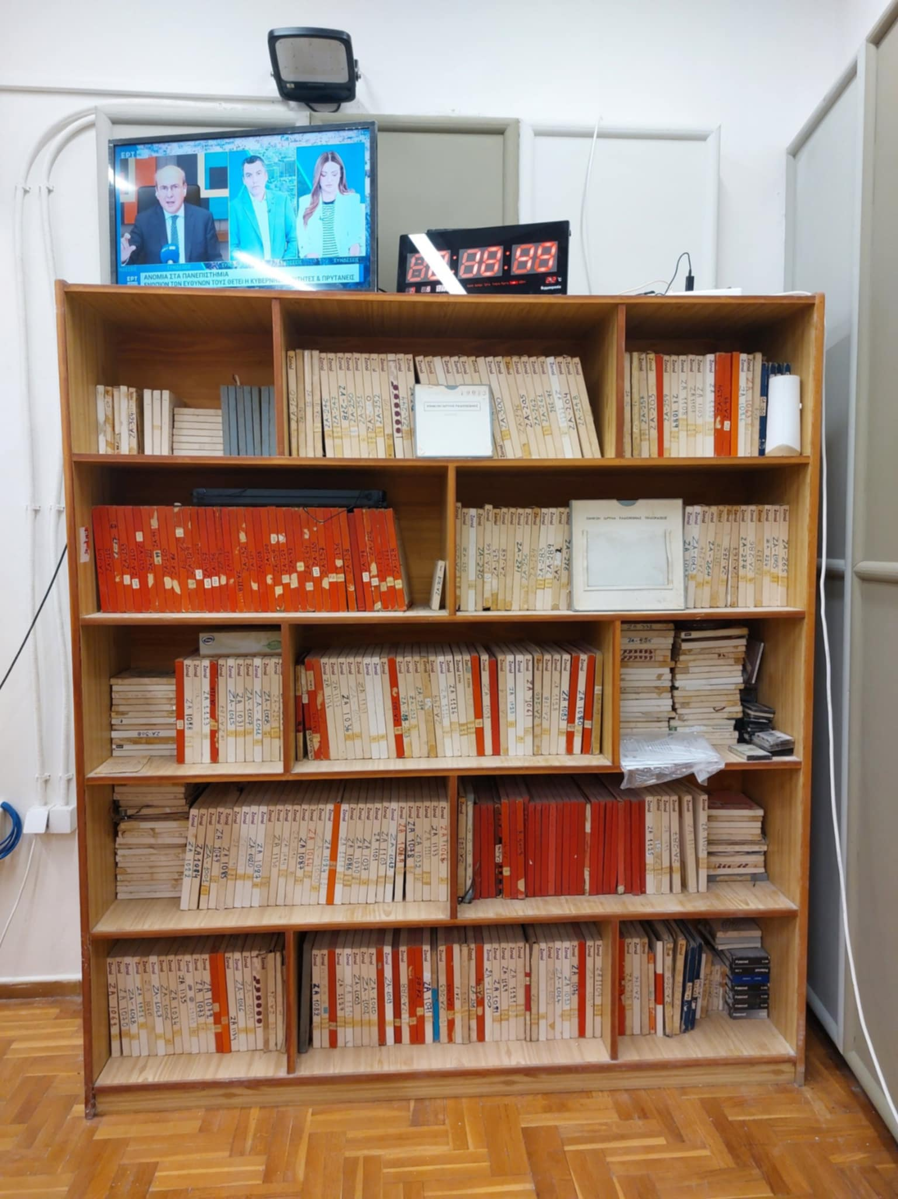
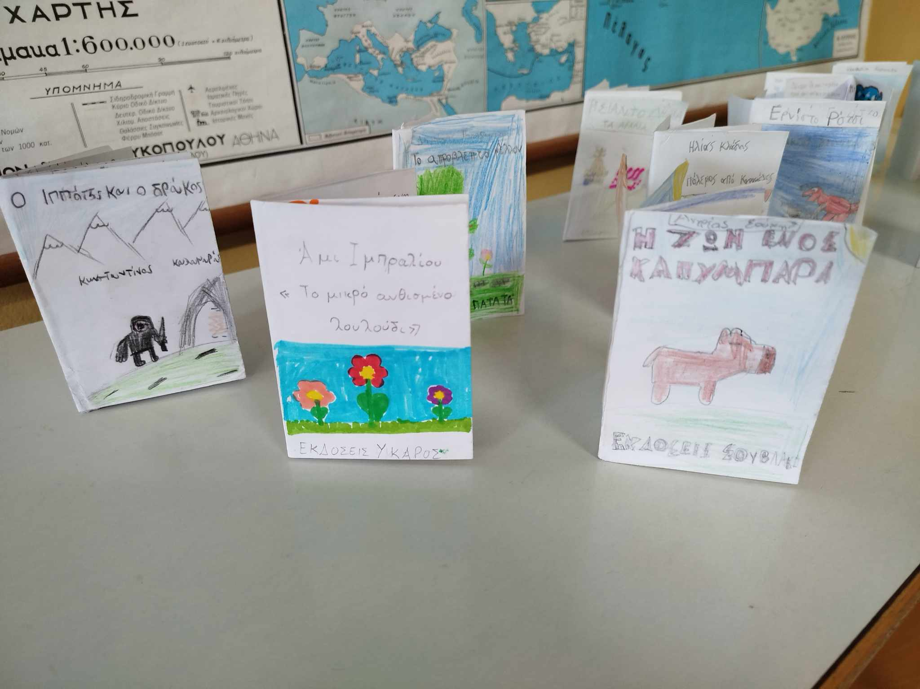
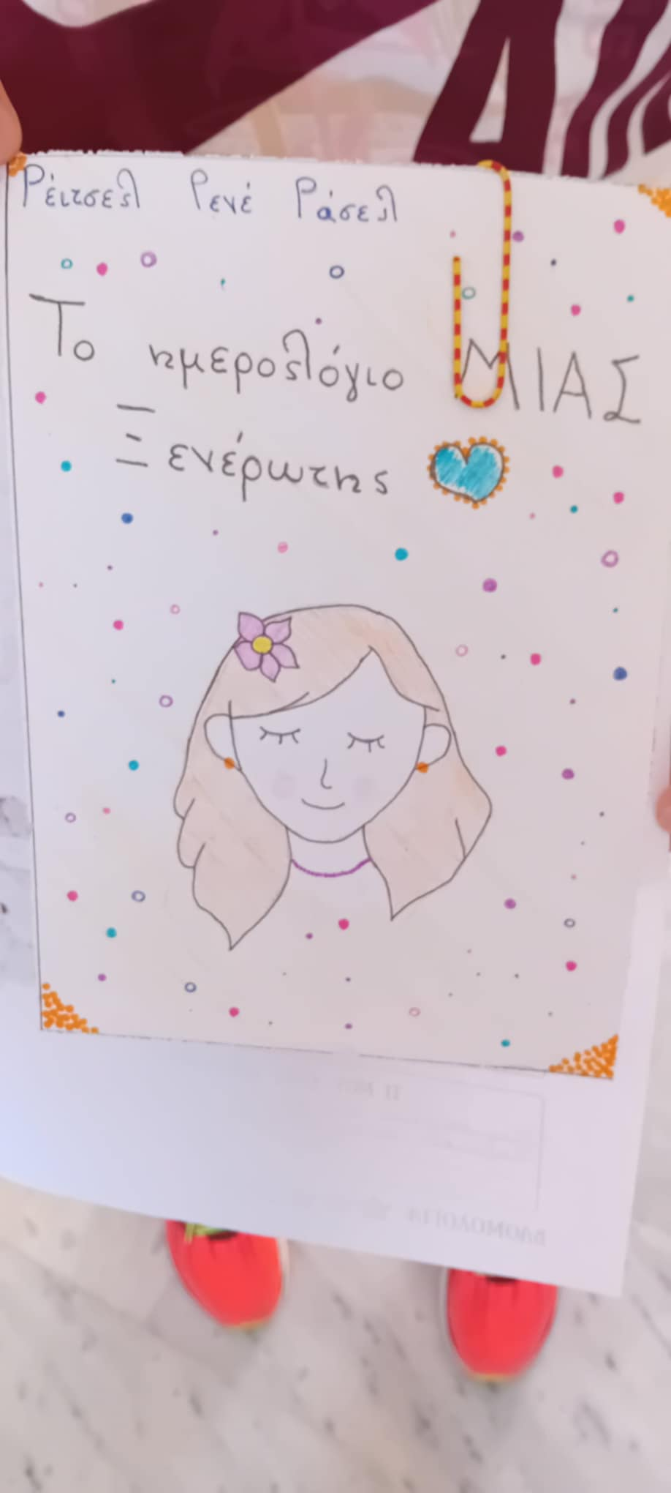
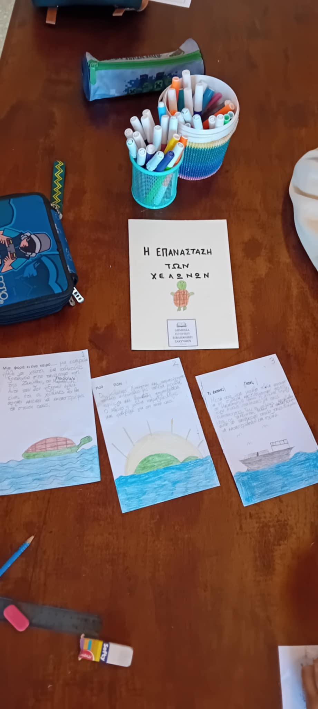
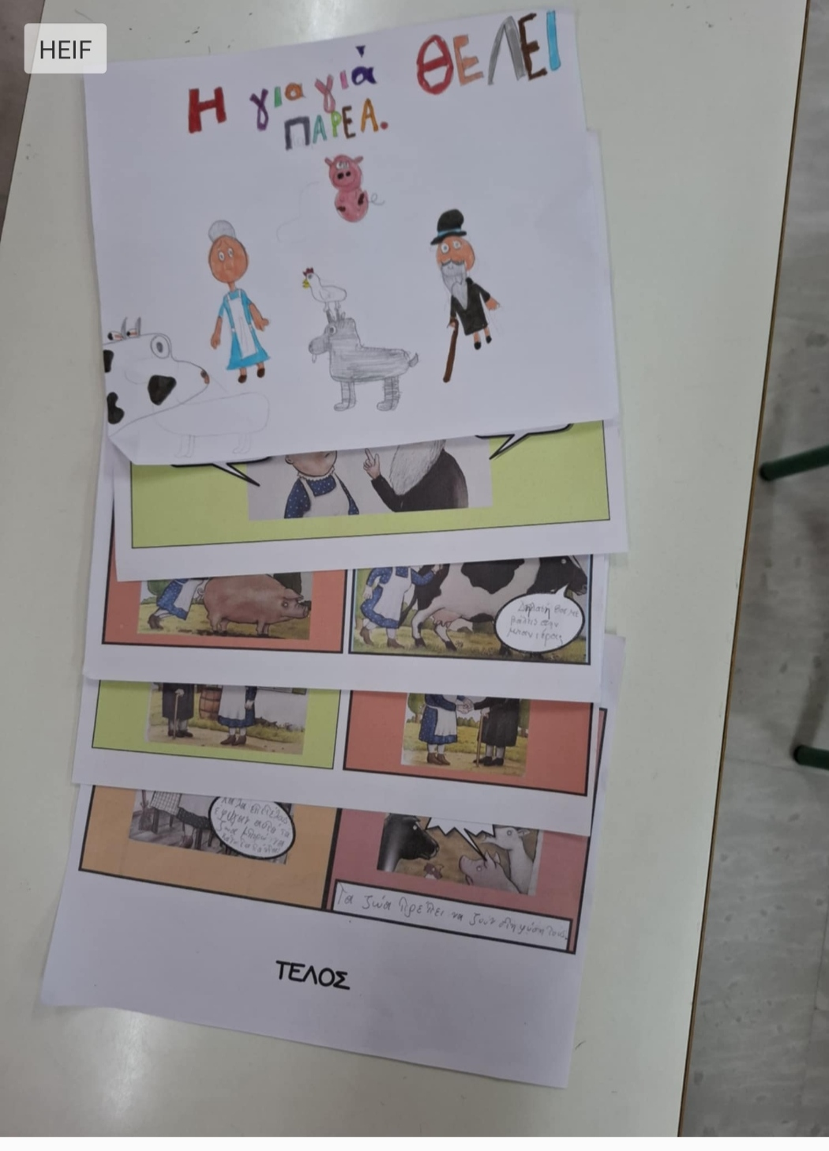
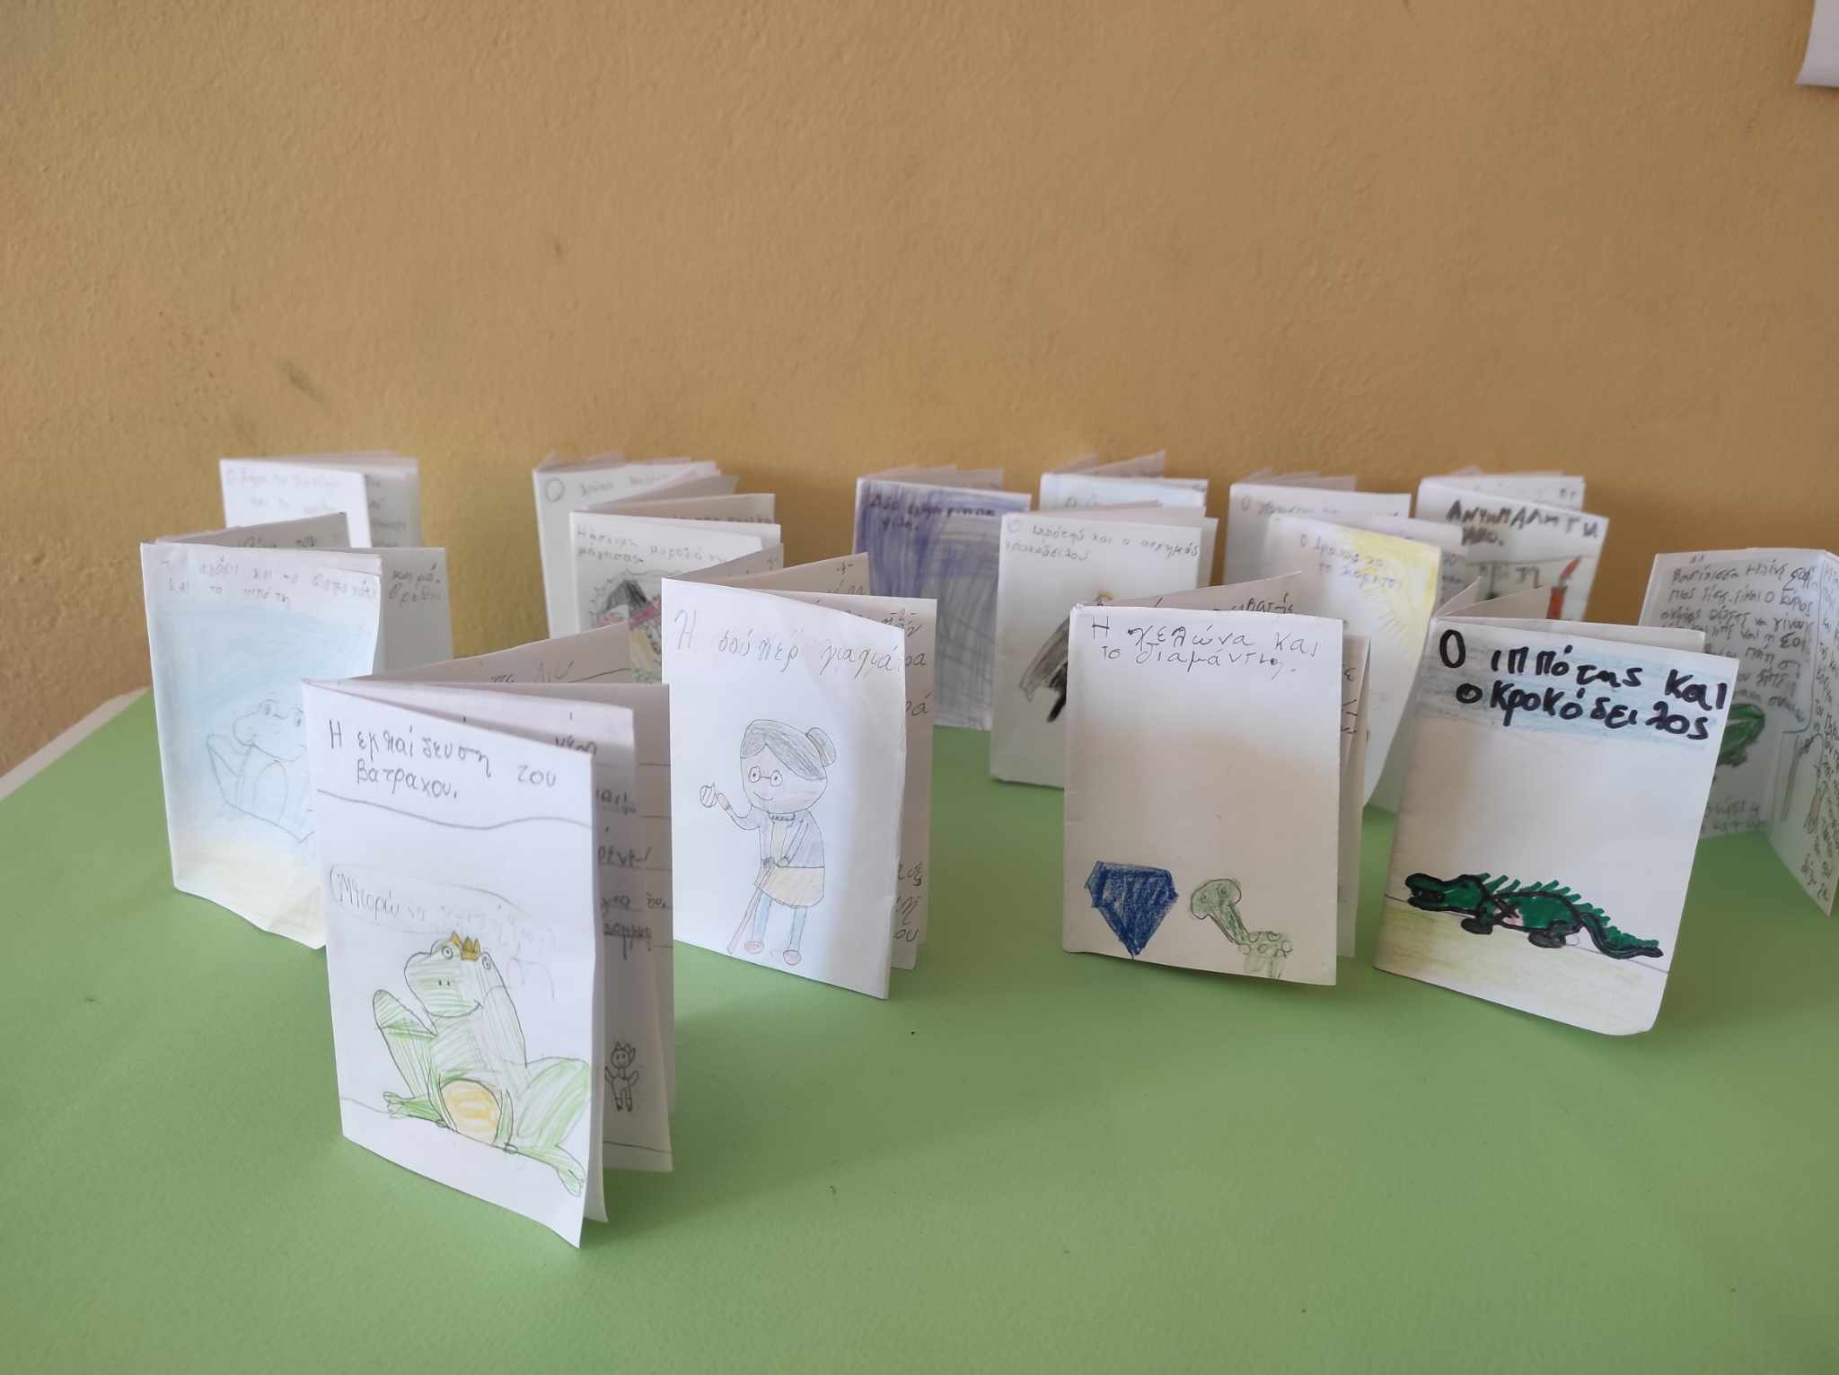
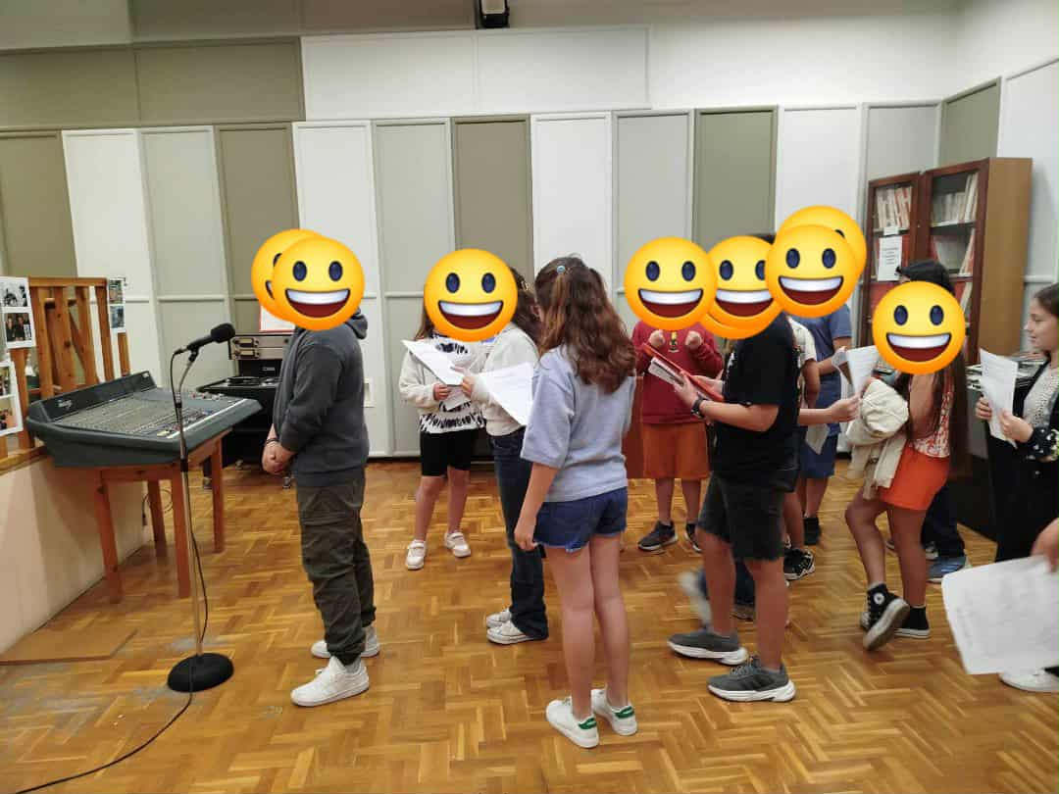
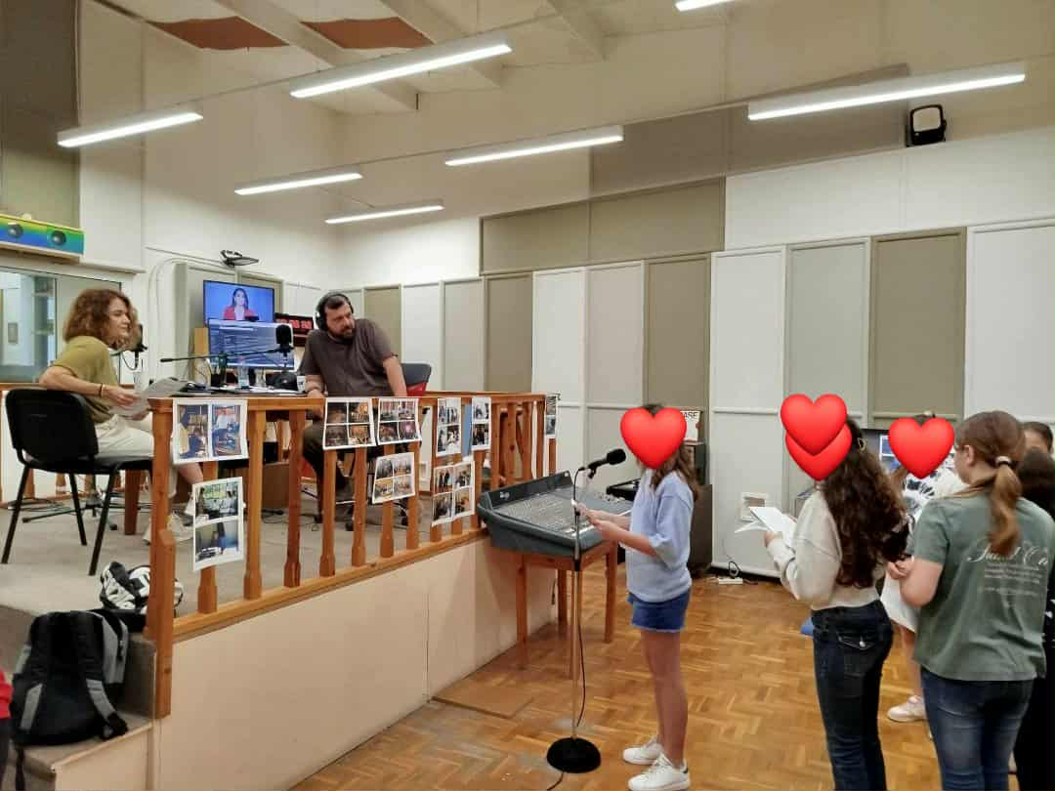
Photo Material (3)

Slide 12
Pedagogical Foundations of the Project
1. Experiential Learning
Dewey's concept: Students learn by doing, organizing, dramatizing, collaborating, and critically thinking with the teacher as a facilitator.
2. Free Voluntary Reading
Krashen's theory: Enjoyable, self-selected reading for pleasure develops literacy (vocabulary, grammar, writing) naturally and can lead to greater school success for children.
3. Multiple Intelligences
Gardner's theory: Variety of activities (linguistic, musical, visual, bodily-kinesthetic e.t.c ) ensures participation by all learners.
4. Motivation & Engagement
Guthrie and Wigfield: Highly motivated readers who enjoy reading for its own sake and active participation is the key to nurturing lifelong readers in the end.

Slide 13
Impact of the Project
A. Active Citizens
The project shapes active, empathetic, and lifelong learners for the 21st century.
B. Reading Enthusiasm
Students showed improved fluency and greater confidence in expressing opinions. They realized that substituting screen time with reading has a lot of mental and emotional benefits.
C. Teamwork Skills
Students learned organizational and teamwork skills through library management and collaboration.
D. Community Ties
Partnership with local libraries and parental involvement reinforced lifelong learning.
The library is now a space of imagination, cooperation and growth, proving that creativity and literacy go hand in hand.

Slide 14
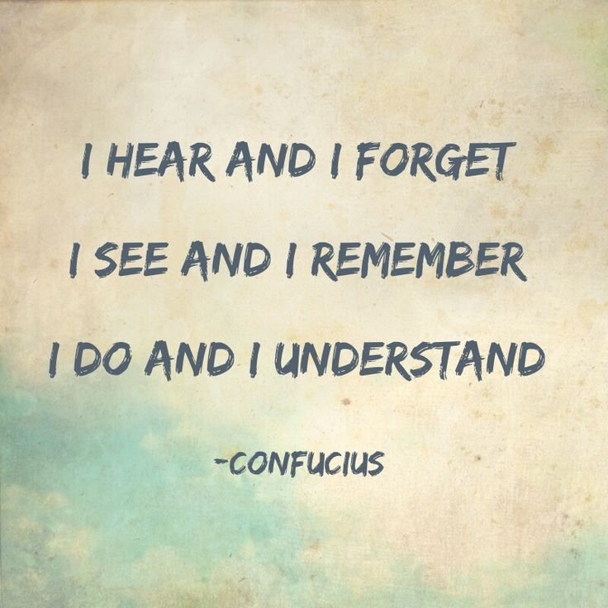
Thank you for your attention!

