Slide 1


Digital Rights & Responsibilities
Leading Organization: 1st Junior High School of Markopoulo, Greece
Digital Rights, Responsibilities and Digital Health
9-15 February 2025
Panagiotis panantoniou Philip skiadas thomas theodoropoulos
Notes:
(Panagiotis)

Slide 2
Digital Rights & Responsibilities
DO YOU KNOW YOUR DIGITAL RIGHTS?
If not, then let’s see them together!
Notes:
(Philip)

Slide 3
DIGITAL RIGHTS
Every human has the right to:
protect his online data
speak freely online
access information on the internet
have his original works protected
digital inclusion (equal access to the Internet and digital services regardless of location, income, etc)
Notes:
(Thomas)
People have the right to protection from digital threats like hacking, identity theft, and cybercrime. This includes the right to secure digital transactions and communications.
People have the right to express themselves freely online, whether through social media, blogs, or other digital platforms, as long as it doesn’t harm others (e.g., hate speech, defamation).
Everyone should have access to the internet and digital information. This includes freedom from censorship and barriers that could prevent access to knowledge or communication.
4. Freestyle
5. Digital content and tools must be accessible to people with disabilities, ensuring that everyone, regardless of ability, can navigate and use the digital world effectively.

Slide 4

How to protect digital rights
Limit data sharing
Use a password like: V8r$zL9pQ3
Use antivirus software
In a website look for “http”
Notes:
(Philip)

Slide 5
DIGITAL RESPONSIBILITIES
Privacy and Security
Respect and Empathy
Digital Footprint
Copyright and Intellectual Property
Digital Literacy
Notes:
(Thomas)
Privacy and Security: Safeguarding personal information and respecting the privacy of others. This involves being cautious about sharing sensitive data and understanding how your data is being collected and used.
Respect and Empathy: Treating others with respect online, avoiding harmful behavior such as cyberbullying, trolling, or spreading misinformation.
(Philip)
Digital Footprint: Being aware that everything you post online can leave a permanent trace, affecting your reputation and possibly impacting others.
Copyright and Intellectual Property: Respecting the work of others, including not illegally downloading or sharing content, and acknowledging sources.
Digital Literacy: Developing the skills to critically analyze digital content, recognizing misinformation, and understanding how algorithms influence what we see online.

Slide 6

What to do & what not to do online
1. Use other people’s posts/work without their consent
2. Safeguard personal information and respect the privacy of others
3. Develop the skills to critically analyze digital content
4. Spread information that isn’t actually true
5. Engage in conversations with strangers
6. Have proper online etiquette (netiquette)
Notes:
(Panagiotis)
This is a quiz during which a person has to roll this dice and according to the number it rolls, he has to say whether that is a digital responsibility or not.

Slide 7

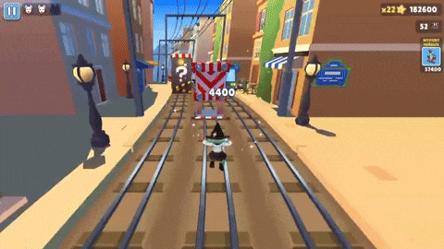
Thank you!
Philip skiadas
Panagiotis papantoniou
Thomas theodoropoulos

