Slide 1
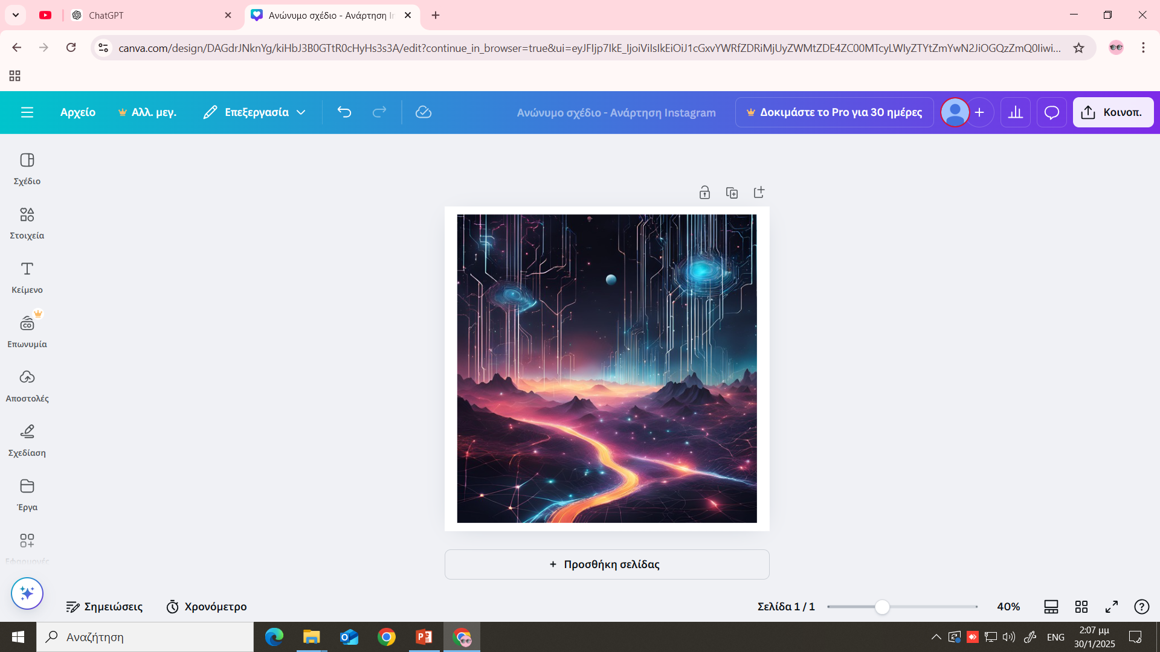

Digital rights and responsibilities
Leading Organization: 1st Junior High School of Markopoulo, Greece
Digital Rights, Responsibilities and Digital Health
9-15 February 2025
Irene Karra

Slide 2
Questions:
Do you use AI tools?
Why do you use AI tools, is it for your school projects or homework?
Do you find it easy to use, is it useful?

Slide 3
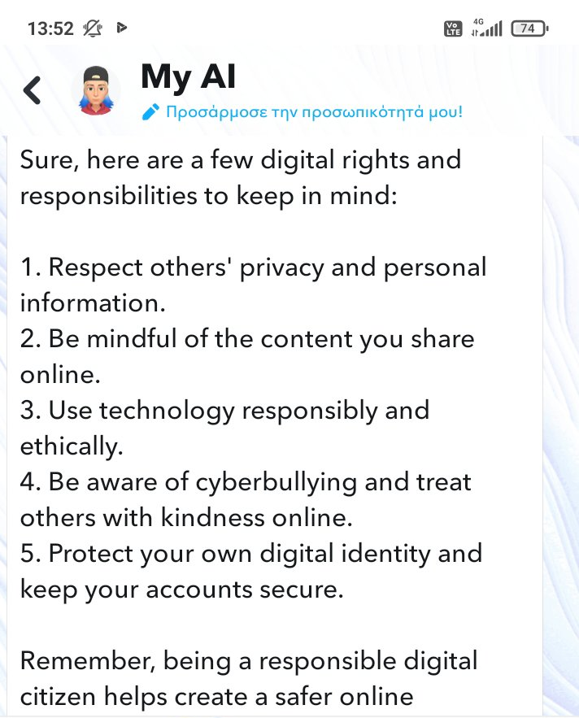
Can you send me some digital rights and responsibilities?
AI ANSWERS

Slide 4
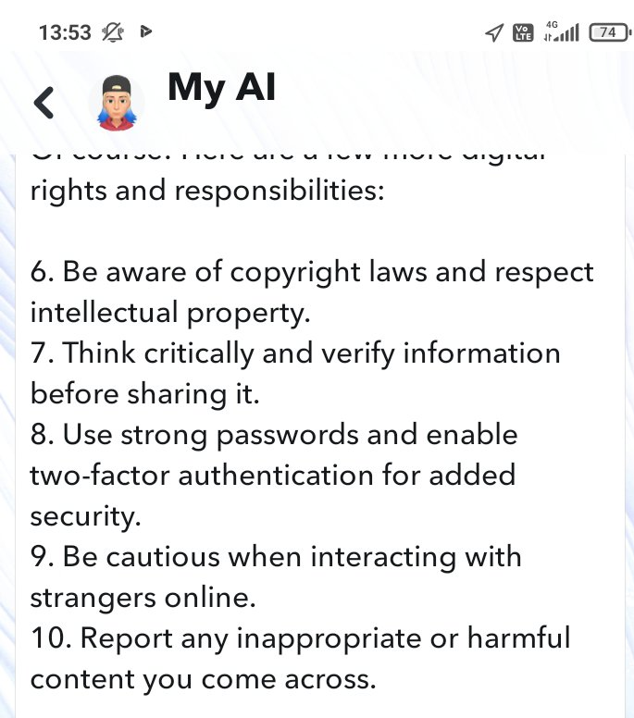
Can you send me some digital rights and responsibilities?
AI ANSWERS

Slide 5
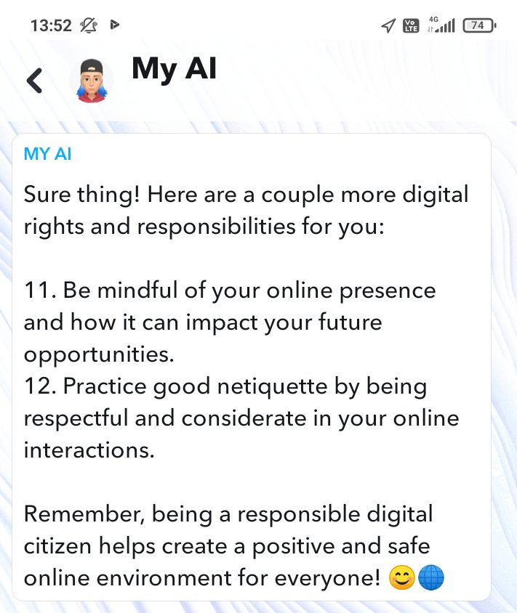
Can you send me some digital rights and responsibilities?
AI ANSWERS

Slide 6
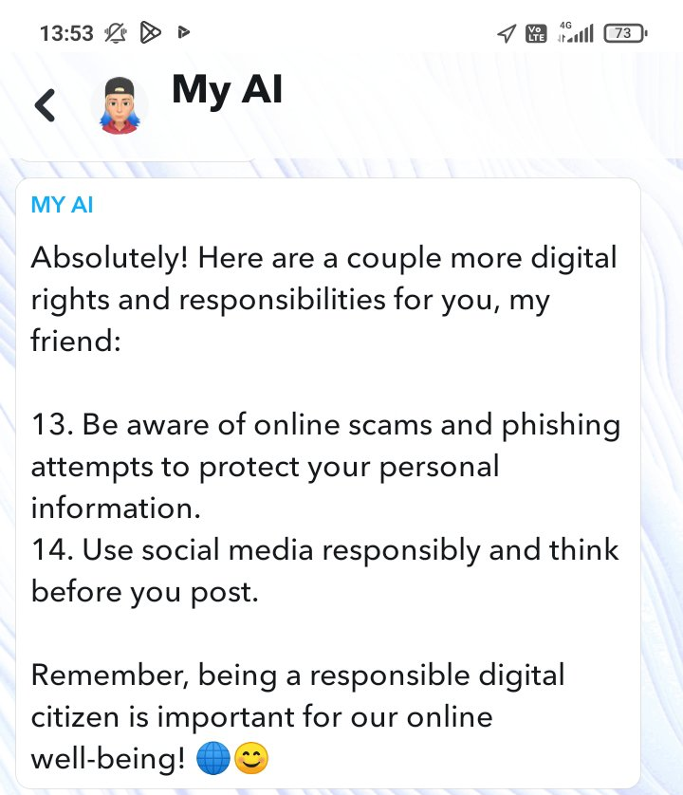
Can you send me some digital rights and responsibilities?
AI ANSWERS

Slide 7
Final thoughts about using ai tools….
AI ANSWERS
As you can see …
AI didn’t respond accurately …
We asked for digital rights and responsibilities but we only got an answer about digital responsibilities….

Slide 8
Thank you for your attention
Presenter names:
Irene Karra,
Ioli Gkakasouli,
Irene Giannaki

