Slide 1

MY DIGITAL RIGHTS AND RESPONSIBILITIES
-By Mary, Vasw, Kelly, Irene
Leading Organization: 1st Junior High School of Markopoulo, Greece
Digital Rights, Responsibilities and Digital Health
9-15 February 2025

Slide 2
WHAT ARE MY DIGITAL RIGHTS?
WHICH ONE IS THE FALSE ONE?
MY RIGHT TO PRIVACY
MY RIGHT TO SPREAD INFORMATION
MY RIGHT TO BE SAFE ONLINE
MY RIGHT TO FREELY EXPRESS MYSELF
MY RIGHT TO ACCESS INFORMATION
MY RIGHT TO HAVE DIGITAL ACCESS
WRONG ONE: MY RIGHT TO SPREAD INFORMATION
BECAUSE: WE DO HAVE THE RIGHT TO SPREAD INFORMATION AS LONG AS THEY ARE NOT FROM AN UNFAITHFULL SOURCE AND SPREAD MISINFORMATION

Slide 3
WHAT ARE MY DIGITAL RIGHTS?
MY RIGHT TO PRIVACY: CONTROL HOW MY PERSONAL INFORMATION IS COLLECTED, USED AND SHARED ONLINE
MY RIGHT TO BE SAFE ONLINE: FREE FROM CYBERBULLING, HARASSMENT AND ONLINE THREATS

Slide 4
WHAT ARE MY DIGITAL RIGHTS?
MY RIGHT TO FREELY EXPRESS MYSELF: EXPRESSING MY OPINIONS AND IDEAS ONLINE WITHOUT FEAR
MY RIGHT TO ACCESS INFORMATION: THE ABILITY TO ACCESS, SHARE AND EDUCATE YOURSELF THROUGH INFORMATION ONLINE, WITHOUT VIOLATING ANY LAWS OR HARM OTHERS
MY RIGHT TO HAVE DIGITAL ACCESS: THE ABILITY TO ACCESS AND USE THE INTERNET AND DIGITAL TECHNOLOGIES WITHOUT BARRIERS

Slide 5
What Would You Do?
You find a USB drive on the ground—do you plug it into your computer or report it?
I would report it
I would keep it and plug it into my computer

Slide 6
What Would You Do?
Your social media account is acting up and something is suspicious
Ignore it
Change your passwords
Enable two-factor authentication for better security.

Slide 7
What Would You Do?
A teenager is being bullied by classmates in an online group chat, with offensive messages and threats being shared.
Send them offensive messages as well
Don’t do anything since it doesn’t concern me
Help the teen reach out to a trusted adult if they are feeling unsafe.

Slide 8
WHAT WOULD YOU DO?
A social media company asks you to share your personal data for a better experience. Do you agree or decline?
1. I would agree as long as I know that this site/social media is trustful
2. I would decline in order to protect my personal data
3. I would agree no matter what this site/social media is

Slide 9
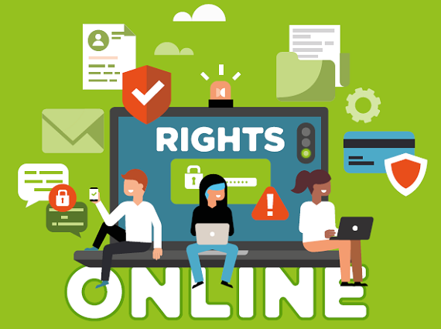
Thanks for watching

