Slide 1

DIGITAL RIGHTS AND RESPONSIBILITIES
Leading Organization: 1st Junior High School of Markopoulo, Greece
Digital Rights, Responsibilities and Digital Health
9-15 February 2025
GKAGKASOULI IOLI, ELSAMANI MAE

Slide 2
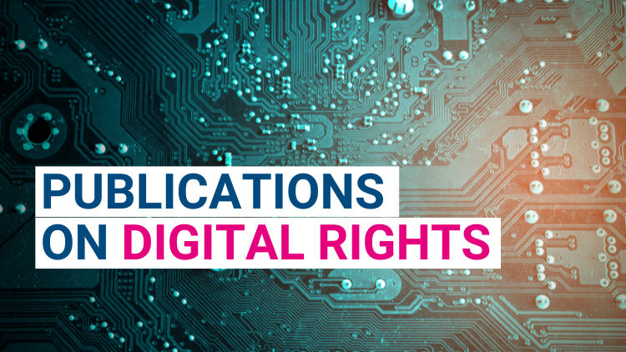
DIGITAL RIGHTS
To post a video or a photo
To communicate online with others
To play video games
To listen to free music
To search for information
To express my opinion

Slide 3
DIGITAL RESPONSIBILITIES
Being mindful of the impact your posts and shares can have on others. Avoid spreading misinformation, and always think before sharing potentially harmful or divisive content.
To keep my privacy and respect the privacy of others
To choose my followers
To approve others’ opinions for my videos
To protect personal information
To use strong passwords
To be mindful of what I share online
To take steps to secure my devices from cyber threats
(Regularly updating software, avoiding suspicious emails, and using antivirus programs are key practices)

Slide 4

DIGITAL RESPONSIBILITIES
Being mindful of the impact your posts and shares can have on others. Avoid spreading misinformation, and always think before sharing potentially harmful or divisive content.
To be respectful and considerate in digital communication. This includes using appropriate language, to respond promptly, and not engaging in harmful online behavior like cyberbullying or trolling.
To respect copyright laws and not pirating content, while also crediting the creators of digital media (e.g., photos, music, articles).
To consider the energy consumption and environmental impact of digital technologies, such as the carbon footprint associated with cloud computing and data centers.
To develop an understanding of how digital tools work and how they impact society, as well as knowing how to critically assess digital content and sources.

Slide 5
RAISE YOUR HAND IF YOU AGREE;
Do you read the terms and conditions when you download an application?
Have you ever made a fake account?
Have you ever used firewall in your computer?
Should organizations be legally required to report data breaches or security issues that put users' personal information at risk?

Slide 6
RAISE YOUR HAND IF YOU AGREE;
Should companies be legally obligated to protect user data from breaches?
Should governments have access to personal data to prevent crime?
Should social media platforms censor hate speech?
Is there a limit to free speech online when it comes to spreading misinformation?

Slide 7
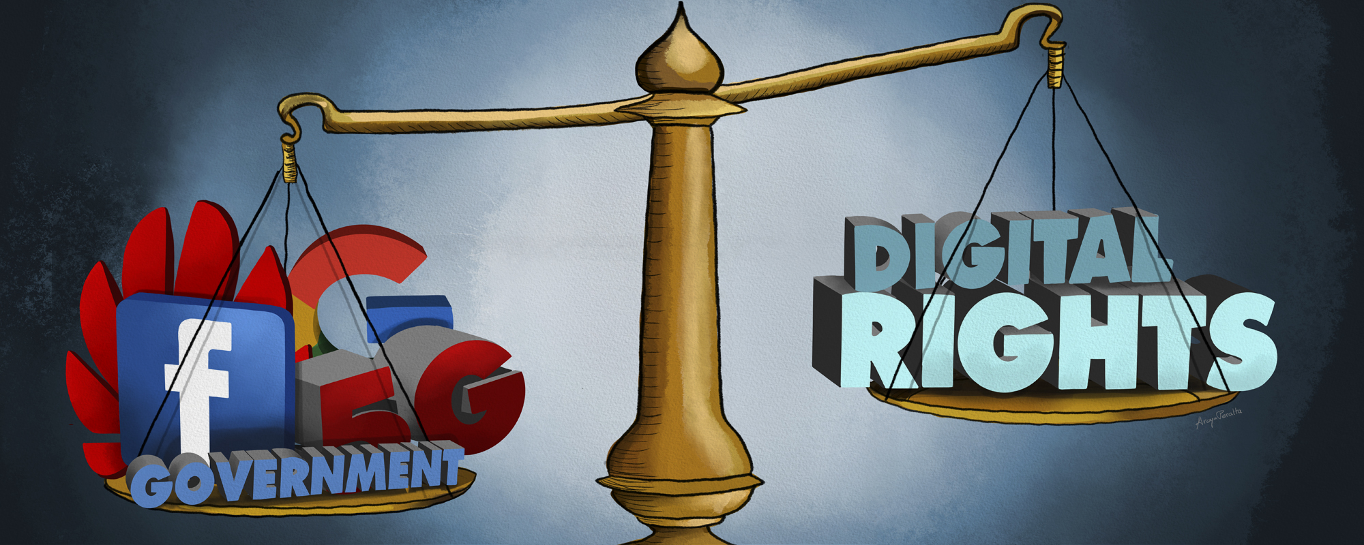

Slide 8
Thank you for watching!!!

