Slide 1
The Shambles York, Britain
ΧΡΙΣΤΙΝΑ ΚΥΡΑΝΟΥ

Slide 2
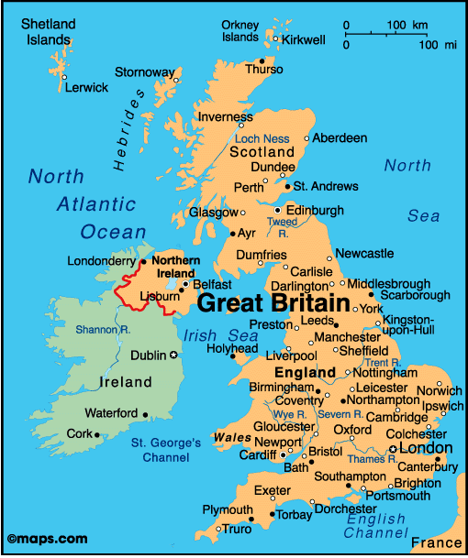

Slide 3
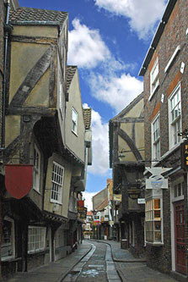
The Shambles York’s oldest street Europe’s best preserved medieval street

Slide 4
The word Shambles originates from the Medieval word Shamel, which means bench. It was a street of butchers’ shops and houses.

Slide 5
In 1872 there were 26 butchers on the street. Livestock was also slaughtered on the Shambles, meat served over what are now the shop window bottoms, the Shamels.

Slide 6
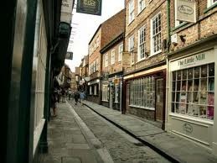
The pavements on either side of the street are raised up to create a channel where butchers would wash their waste through.

Slide 7
Narrow, cobbled street lined with wooden-framed buildings, some 600 years old (since 14th century).

Slide 8
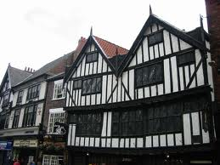
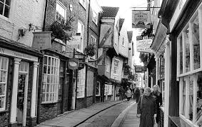
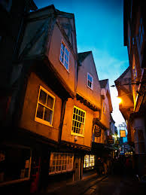
Wooden-framed buildings

Slide 9
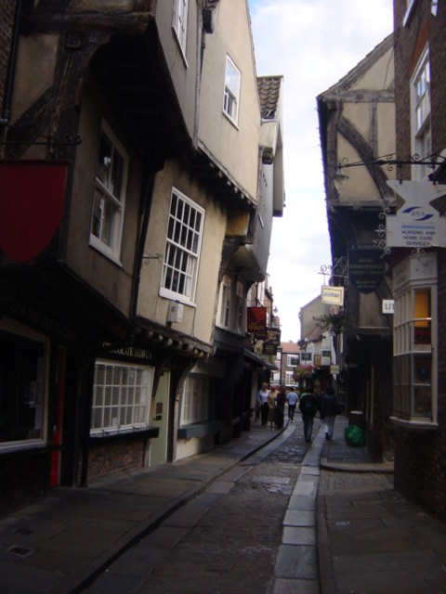
They lean together in the middle with roofs that are so close they almost touch.

Slide 10
The Shambles won the award for Britain’s Most Picturesque Street 2010 in the Google Street view awards.

Slide 11
It is one of UK’s most visited streets and has a variety of shopping, tourist attractions, restaurants and many other things to see and do like tours, ghost walks, historic talks.

Slide 12
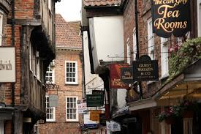
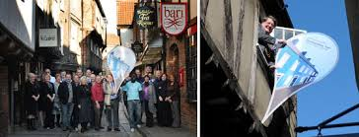

Slide 13
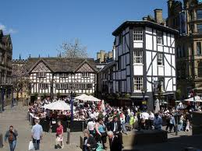

Slide 14
The End

