Slide 1
BOTTICELLI & RAPHAEL
SIMILARITIES & DIFFERENCES
Καρυδάκη Νάντια
Μάρκου Ιωάννα
Καλλέργη Κατερίνα
Λιουδακη Νίκη

Slide 2
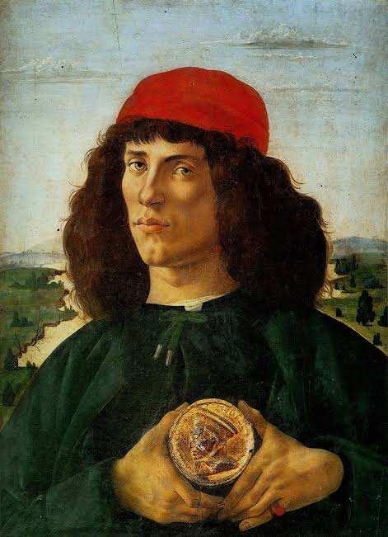
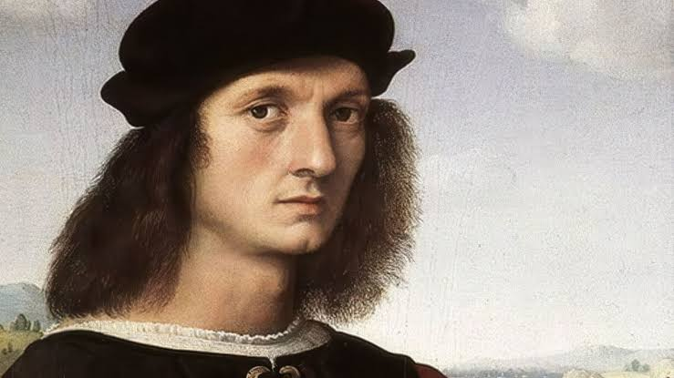
Botticelli Raphael
Sandro Botticelli and Raphael were both prominent Italian Renaissance painters,yet they belonged to different phases of the period exhibited distinct artistic styles.

Slide 3
Similarities
Subject Matter: Both artists explored religious and mythological themes in their works. Botticelli ΄ s “The Birth of Venus” and Raphael ΄s “The School of Athens” exemplify their engagement with classical subjects
Influence on Later Art: Their artworks have inspired subsequent generations. For instance, Botticelli ΄s depiction of the Three Graces influenced many artists, including Raphael,who incorporated similr figures in his works.

Slide 4
Differences
Artistic Periods: Botticelli was a key figure of the Early Renaissance, focusing on linear grace and decorative detail.In contrast, Raphael was a leading artist of the High Renaissance emphasizing balanced composition and anatomical accuracy.
Style and Technique: Botticelli ΄ s paintings often feature ethereal figures with flowing lines,creating a sence of movement and elegance.Raphael ΄s works are characterized by harmonious composition and realistic representation of human figures, reflecting the High Renaissance ideals of balance and proportion.
Use of Space and Perspective: Raphael emloyed linear perspective to create depth and three-dimensionality in his paintings, as seen in “The School of Athens”.Botticelli ΄s compositions, while intricate,often present figures in a more flattened space, focusing on decorative elements.

Slide 5
In summary, while Botticelli and Raphael shared common thematic interests,their artistic approaches and techniques reflect the evolving styles of the Renaissance period in which they worked.

Slide 6
THANK YOU FOR YOUR ATTENTION

