Slide 1
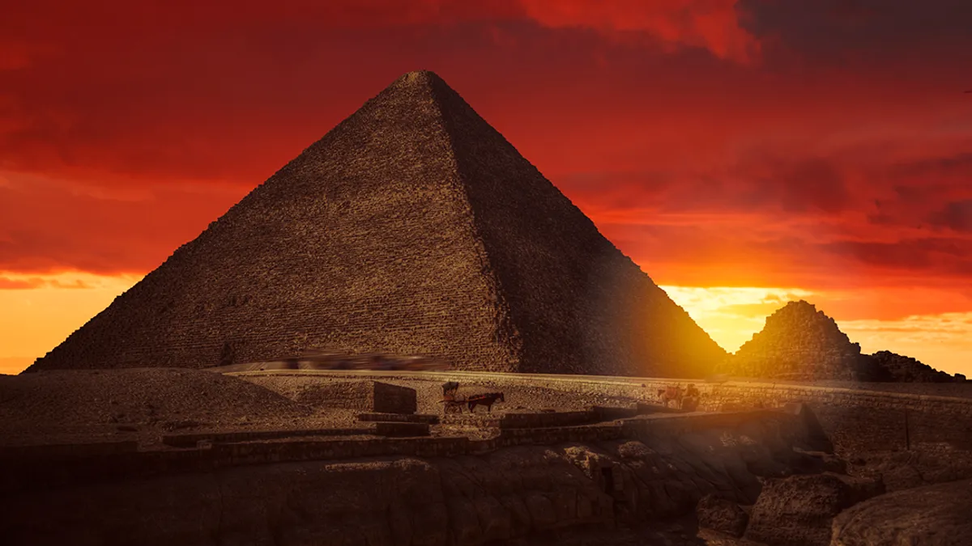
The Great Pyramind
By Alexia Mitilinaiou and Eftychia Maragoudaki
Class : Γ’2

Slide 2
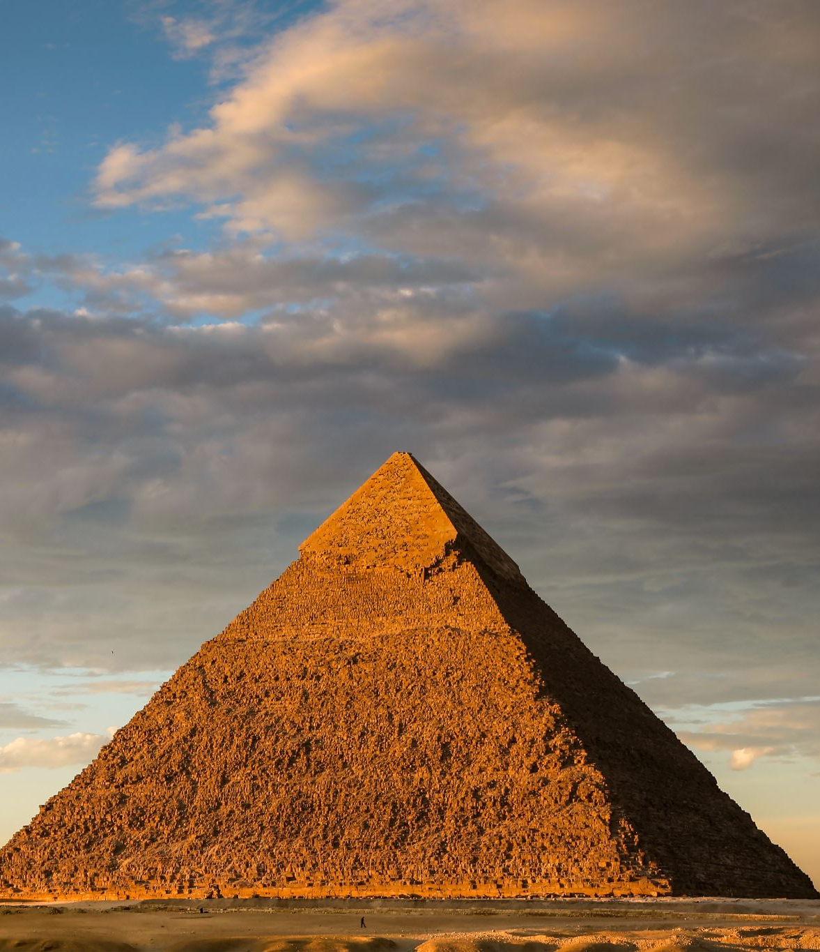
When and by whom the great pyramid was made and built?
Pharaoh Khufu was the first Egyptian king to build a pyramid in Giza, a project he began in circa 2550 B.C. His Great Pyramid is the largest in Giza and originally towered some 481 feet (147 meters) above the plateau—it's a bit shorter now with its smooth casing stones long gone.

Slide 3
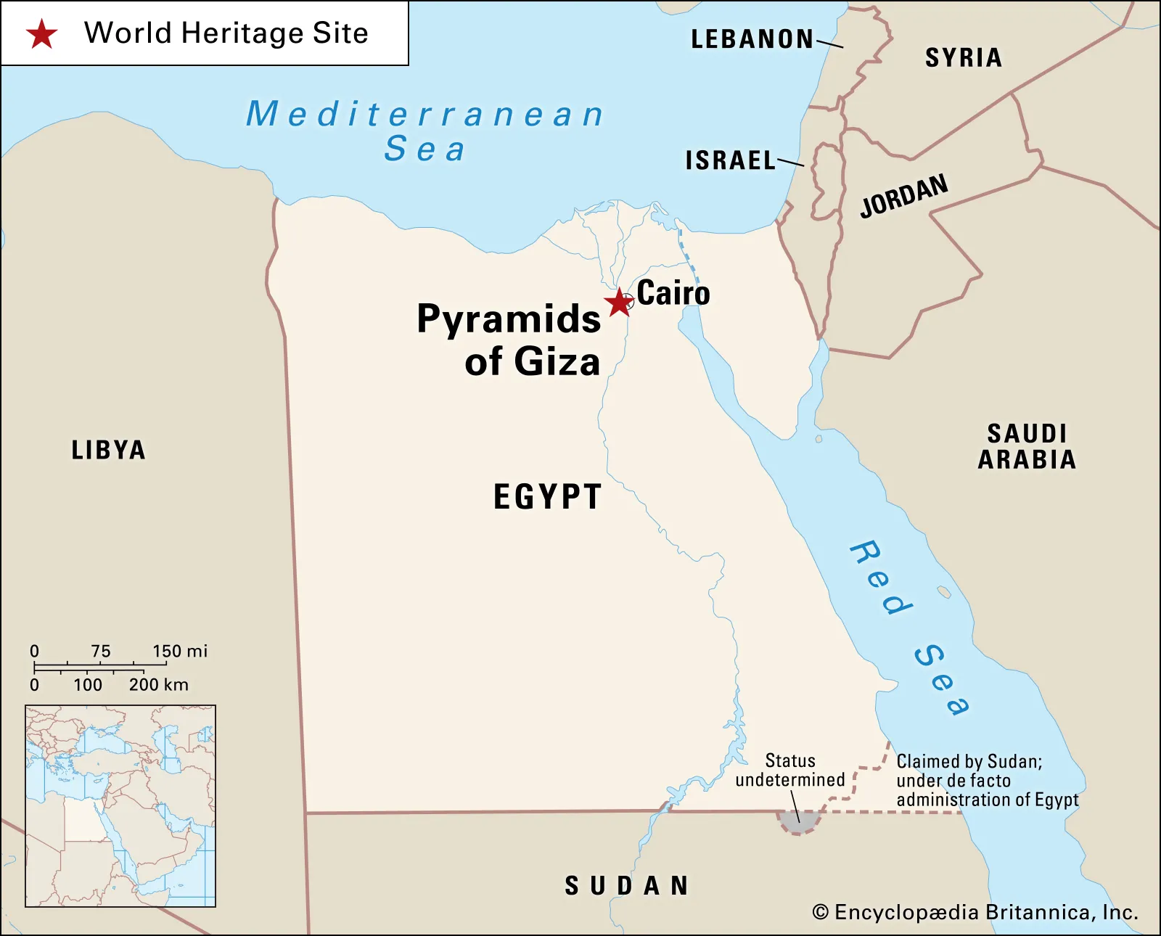
Where it was found??
Pyramids of Giza, three 4th-dynasty (c. 2575–c. 2465 BCE) pyramids erected on a rocky plateau on the west bank of the Nile River near Al-Jīzah (Giza) in northern Egypt. In ancient times they were included among the Seven Wonders of the World.

Slide 4
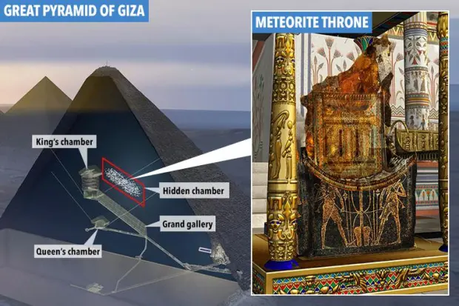
The Inside of The Great Pyramid
Like its neighbors, the Great Pyramid has very little open space inside its hulking mass. Napoleon would have reached the King's Chamber through a very tight ascending passageway, past the Queen's Chamber (a misnomer), and then through a taller corbelled passageway called the Grand Gallery. And also, there are three known chambers inside of the Great Pyramid. The lowest was cut into the bedrock, upon which the pyramid was built, but remained unfinished. The so-called Queen's Chamber and King's Chamber, which contain a granite sarcophagus, are above ground, within the pyramid structure.

Slide 5

Who discovered The Great Pyramid ?
So as archeologistis have reported that The Great Pyramid has three parts that you can see throughout the presentation .As a result , The Great Pyramid was discovered from different people in each of its part. Georg Steindorff of Germany (Hildesheim) received the middle section and the Khafre Pyramid, along with the area behind the Sphinx known as the Central Field. Italian Ernesto Schiaparelli (Turin) received the southernmost section, the Khufu Pyramid and the Eastern Cemetery .And maybe a few more .

Slide 6
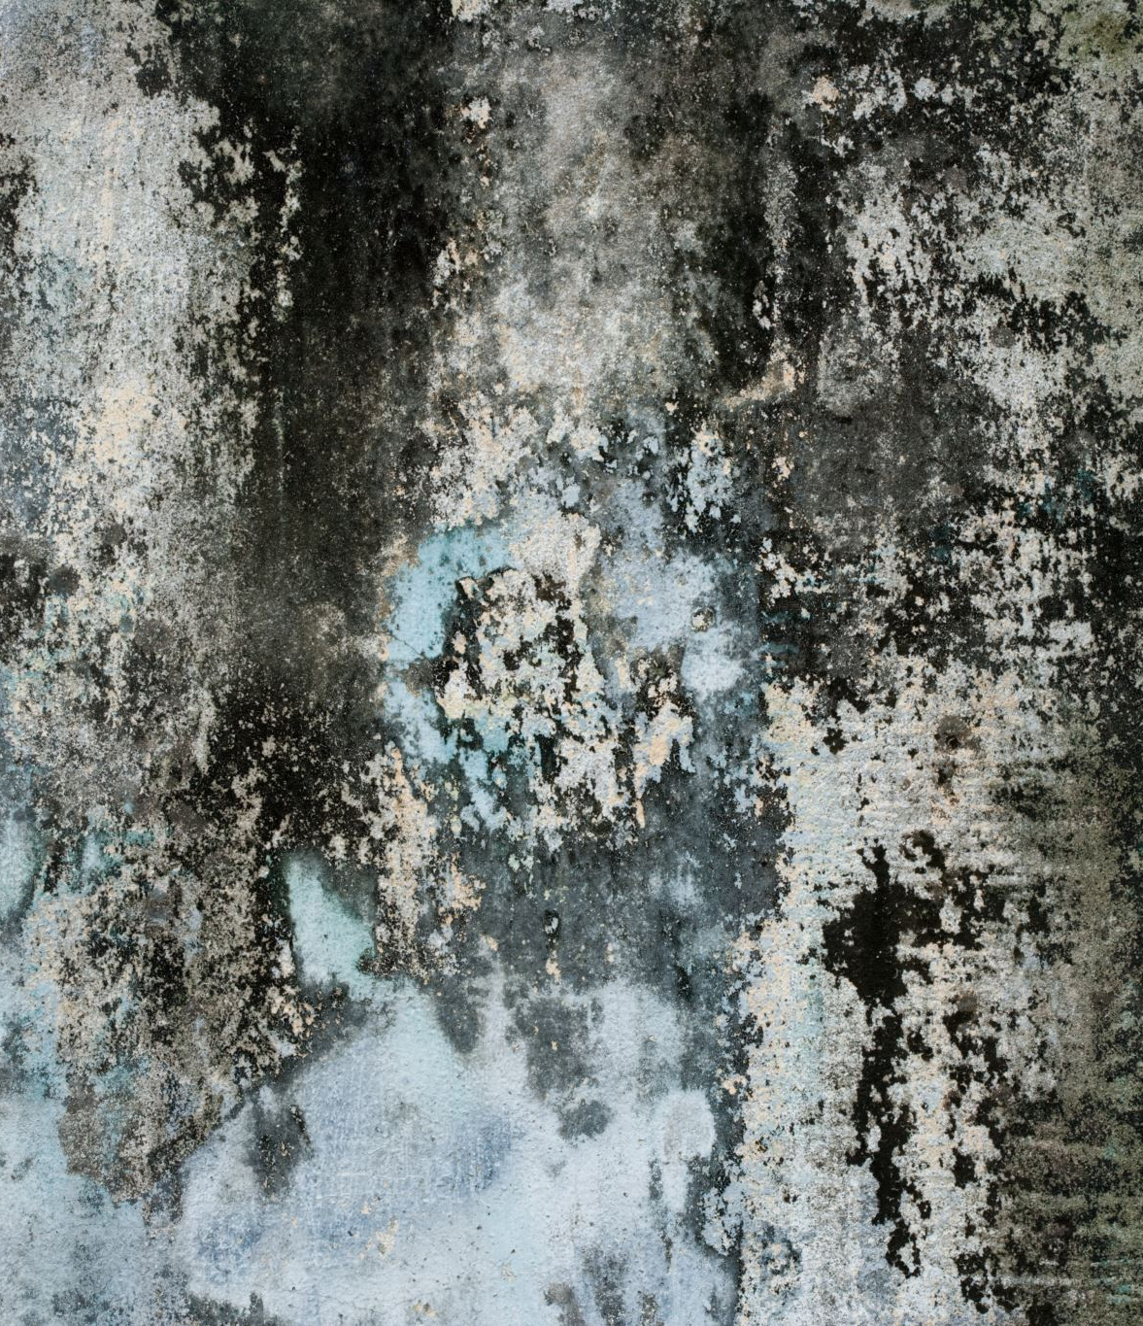
What materials were used to built The Great Pyramid?
The pyramids were built of limestone, granite, basalt, gypsum (mortar), and baked mud bricks. Limestone blocks were quarried at Giza and possibly other sites. Granite likely came from upriver at Aswan. Alabaster came from Luxor and basalt from the Fayoum depression. Around 5.5 million tonnes of limestone, 8,000 tonnes of granite (transported from Aswan, 800km away), and 500,000 tonnes of mortar were used to build the Great Pyramid. This mighty stone formed part of an outer layer of fine white limestone that would have made the sides completely smooth. This as we all can see is a very high number of material and especially limestone and other significant materials tha help the grata pyramid being built.

Slide 7
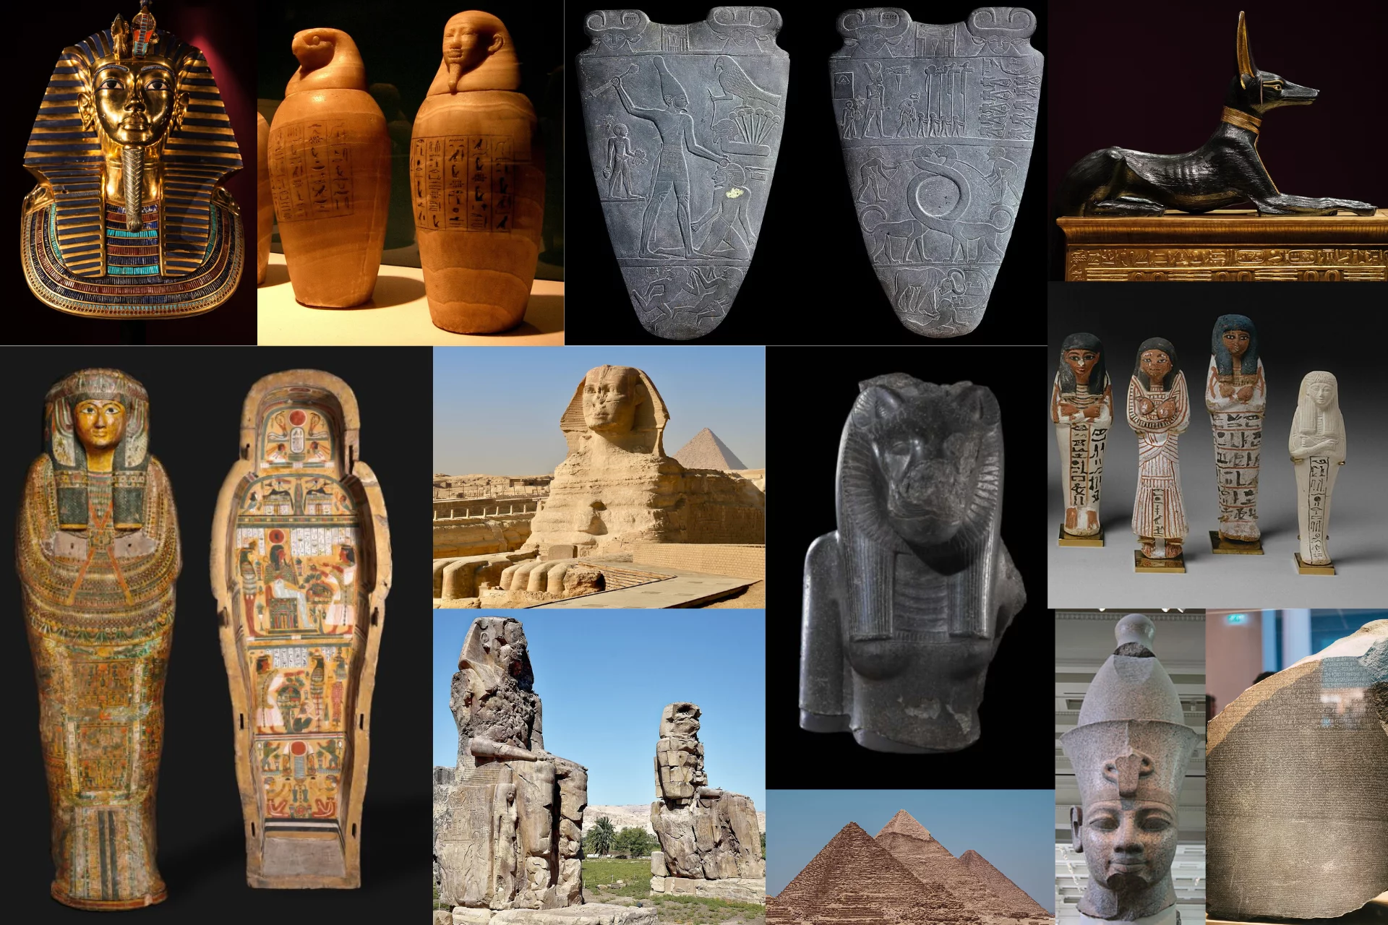
Which were the most significant artifacts found inside The Great Pyramid??
The Dixon Relics
Named after Waynman Dixon, a 19th-century British explorer (not an archaeologist), the Dixon Relics is a set of three artifacts. Dixon found them in 1872 in the shafts of the Queen’s Chamber of the original Great Pyramid (Khufu’s pyramid). At the time of discovery, the artifacts were thought to be unrelated, but more research and study have proven otherwise. The artifacts are a hook, a granite ball, and a short rod, possibly made of cedar. Dixon and his partner, Dr. James Grant, brought the artifacts back to Britain. Dixon’s Relics disappeared for a century until another researcher found that the artifacts were passed down through the family. In 1972, the Dixon Relics were given to the British Museum by his family, where they disappeared again until 1993. One artifact has remained missing: the rod.

Slide 8
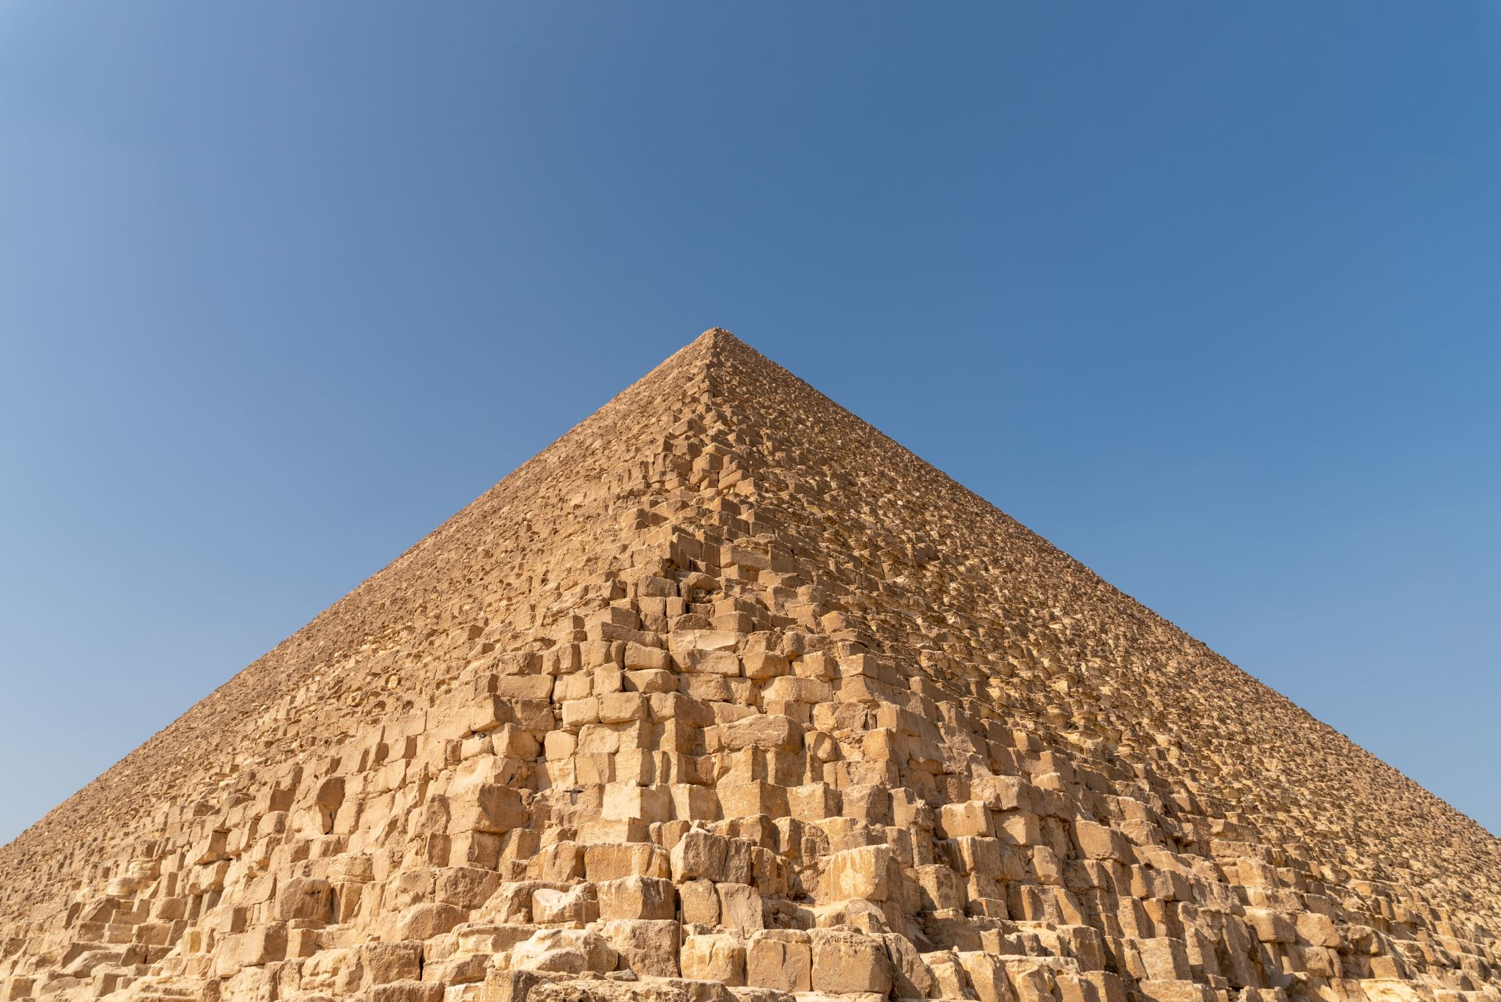
More significant artifacts inside The Great Pyramid
Khufu’s sarcophagus in 1904:
The largest and oldest pyramid in the Great Pyramids of Giza is Khufu’s, a pharaoh in the 26th century BC. His sarcophagus was found in the exact central axis of the pyramid. However, his mummy was not inside of it. The Great Pyramid was looted, likely hundreds of years ago, despite the entrance to the burial chamber being filled with limestone to discourage looting. Instead, archaeologists or explorers did find his empty sarcophagus (which would have contained a smaller sarcophagus with his mummy and treasures). The sarcophagus is made of red granite and is damaged from where looters likely broke the top to get the artifacts and the mummy out.
Although nothing was actually ,found in the sarcophagus, the artifact is proof of the way that Khufu was buried, and how the burial chamber was meant to be hidden. However, it is also a testament to the will of the looters, who were able to find the burial chamber and still loot the pyramid and many of the artifacts.

Slide 9
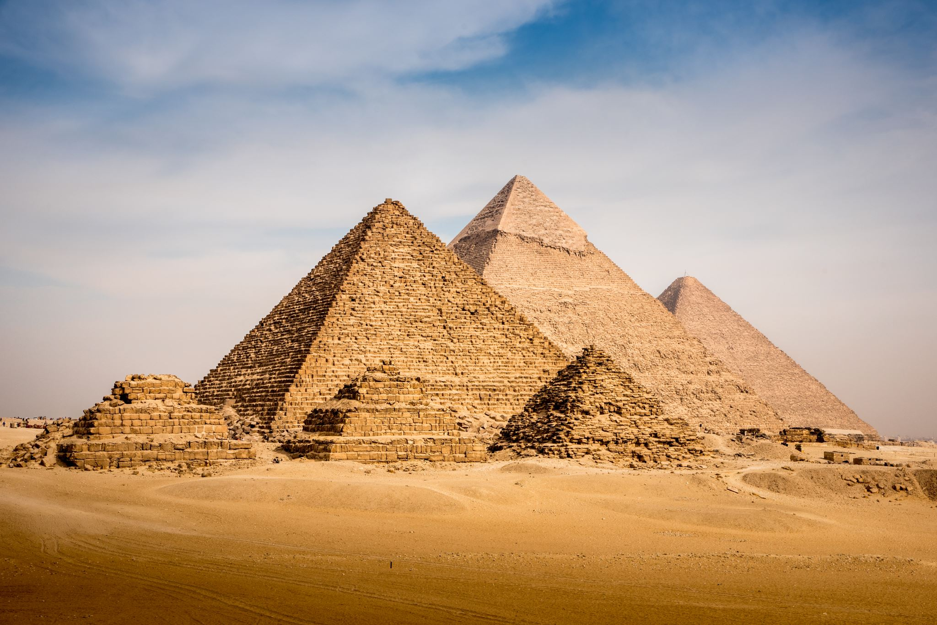
Other significant artifact:
Menkaure’s Triad Statue:
There were many triad statues believed to be in Menkaure’s pyramid (the smallest pyramid of the three). One of these triad statues is considered a great artifact: the triad of Menkaure, the goddess Hathor, and the personified nome (a geographic area, in this case, it is the area that Menkaure rules). George Andrew Reisner found the statue, among many others, in his excavation of Menkaure’s funerary complex in 1908. The statue is made of greywacke, a variety of sandstone. The statue, although somewhat typical for Ancient Egyptian statues, is incredibly important, as it reinforces the Ancient Egyptian art style. For one, the triad or idea of items in three is very prevalent in Ancient Egyptian culture (more information can be found on this here). Beyond that, though, the statue also shows the power of the king, especially associated with the goddess Hathor. One interesting point to note, though, is that this is the only triad statue found in Menkaure’s pyramid where the pharaoh is not in the middle, Hathor is. Even still, the statue is evidence in the depiction of pharaohs as equal to deities in their power.

Slide 10
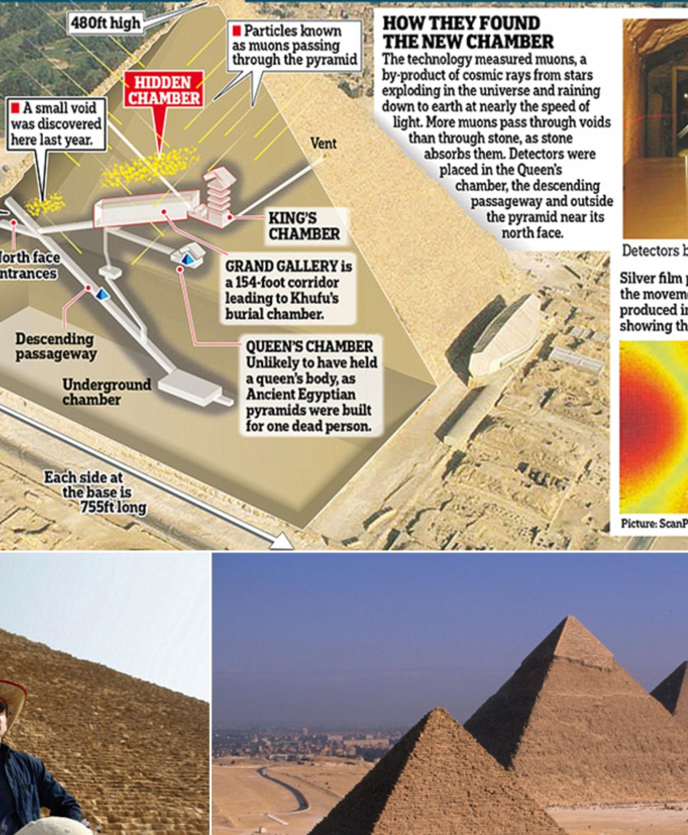
So……Who lived there? You might ask and here is the answer:
No, people did not live inside the Great Pyramids of Egypt. The pyramids were monumental tombs built for the pharaohs and other high-ranking individuals in ancient Egypt. They were primarily used as burial places and served as the final resting spots for the deceased rulers. Another thing to say is that The Pyramids of Giza, like the Egyptian pyramids that came before and after them, were royal tombs, a final resting place for their pharaohs, or kings. They were often part of an extensive funerary complex that included queens' burial sites and mortuary temples for daily offerings.

Slide 11
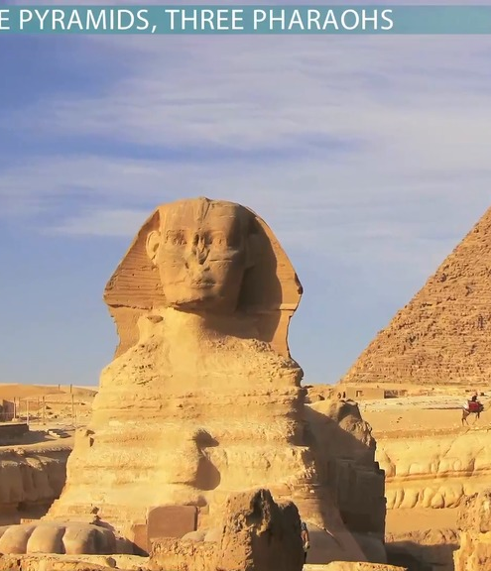
But what was its used for :
Historians believe the primary role of the Great Pyramid of Giza was to act as a tomb for the great Egyptian King Khufu. Egyptians believed that their pharaohs would go on to become gods in the afterlife, but in order to prepare for a safe transition into the next world, they had to have the right burial chamber. And also , The pyramids reflected the power of the pharaoh and were an important religious symbol. The pyramids of Giza were constructed to honor the pharaoh and to serve as his tomb after death. The pharaohs were seen as part God and part human, and it was believed that the pharaoh would move into the afterlife after death.

Slide 12

THE END OF THE PRESENTATION

