Slide 1
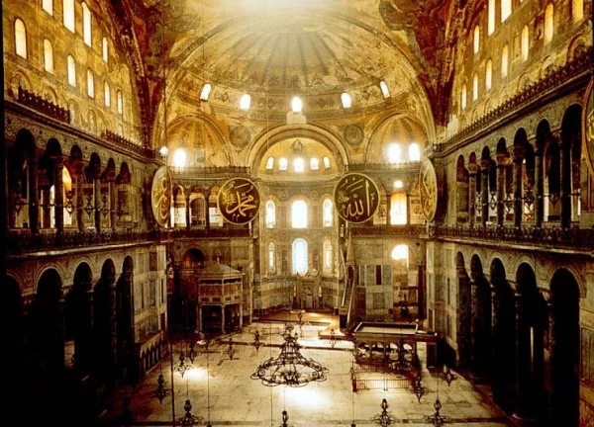
The history of The Church of Holy Wisdom
by: Markella Prodromou
Melina Hotzai

Slide 2
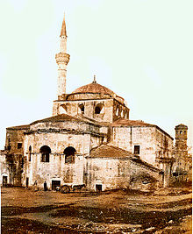
Hagia Sophia History
Unable to repair the damage caused by the fire, Justinian ordered the demolition of the Hagia Sophia in 532. He commissioned renowned architects Isidoros and Anthemios to build a new basilica.
The third Hagia Sophia was completed in 537, and it remains standing today.
At December 27, 537. Justinian is reported to have said, “My Lord, thank you for giving me the chance to create such a worshipping place.”

Slide 3
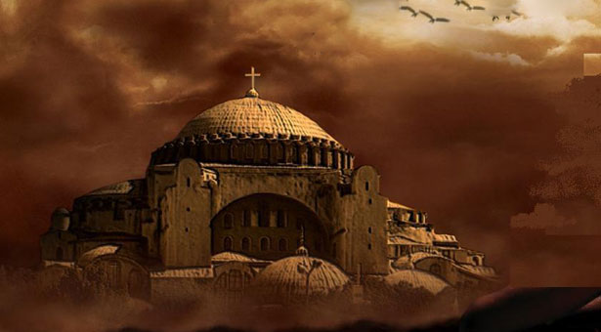
Hagia Sophia’s Tumultuous History
However, during the Crusades, the city of Constantinople, and by extension the Hagia Sophia, was under Roman control for a brief period in the 13th century. The Hagia Sophia was severely damaged during this period, but was repaired when the Byzantines once again took control of the surrounding city.

Slide 4
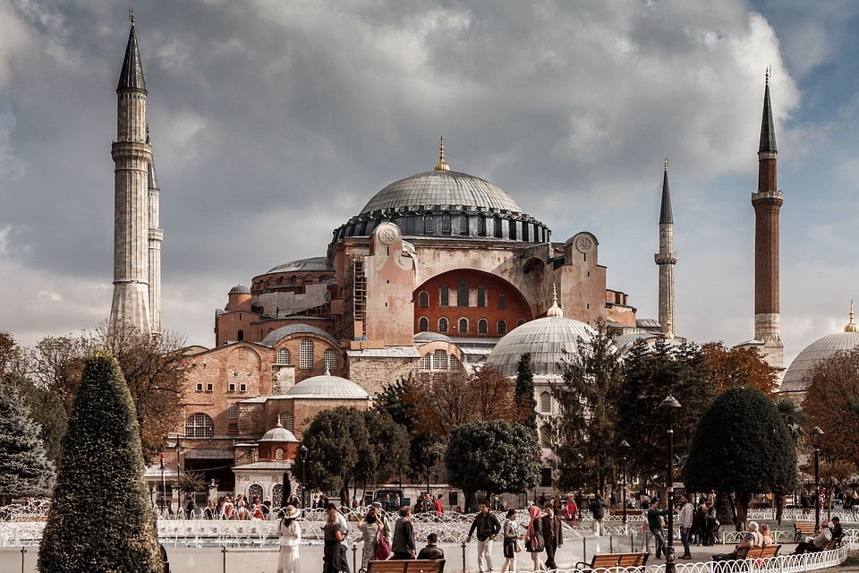
Hagia Sophia Today
The Hagia Sophia’s role in politics and religion remains a contentious one, even today—some 100 years after the fall of the Ottoman Empire.
Since 1935, nine years after the Republic of Turkey was established by Ataturk, the legendary structure has been operated as a museum by the national government, and it reportedly attracts more than three million visitors annually.

Slide 5
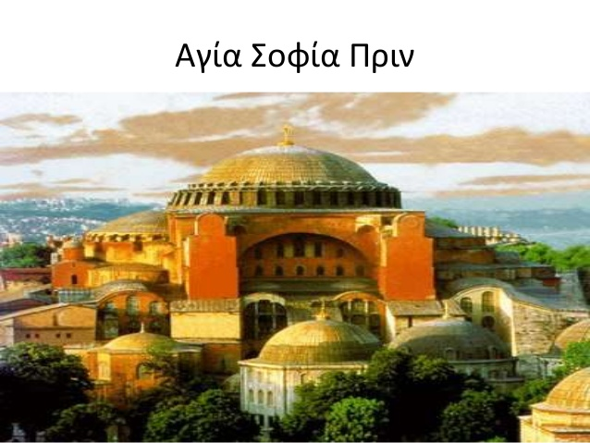
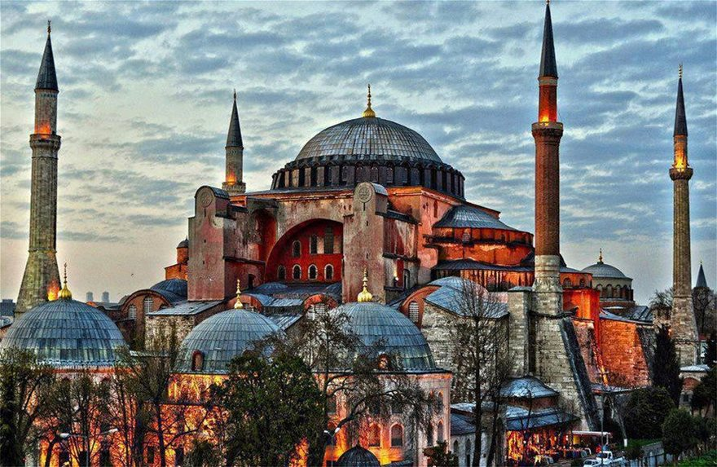
Hagia Sophia before and after

Slide 6
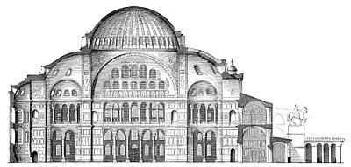
sources
www.history.com
slide share
greek national pride
www.arttravel.gr

