Slide 1
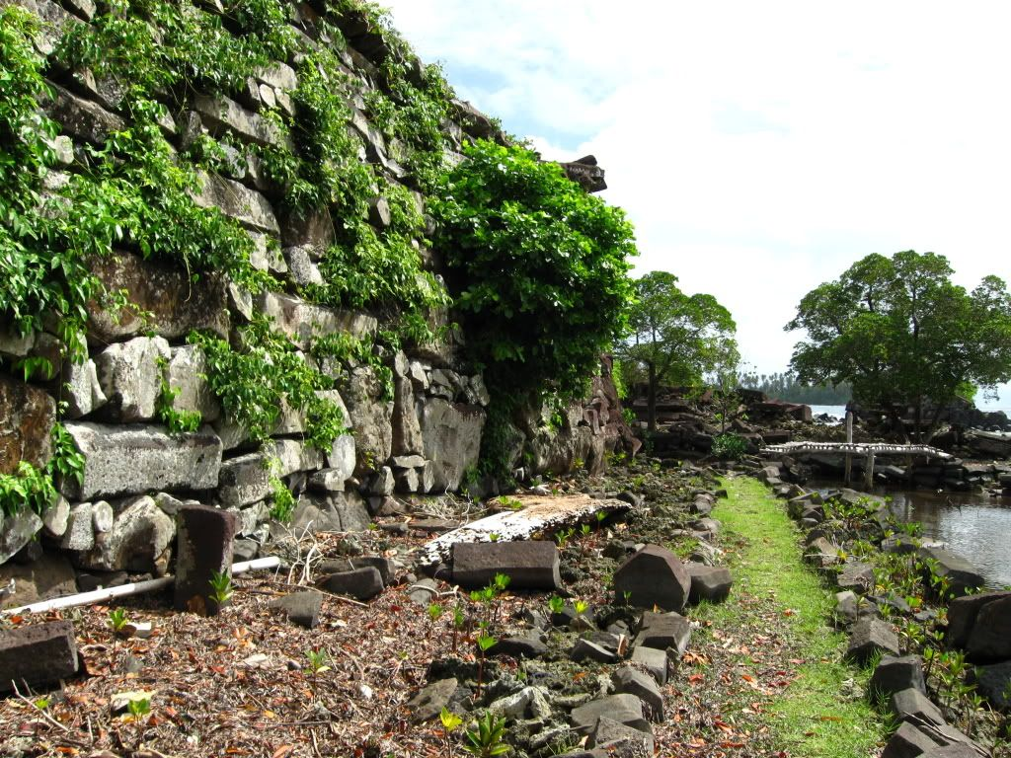
THE Hanging Gardens of Babylon
Made by: Efraimidou Katherine
Villioti Garifallia
Γ΄2 (2018-2019)

Slide 2
location
The Hanging Gardens of Babylon were located on the outer wall of Babylon , on the Eastern shore of the Euphrates River and just South of Baghdad, Iraq.
They were built about 2500 years ago in 600 BC
Today there is nothing left of the Hanging Gardens of Babylon, and they might have been purely legendary

Slide 3
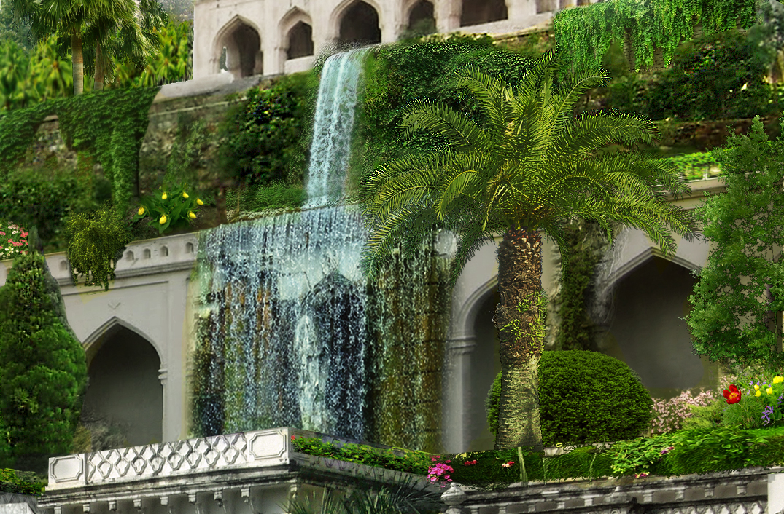
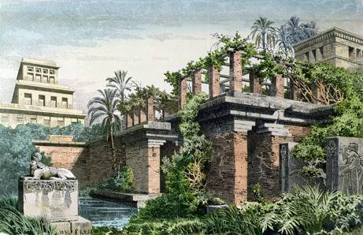

Slide 4
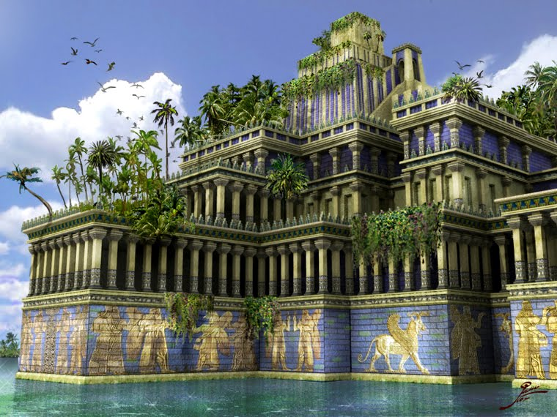
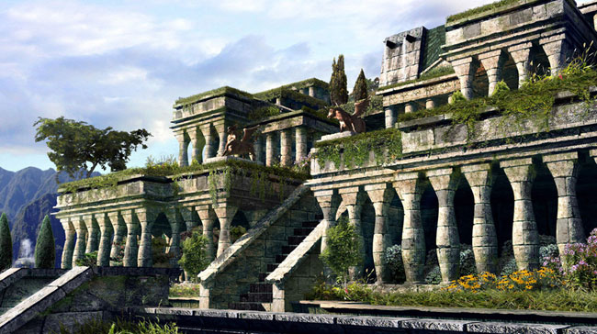

Slide 5
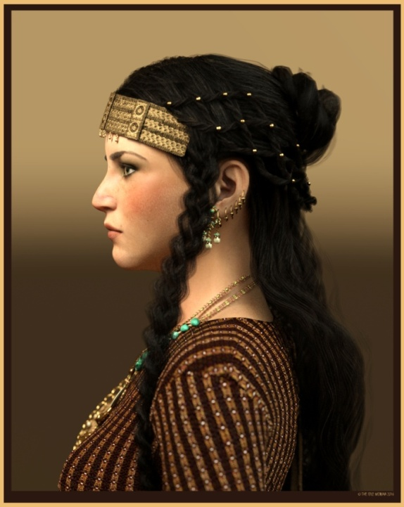
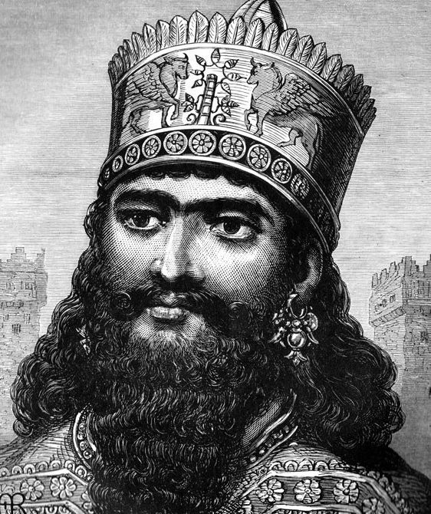
creation
BUILD BY:
Nebuchadnezzar II, the king of the Babylon Empire in 605 BC – 562 BC
PURPOSE:
Gift for his wife Amytis

Slide 6
The king’s wife, Amytis, came from Medes, a land that was green and mountainous; When she came to Babylon she was greatly depressed by the hot, flat terrain so the king created the gardens to cheer up

Slide 7
The Hanging Gardens of Babylon were sometimes referred to as the Hanging Gardens of Semiramis after the semi-legendary and semi-divine female Assyrian ruler thought by the Greeks to have extensively rebuilt Babylon in the 9th century BCE.

Slide 8
A Myth or a fact?
The Hanging Gardens are the only ones of the Seven Wonders of the ancient world that may not even have existed.
There is no documentation in Babylonian sources that the gardens ever existed.
There is also no solid archaeological evidence that they existed.
Several ancient Roman and Greek writers wrote about the gardens. They wrote about why they were built, how they were built, and the size of the gardens. They even described how the gardens were watered. They didn't all agree on why they were built or who they were built for, though.

Slide 9
There are many clay tablets that exist from the time period when the Hanging Gardens would have existed. None of these ancient tablets mention the Hanging Gardens.
Many believe that if the gardens did exist they would have been located south of Bagdad in Iraq.
Some historians and archaeologists believe that the gardens did exist and were destroyed by war and erosion. Some believe it was earthquakes that eventually devastated and destroyed the gardens.

Slide 10
The most popular theory is that the gardens were built by king Nebuchadnezzar II to make his wife happy. She was homesick for the plants and gardens of her homeland.
King Nebuchadnezzar II ruled Babylon from 605BC, for a period of 43 years. It was during this time that he is said to have had the Hanging Gardens built.
If the gardens actually existed, it would have taken 8,200 gallons of water each day to keep the plants watered. The gardens were thought to be about 75 feet high.
The water would have had to have been carried up or transported to the top of the gardens by a primitive water irrigation system.

Slide 11
In the ‘Hanging Gardens', the plants did not actually hang. They grew from many different levels of terraces (similar to balconies).
The word ‘hanging' comes from the Latin word ‘pensilis' or the translation of the Greek word ‘kremastos'. It actually means overhanging instead of just hanging.
Between 1899 and 1917 a German archaeologist Robert Koldewey may have unearthed the Hanging Gardens. What he unearthed resembled what Diordorus Siculus had described. In the bottom of the ‘hanging gardens' there were three strange holes in the floor that would have worked well for a chain pump irrigation system. This would have made it possible to irrigate the plants.

Slide 12
A Greek historian named Diordorus Siculus described the gardens as being 400 feet wide by 400 feet long. He also said that the walls were more than 80 feet high.
Recent excavations have found traces of aqueducts near Nineveh, which would have supported such a garden. Nineveh is 300 miles away from Babylon.

Slide 13
Thank you for your time Sources:
https://www.ancient.eu/Hanging_Gardens_of_Babylon/
http://shortsleeveandtieclub.com/the-myth-of-the-hanging-gardens-of-babylon/
http://www.softschools.com/facts/wonders_of_the_world/hanging_gardens_of_babylon_facts/67/
https://news.nationalgeographic.com/news/2013/13/130531-babylon-hanging-gardens-nineveh-seven-wonders/
https://slideplayer.com/slide/7409518/

