Slide 1
A foreign language dictionary project
www.musiclexis.com

Slide 2
An online dictionary for foreign language learners which is different from common dictionaries. All dictionaries offer sentence examples, but in MusicLexis the examples are taken from popular songs.

Slide 3
Why musical examples?
The musical examples both demonstrate how a lexical item is used and they can easily stick in the students’ minds, facilitating memorisation and learning of the new vocabulary
I
Notes:
The musical examples are usually taken from the refrains of popular songs, but they can also be sentences contained in the rest of the lyrics of a song.

Slide 4
Wikis for 10 languages:
English
French
German
Greek
Italian
Polish
Portuguese
Romanian
Spanish
Turkish

Slide 5
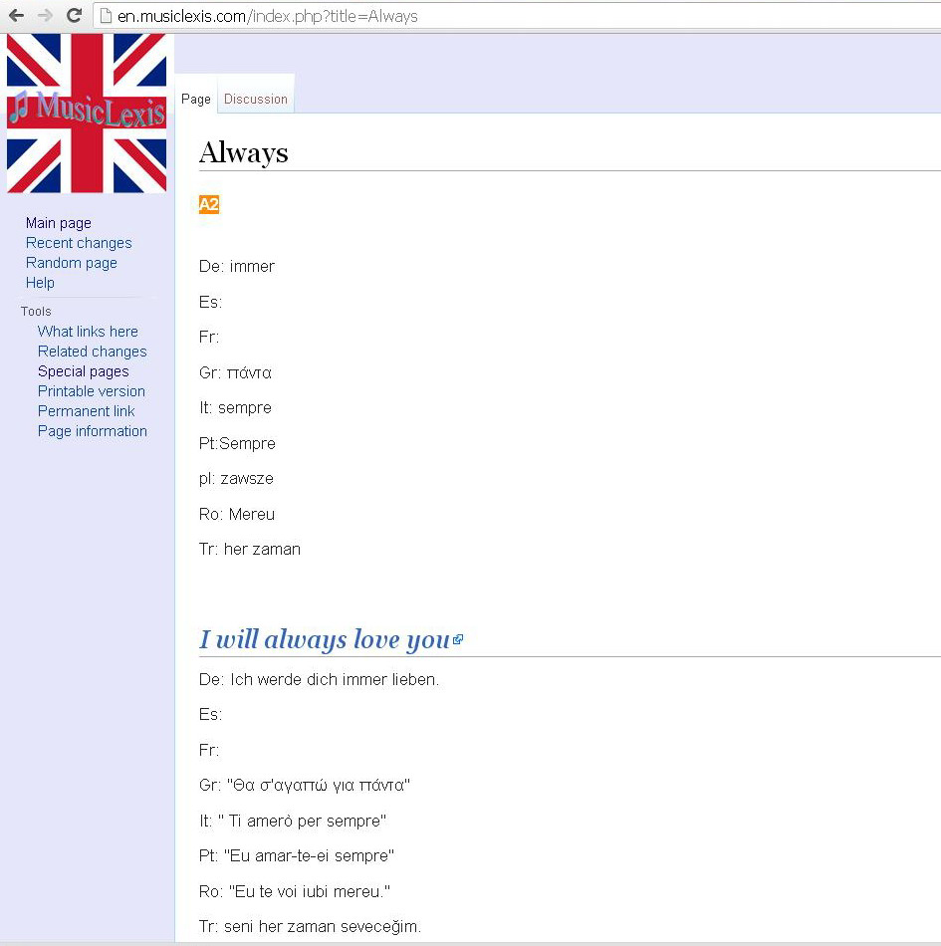
The basic features of the dictionary:
Translation of each lexical item into other languages
A musical example
Translation of the musical example into other languages

Slide 6
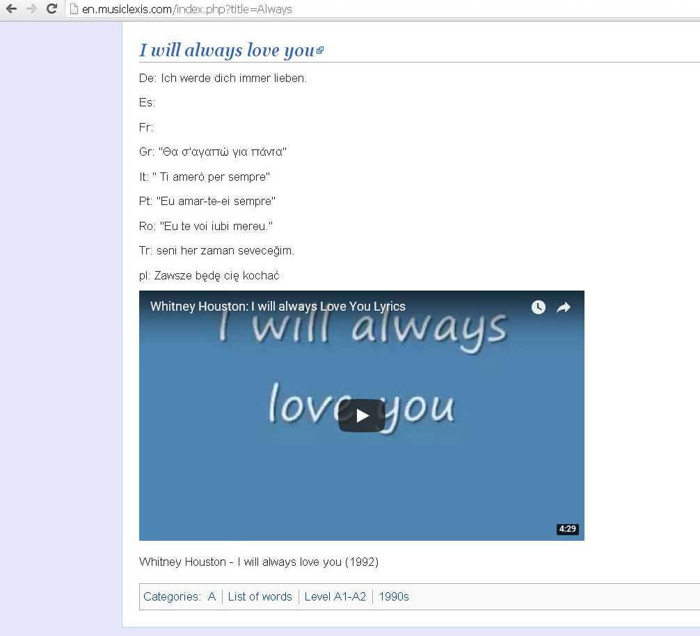
The basic features of the dictionary:
An embedded YouTube video which displays the lyrics of the song

Slide 7
In the English wiki the items are grouped according to their level

Slide 8
eTwinning project: “MusicLexis: The most fun dictionary ever”
&

Slide 9
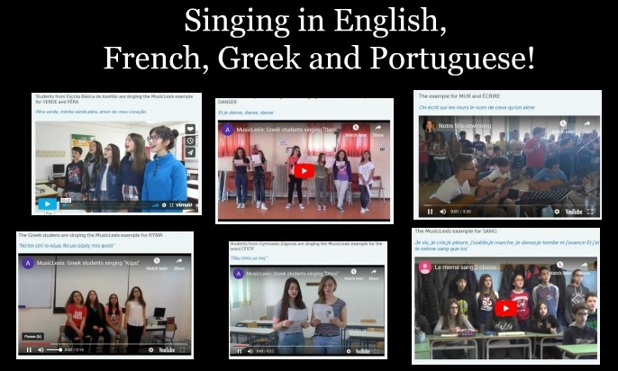
2 of the most enjoyable activities

Slide 10
Some ideas for the future:
New wikis for more languages
Improving the appearance of the website
MusicGrammar !?

