Slide 1
GAMES CHILDREN PLAY FREE TIME ACTIVITIES SURVEY ST2

Slide 3
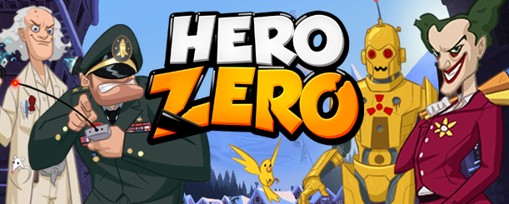
FREE TIME
HI!! MY NAME IS NICK AND I AM 11 YEARS OLD. IN MY FREE TIME
I LIKE PLAYING HERO ZERO , WATCHING TV IN MY LIVING ROOM ,
BUT I NEVER DANCE.

Slide 4
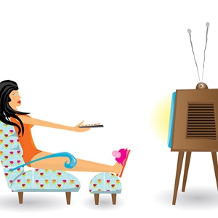
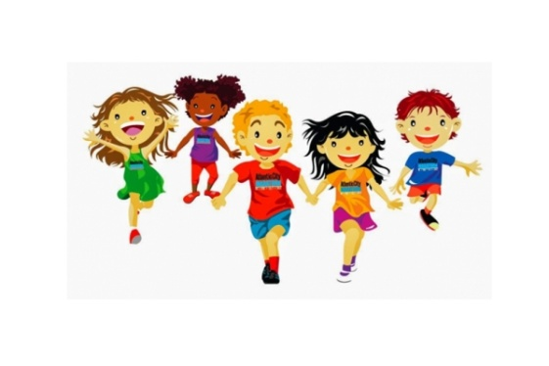
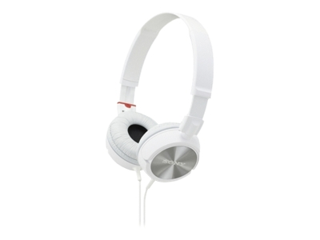
My free time!!!!
Hi! My name is Zenia. In my free time I like playing computer games, watching TV, listening to music, playing with my friends and going to the cinema.

Slide 5
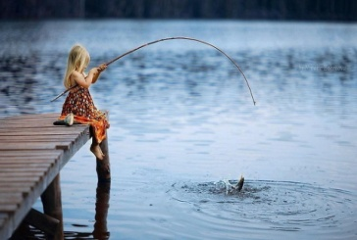
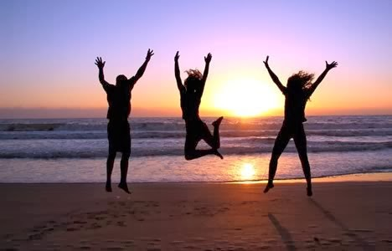
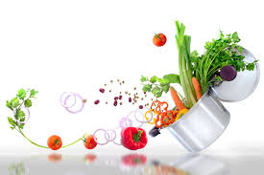
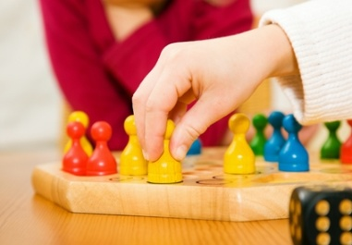
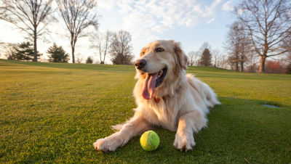
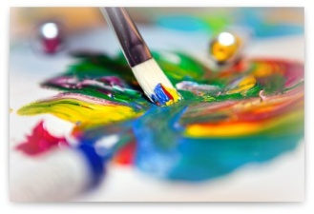
My free time!
Hi! My name is Joanna. In my free time I like reading books, listening to music, watching TV, cooking, hanging out with friends and going to the cinema. I never play board games, draw, play with my pets and I never go fishing.

Slide 6
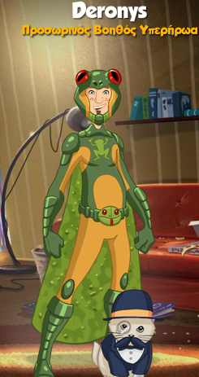
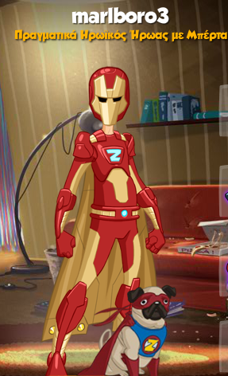
IN MY FREE TIME
Hi!! My name is John and I am 11 years old. In my free time I like playing computer games,
basketball and I playing baseball, but I never read books ,playi board games
and I never swim in my pool in winter!!

Slide 7
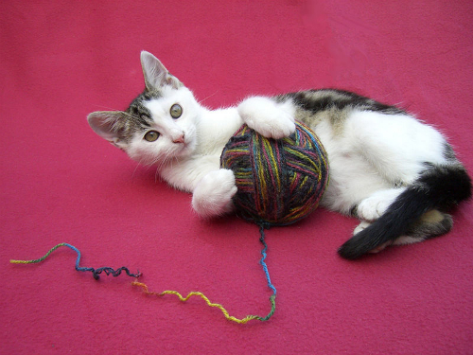
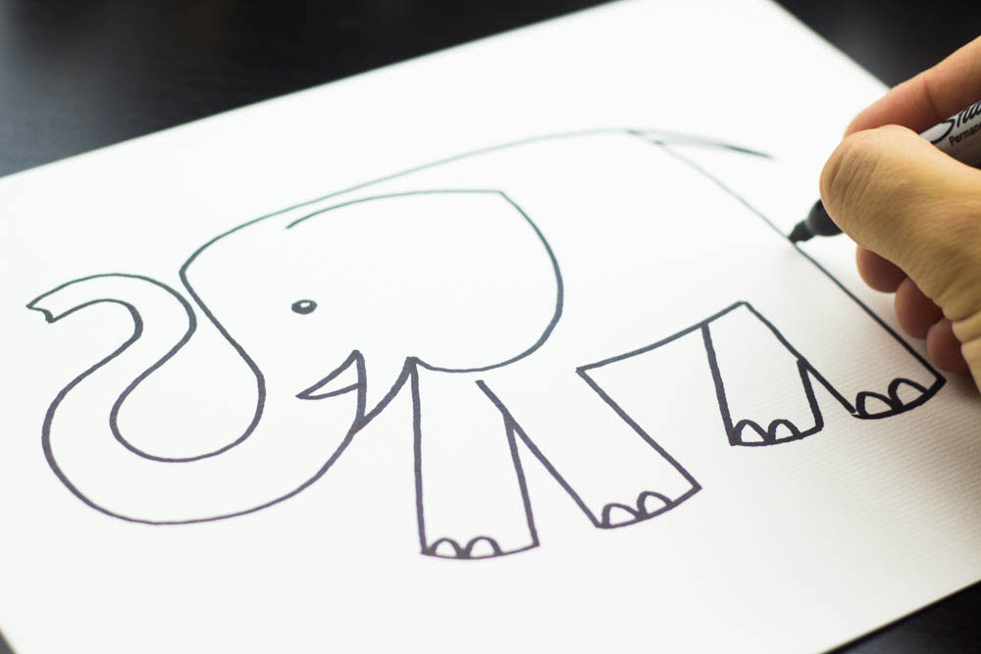
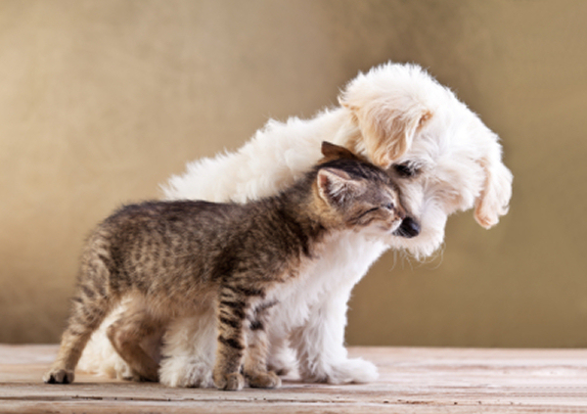
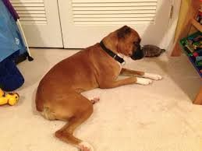
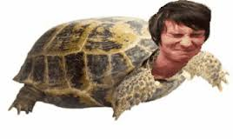
Free time
HI! My name is Voula and I am 11 years old! In my free time I always draw , play with my pet, I usually play computer games, play with my sister, I often read books and watch TV. I never go fishing and I rarely go to the cinema!!!

Slide 8
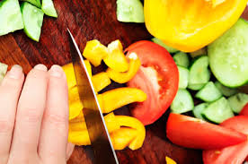
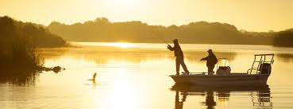
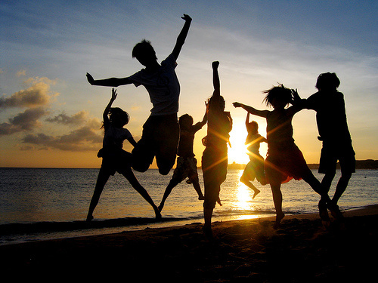
My free time!
Hi! My name is Carmen. In my free time I like reading books, listening to music, dancing and singing. I usually play music and cook. I like to play with my pets too. I often draw and do sports. Sometimes I hang out with my friends, I like to go to the cinema too. I rarely play computer and board games. I never go fishing and play with my two brothers because they are too big to play with me.

Slide 9
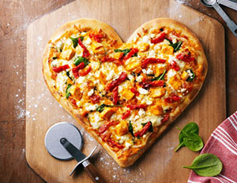
Zoe and free time activities .
In my free time I always listen to music, cook delicious dishes ,hang out with my friends and play with my siblings.
I sometimes draw and watch TV.
I never go fishing and play music.

Slide 10
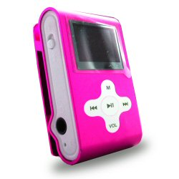
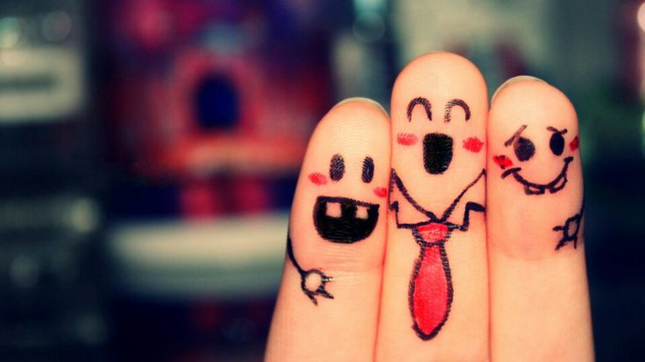
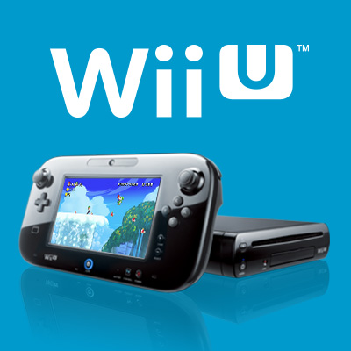
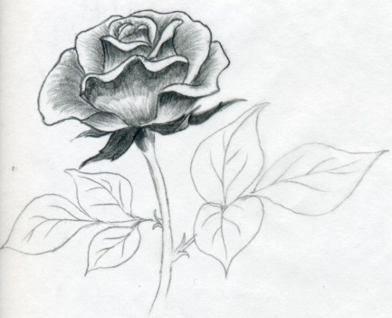
FREE TIME!!!!!$$$
HELLO I AM YOTA AND I WILL TELL YOU ABOUT MY FREE TIME !!
I LOVE LISTENING TO MUSIC
I HATE BOOKS
I LOVE VIDEO GAMES LIKE WII U!!
ILOVE SINGING!!!!☺
I HANG OUT WITH FRIENDS
I ALSO LIKE DRAWING!!!
BYE BYE !!!

Slide 11
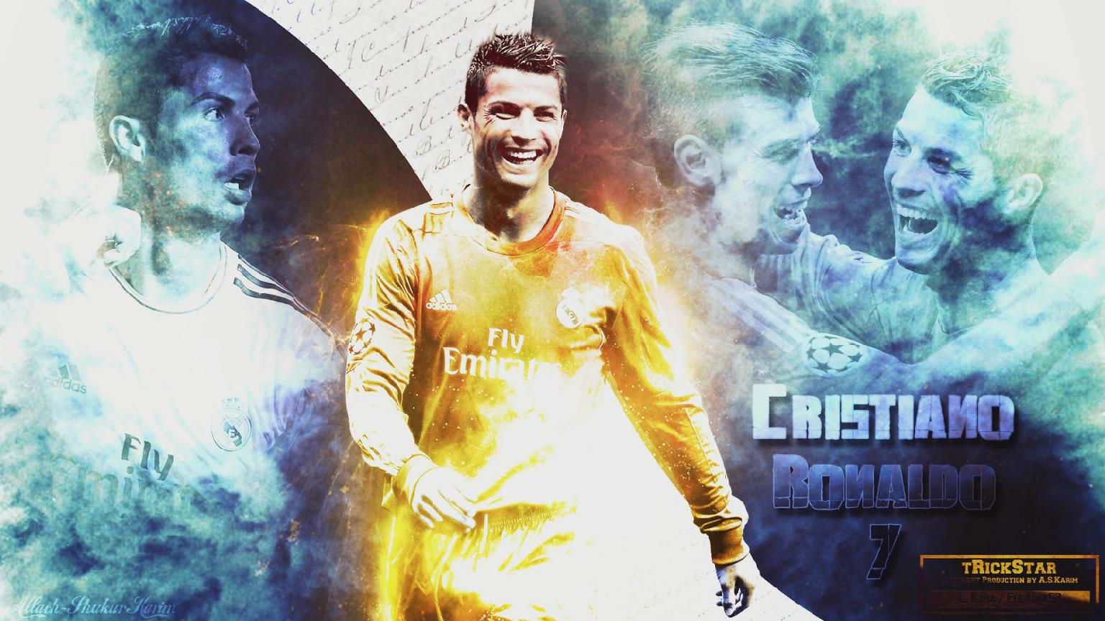
Free Time
My name is Michael and I am 11 years old. I like playing computer games and
playing football. I don’t like reading books, cooking and dancing.

Slide 12
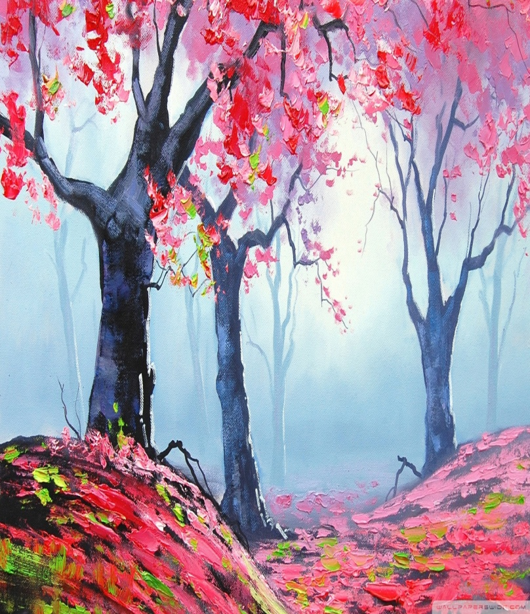
Free Time
Hello! My name is Dimitra and I am 11 years old. I always play with sister. I usually draw, read books, watch TV and ride a bike. I never do sports, play music and go fishing..

Slide 13
FREE TIME...!!!
Hi my name is Antonis. In my free time I always play with my pets and do sports. I rarely play music and dance. I never cook.

Slide 14
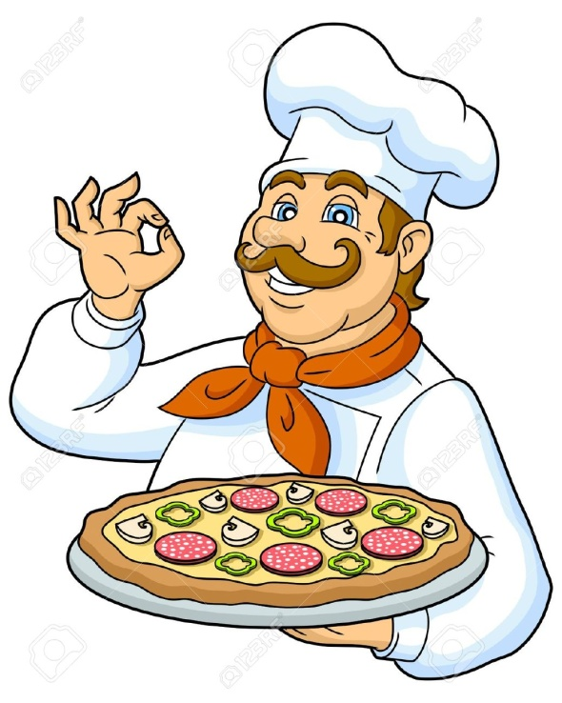
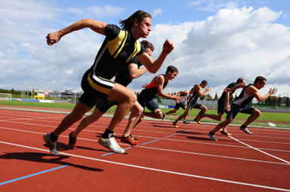
Free time!!!
Hi! My name is Teos and I’m 11 years old! I always play computer games and do sports. I often listen to music, ride my bike, cook and hang out with friends.

Slide 15
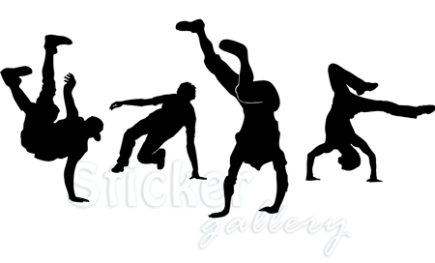
Free time
Hi! My name is Despoina, I’m 11 years old. I always listen to music, do sports, dance and play with my pet.

Slide 16
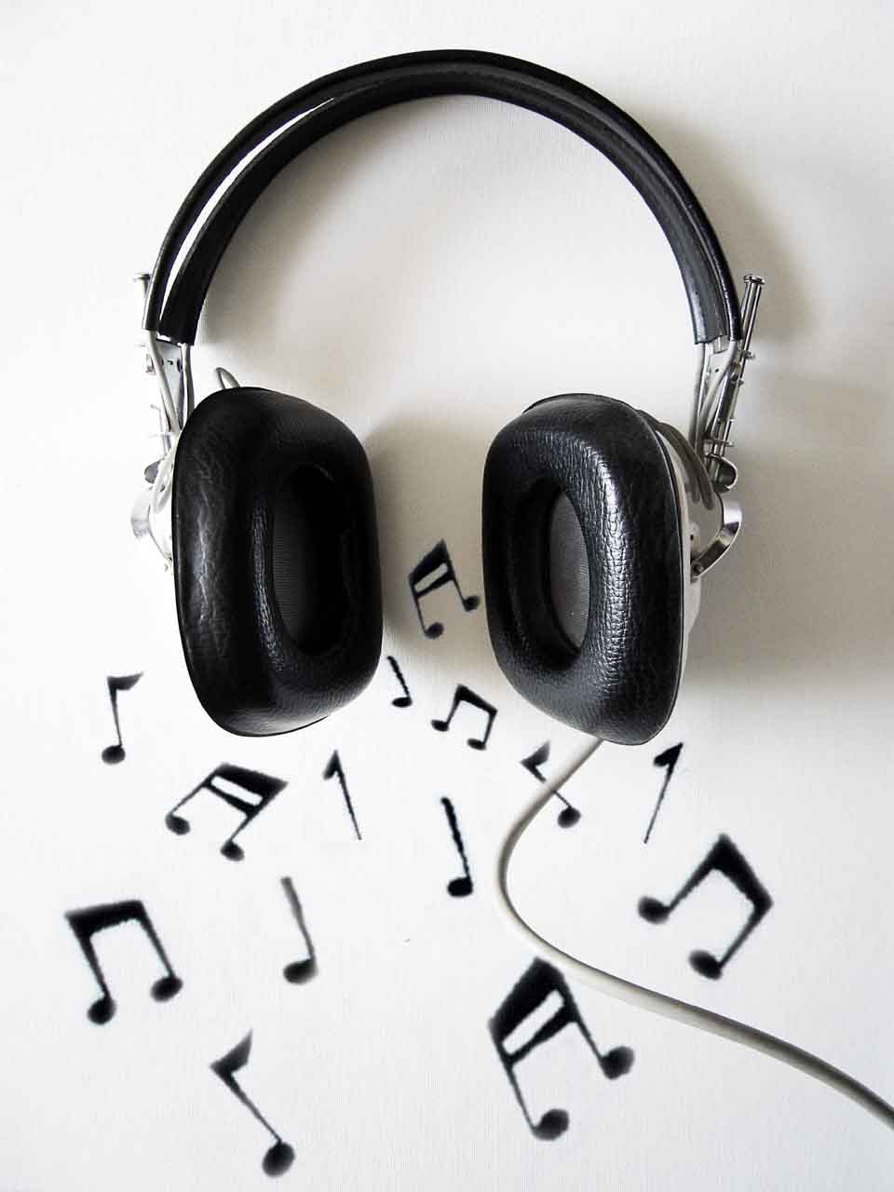
Kostantina and free time activities…!
In my free time I always listen to music and do sports.
I also, play board games and computer games with my two brothers…!
I usually hang out with my friends and go to the cinema with them….
I NEVER go fishing and play music.
THE END...!

Slide 17
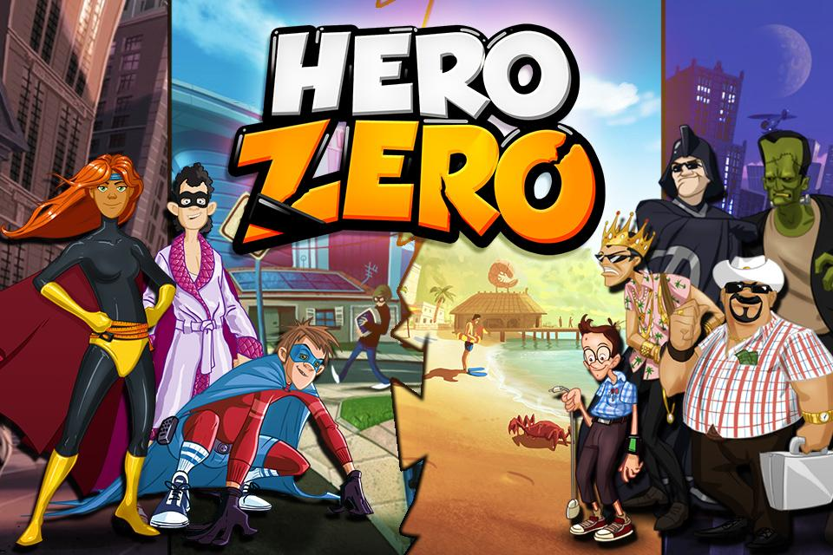
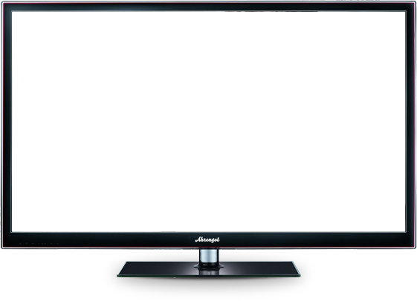
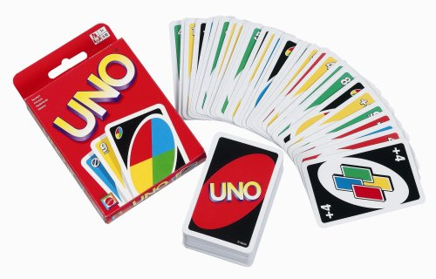
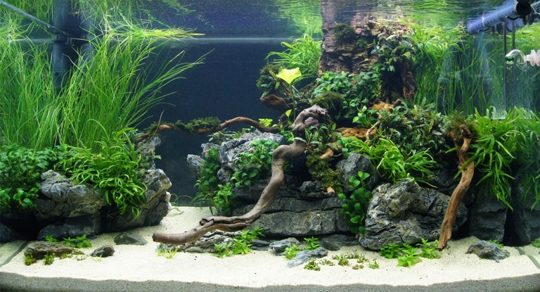
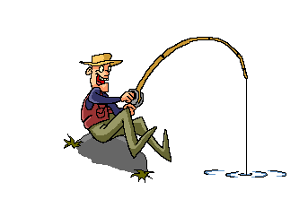
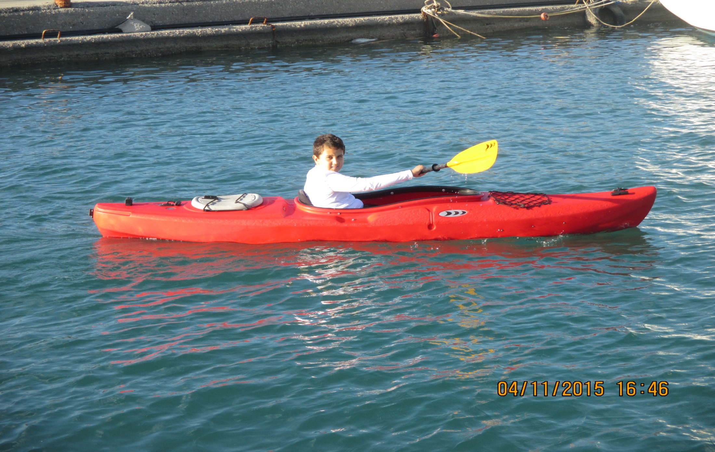
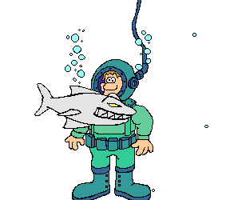
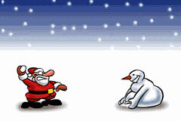
FREE TIME
I USUALLY
I OFTEN
I ALWAYS
I ALWAYS
I OFTEN
I USUALLY
BY JOHN MAVROGENIS
PLAY COMPUTER GAME
Play board gameS
play with my pets
Go fishing
DO SPORTS
Watch TV

