Slide 1
CASTLE
or
AMBARIZA
1ST PRIMARY SCHOOL PEFKIS
ATHENS, GREECE

Slide 2
CASTLE or AMPARIZA
TWO TEAMS (i.e. boys vs girls)
ONE COURT (i.e. basketball court) DIVIDED IN THE MIDDLE
TWO COLUMNS (these are the two Castles) ONE AT EACH SIDE OF THE WHOLE COURT
THE COLUMNS – CASTLES ARE PROTECTED BY THE GUARDS (ONE or TWO CHILDREN)

Slide 3
TWO OTHER COLUMNS OR SPOTS ARE USED AS “PRISONS”. THE PRISON FOR THE BOYS’ TEAM IS LOCATED IN GIRLS’ COURT AND THE PRISON FOR THE GIRLS’ COURT IS LOCATED IN BOYS’ COURT.
THE PURPOSE OF THE GAME IS TO TOUCH THE OPPONENT’S CASTLE – COLUMN.

Slide 4
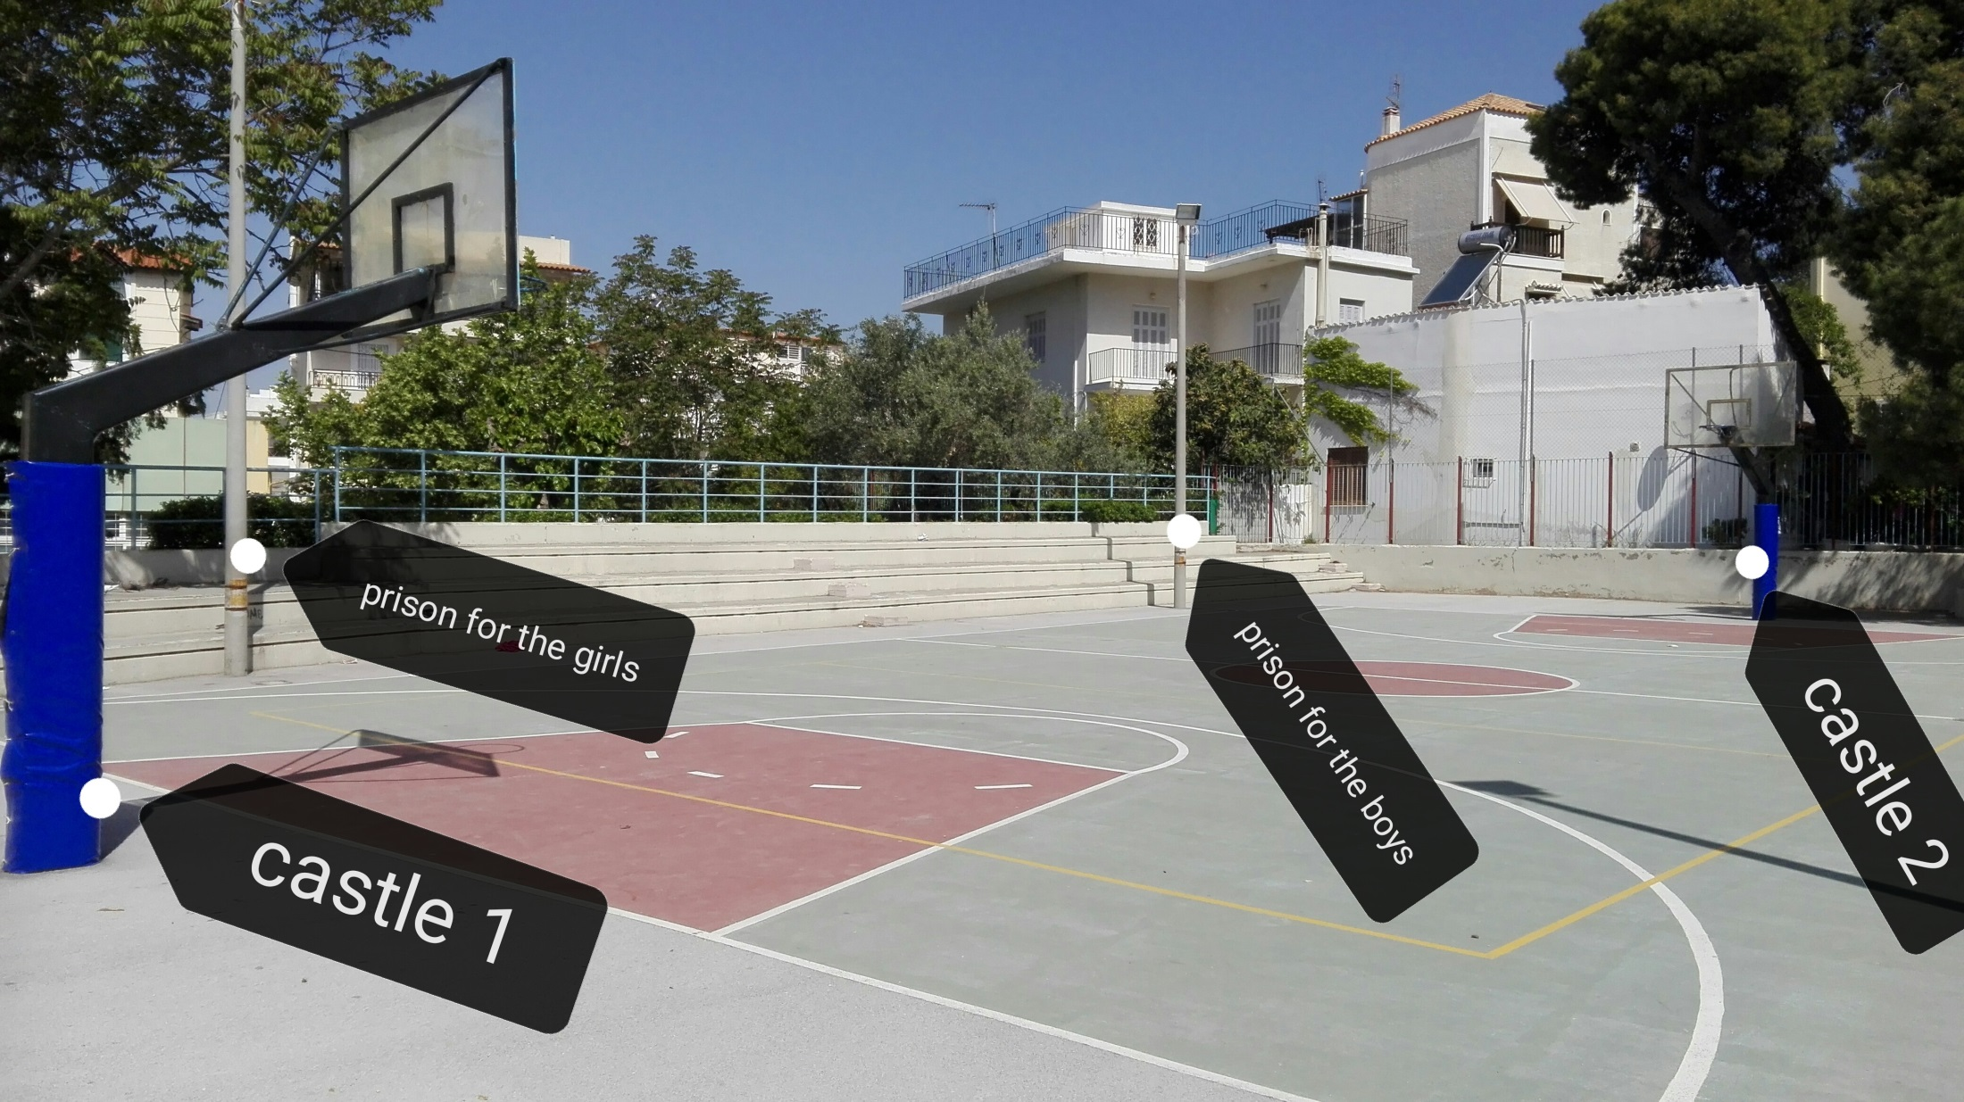
GIRLS’ COURT
BOYS’ COURT

Slide 5
YOU CAN CATCH AND SEND TO PRISON AN OPPONENT PLAYER ONLY IF HE IS YOUR COURT WHEN HE IS ATTACKING
WHEN SOMEONE IS CAUGHT, HE MUST GO TO PRISON AND MUST WAIT TO BE LIBERATED BY ANOTHER PLAYER OF HIS TEAM BY TOUCHING.

Slide 6
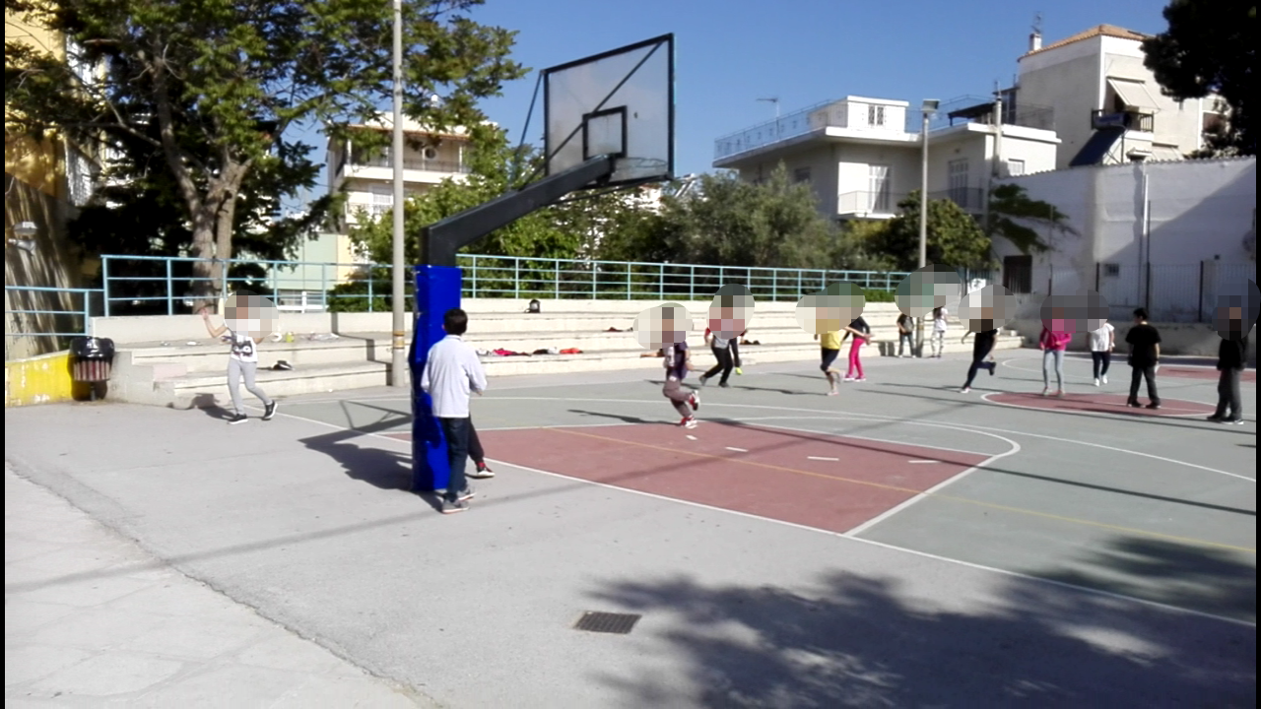
One boy is in prison and a girl is guarding him

Slide 7
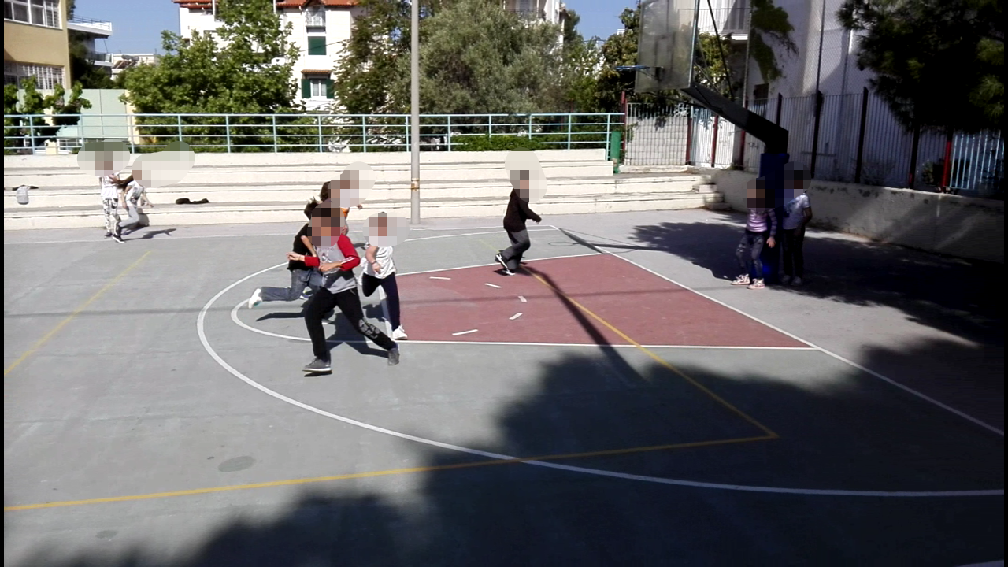
BOYS ARE ATTACKING

Slide 8
S C O R E: WHEN A PLAYER TOUCHES THE OPPONENT’S CASTLE – COLUMN, HE SCORES!!!
AFTER SCORING, EVERYBODY RETURNS TO HIS COURT, AND THE GAME STARTS AGAIN. THE SCORE IS 1 FOR THE TEAM THAT HAS SCORED AND 0 FOR THE OTHER TEAM.
THE GAME ENDS EITHER WITH TIME LIMIT (i.e. 15 minutes) OR WITH SCORE ACHIEVEMENT (i.e. THE FIRST TEAM TO SCORE 5 TIMES)

Slide 9
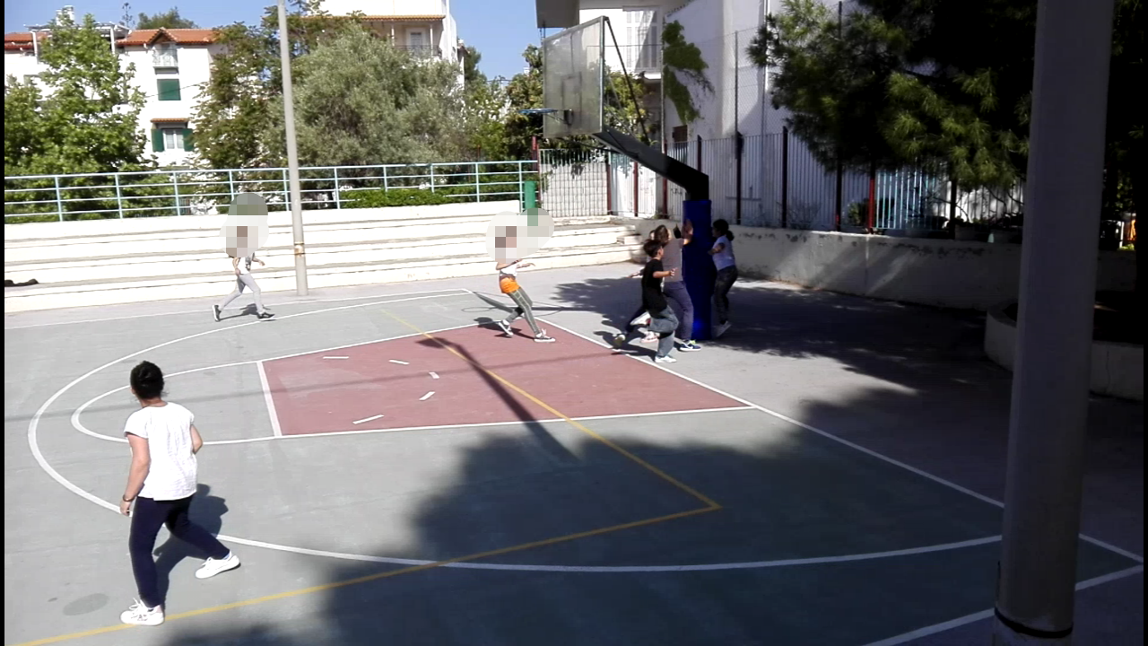
One boy is scoring / touching Castle 2 before the girls touch / capture him

Slide 10
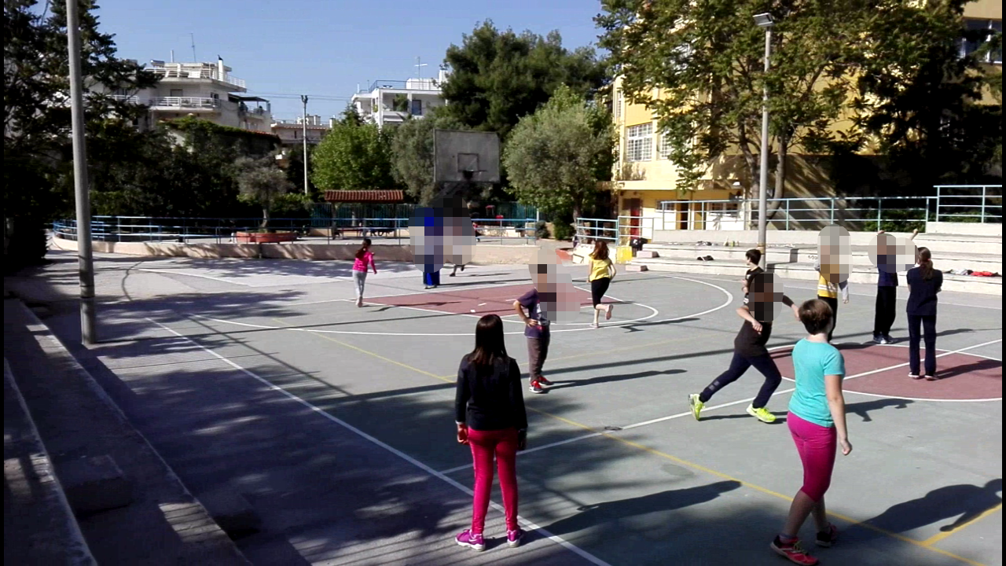
One girl is trying to score / touch Castle 1 and another one is following her

Slide 11
Two girls are attacking, one boy is trying to catch one and the boy / guard is watching

Slide 12
HAVE FUN
ΚΑΛΗ ΔΙΑΣΚΕΔΑΣΗ
KALI DIASKEDASI

