Slide 1
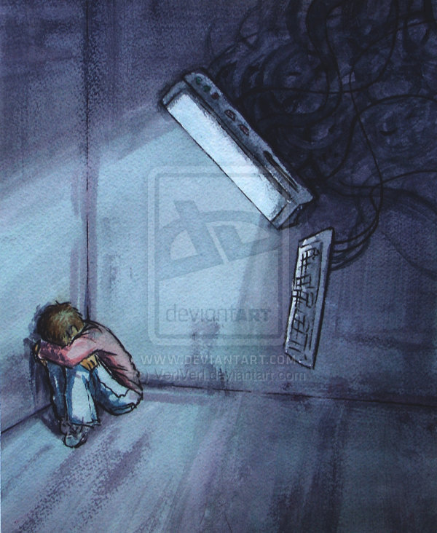
Cyberbullying project
Ομάδα εργασίας
Νικόλας Μπάρλος
Άρης Οικονομάκης
5^{ο} Δ.Σ. Ηρακλείου Αττικής, 2016
Notes:
🙂

Slide 2

What is cyberbullying
Cyberbullying is bullying that takes place using electronic technology. Electronic technology includes devices and equipment such as cell phones, computers, and tablets, as well as communication tools including social media sites, text messages, chat, and websites.

Slide 3
Cyberbullying can take many forms
Exclusion: Teenagers intentionally exclude others from an online group.
Cyberstalking: Teens will harass others by constantly sending emails, messages, or tagging others in posts they don’t want to be tagged in.
Gossip: Post or send cruel messages that damage another’s reputation, relationships, or confidence.
Outing/Trickery: Trick another teen into revealing secrets or embarrassing information which the cyberbully will then share online.
Harassment: Post or send offensive, insulting, and mean messages repeatedly.
Impersonation: Create fake accounts to exploit another teen’s trust. They may also hack into an account and post or send messages that are damaging to the person’s reputation or relationships.
Cyber Threats: Threaten or imply violent behavior toward others to make them feel uncomfortable.
Flaming: Fights online that involve hateful or offensive messages that may be posted to various websites, forums, or blogs

Slide 4


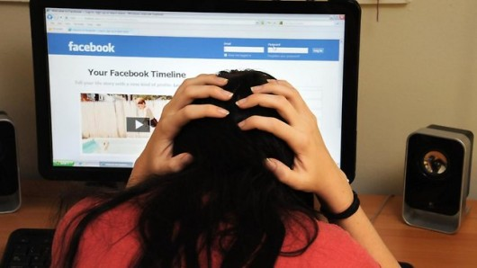

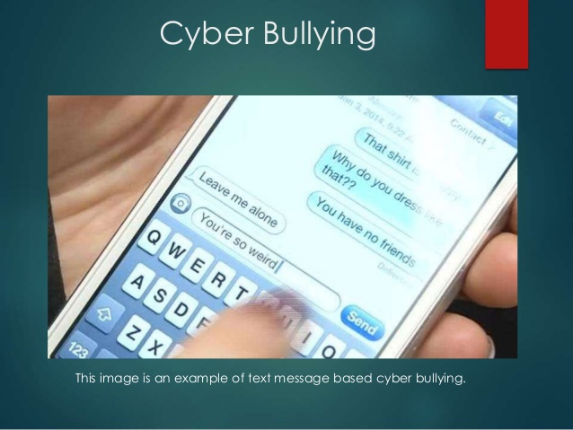
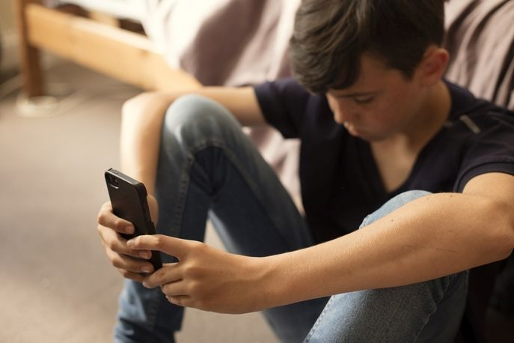
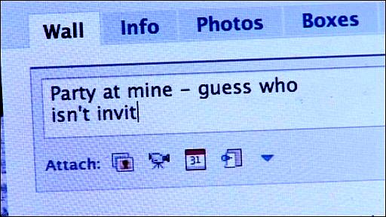
CYBERBULLYING CAN TAKE MANY FORMS

Slide 5

Cyberbullying stories
“I have many hobbies that I like to share and I am put down for them. It makes me want to throw those hobbies away because it has been happening ever since I started posting my work on the internet”.
Nick

Slide 6
Cyberbullying stories
"Once I went on Facebook and all my friends were making fun of me. They said that I should kill myself and no one likes me and stuff like that. I was depressed for a long time. All my 'friends' weren't talking to me and I didn't know what to do. I went home and thought about suicide but I just couldn't. The principal in my school had found out about this and confronted these kids. They said sorry but they didn't mean it. I've always thought about suicide ever since." - 12 year-old girl
"Well I always get bullied and I hate it I feel like killing myself sometimes." - 13 year-old girl

Slide 7
Statistics
According to the i-safe foundation
Over half of adolescents and teens have been bullied online, and about the same number have engaged in cyber bullying.
More than 1 in 3 young people have experienced cyber-threats online.
Over 25 percent of adolescents and teens have been bullied repeatedly through their cell phones or the Internet.
Over half of young people do not tell their parents when cyber bullying occurs.

Slide 8
Statistics
According to the Cyberbullying Research Centre
Over 80 percent of teens use a cell phone regularly, making it the most popular form of technology and a common medium for cyber bullying
About half of young people have experienced some form of cyber bullying, and 10 to 20 percent experience it regularly
Mean, hurtful comments and spreading rumors are the most common type of cyber bullying
Girls are at as likely as boys to be cyber bullies or their victims
Boys are more likely to be threatened by cyber bullies than girls
Cyberbullying affects all races
Cyber bullying victims are more likely to have low self esteem and to consider suicide

Slide 9
Are you a victim of cyberbullying? Here is what you can do
Know that it’s not your fault. What people call “bullying” is sometimes an argument between two people. But if someone is repeatedly cruel to you, that’s bullying and you mustn’t blame yourself. No one deserves to be treated cruelly.
Don’t respond or retaliate. Sometimes a reaction is exactly what aggressors are looking for because they think it gives them power over you, and you don’t want to empower a bully. As for retaliating, getting back at a bully turns you into one – and can turn one mean act into a chain reaction. Remove yourself from the situation.
Save the evidence. The only good news about bullying online or on phones is that it can usually be captured, saved, and shown to someone who can help. You can save that evidence in case things escalate.
Tell the person to stop. This is completely up to you – don’t do it if you don’t feel totally comfortable doing it, because you need to make your position completely clear that you will not stand for this treatment any more. You may need to practice beforehand with someone you trust, like a parent or good friend.

Slide 10
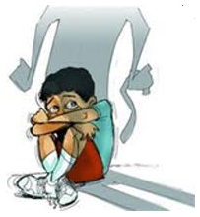

Slide 11


Slide 12

References
https://www.isafe.org
https://cyberbullying.org
https://en.wikipedia.org/wiki/Cyberbullying

Slide 13


