Slide 1
FORTNITE
ATA LACO

Slide 2
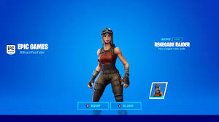
RENEGATE RAIDER

Slide 3

PURPLE SKYLL

Slide 4

CRYSTAL

Slide 5

LOOX

Slide 6

NINJA

Slide 7

MADALORIAN

Slide 8

KABOOM

Slide 9
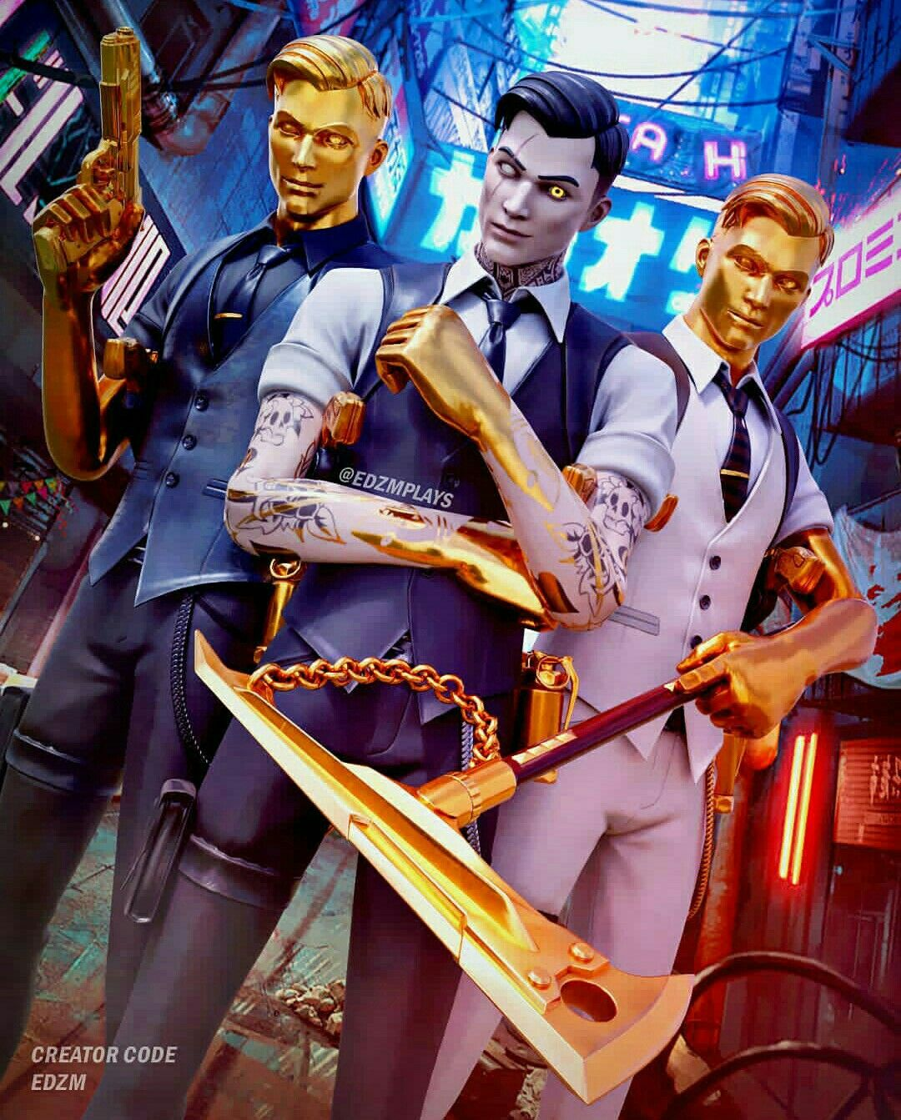
MIDAS

Slide 10
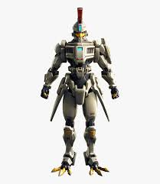
ROBOT

Slide 11

BRITE BOMBER

Slide 12

KRATOS

Slide 13

DEFEULT

Slide 14

JENNY FER WOTER

Slide 15
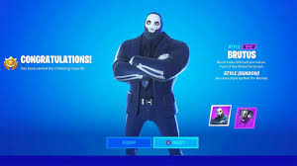
BRUTUS

Slide 16

SKAY

Slide 17

BLACK knight

Slide 18

PINK GHOOL TROOPER

Slide 19
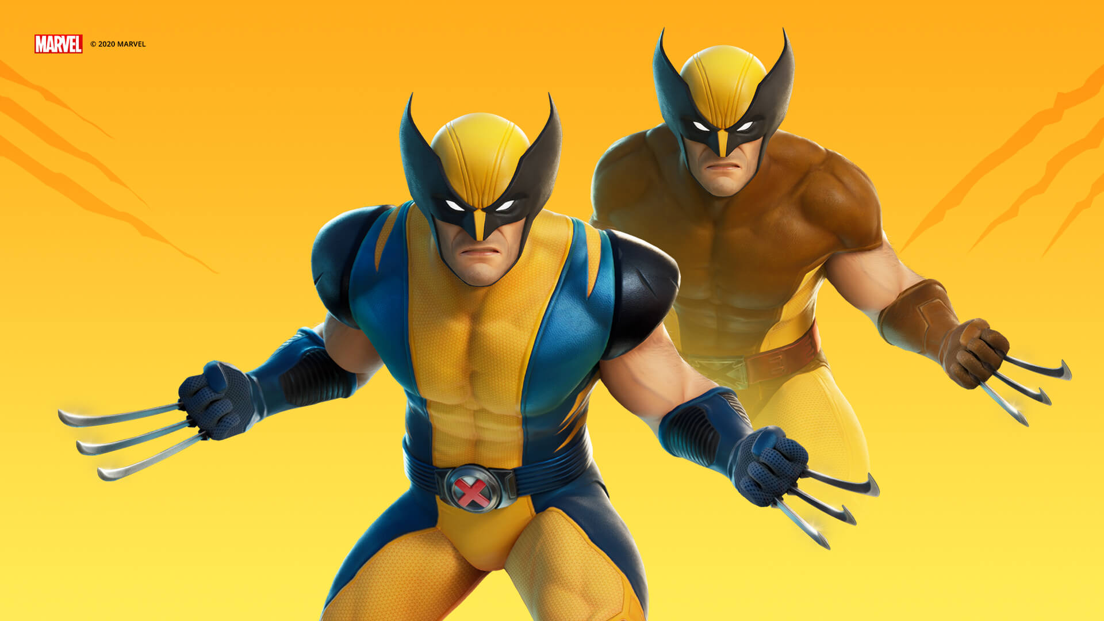
WOLVERIN

Slide 20

LEXA

