Slide 1
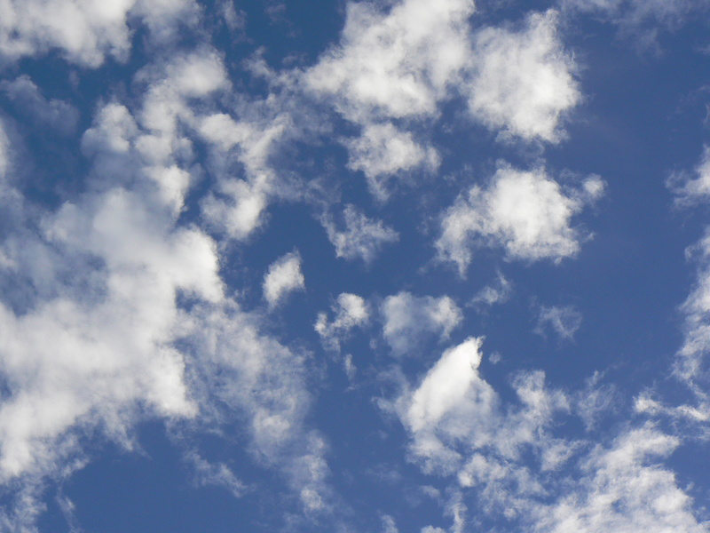
Activities on Air
Comenius Project
“Living with the elements”
6th Primary School of Egaleo, Athens

Slide 2
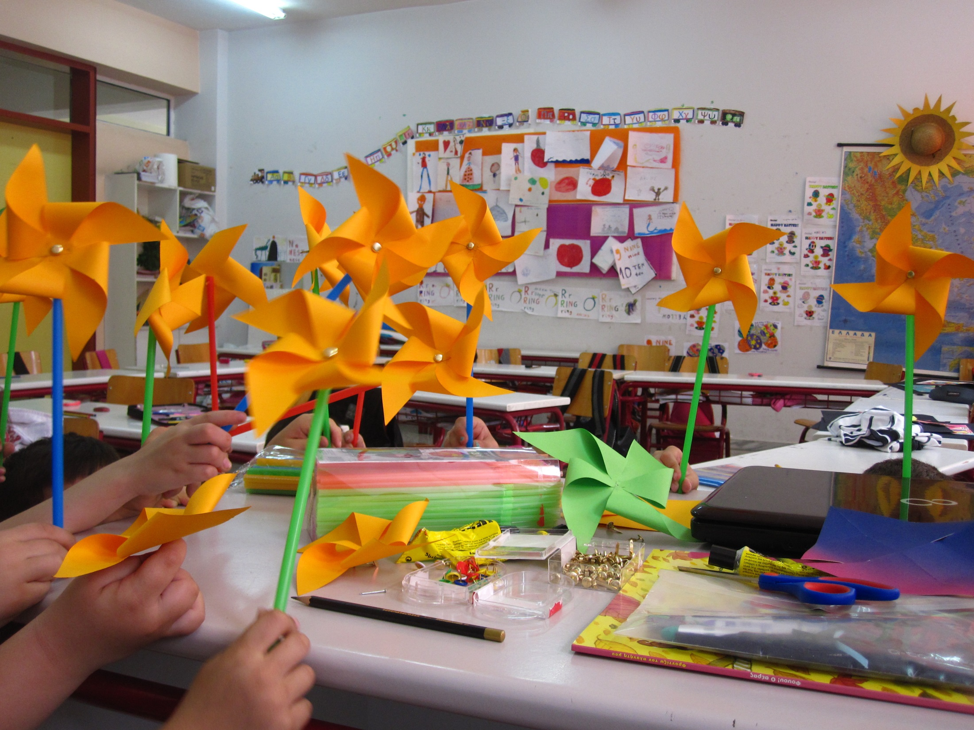
Grade A – Making windmills

Slide 3
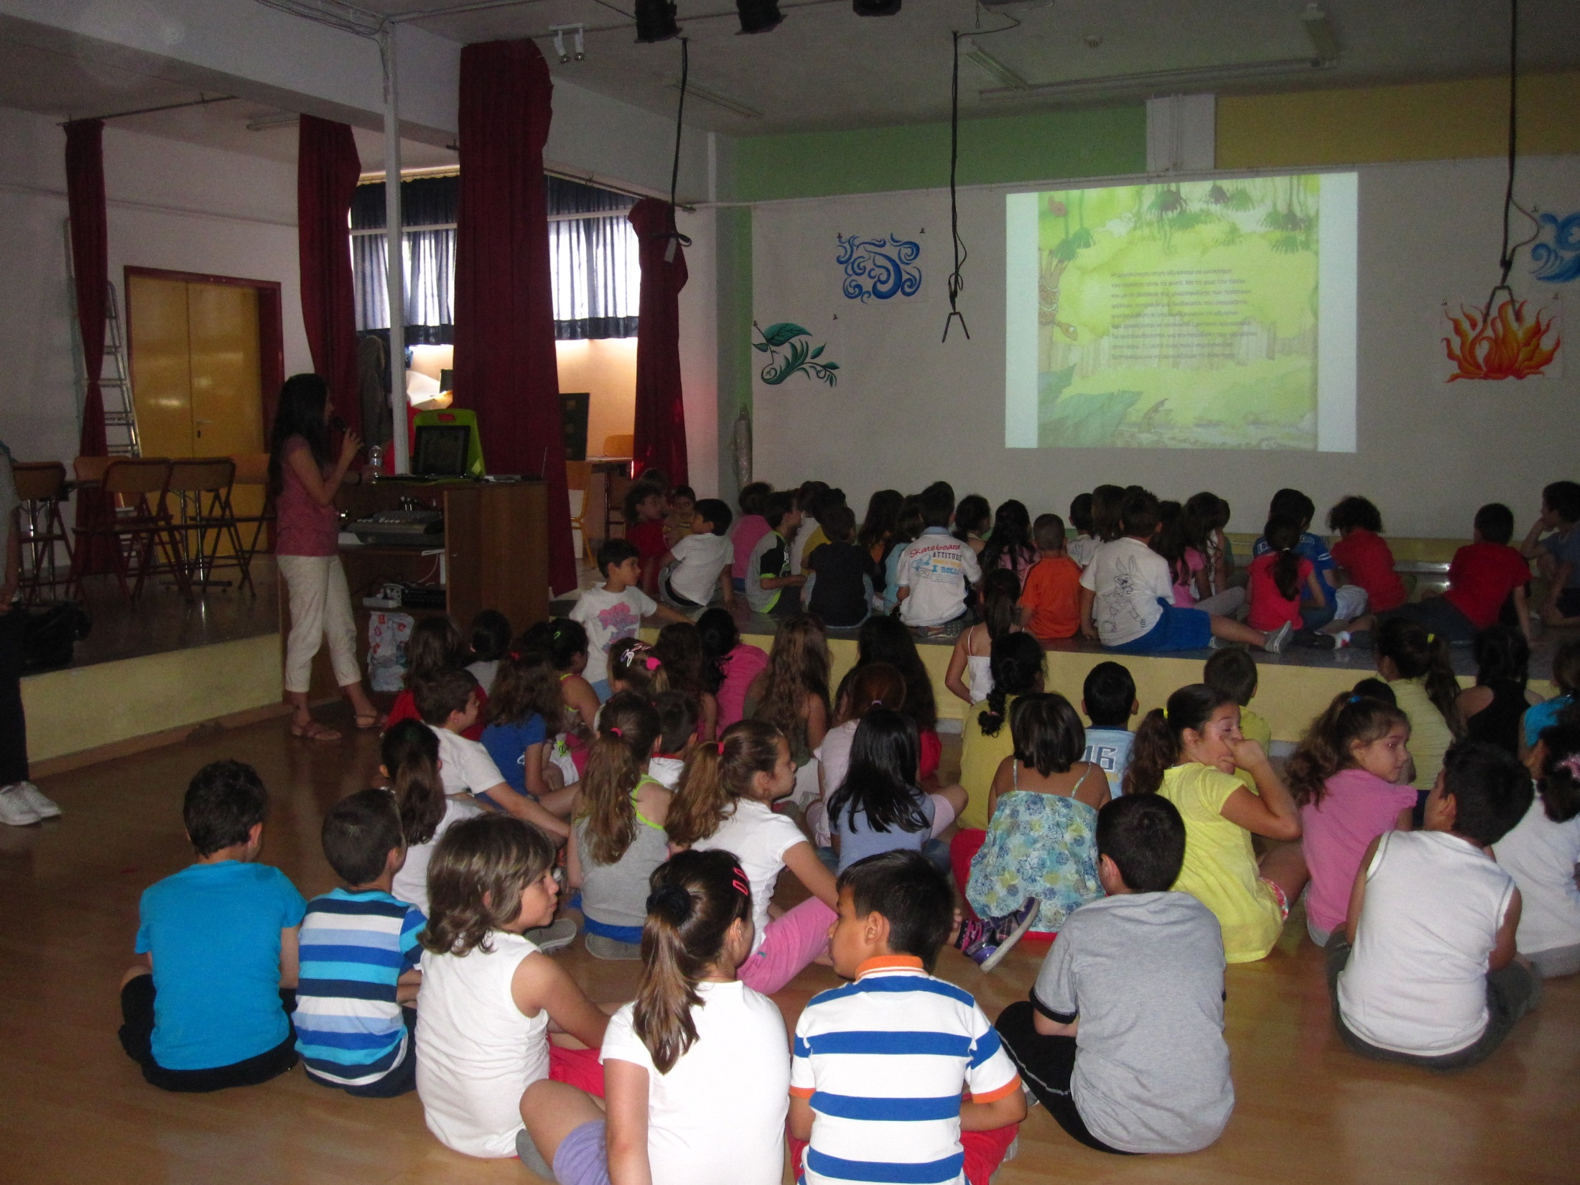
Grades A & B – Book reading

Slide 4
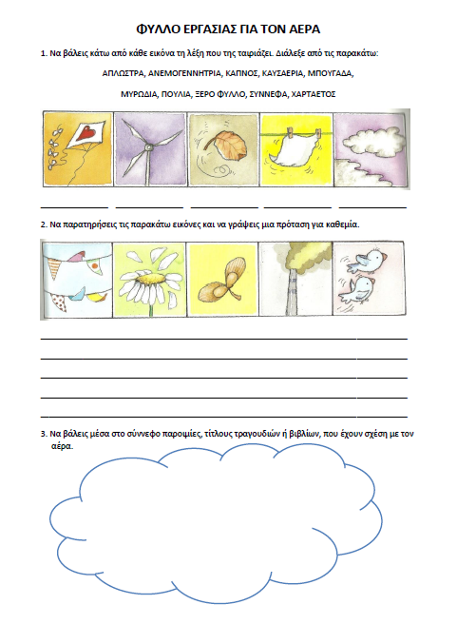
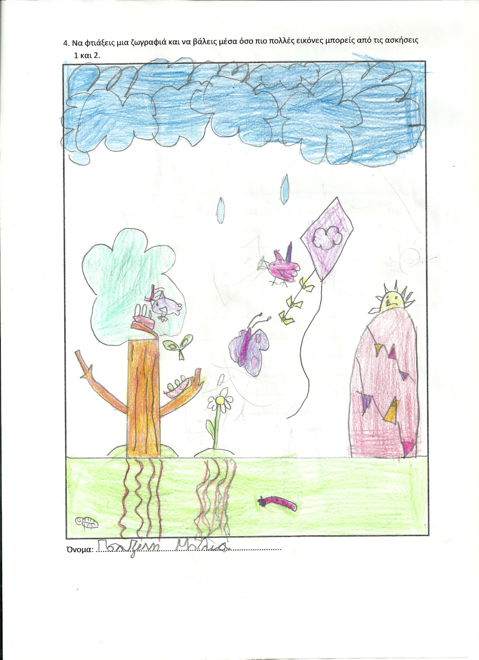
Grades A & B – Worksheet on Air

Slide 5
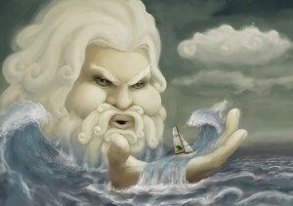
Grade C – Aeolus in mythology
Aeolus was not a God in the greek mythology, but the treasurer of the winds, appointed by Zeus.
He kept the winds in his windbag,
letting them loose only after Zeus’ command.

Slide 6
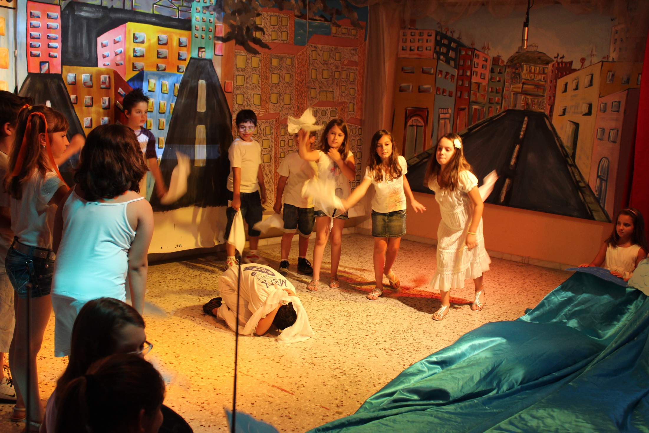
Grade C – Theatrical play “Blow, wind...”

Slide 7
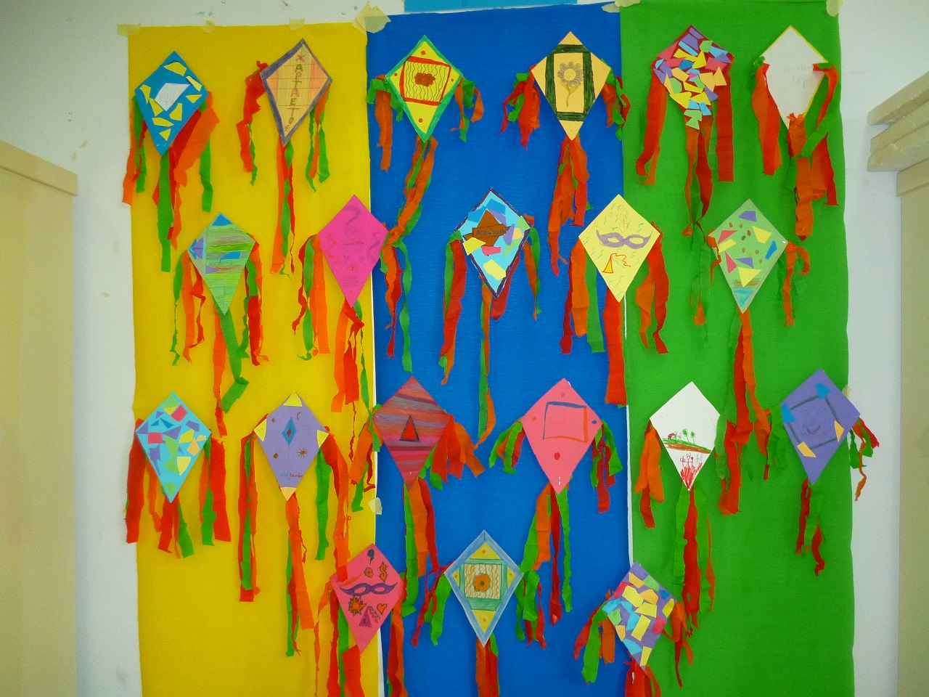
Grade C – Making kites

Slide 8
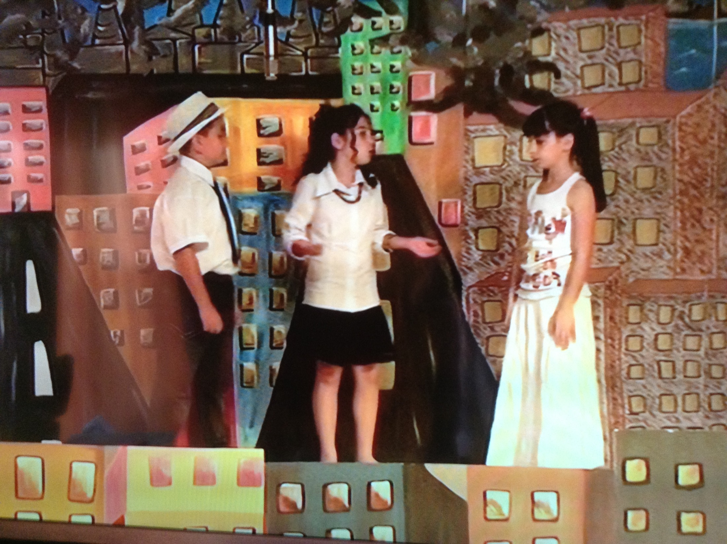
Grade D – Theatrical play “Get on the roof to eat the cloud”

Slide 9
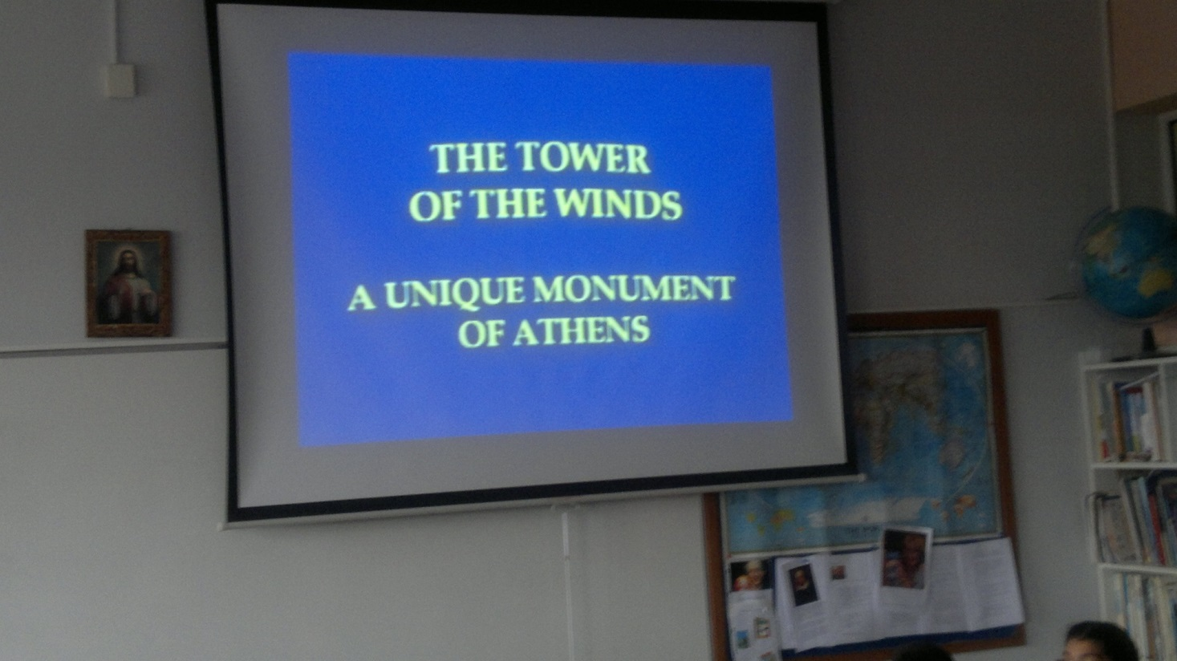
Grade E – Studying the Tower of the Winds

Slide 10
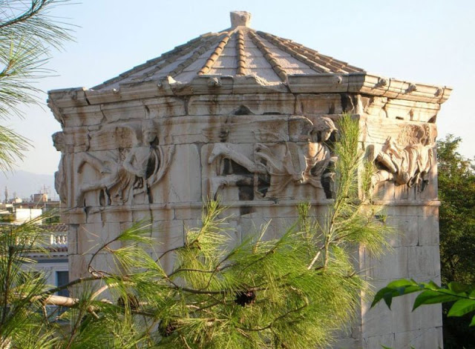
Grade E – Studying the Tower of the Winds

Slide 11
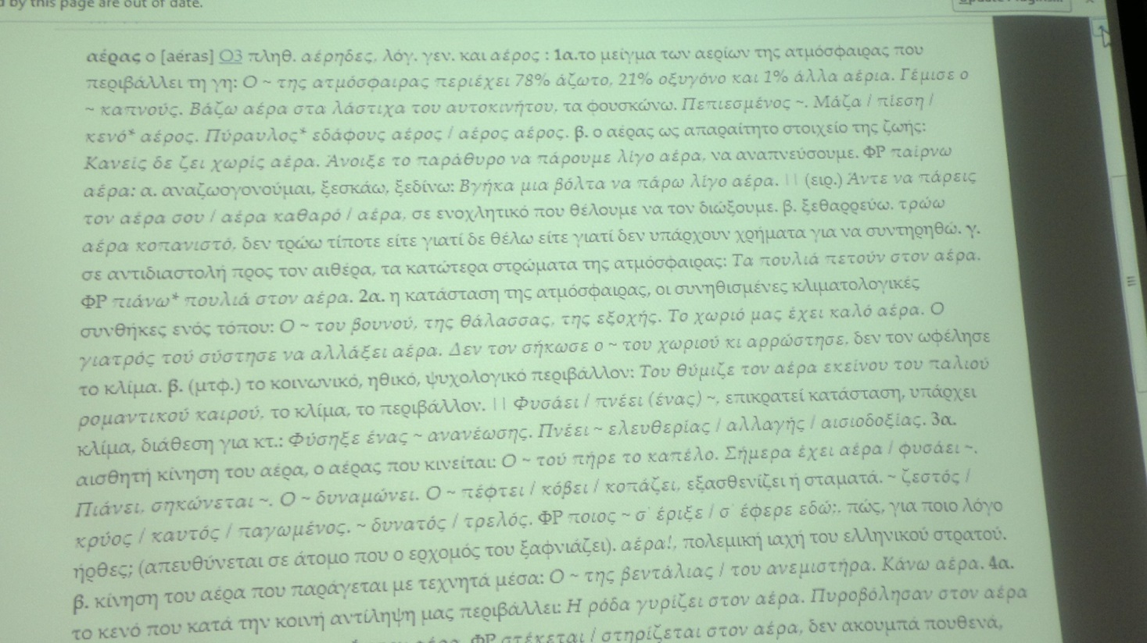
Grade E – Studying “Air Phrases”

Slide 12
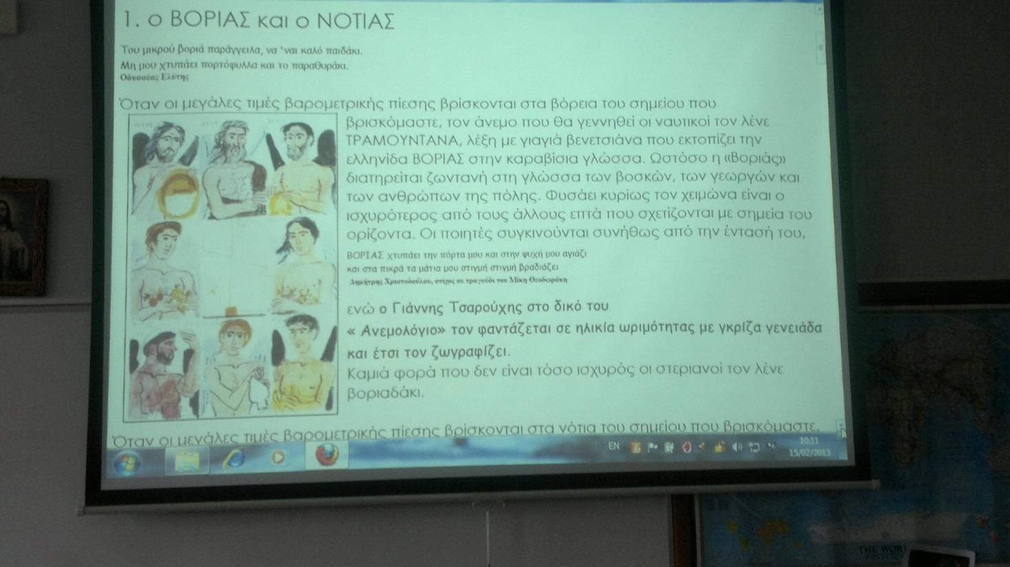
Grade E – The winds in art: “Anemologio”

