Slide 1
lynx - an endangered species
a poem about the lynx.

Slide 2
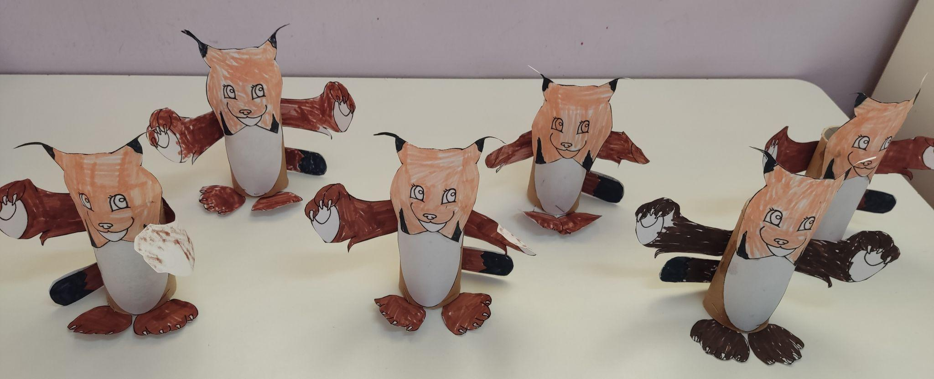
5th Kindergarten of Kilkis - Greece (a class - Theopi)
I am a lynx
I have sharp teeth
and long ears

Slide 3
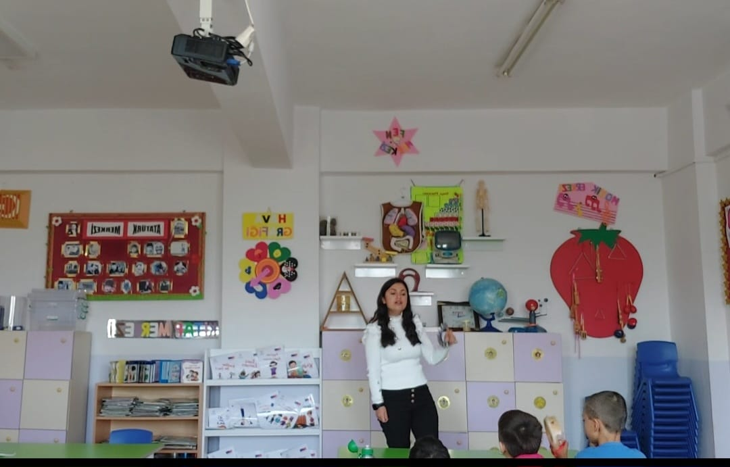
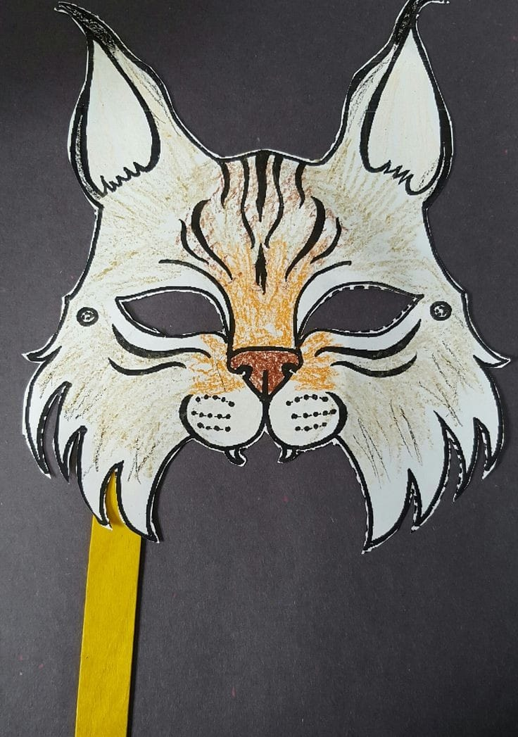
SERAP TAŞ-TURKEY-ANTALYA/SERİK-MEHMET AKİF ERSOY PRİMARY SCHOOL
I am from the feline family
I have a lot of brown color

Slide 4
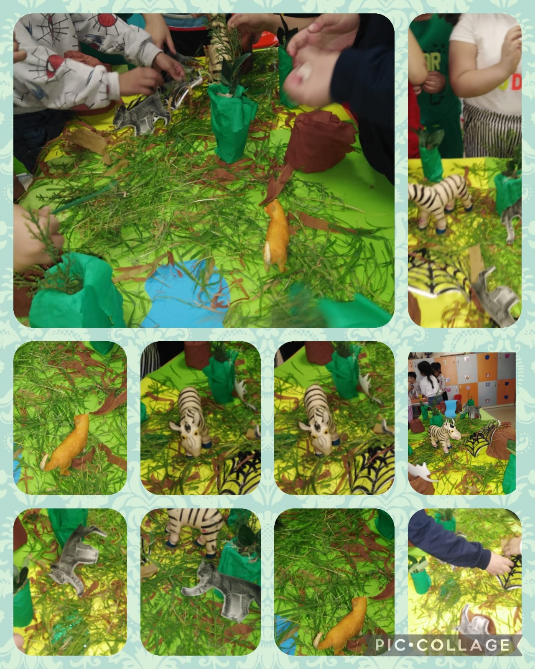
KEZBAN ÖZDEMİR SAVCI MUSTAFA ÇAKMAK PRİMARY SCHOOL GAZİANTEP /TURKEY
The lynx is a forest animal and prefers rocky and mountainous areas.

Slide 5
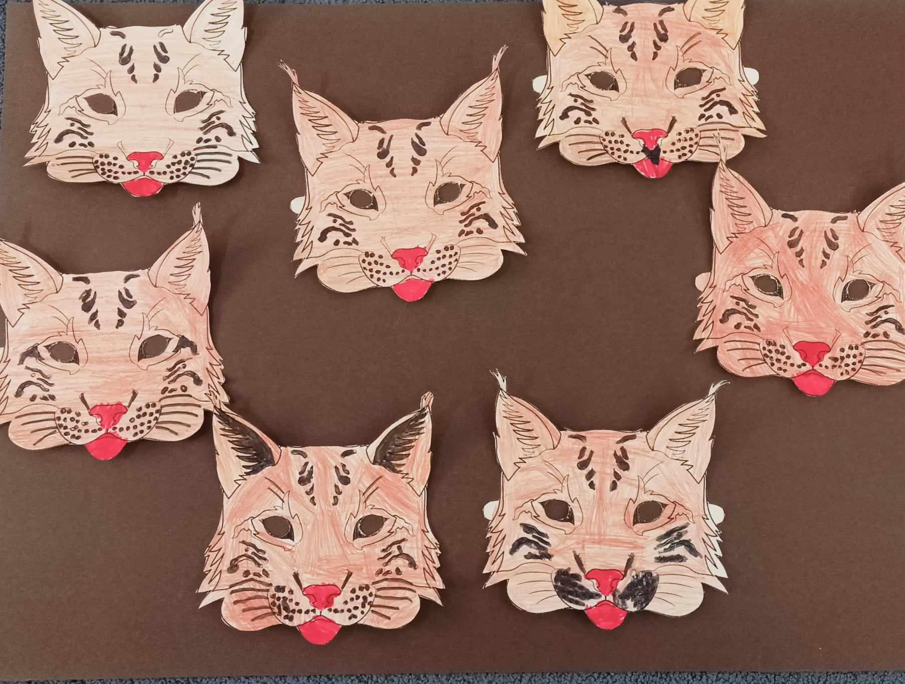
5th Nipiagogio Kilkis -Grece (Maria- B class)
I have long whiskers
and a black short tail.
I can hear far away
and i also see well in the dark.

Slide 6
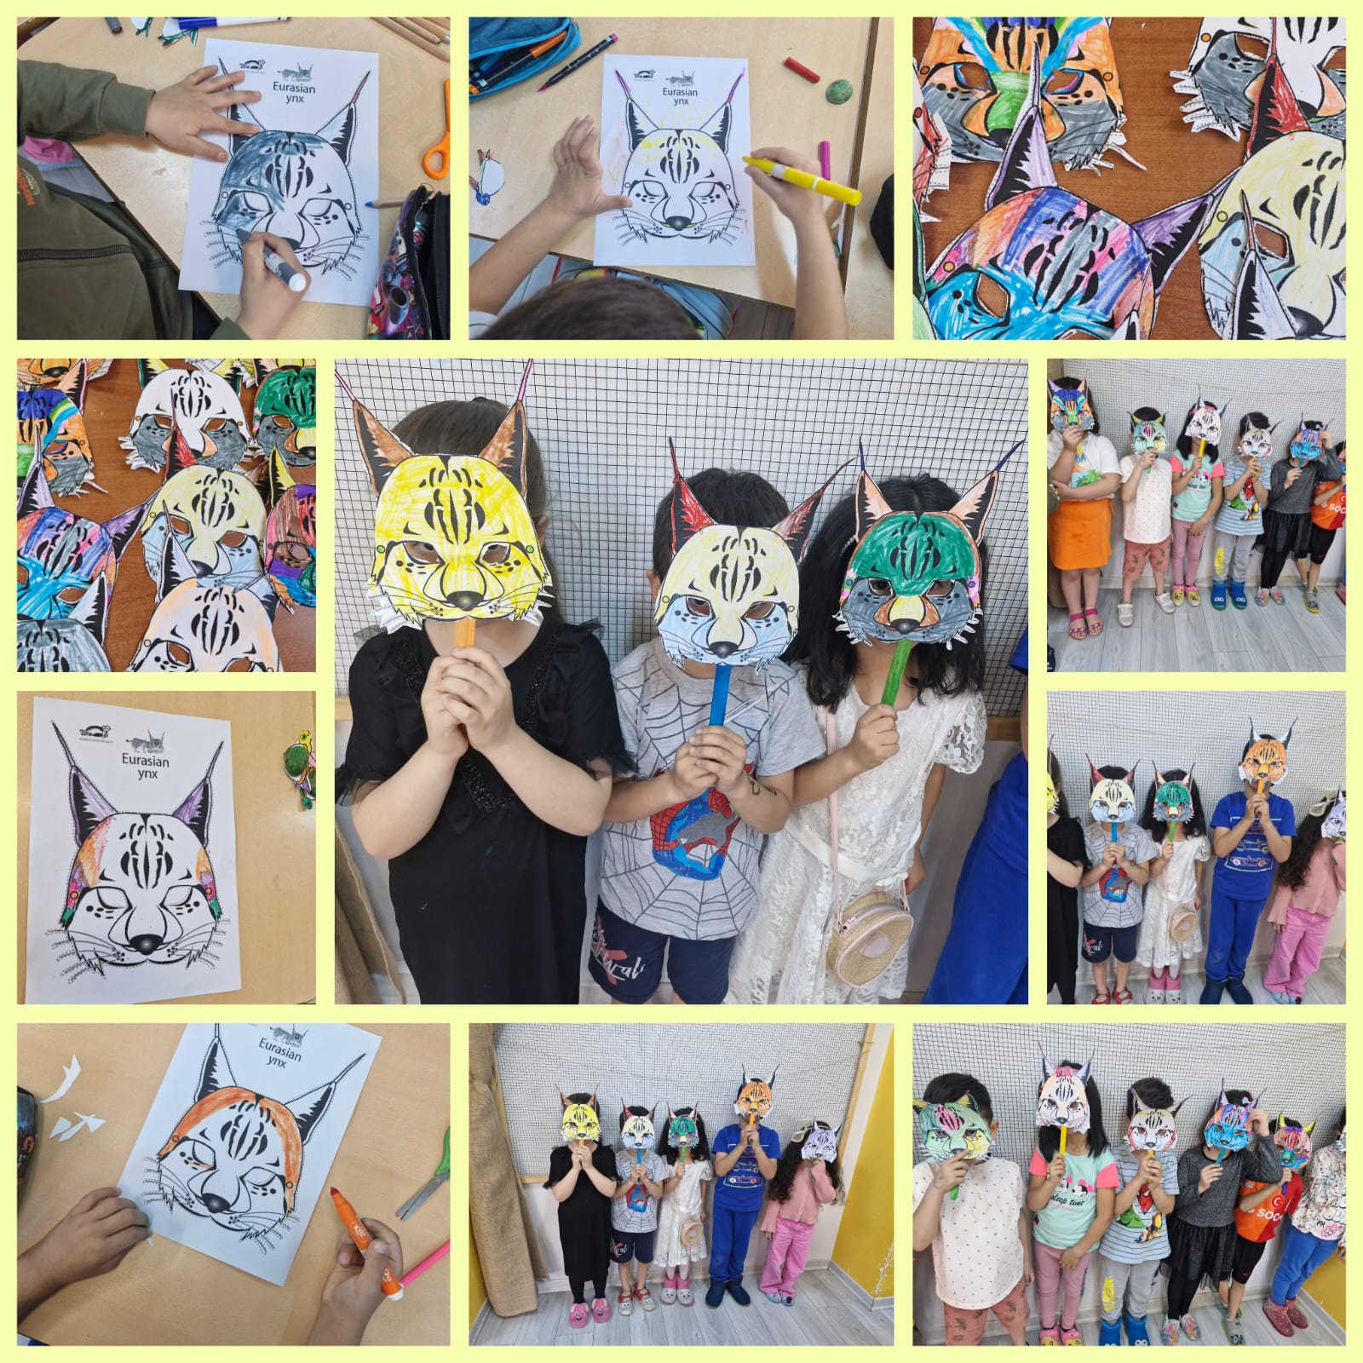
EMİNE YILDIRIM/HAYME HATUN ANAOKULU
My ears are longer than cats and have hairy tips. When winter sets in, not only the hair on my ears but my entire body is covered with a thick layer of feathers.

Slide 7
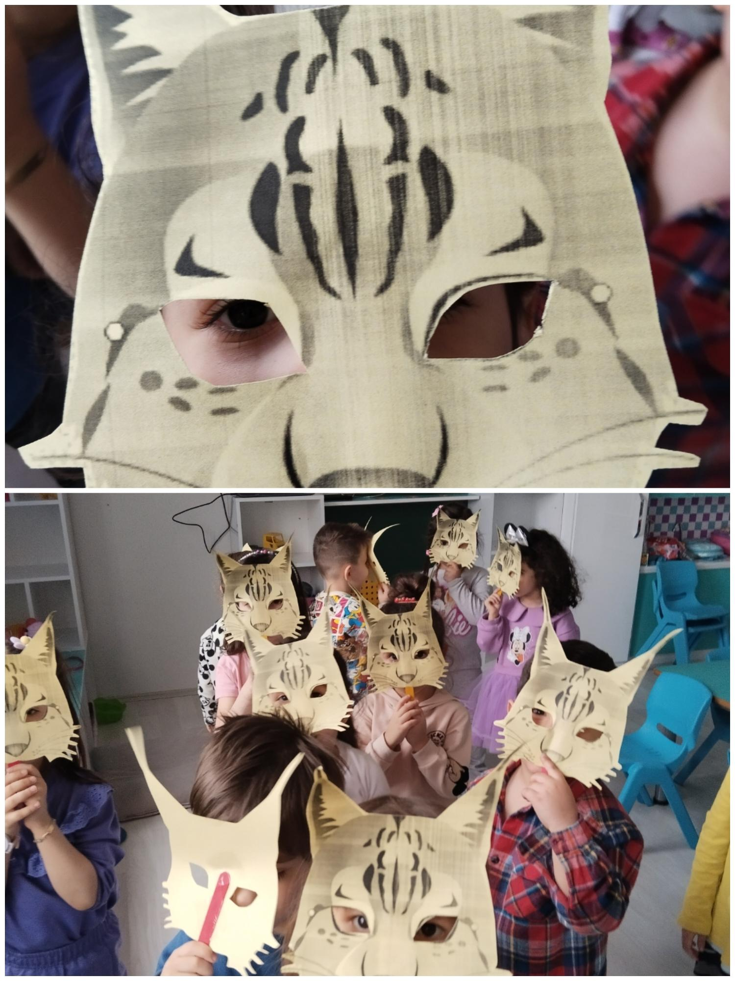
Ayşegül ATEŞ Selçuklu Belediyesi Saygı Anaokulu
I met new people. And with children. With children who just know and understand me

