Slide 1
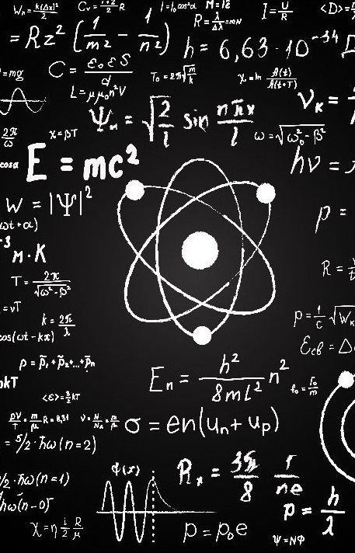
An interview with the greatest scientist of this universe

Slide 2
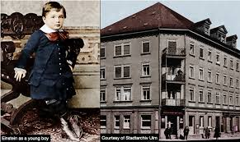
Professor Einstein, can you tell us about your early childhood? | I was born in Ulm, Germany, in 1879. As a child, I was quiet and observant. My excitement with science began when my father gave me a simple compass—I was hypnotized by the needle's movement and wondered about invisible forces.

Slide 3
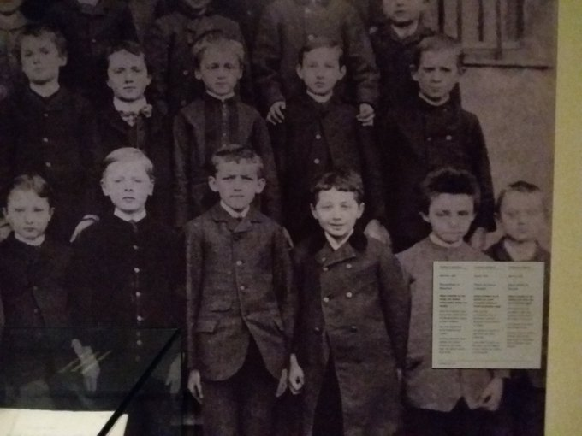
Is it true that you struggled in school? | That is a common myth! I was not a poor student, but I did find the traditional teaching style very bad. I preferred self-learning, which led me to read advanced mathematics and philosophy at a young age.

Slide 4
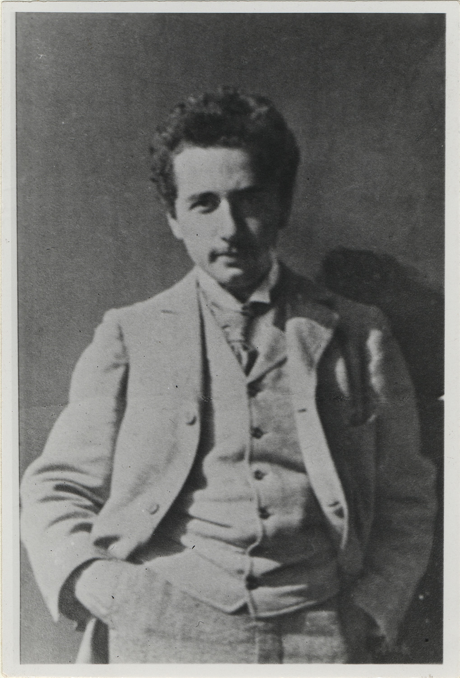
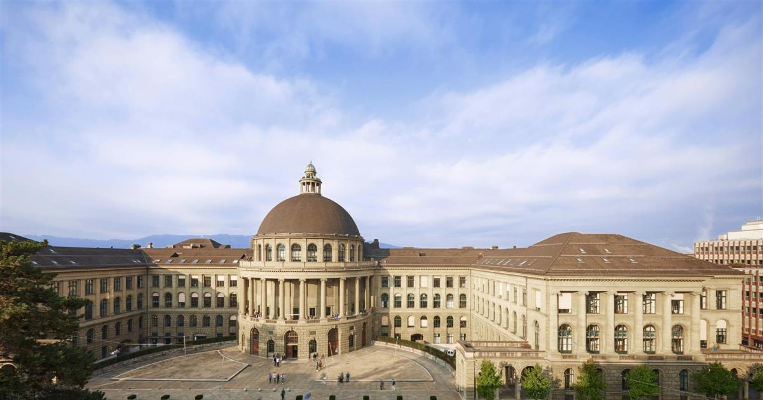
Why did you move to Switzerland as a teenager? | I left Germany in 1895 and later started my studies at the Swiss Federal Polytechnic in Zurich. It was there that I found an environment that fitted my independent thinking.

Slide 5
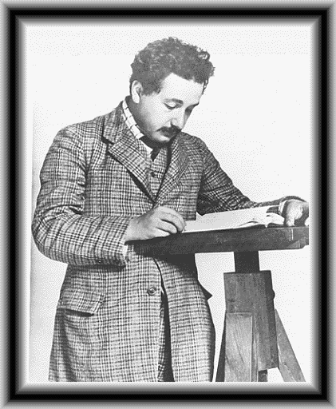
What were your first years after graduation like? | I struggled to find an academic position, so I took a job at the Swiss Patent Office. Surprisingly, this routine work allowed me the mental freedom to develop my ideas about physics.

Slide 6
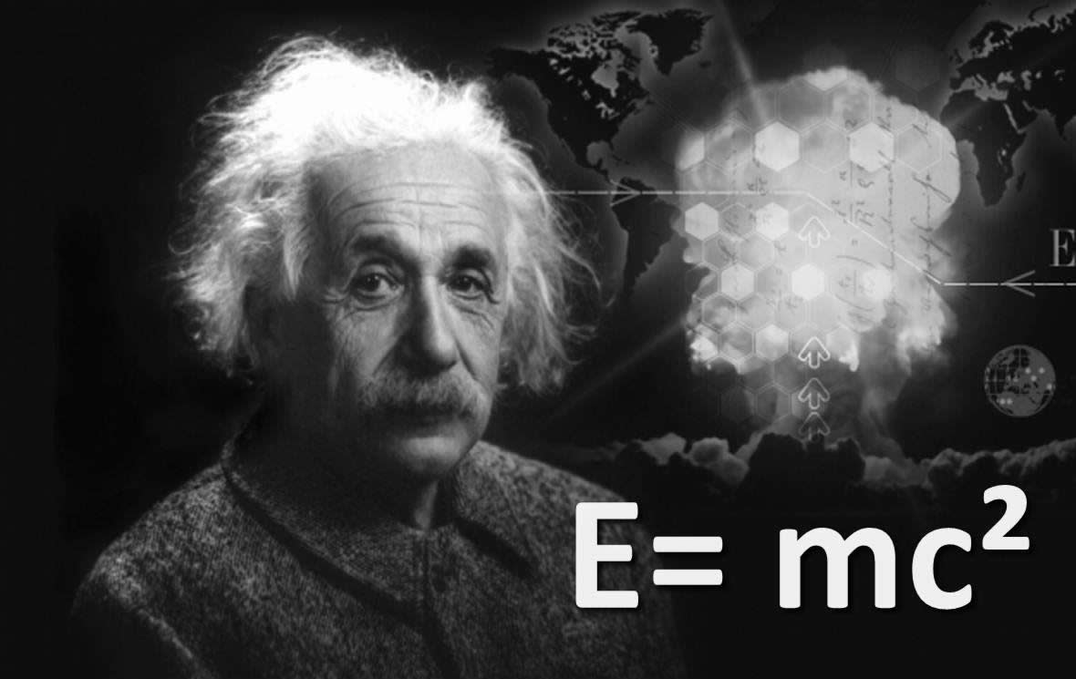
Your "miracle year" in 1905 produced groundbreaking papers. How did that happen? | While working at the Patent Office, I published four papers that changed physics forever. These included my work on the photoelectric effect, Brownian motion, special relativity, and the famous equation E=mc².

Slide 7
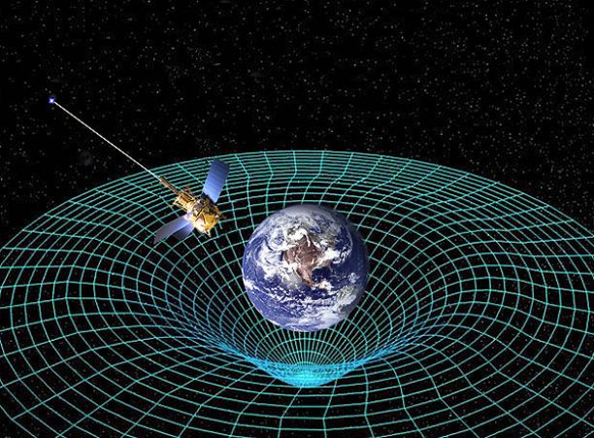
How did your theory of relativity change the world? | Special relativity changed our understanding of space and time, while general relativity, developed later, showed how gravity warps space itself. When my predictions were confirmed in 1919, my name became known worldwide.

Slide 8
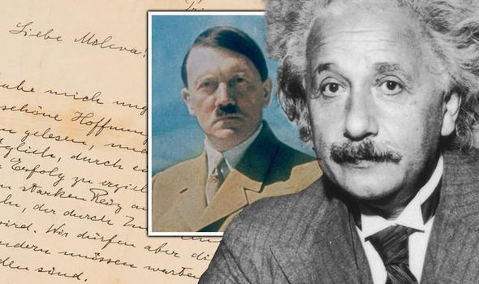
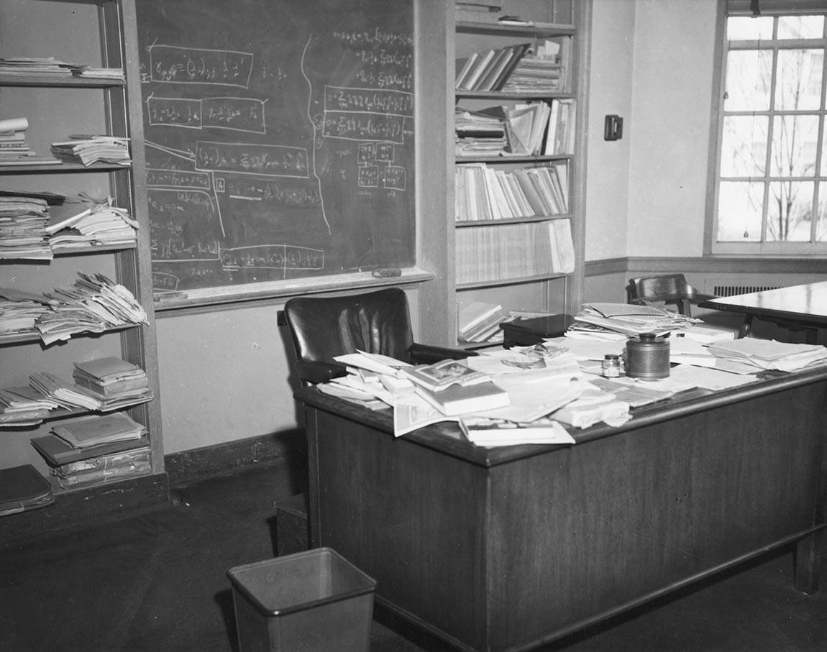
You fled Germany in the 1930s. What led to that decision? | As a Jewish scientist, I saw the rise of the Nazis as a great danger. I left for the United States in 1933 and took a position at the Institute for Advanced Study in Princeton.

Slide 9
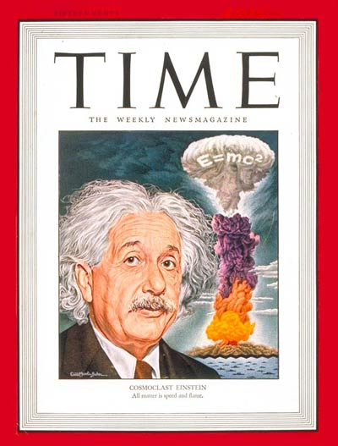
What role did you play in the development of the atomic bomb? | I personally opposed war, but I co-signed a letter to President Roosevelt in 1939 warning that Nazi Germany might develop nuclear weapons. That letter contributed to the Manhattan Project, though I was not involved in the actual research.

Slide 10
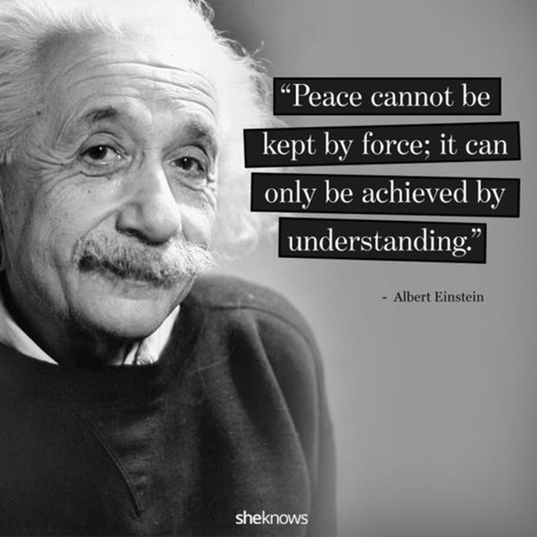
What was your greatest hope for humanity? | I always believed in the power of science and reason, but above all, I wished for peace. After World War II, I fought against the nuclear weapons and for the global cooperation.

Slide 11
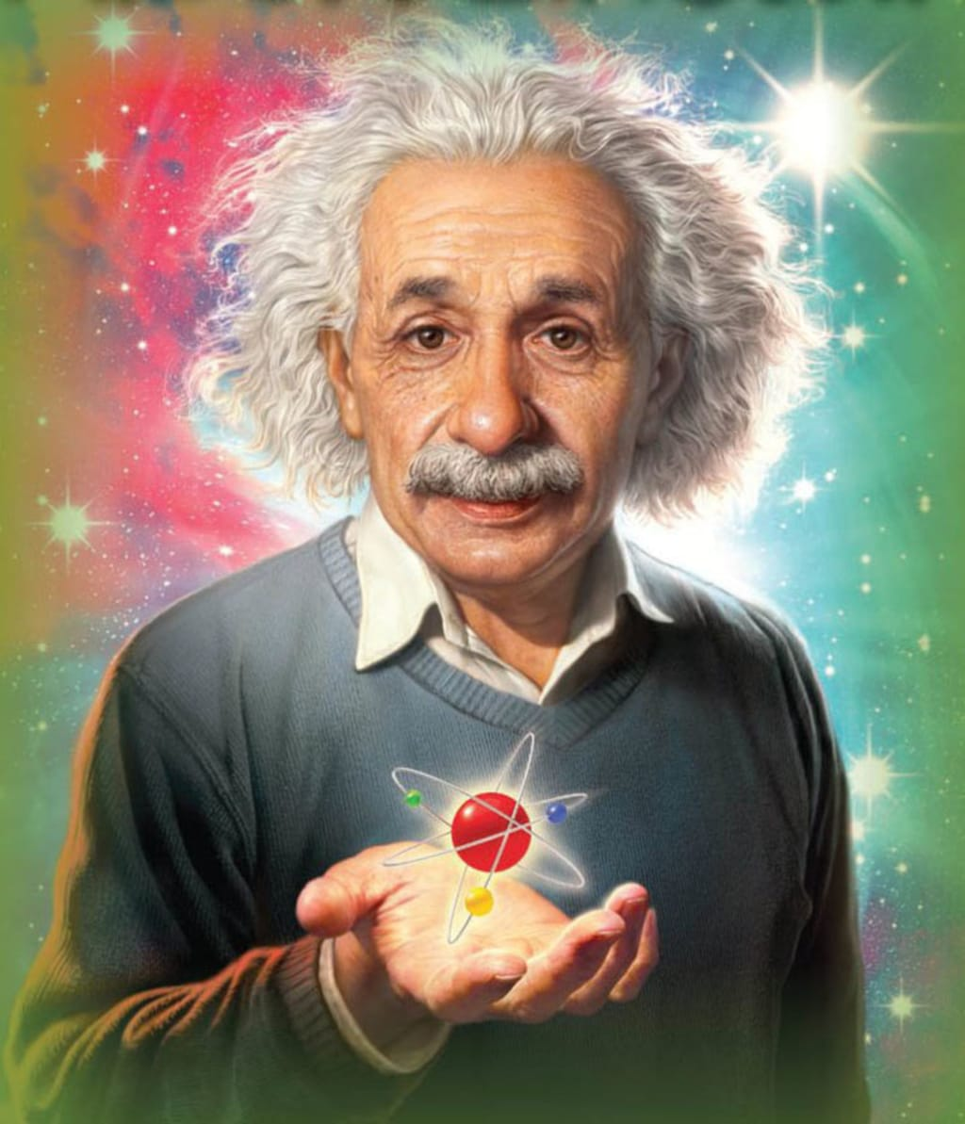
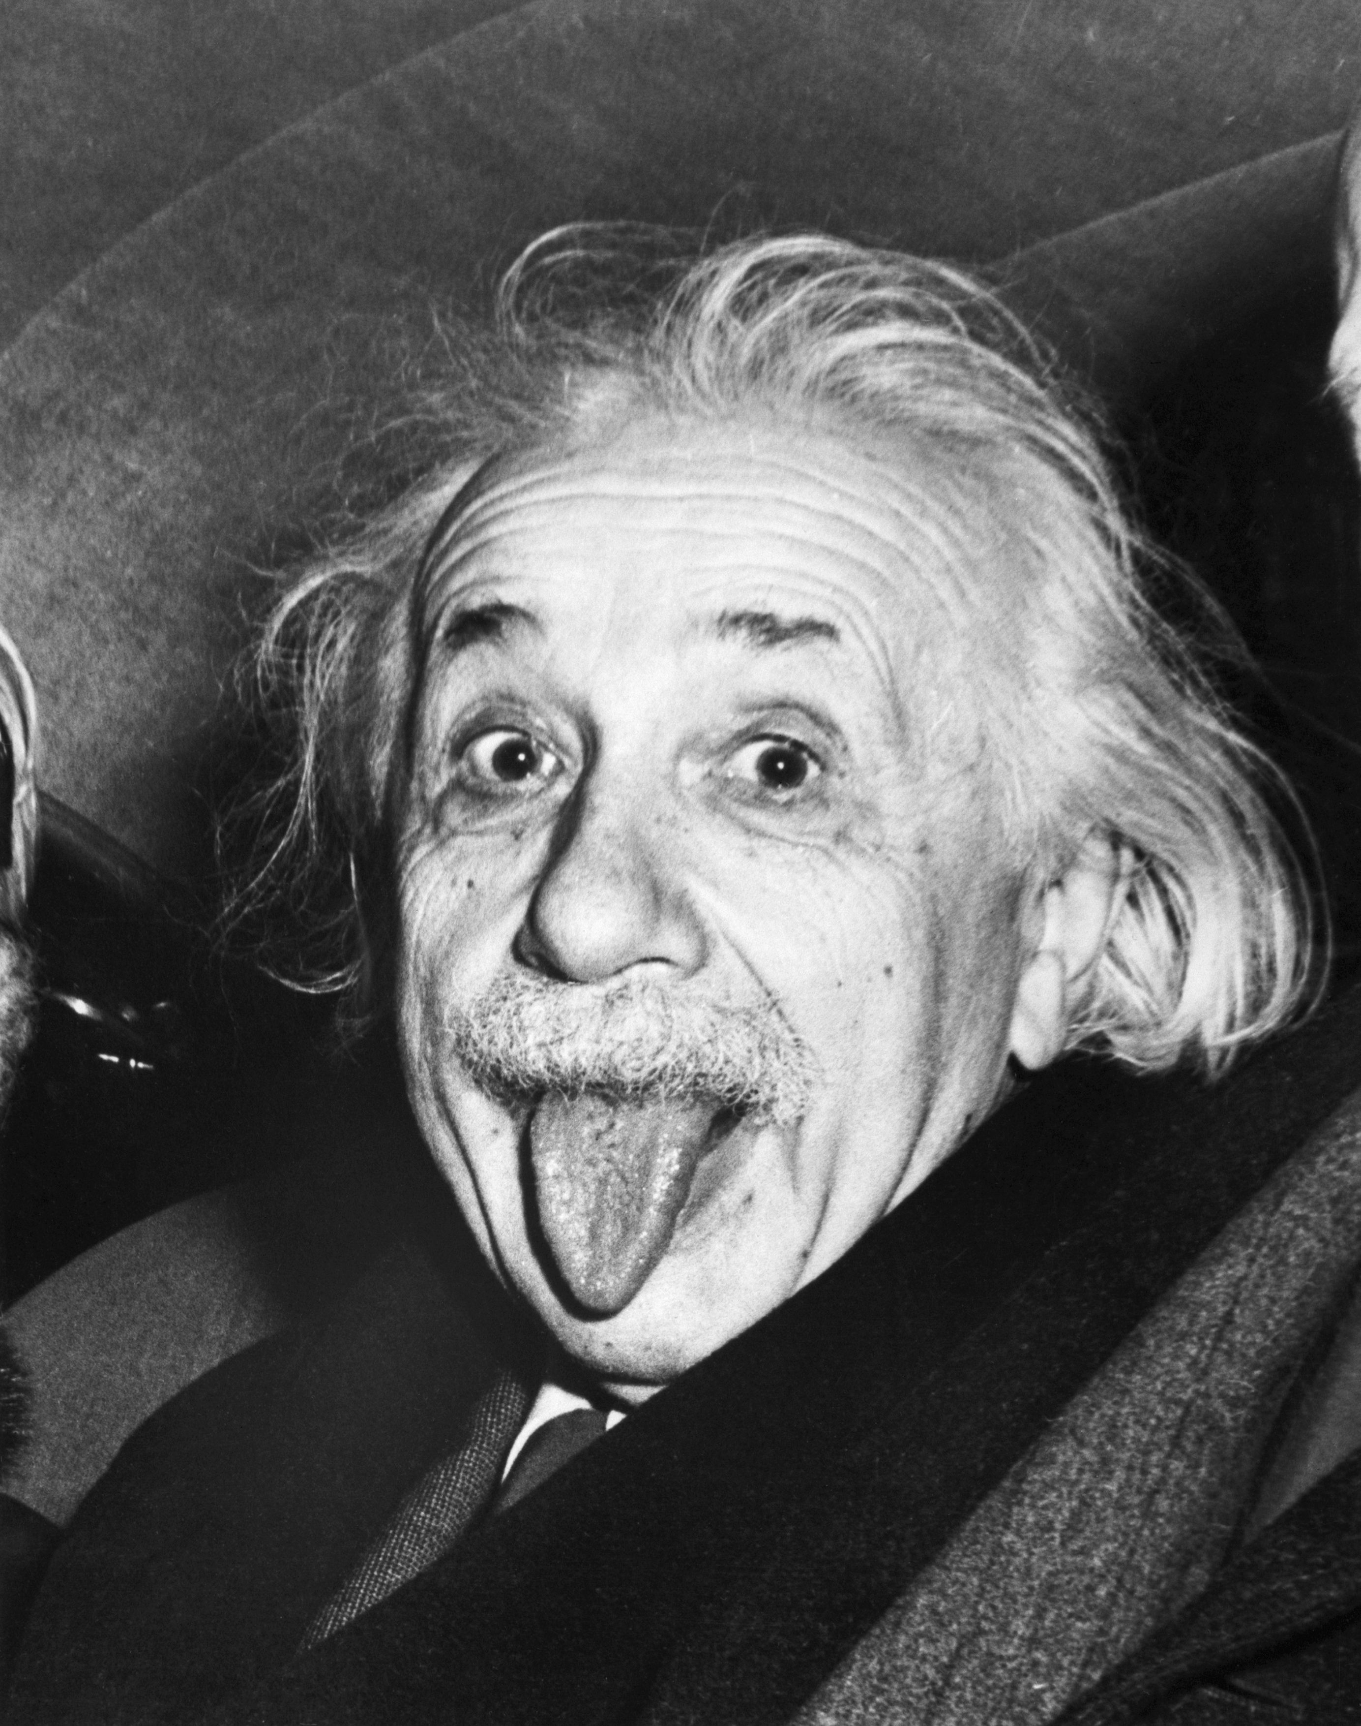
Looking back, what do you consider your greatest achievement? | Beyond any single equation, I am proudest of changing how we think about the universe. My curiosity and desire to understand nature shaped my life, and I hope they continue to inspire others.

