Slide 1
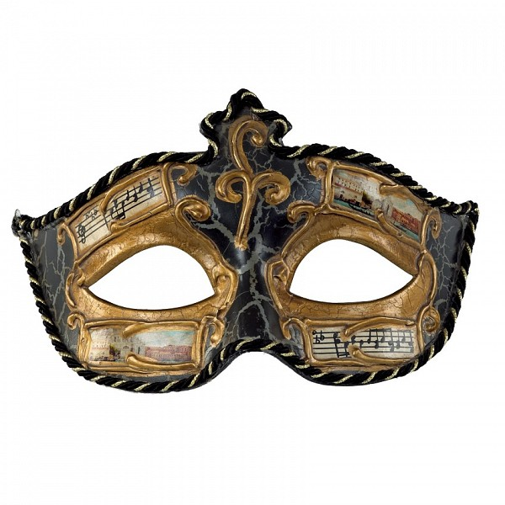
Interviewer : Good morning miss Penny . So , you have applied for the leading role of the play “ Phantom of The Opera” ,right?
.

Slide 2
Penny: Yes , that is right . I have applied for the role!

Slide 3
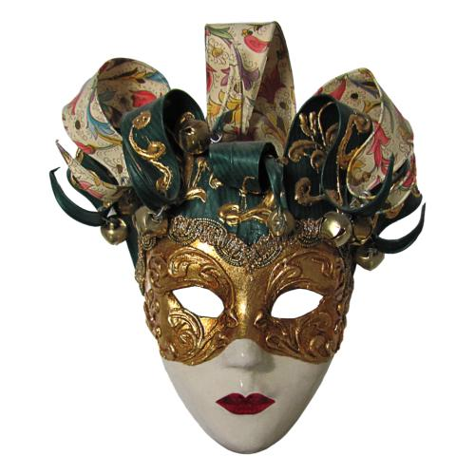
Interviewer : Can you tell me what made you reply to our advertisement?

Slide 4
.
Penny: I have studied acting in the “Royal Drama Academy” for three years and I am really interested in following this career .

Slide 5
Interviewer: Have you had any previous experience?

Slide 6
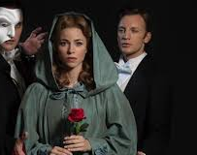
.
Penny : Yes! I have performed in a play called “Friends “!

Slide 7
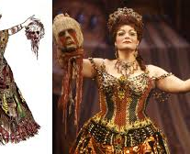
.
Interviewer: Very nice ! What makes you think that you are suitable for this role?

Slide 8
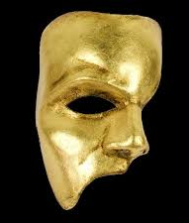
.
Penny: I believe that I would be perfect for this role because I love acting , singing and dancing . I have dreamed about starring in this play since I saw it for the first time , when I was 10 years old .

Slide 9
.
Interviewer: I think I have asked everything I needed to know . Thank you . Now you can ask me any questions you may have !

Slide 10
.
Penny: Thank you . When will I know if I have been selected?

Slide 11
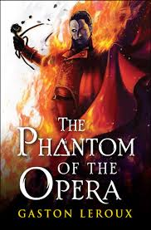
.
Interviewer: We will contact you to let you know when you can come to the audition until next Wednesday .

