Slide 1
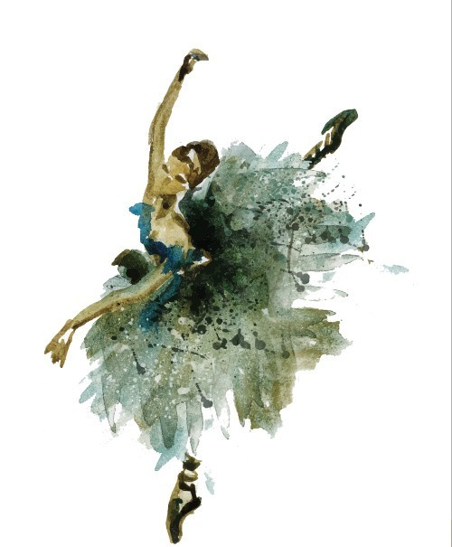
Interview
Interviewer: Good morning miss Nefeli ! So , you have applied for the position of dance teacher , right?

Slide 2
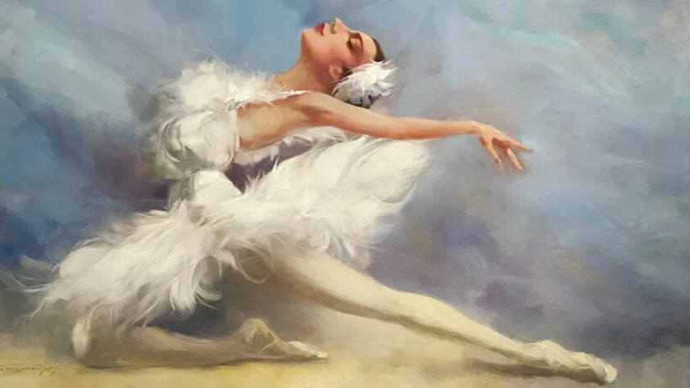
NEFELI : Good morning! Thank You for inviting me to the interview . And yes I applied for the dance teacher position !
.

Slide 3
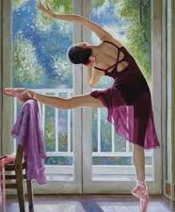
INTERVIEWER : CAN YOU TELL ME WHAT MADE YOU REPLY TO OUR ADVERTISEMENT?
.

Slide 4
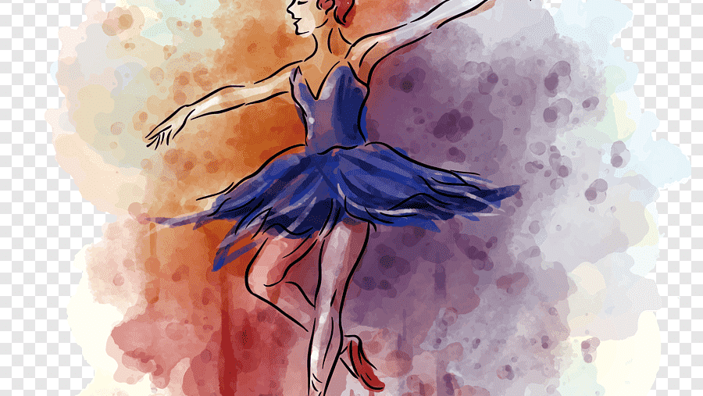
NEFELI :SO , I WAS 2 YEARS OLD WHEN I STARTED DANCING AND since THEN I have WANTED TO BECOME A DANCE TEACHER.
.

Slide 5
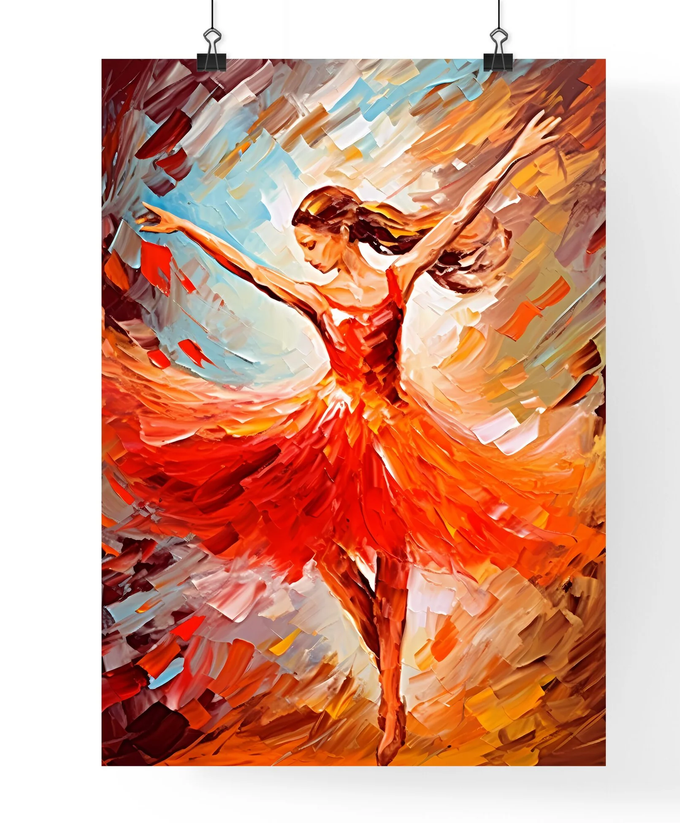
Interviewer : do you know exactly what you would be doing as a dance teacher?
.

Slide 6
Nefeli : as a dance teacher I imagine I would have to teach kids and adults how to dance and prepare them for any dance competitions.
.

Slide 7
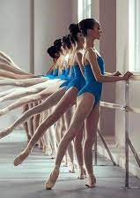
Interviewer : that’s very nice and interesting! WHAT KIND oF STUDENT WERE YOU?
.

Slide 8
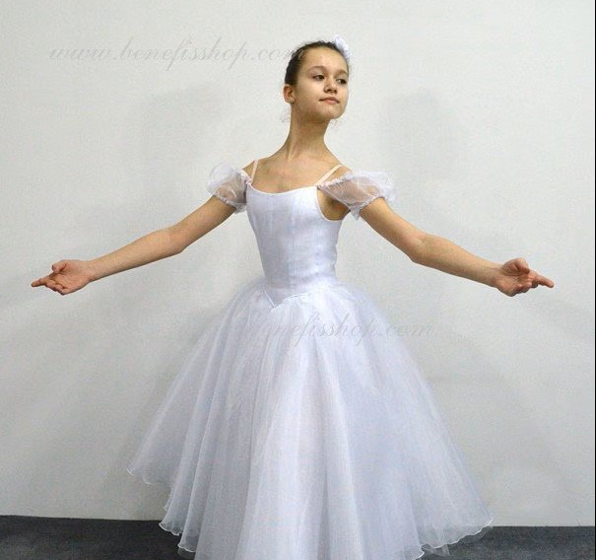
NEFELI: I WAS A VERY GOOD STUDENT
.

Slide 9
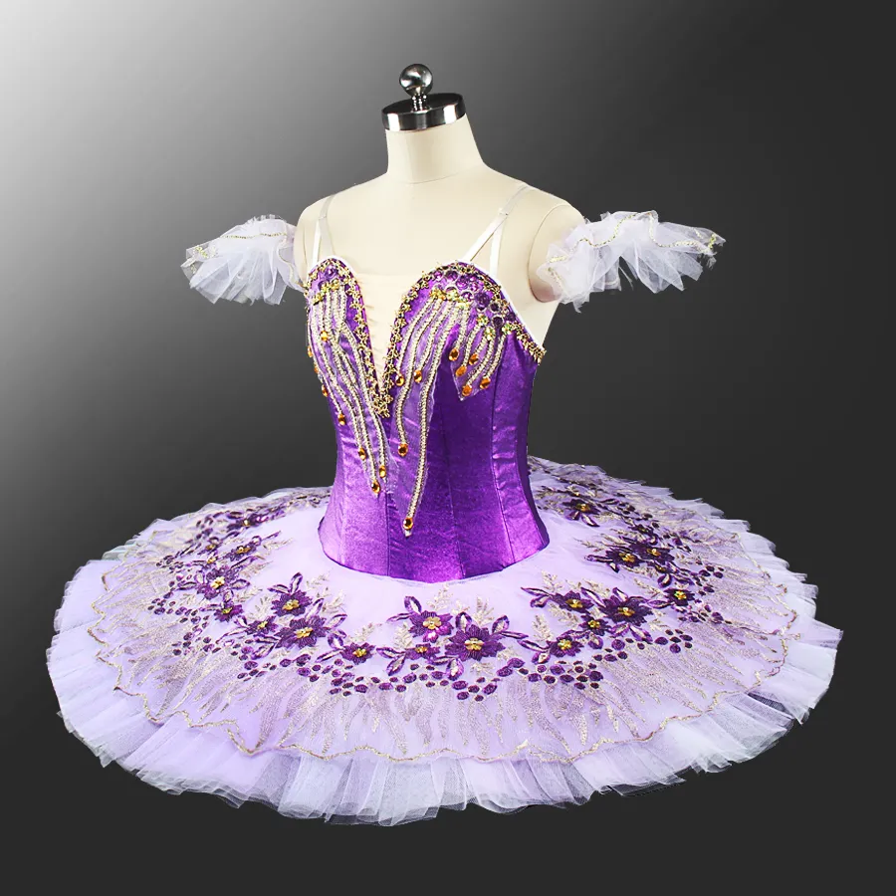
INTERVIEWER : SO, NOW YOU CAN ASK ME ANY QUESTIONS you may have!
.

Slide 10
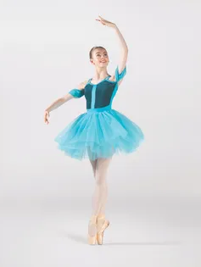
NEFELI: I would like to know what time my job would start.
.

Slide 11
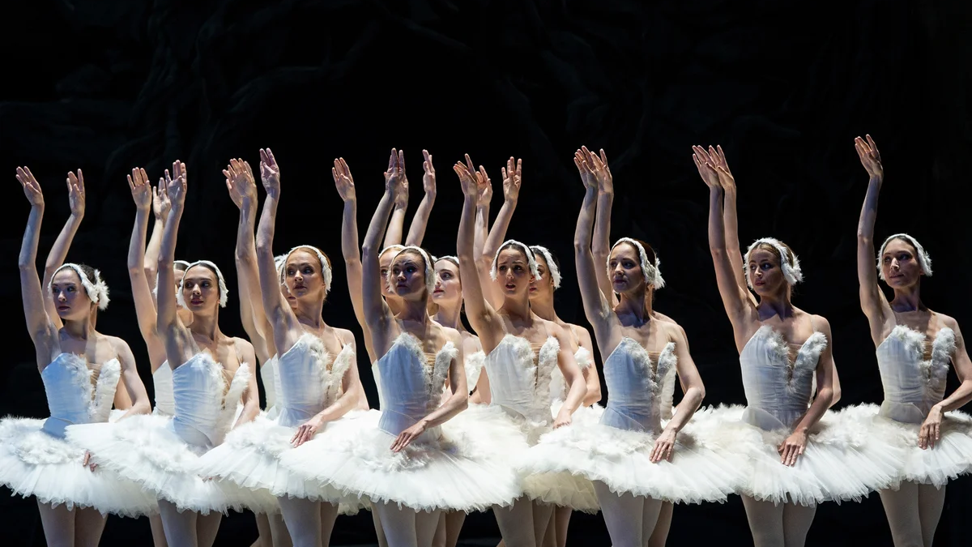
Interviewer :YOU CAN COME AT 5:00 IN THE AFTERNOON! I HAVE ASKED EVERYTHING I WANTED ! Thank you for coming!
.

Slide 12
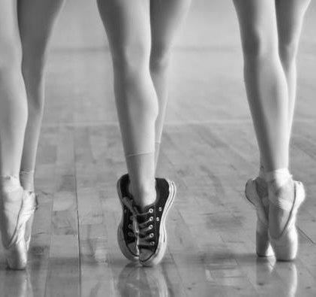
Nefeli :Thank you ! When will I know if I have been selected for the job?
.

Slide 13
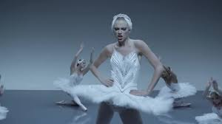
Interviewer :We will be making our decision next Thursday and we will let you know.
.

