Slide 1
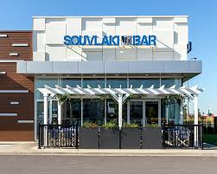
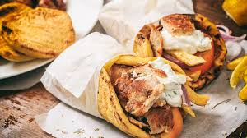
Job Interview

Slide 2
-Hello!
-Hello! You are going to answer some questions about
this job.
-What job I am going to do?
-You are going to be a «souvlatzis»! You don’t know what
job you are going to do?
-I think that I know, but if you were my boss I would be
very sad because you are very rude, but I don’t know
how it goes…
-Ok… Never mind. What is your name?

Slide 3
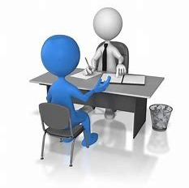
-My name is Mustardela.
-Mustardela? Can you repeat it?
-MUSTARDELA!
-Ok. The next!
-No no! Wait wait! My real name is Angela [oh God].
-Well, what is your surname?
-My surname is Betson.
->: ( Ok, how old are you?

Slide 4

-I am 21 years old.
-Fine. Next question: Are you patient?
-Sometimes, unless the customer is annoying.
-It is very important to be patient with your customers. If you
do something stupid, you won’t get paid for a long time!

Slide 5
-Ok ok I understand.
-Your basic salary is 500 euros.
-If I were you, I would give bigger salary.
-500 euros are ok!
-Ok, ok! Don’t be angry! So, did I get the JOB?
-Mmm… I don’t think so.
-What???????
-Ok. You got the job! CONGRATULATION
-YEAAAAAA!!!!!!!!!

Slide 6

-Oh! Before you go, I want to ask you the last question.
Do you like souvlaki?
-Of course NOT!!!
-☹
-I mean that I like it!
-Ok. See you tomorrow at 2 o’ clock! Bye!
-Bye!
Fedra, Eugene
ST2

