Slide 1
Come to my party
- Konstantinos taxiarchis roussas

Slide 2
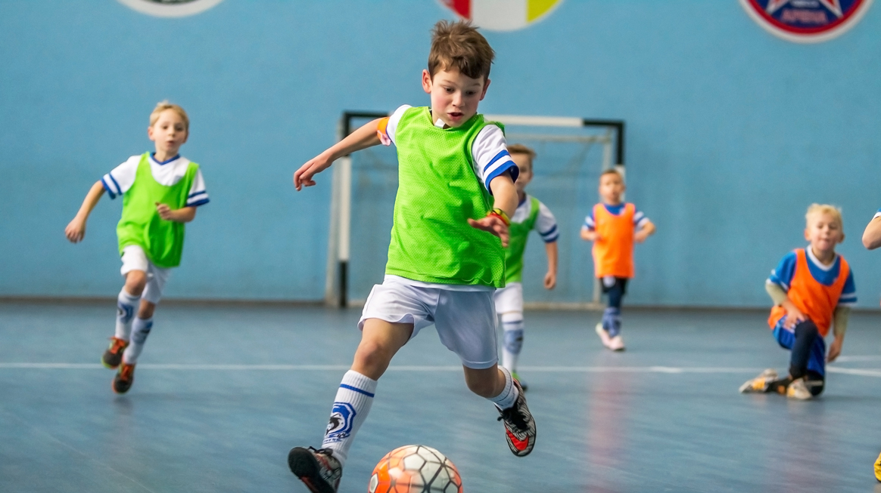
More info
Hello Konstantine,
I want to invite you to my party for my birthday! 🎉
We will play football, eat pizza and have fun! ⚽
I will be very happy to see you! 🥳
The party is next Sunday, January 12th, at 6 pm at Pefki’s football stadium! 🏟️
See you there! Your friend,
Konstantinos!

Slide 3
Thank you
KONSTANTINOS ROUSSAS
D΄2

