Slide 1
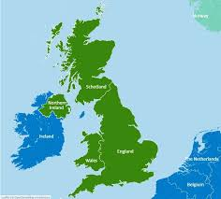
Our next destination was the United Kingdom.

Slide 2
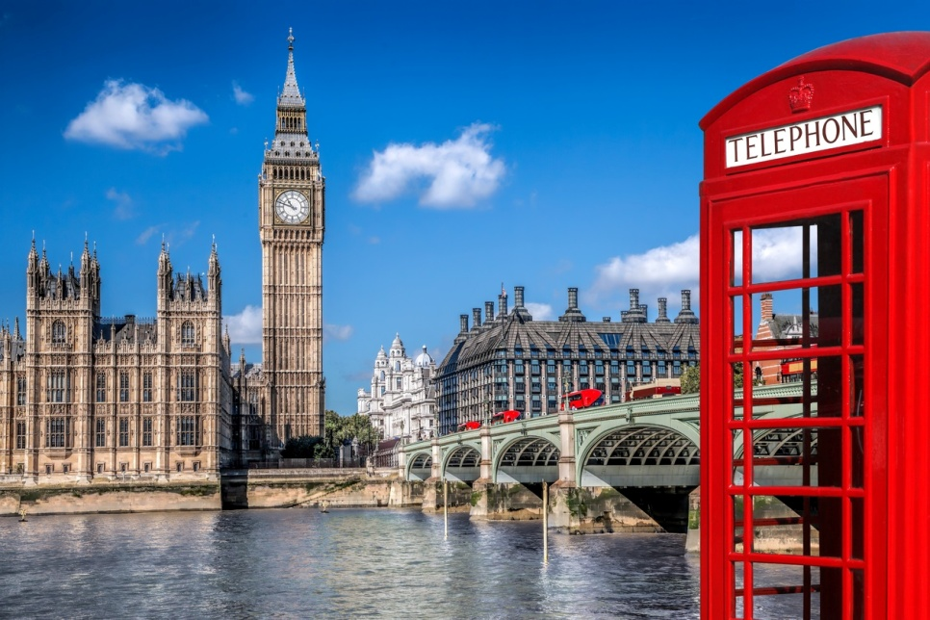
We talked about its counties and we focused on Great Britain and its capital, London.
We discussed about the fact that London is a cosmopolitan city and we went on a visual tour around the center.

Slide 3
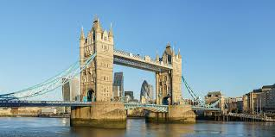
Our first stop was London Bridge. We talked about its history and we sang the song “London Bridge is falling down”.
https://www.youtube.com/watch?v=xaXCf_fPD2k

Slide 4
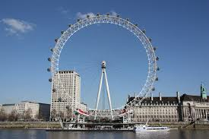
Our next stop was the London Eye. The students were excited by its spectacular view and they were thrilled to ask their parents to travel to London the soonest possible!

Slide 5
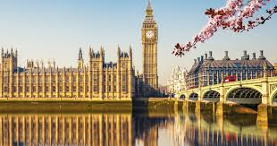
Then we talked about The Big Ben and watched a video about the way it strikes.
https://www.youtube.com/watch?v=mNlugNFwLII

Slide 6
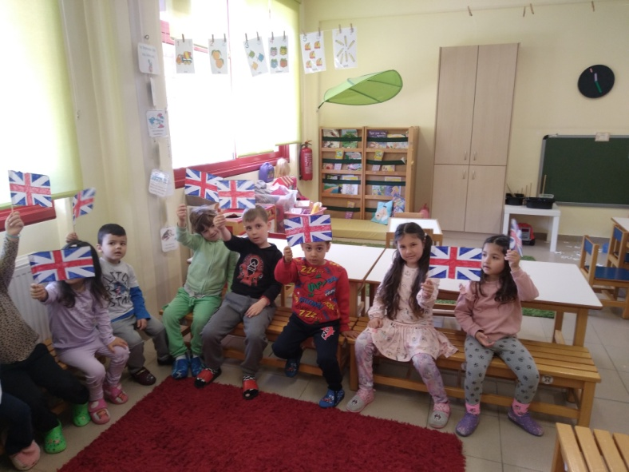
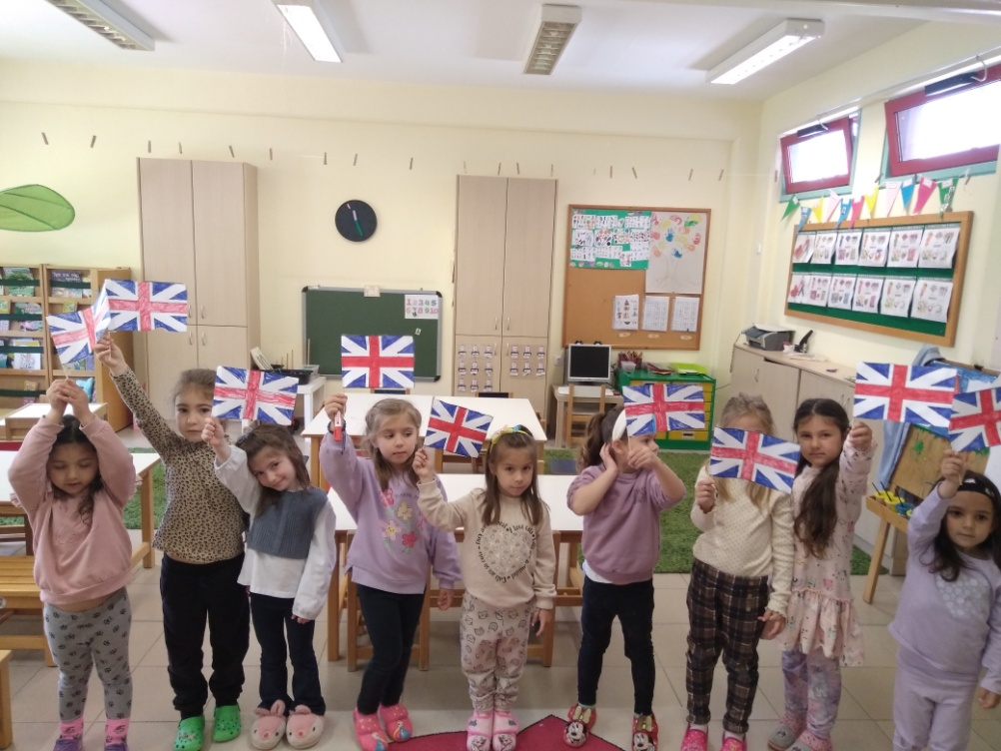

We made a flag.

Slide 7

We danced some traditional medieval dances.

Slide 8
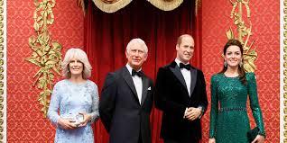
We paid a visit to some of the most famous museums! Madam Tussaud’s

Slide 9
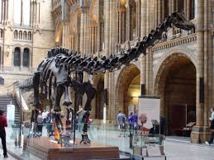
The Natural-History Museum

Slide 10
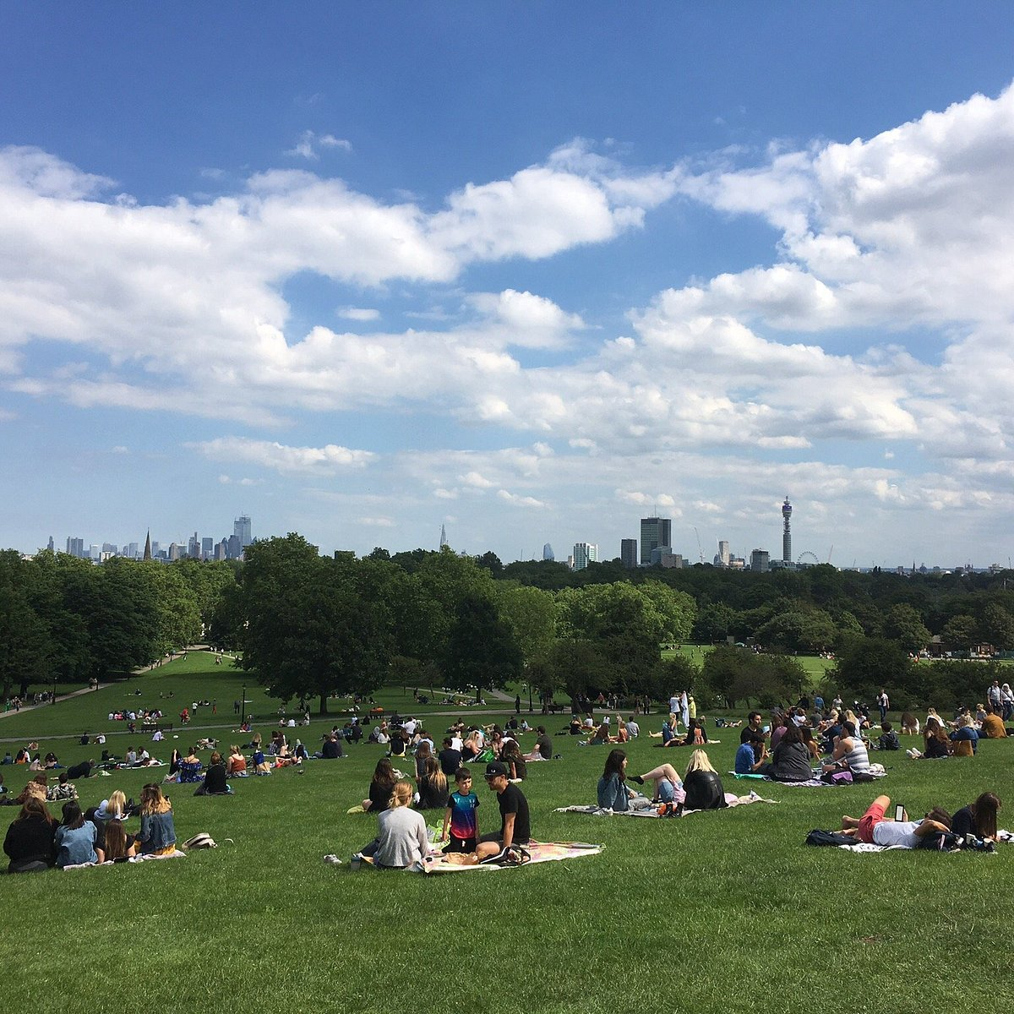
We hung around the Hyde Park using our imagination…

Slide 11

And we promised to become fluent speakers of English until we visit the country….

