Slide 1
AFRICA

Slide 2
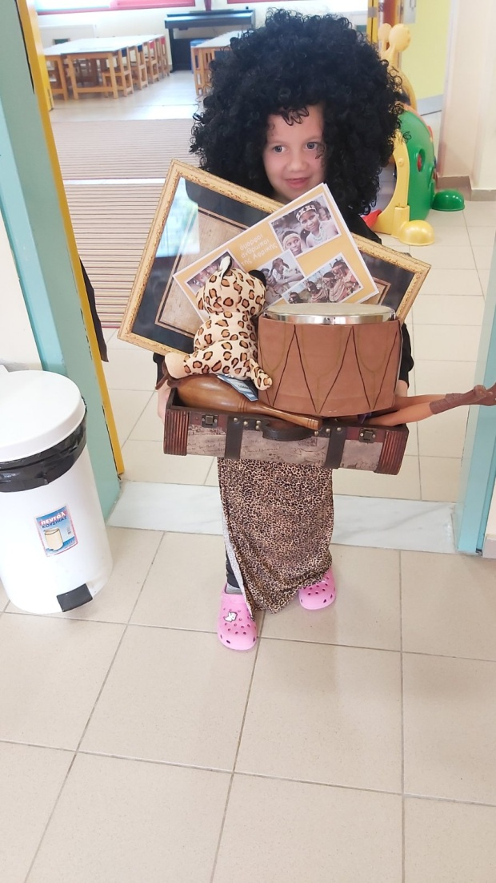
Next destination is the continent of Africa.
Our exotic friend visited us, of course, bringing to our
classroom with her suitcase souvenirs from Africa.

Slide 3
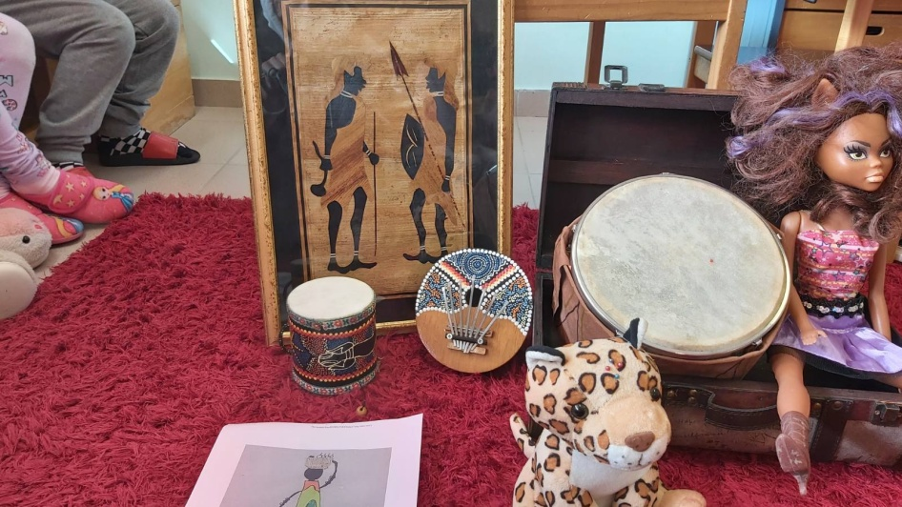
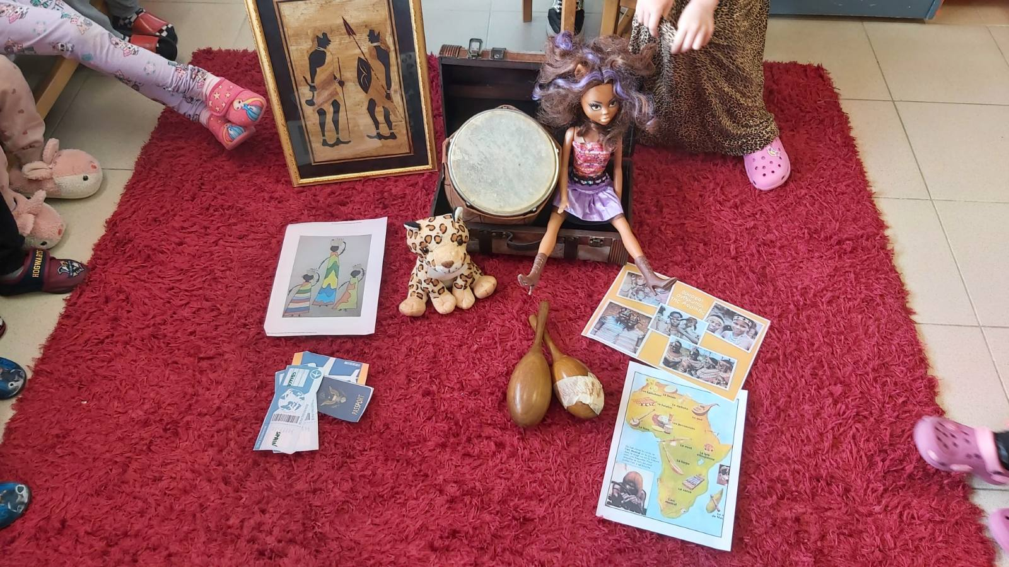
We talked, we got to know the continent, its countries,
the habits of its inhabitants and its place on the world map.

Slide 4
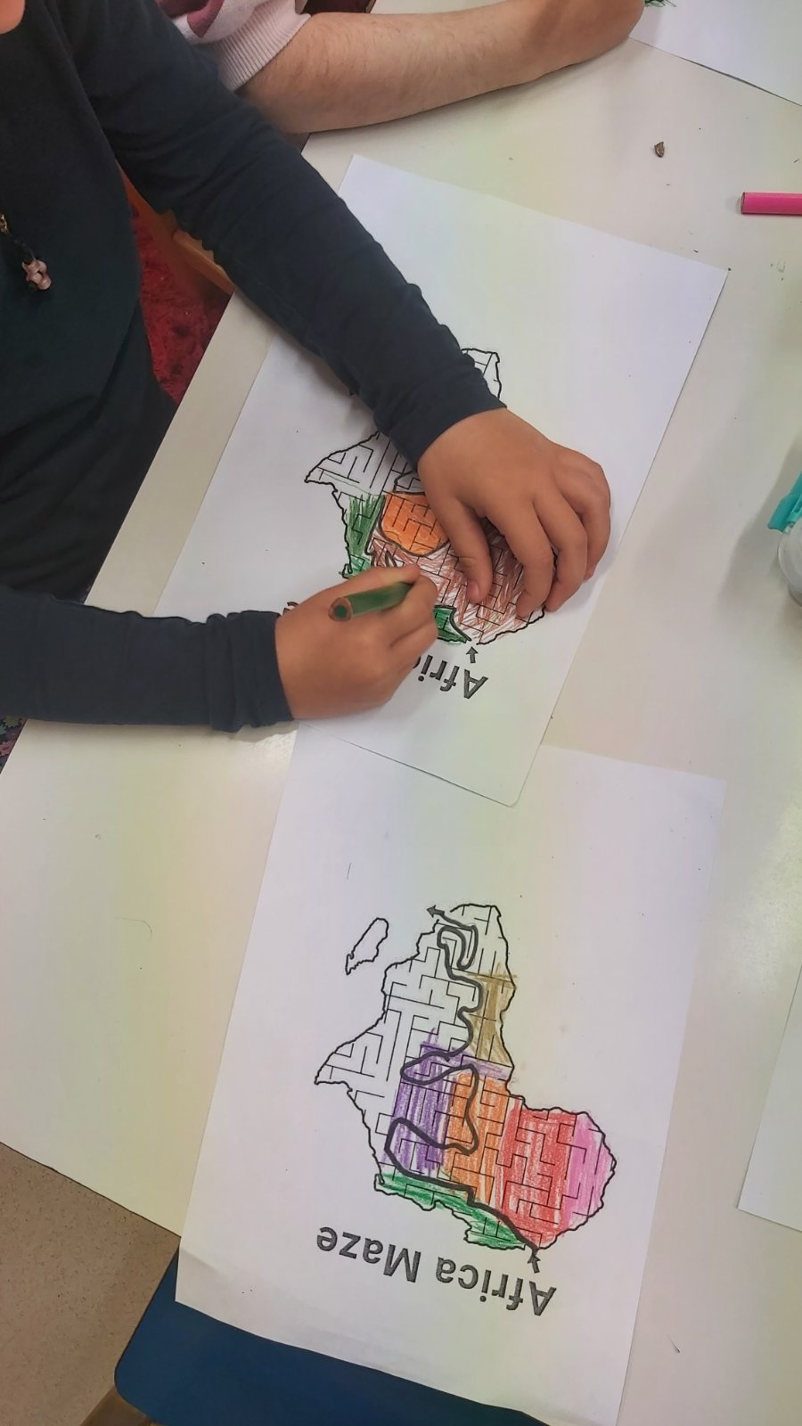
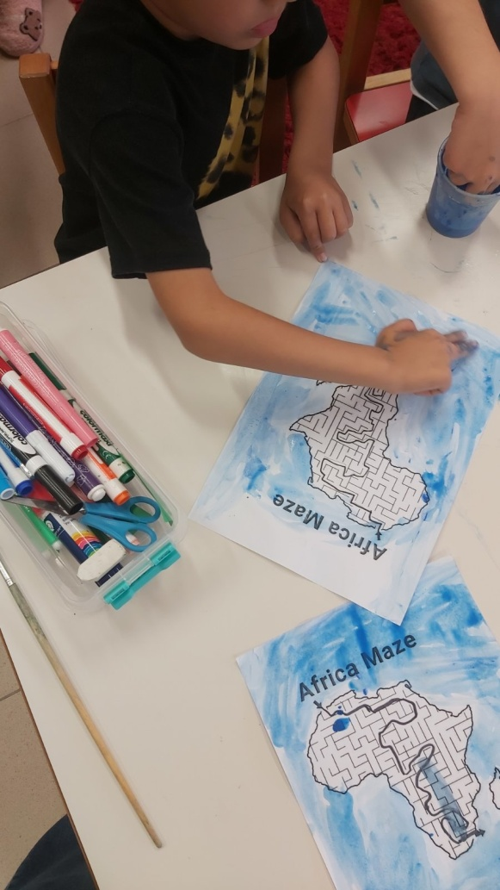
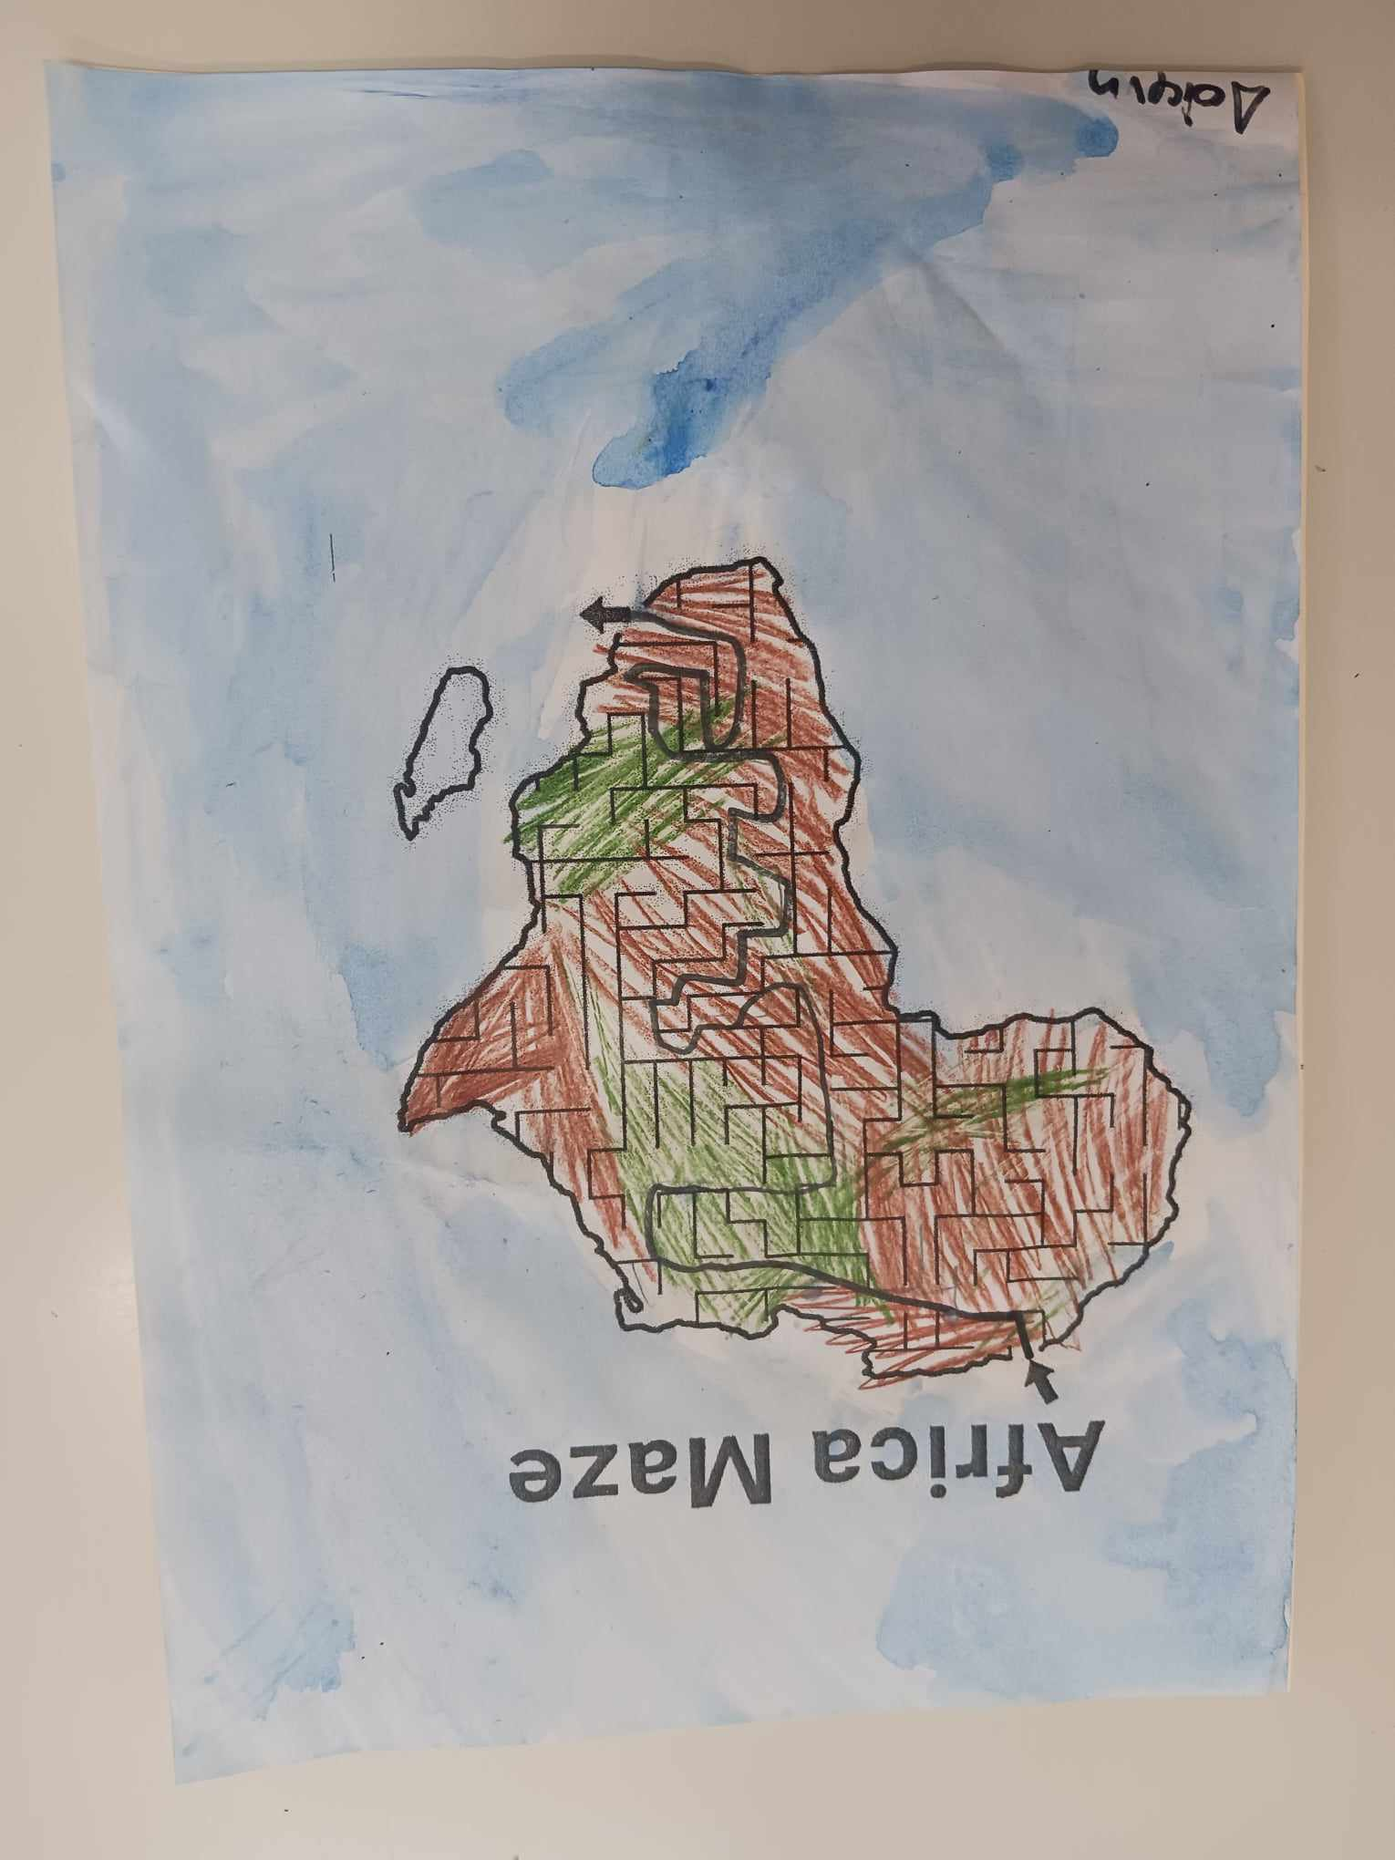
We took her through a labyrinth

Slide 5
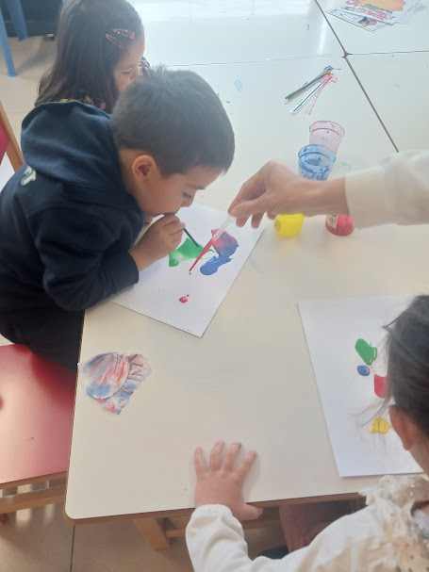
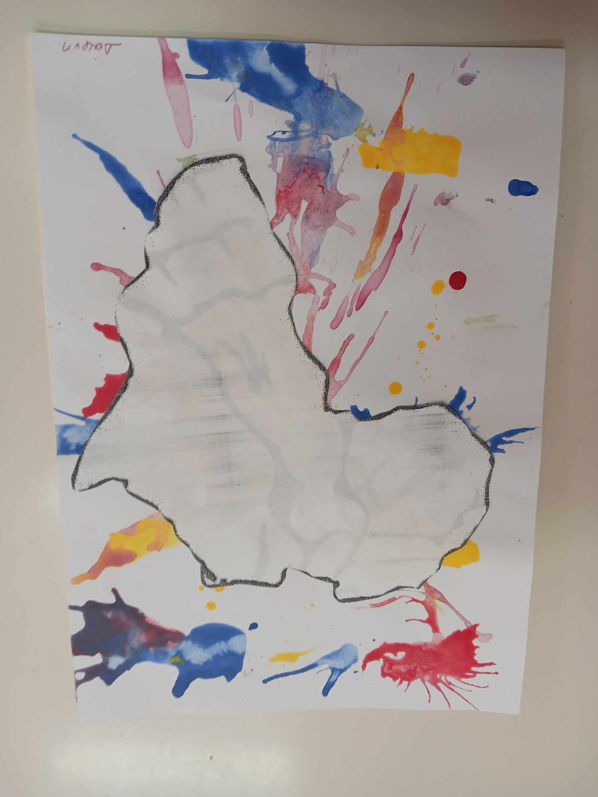
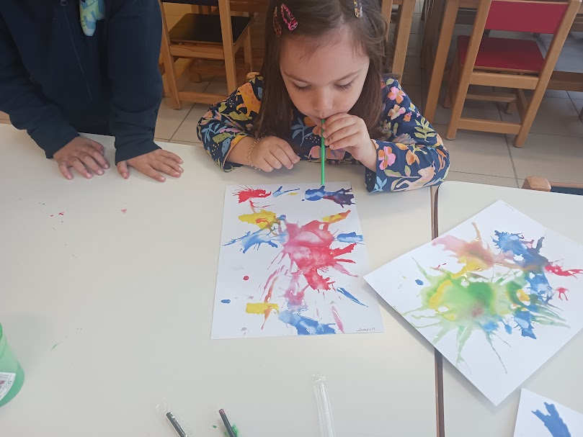
We placed her in a colorful world

Slide 6
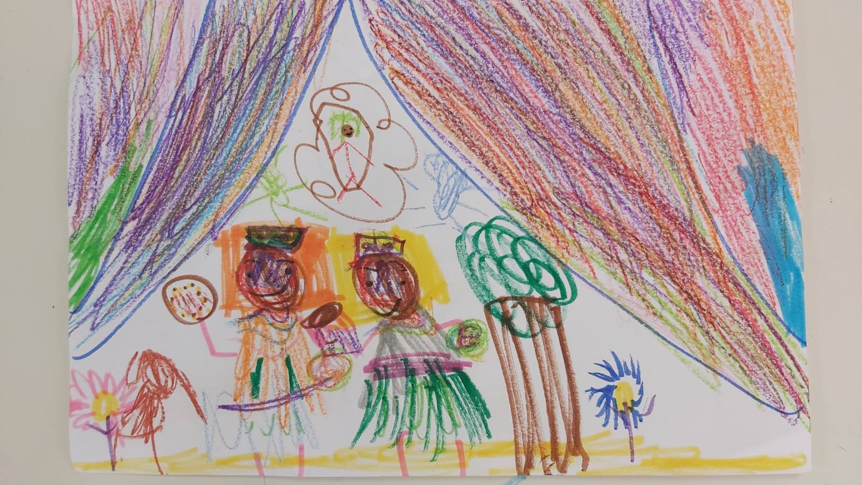
We painted the inhabitants of…

Slide 7
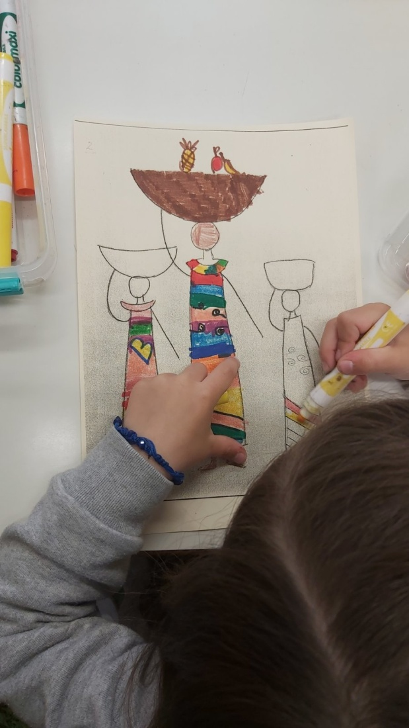
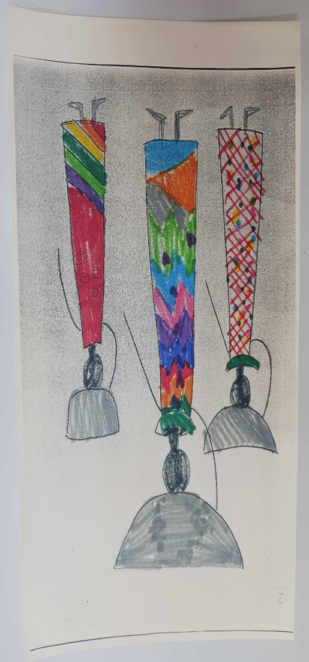
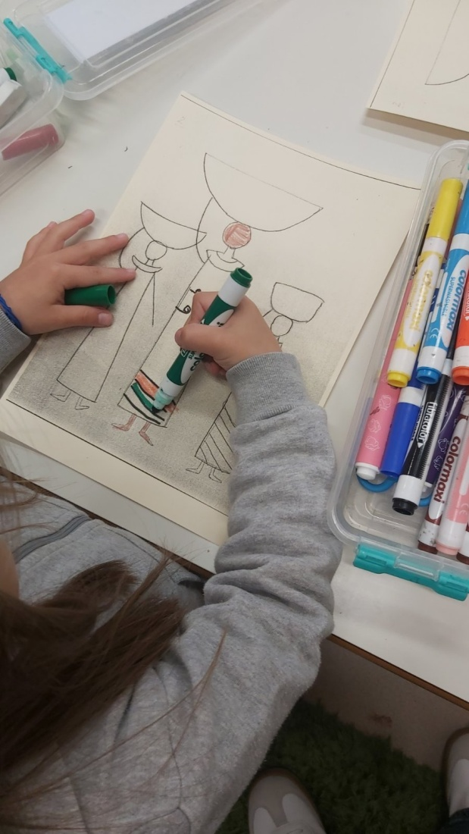

Slide 8
We listened to a lot of music…….
Music on the African continent is an integral part of everyday life as part of religious ceremonies, celebrations and social rituals.
It is closely linked to the most important events in people's daily lives.

Slide 9
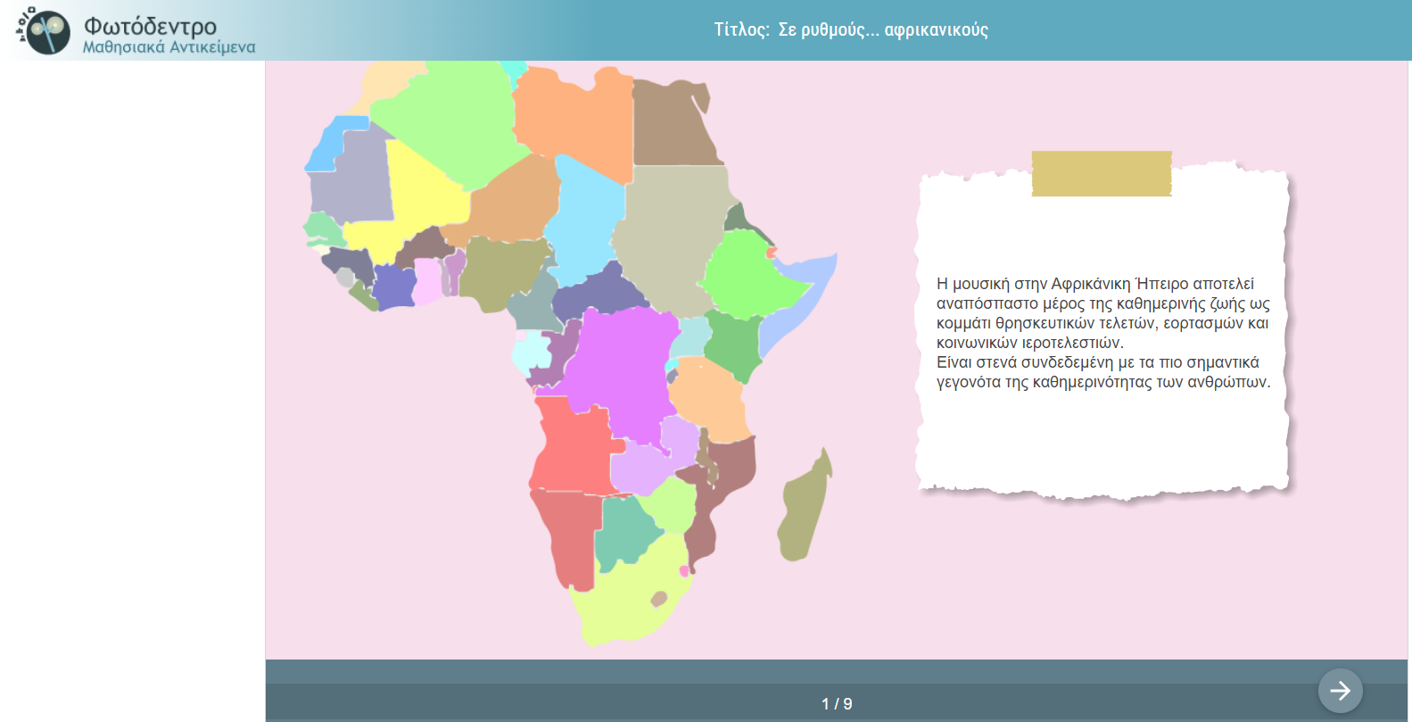
We moved to the rhythms of ... African
https://photodentro.edu.gr/v/item/ds/8521/11100

Slide 10
Δημιουργήσαμε ένα δικό μας αυτοσχέδιο μουσικό κομμάτι χρησιμοποιώντας το σώμα μας

Slide 11
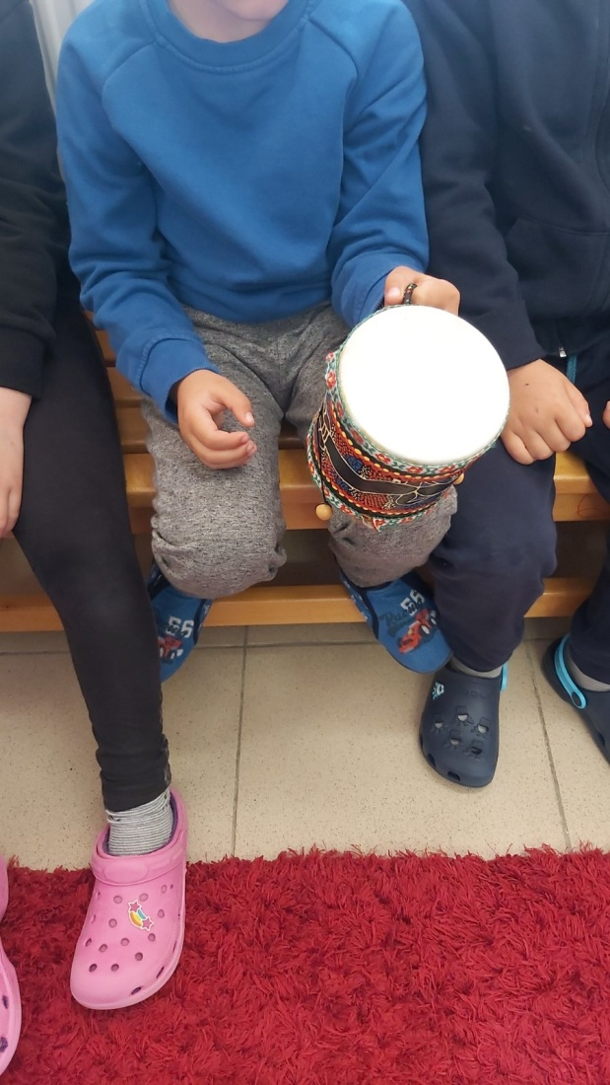
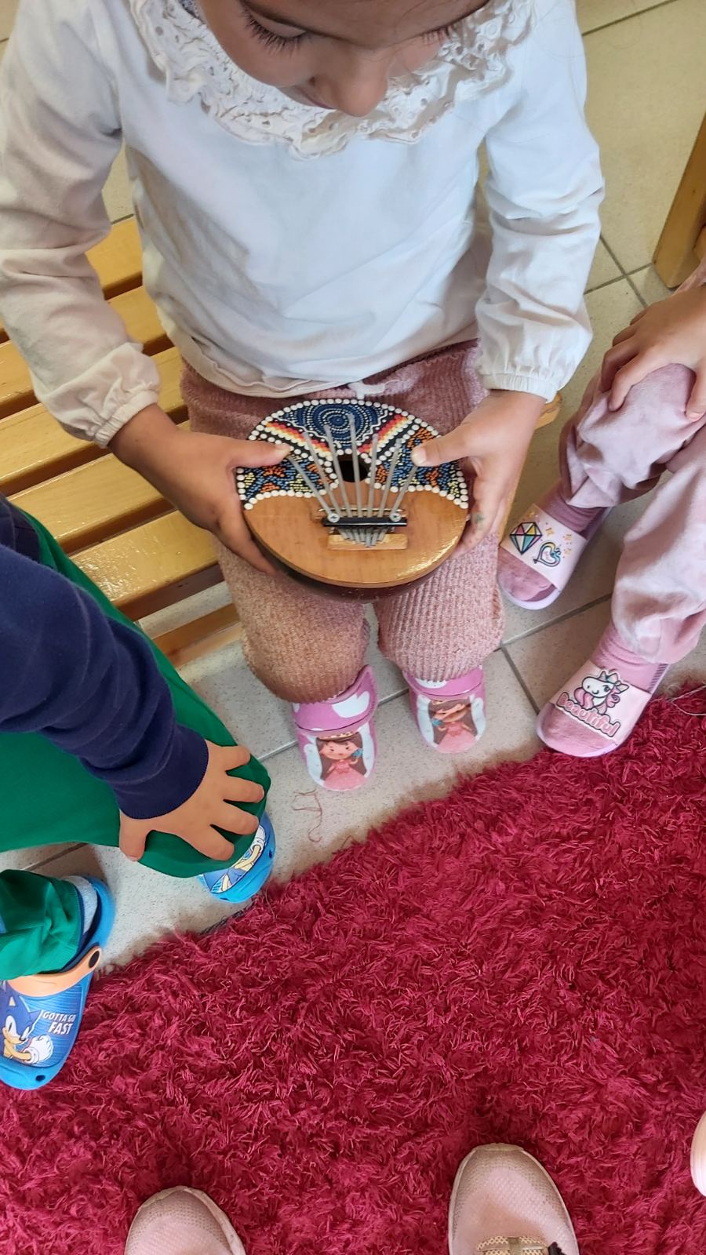
We brought African musical instruments to the school.

Slide 12
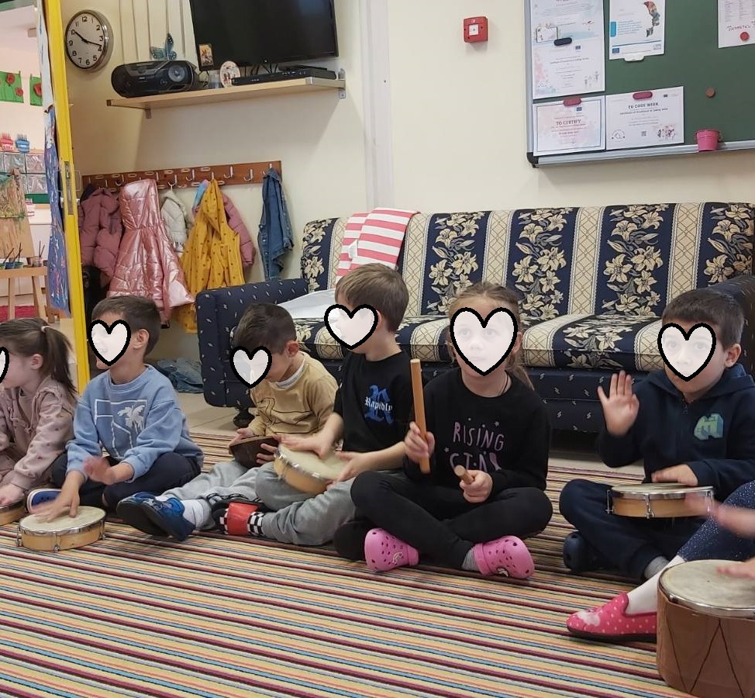
We played music

Slide 13
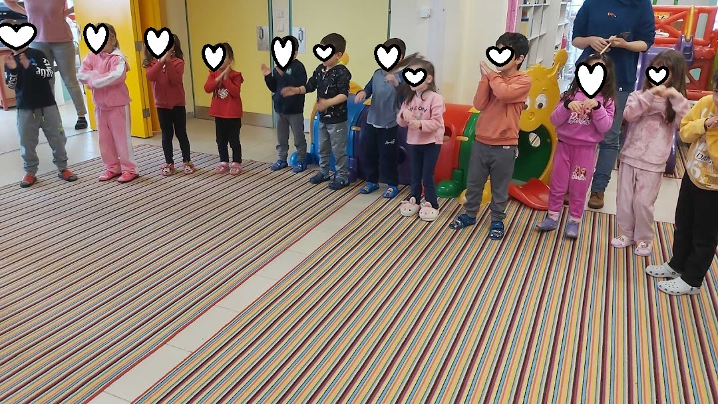
We danced the game song from Morocco “RAM SAM SAM “
https://www.youtube.com/watch?v=HwoXD_RVETg

Slide 14
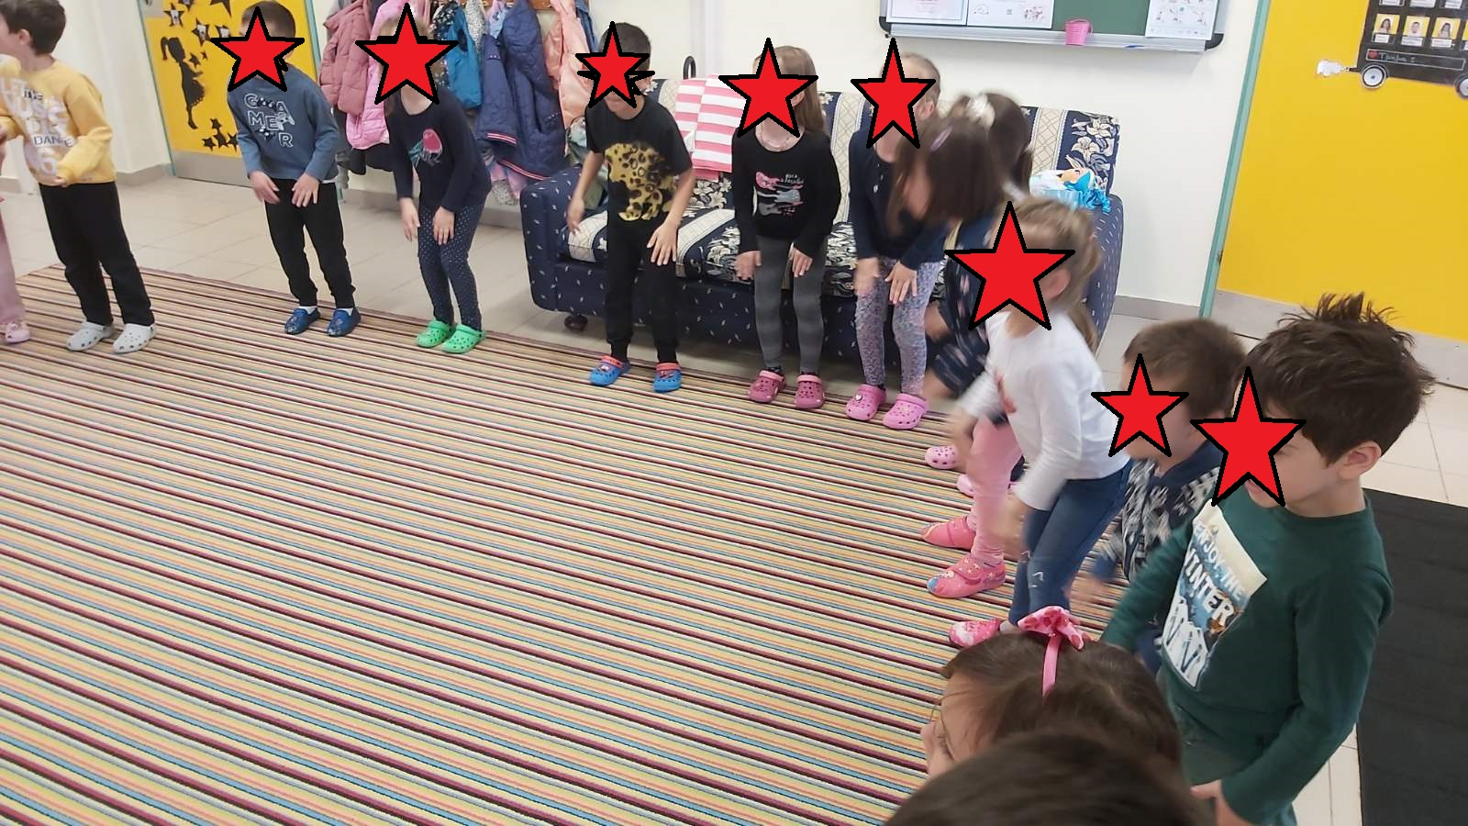
And also the game song from GANA
“ KOKOLEOKO”:
https://www.youtube.com/watch?v=Sd0hdP4giYI

Slide 15
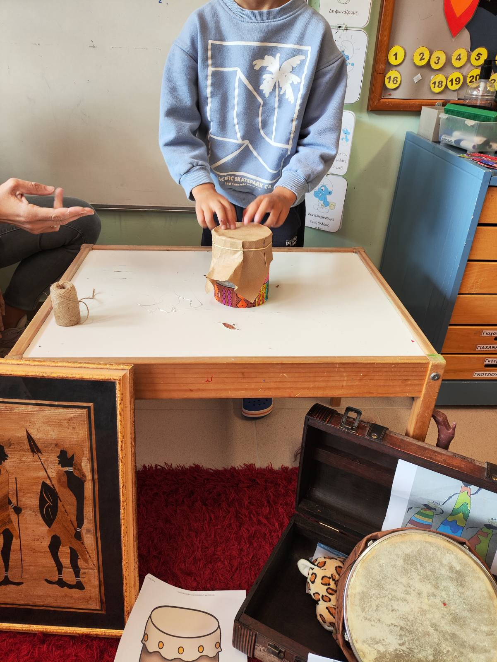
We made our own musical instruments

Slide 16
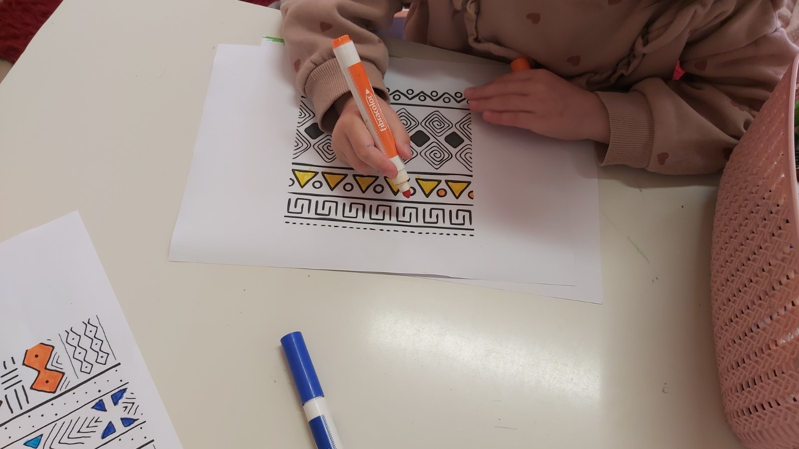

Slide 17
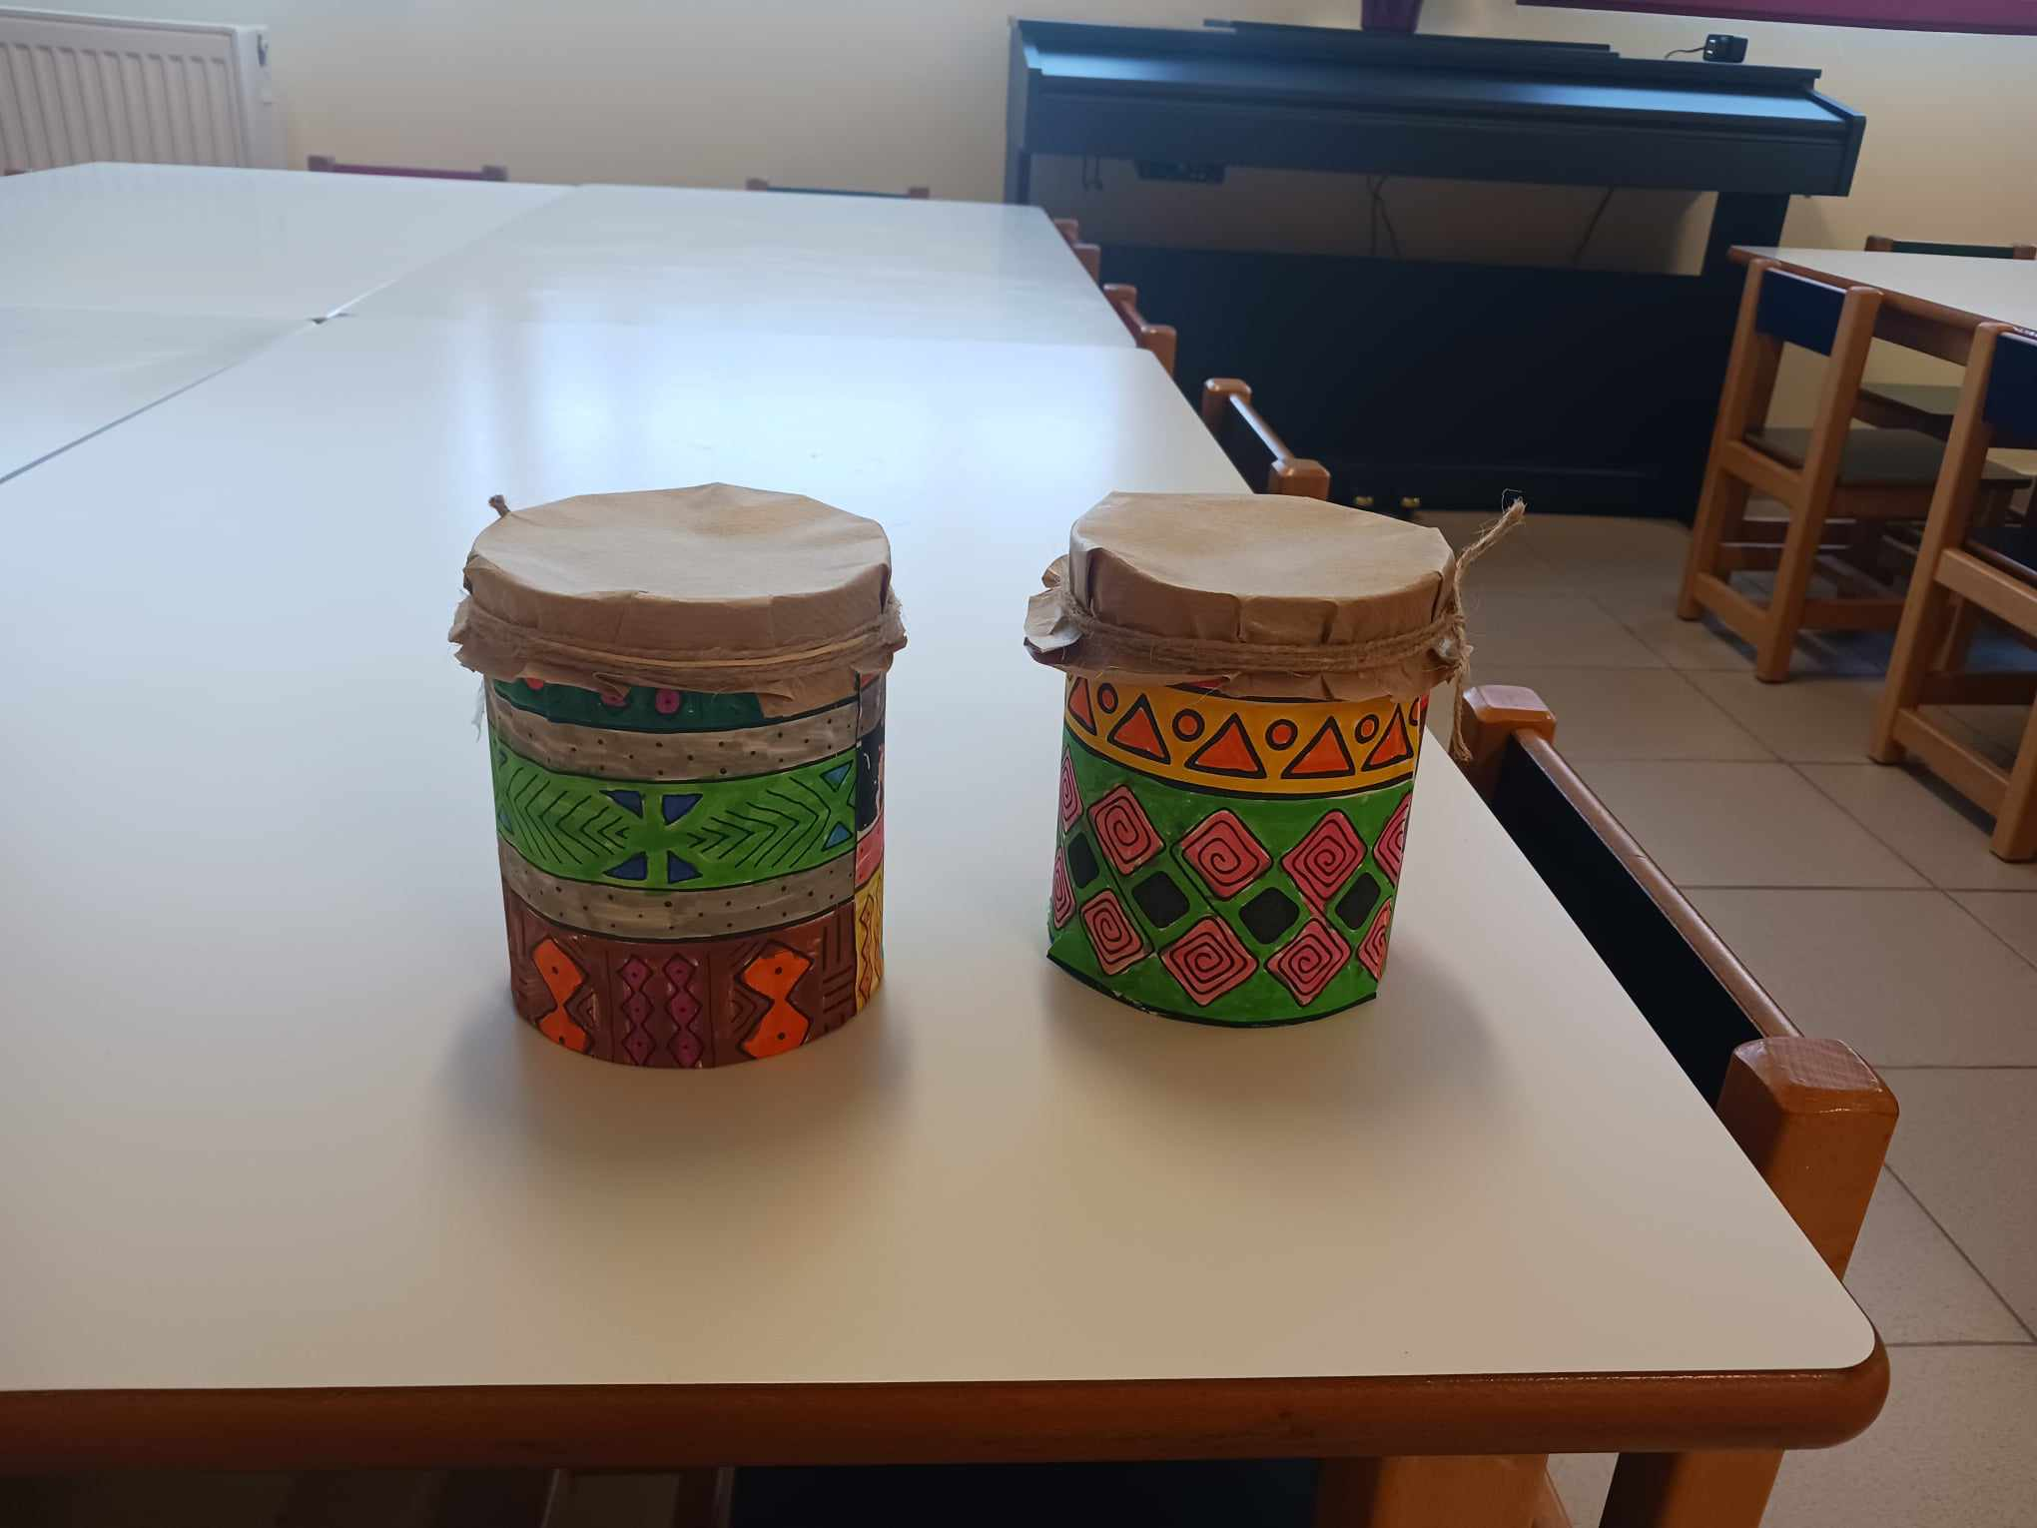
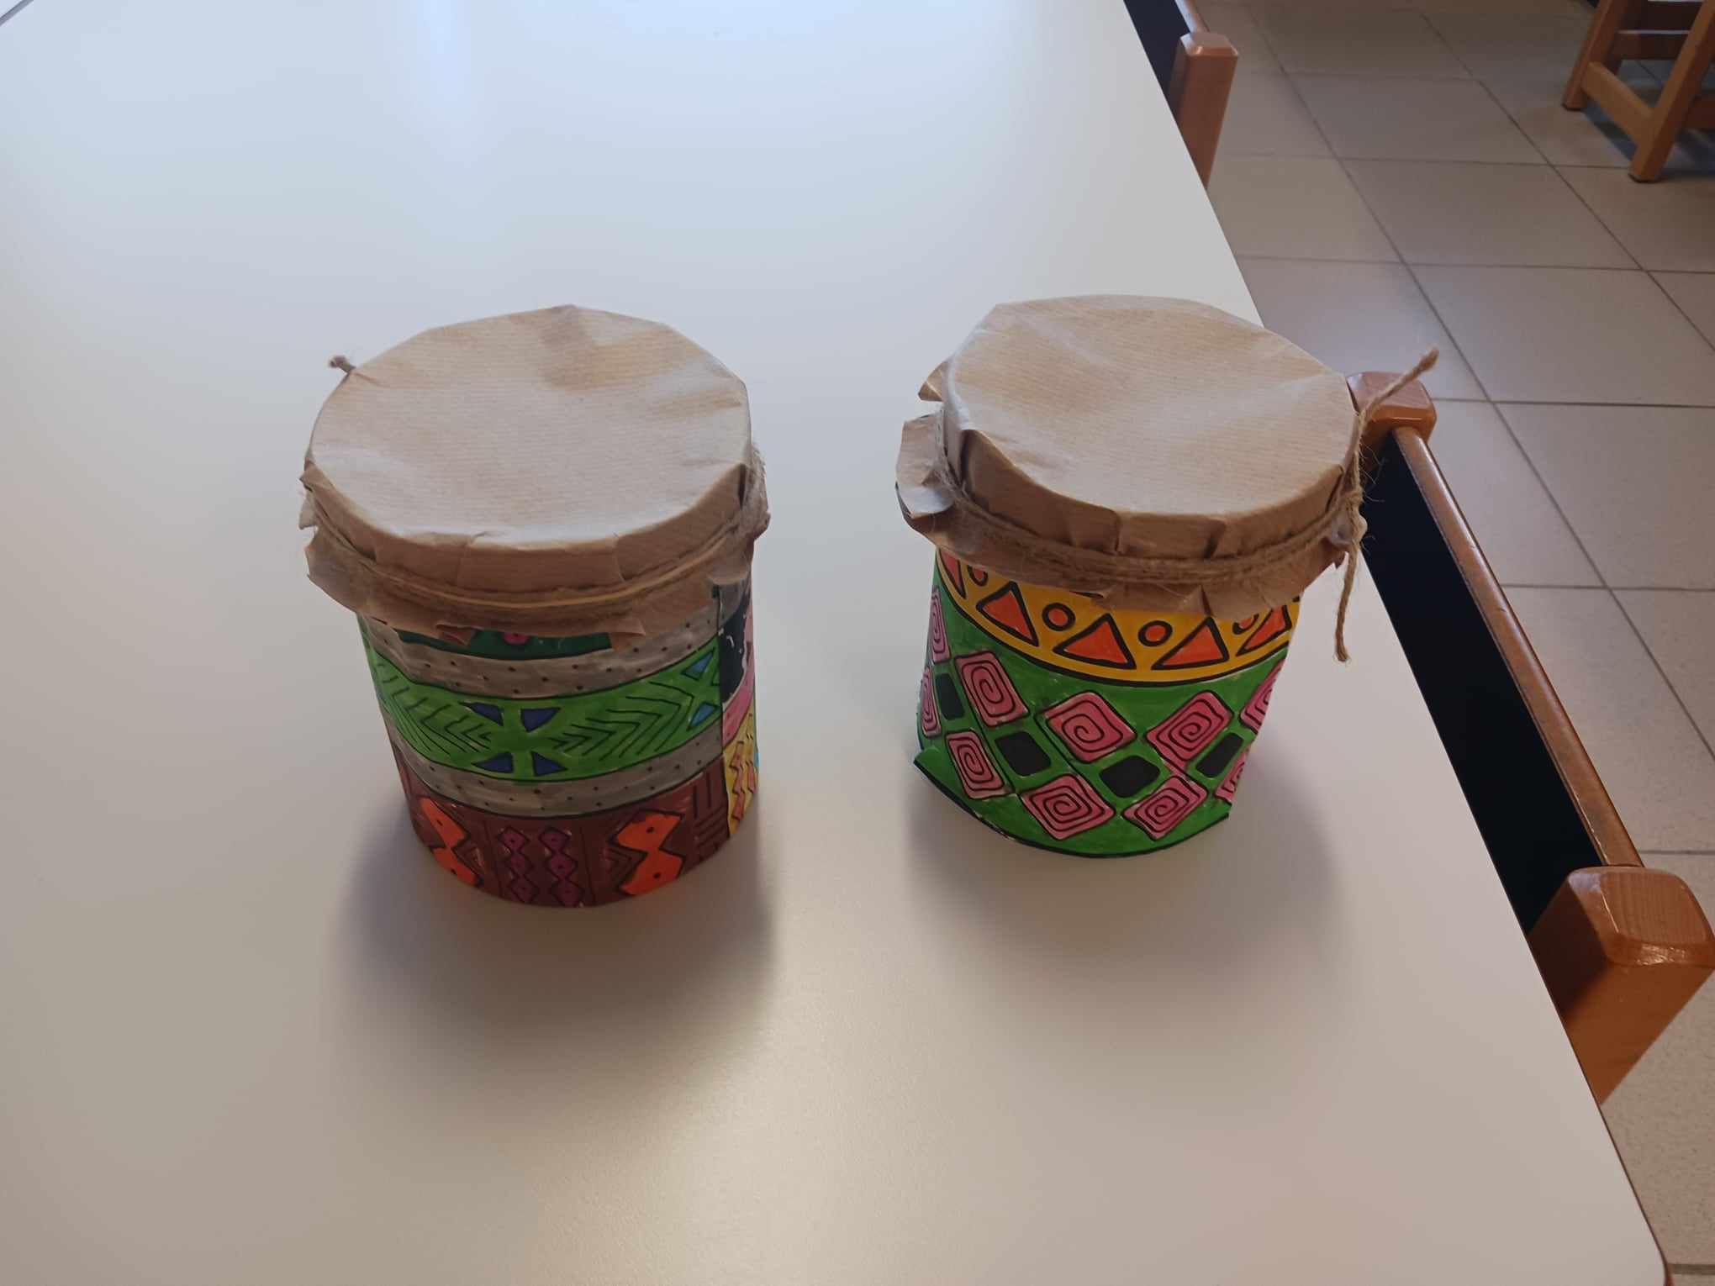

Slide 18

Τhe journey continues with last destination ....

